Slide 1
Analyzing Population and Migration

Slide 2
Basic Population Statistics
Birth Rate
Death Rate
Rate of Natural Increase(RNI)
Doubling Time
Demographic Equation
Total Fertility Rate
Replacement Rate

Slide 3
Birth Rate
Also called crude birth rate or CBR
Annual Statistic
Measures the total amount of infants born living in one calendar year
This number is divided by 1,000 to receive a small integer number for the birth rate
The 1,000 represents 1,000 members of the population
This makes the data easier to work with.
Birth Rate Formula:
Live Births
Population/1,000

Slide 4
More Info on Birth Rate
High birth rates (18-50) are found in rural LDCs with economies based on agriculture
Low birth rates (8-17) are found in urbanized MDCs

Slide 5
Death Rate
Also called crude death rate or CDR
Annual statistic
Calculated the same way the birth rate is
Death Rate Formula:
Deaths
Population/1,000

Slide 6
More Info on Death Rate
A high death rate can show whether a country is experiencing war, disease, or famine
LDCs typically have a high CDR due to a combination of poverty, epidemics, and a lack of medical care
These lead to a low life expectancy, which results in a higher death rate
However, thanks to the Green Revolution, hygiene, health care, and life expectancy have increased resulting in lower death rates in LDCs

Slide 7
The Rate of Natural Increase
Rate of Natural Increase(RNI)
Sometimes referred to as the natural increase rate(NIR)
The RNI is the annual percentage of population growth of that country for a one-year period
Includes % sign in answer
Rate of Natural Increase Formula:
Birth Rate – Death Rate
10

Slide 8
Negative RNI
It is possible to have a negative RNI if the death rate is more than the birth rate
If an RNI is negative, that means that the population in that country has decreased during that year it was measured
RNI is negative if an event such as a natural disaster has occurred or vicious epidemics hit the country
EX: Haiti(2010)- RNI: -7.39%
Reason: 2010 Earthquake in Haiti

Slide 9
Shrinkage in RNI
Another explanation of a negative RNI is in MDCs that are highly urbanized and where their role of women in society is improving.
If a woman is engaged in business, political activity, or urban social networks, she is less likely to have children
Double-income no-kid(DINK) households are more common as well as single parent-single child homes

Slide 10
A Flaw in the ‘Natural’ Increase
Does not account for immigration or emigration
A country with a high RNI can have a low long-term population if there is a large amount of emigration
A country with a low RNI could grow if there was high immigration
Statistics state that new immigrant populations have much higher fertile rates than the general population already living in the country
EX: The United States; population growth isn’t necessarily from immigrants crossing the border, but the fact that they will have children in the United States after they have settled

Slide 11
Doubling Time
Doubling Time Formula:
70
Rate of Natural Increase
This formula is considered an estimate since emigration is not taken into consideration when calculating the RNI
Without accounting for emigration, population would be lower than actually predicted

Slide 12
The Net Migration Rate
Net Migration Rate Formula:
(# of Immigrants - # of Emigrants)
Population/1,000
This statistic can be negative due to push factors such as disease

Slide 13
Total Fertility Rate
TFR
An estimated number of children born to each female of birthing age (15-45)
Total Fertility Rate Formula:
Number of Children Born
Women Aged 15 to 45
Not an annual statistic
Can’t have a negative TFR

Slide 14
The Replacement Rate
The Replacement Rate of a TFR is 2.1
2 Parents to replace themselves=2 kids
Why the .1?
Called “error factor”
Some part of the population will die before reaching adulthood
Epidemics
Accidents

Slide 15
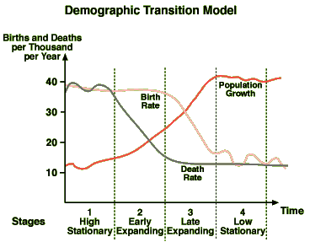
The Demographic Transition Model

Slide 16
The Demographic Transition Model
A theory of how population changes over time
Provides insight into migration, fertility, economic development, industrialization, urbanization, labor, politics, and the roles of women
Mapping countries on the model gives info about their economy, migration, population, and even their quality of life
Mapped lines are theoretical estimates and averages
A country’s data cannot exactly follow the average statistics

Slide 17
Predictions
The DMT (Demographic Transition Model) can be used to predict a country’s growth over the years
Can also be used to predict world growth(early stage three)
We are able to approximate a population projection that approximates that the earth’s population is only 2/3rds full
Once global populations stabilize in stage four, global population will be around 10 billion people

Slide 18
NICs
Newly Industrialized Countries
Include BRICs- Brazil, Russia, India and China
Turning point from agricultural economy of stage two to the manufacturing-based economy of stage three
Theoretical model
China does not follow this model with their one-child policy
This makes them seem more advanced than other NICs

Slide 19
MDCs
More developed countries
Includes United States, Great Britain and Germany
Birth rate of 11 and a death rate of 10
Very little growth

Slide 20
S-Curve of Population
Any population given enough food and protection will experience a rapid population growth followed by a plateau or decline due to a population reaching or exceeding the area’s carrying capacity
Human population may reach equilibrium in the global habitat

Slide 21
Stage 1
Pre-Agricultural Societies
Subsistence farming and transhumance
Transhumance- the seasonal migration for food and resources or owning livestock
CBR and CDR fluctuate
Climate, warfare, disease, and ecological factors affect these rates
Birth and Death Rates are high
Little population growth until the later part of stage one when death rates start to decline
RNI is generally low
Can be negative during epidemics

Slide 22
Stage 1- Births and Deaths
Children were an expression of a family’s productivity and status
More kids = more work gathering crops, hunting, etc..
Child Mortality and Infant Mortality is high
Motivated parents to have a few extra children just in case some died
Very low life expectancy
Lack of modern medicine and health care, limited sanitation, low nutritional standards, and warfare contribute to low life expectancy and high death rate
Hard physical labor and constant migration wore down the body and decreased life span

Slide 23
Stage 2
Typically agriculture-based economy
Commercial agriculture as opposed to subsistence agriculture
Birth rates remain high while death rates decrease
RNI goes up significantly

Slide 24
Stage 2- Births and Deaths
Compared to stage one, children are even more important as a source of labor
Commercial agriculture = profit. More children=more farm work=more crops= more profit
Child mortality is still high due to lack of health care and poor nutrition
Majority of population lives in rural areas
Seasonal migrations become less common= lower death rate
Improved farming techniques; domestication of animals also reduces death rates
Expanded trade of agricultural goods brings a larger and more varied food supply
Increase in food volume, year-round availability, and nutrient quality provides for longer life spans

Slide 25
Stage 3
Industrialized or manufacturing-based economies (secondary economic activities)
Shifted economics to a more service-based focus
Completes the S-Curve and moves to stage 4

Slide 26
Stage 3- Births and Deaths
Birth Rates Decrease
Effects of urbanization, increases in health care, education, and female employment result in less fertility
Women’s education and increased employment results in less children because of school and job commitments
Death Rates
Access to health care, better nutrition, and education lower death rates
Death rates eventually bottom out
Life expectancies can increase in stage 3, but the death rate eventually bottoms out during stages 3 and 4

Slide 27
Stage 4
Birth and Death Rates converge to result in limited population growth and even population decline
MDCs with service-based economies
Services such as finance, insurance, real estate, health care, and communication drive the economy
Decreasing manufacturing
EX: In the US, services are 80% of the GDP and manufacturing is a mere 17%
Highly urbanized countries with the longest life expectancies, sometimes averaging over 80 years

Slide 28
Stage 4- Births and Deaths
Birth Rates bottom out
High degree in access to medical care
Roles of women in society increase, therefore less time to have children
When birth rates reach the same as death rates there is a zero population growth(ZPG) and an RNI of 0.0%
Birth rates can decline until they are less than death rates, and this causes a population decrease and a negative RNI
Death Rates remain low
Vary slightly based on the age of the overall population
Younger average age will result in low death rates, and a higher average age will result in slightly higher death rates

Slide 29
Stage 4
Incentives are offered in countries that are near or below zero population growth levels
Small number of children = less of a future work force; this is why they offer incentives- greater work force
Many of these countries have depended on foreign guest workers, like the gastarbeiter in Germany
These workers usually come from countries such as Turkey, North Africa, the Middle East, and more recently, the former Soviet Union

Slide 30
The Big Picture
 | Birth Rates | Death Rates | Life Expectancy | RNI
Stage One | High(25-50) | High(25-40) | Low(33-50) | Low-Moderate (-.1-1.9%)
Stage Two | High(25-50) | Decreasing (8-25) | Increasing(<70) | Highest (1.5-3.5%)
NICs | Decreasing (12-30) | Lowering(5-18) | Increasing(<75) | Higher (1.1-2.7%)
Stage Three | Lowering (12-20) | Low(5-12) | Higher(<78) | Lowering (.5-1.2%)
Stage Four | Low(8-16) | Low(5-12) | Highest(<82) | Low to Negative (.8 to -.6%)

Slide 31
The Big Picture

Slide 32
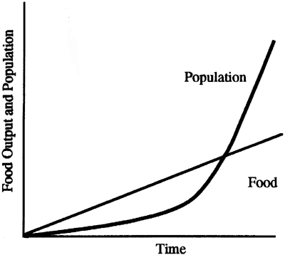
Malthusian Theory
Thomas Malthus published An Essay on the Principle of Population in 1798
Predicted that the global population would one day expand to the point where it could not produce enough food to feed everyone
Why this idea?
UK was engaged in the Industrial Revolution and people were being born at a high rate
Britain was moving from stage two to stage three on the DTM
Malthus saw massive migration to the cities and enormous population growth

Slide 33
Mathematically
Malthus saw that food production grew over time, but slowly linear
Meanwhile, human population grows exponentially
Population is the J-Curve of exponential population growth

Slide 34
What Happened, Instead?
Agricultural technology was going to boost food production in multiples in the 1800s
By 1900, inventions such as the internal combustion engine, artificial fertilizers, pesticides, irrigation pumps, the tin can, and the refrigerator would increase food production/storage
A large volume of food would be added to global production and supply
Food production has continued to stay ahead of population growth

Slide 35
Neo-Malthusians
Three Important Points
Sustainability- When the world does reach 10 billion people, there may be problems keeping up with food demand over the long-term
Many agricultural regions already have significant ecological problems
Soil erosion and soil nutrient loss and in arid regions, depletion of irrigation sources and soil salinization
Increasing Per Capita Demand- The amount of food consumed per person is increasing
MDCs consume around eight times more the amount of food and resources that a LDC consumes
As more LDCs develop, more food and resources will be consumed
Natural Resource Depletion- Theorists like Paul Ehrlich have also warned about our over-consumption of other resources such as timber, minerals, energy, and other nonrenewable resources
We need to conserve and look for alternatives so that we can stretch out supplies over time

Slide 36
Population Pyramids
Shape: | Triangular | Extended Triangle | Column | Reduced Pentagon
Growth: | Fast-Growing | Moderate Growth | Slow Growth | Shrinking
Examples: | Laos, Mozambique | Mexico, Brazil | USA, Uruguay | Germany, Hungary

Slide 37
Gaps and Busts
External War
Baby Bust or Epidemic

Slide 38
The Top
Elderly Citizens
Increased mortality and old age cause a significant decline in elderly population
Male side of the pyramid decreases quicker than the female side
Females live on average 4-5 years longer than males

Slide 39
Population Density
Two main ways to calculate population density
Arithmetic density is the number of people per square unit of land
Most island nations and microstates have extremely high arithmetic densities
Other countries that are known for their high arithmetic densities are India, Bangladesh, Japan, and South Korea
Physiologic density is the number of people per square unit of farm land
More practical tool in understanding the sustainability of a population of a certain region or country
Limits can include overcrowding on farms or lack of abundant farming regions due to geography

Slide 40
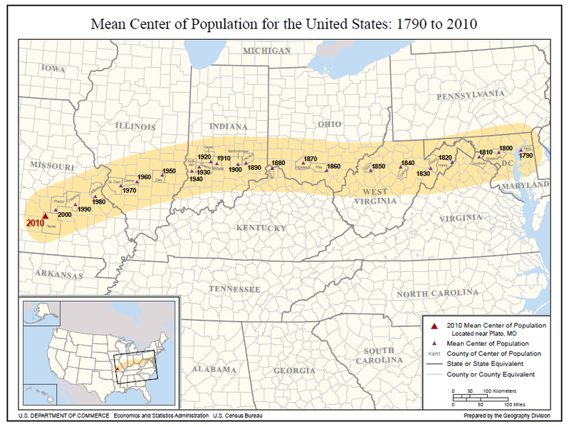
Center of Population
Can be found be averaging the spatial weight of population across the country
In the US, the population center has continuously moved west each decade since the first census in 1790
Originally, land in the Eastern United States was already owned and farm populations were high
Because of this, people who wanted their own land were forced to migrate westward in order to start their own farms
During WWII, arithmetic density and population center moved westward
After WWII, population shifted South and West due to the Sunbelt Migration

Slide 41
Population and Sustainability
Across the ecumene, the living space of humans on the earth’s surface, there are certain limits to how many people an environment can support
Some regions support human settlement better than others
EX: Grasslands can support more people than deserts
More people are moving into arid regions. Dry regions will eventually lose sustainability, but we cannot predict when
Overpopulation is a concern for all regions
Certain resources such as clean water, endangered plant and animal habitats, and nonrenewable energy sources like oil will be depleted
Many theorists have expressed a desire for large-scale family planning and contraceptive programs
These ideas are generally rejected based on religious beliefs
If there is overpopulation, personal space will decrease and this can cause social unrest and armed conflicts
To achieve sustainable resources for use in the coming decades, global programs that enforce recycling, energy conservation, farming practices, and a reduction of personal consumption are believed to be necessary

Slide 42
Migration
Many different types
Inter-regional or internal migrants move from one region of the country to another
EX. Rural-urban migrants
Intraregional migrants move from one area to another within the same region
Transnational migrants are people that move from one country to another

Slide 43
Migration
General voluntarily, but there are forced migrations
People that are forced to move by war, disasters, or fear of government repression are known as refugees
Some countries have programs to receive refugees from other countries and grant them asylum temporarily or even permanently
Host countries face economic burdens from supporting extra people
Basic nutritional and sanitation needs are barely met if the host nation is a developing nation struggling to provide for its own people
People seeking refuge that do not have government authorization are viewed as illegal immigrants
Some countries have amnesty programs allowing illegal immigrants the opportunity to apply for official citizenship without facing arrest or deportation

Slide 44
Various Migrations
Step Migrations are when people move up in a hierarchy of locations, with each move to a more prosperous location
Intervening opportunities for work and economic improvement will increase the migrant’s distance traveled. Also intervening obstacles.
Chain Migrations are when a pioneering individual or group settles to a new place, establishing a new migrant threshold
The pioneer provides information on employment opportunities, access to markets or social networks, and encourages others to migrate to the location
More and more people move and a growing immigrant community is started

Slide 45
Cyclic Movements and Remittances
Migrants who migrate purely for employment purposes have a cyclic movement from place to place
For transnational labor migrants, foreign employees work for a limited period of time before returning to their home country
This is sometimes called periodic movement if it is on an annual or seasonal basis
EX: agricultural workers coming from Mexico to the US for different harvest periods, then coming home to return to their harvest on family farms
The receiving country benefits from the inexpensive labor into their economy
Socio-economic cost of receiving this flow of immigrants includes crime, unemployment, the social welfare burden, and national security concerns
The loss of skilled workers in sending countries poses a problem (brain drain)
The largest positive economic effect of migration is the sending of remittances
Remittances are monetary and other cash transfers sent from transnational migrants to their families and communities back home
Remittances create a positive impact in the migrant’s home country

Slide 46
Push and Pull Factors
NICs experience rapid internal rural-to-urban migrations
Employment at urban manufacturing locations seems to be the main intervening opportunity for internal immigrants
Push Factors are things about the rural agricultural landscape and livelihood that force people out of the farms
Pull Factors are things about cities that draw people to the urban landscape
The opposite of a pull factor is NOT a push factor

Slide 47
Examples
Push Factor: Armed Conflicts
When conflicts emerge in rural areas, many people flee and become refugees to the safety of cities
Push Factor: Environmental Hazards
Over usage of agricultural chemicals can poison soils and water supplies
Improper use of pesticides can lead to birth defects in children
Natural Disasters are also push factors
Push Factor: The High Cost of Land
In NICs, land prices increase
Farmers who have owned land may have the opportunity to sell their land for more money than several years of harvests. This money could be used for migration
Pull Factors
Mainly employment related
Pull of Services such as medical care or education are also substantial pull factors. Media can also be used as a pull factor
Clean water is not considered as a pull factor since there are cases where the rural population has less contaminated water than the urban population

