Slide 1
Intro to Human Geography

Slide 2
Space and Place
Space refers to the geometric surface of the earth
Place is an area of bounded space that is viewed as significant
When this is recognized, we normally assign a toponym (place name)
Places change over time
Sequent occupancy- the succession of groups and cultural influences throughout a place’s history

Slide 3
Scale
Scale is the relationship of an object or place to the earth as a whole
Two types of scale
Map Scale
The ratio of distance on a map to actual distance
Relative Scale
Also known as the scale of analysis
Describes the level of aggregation
The level at which you group objects together for examination

Slide 4
Three Types of Region
Vernacular Region (also Perceptual Region)
A place where the language or customs of the people are constant
Formal Region
A region with a defined boundary that has a homogeneous characteristic or uniformity. A homogeneous characteristic could be language
Understand the contrast in the use of language for both Vernacular and Formal regions.
Functional Regions have a central place or node that is a point of origin
The influence of this point is strongest in the areas close to the center, and the strength of influence diminishes as distance increases from that point
Distance decay plays a big factor!
Example - A sports team will have the strongest fan base and media coverage in areas close to their home city. There are fans in other nearby cities, but their numbers decrease as the distance between the two cities increase
Based on a central location

Slide 5
Regional Boundaries
Culture regions tend to have unclear borders
Political regions have well defined boundaries
Environmental region boundaries are transitional and measureable
The environmental transition zone between two bioregions, or biomes, is known as an ecotone
EX: The space between the Sahara Desert and the tropical savanna of Africa is known as the Sahel

Slide 6
Location..(Location, Location)
Absolute location describes a place using coordinates such as latitude and longitude
Notation
Latitude & Longitude
Degrees can be divided into minutes, and minutes can be divided into seconds
Relative Location
Measured in terms of spatial relationships
Next to the gymnasium, across from the bell tower, etc.

Slide 7
Time Zones
Divided up into 15 degree wide longitudinal zones around the world
Because 360(degrees in a rotation)/24(hours in a day)= 15
Dividing lines between time zones often follow political boundaries, and can occasionally follow local area divisions
Time zones were created during the era of transcontinental railways to standardize time across long east-west train lines

Slide 8
Site and Situation
Site
The physical characteristics of a place
EX: The Acropolis is located on elevated ground
Situation
The place’s interrelatedness with other places
EX: The Acropolis relates to other defensive Greek monuments because of their Ancient Greek architectural style and their frequent location of construction on an elevated hill

Slide 9
Distance
Distance can be regarded in both absolute and relative terms like scale and location
Linear absolute distance can be measured as Euclidean distance, the straight line of distance from one point to another
Geographers often use the concept of distance decay to explain relative distance
Distance decay is a concept that states the further away different places are from a place of origin, the less likely interaction will be with the original place
Relative distance is expressed by the principle of Tobler’s Law which states that all places are interrelated, but closer places are more related than further ones
When the length of distance becomes a factor that inhibits the interaction between two points, this is known as the friction of distance
EX: When the time and cost of moving a product prevents it from being sold in far away locations

Slide 10
Space-Time Compression
Space-Time Compression is the decreased time and relative distance between places due to technological advances in communication and transportation systems.
Technology can reduce the relative distance between places
Transportation such as airplanes or trains can reduce travel time between two distant points and, as a result, increase their interaction
The Internet can also influence space-time compression.

Slide 11
Spatial Interactions
Patterns
Land survey patterns
Diffusion Patterns
Density
Central Places
Core and Periphery

Slide 12
Spatial Interactions
Patterns
Cluster- objects are grouped together on the earth’s surface
Agglomeration- when clustering occurs purposefully around a central point or an economic growth pole
Random pattern- no reason for a particular distribution of a spatial phenomenon
Scattered- objects that are normally ordered but appear dispersed

Slide 13
Spatial Interactions - Land Survey Patterns
Different types of land survey patterns
Metes and Bounds
Developed in Europe centuries before the US used this method
East of central Ohio and Ontario, land surveys until the 1830s used natural landscape features to divide the land (metes and bounds).
Township and Range
After the 1830s, new technology allowed surveyors to divide the land based on lines of longitude and latitude
This produced the geometric shape to many western states of the United States.
Long lots
Former French colonial areas such as Quebec and Louisiana have long-lot patterns
These have a narrow frontage along a road or waterway with a long lot shape behind

Slide 14
Spatial Interactions - Diffusion Patterns
There are various ways and patterns in which human phenomena diffuse spatially or spread across the earth’s surface
That point of origin or place of innovation can be called a hearth.
Expansion Diffusion
Originates in a central place and expands outwards in all directions.
Distance does not have to be equal in all directions
Hierarchical Diffusion
Originates in a first-order location and later moves to second-order locations, which move to tertiary-order locations, which leads to an endless cycle.
Relocation Diffusion
Begins at a point of origin and then crosses a significant physical barrier, and later relocates on the other side

Slide 15
Contagious Diffusion (under Expansion Diffusion)
Begins at a hearth, then moves outward to nearby locations, especially along adjoining transportation lines
EX: Disease
EX2: News in rural areas

Slide 16
Stimulus Diffusion
A general or underlying principle diffuses and then stimulates the creation of new products or ideas
Hamburger becomes veggie burger or falafel burger.

Slide 17
Spatial Interactions - Density
Number of objects per square unit of distance is known as arithmetic density.
Agricultural density is the people per square unit of land actively under cultivation.
Physiologic density measures the number of people per square unit of arable land.

Slide 18
Spatial Interactions - Central Places
Central Places are any node of human activity
Most often the centers of economic exchange
Markets are often located at transportation nodes
Central Place Theory
Developed in the 1930s by a German geographer Walter Christaller
In the model, city location and the level of urban economic exchange could be analyzed using central places within hexagonal market areas which overlapped each other
Fewer large settlements than smaller ones

Slide 19
Spatial Interactions - Cores and Peripheries
Many different regional, cultural, economic, political, and environmental phenomena and human activities display some sort of core and periphery relationship
A country’s capital is the core of its political landscape
The core does not have to be in the center of the peripheral landscape

Slide 20
Map Types
Topographic Maps
Thematic Maps
Chloropleth Maps
Isoline Maps
Dot Density Maps
Flow-line Maps
Cartograms

Slide 21
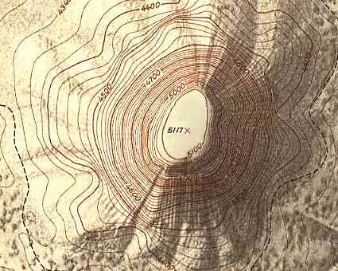
Topographic Maps
Show the contour lines of elevation
Highly accurate in location and topography
Used for engineering surveys and land navigation

Slide 22
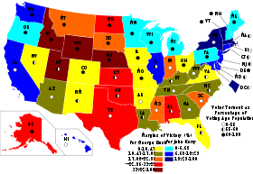
Thematic Maps - Chloropleth Maps
Expresses geographic variability of a particular theme using color variations
Root word “chloro”
These variations can be expressed using colorized symbols, contour areas filled with different colors, or polygons denoting country boundaries to express the variability in map data
Map shown is based on 2004 presidential election statistics

Slide 23
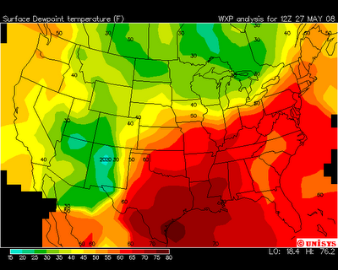
Thematic Maps - Isoline Maps
Calculate data values between points across a variable surface
Series of contour lines can be drawn to show changes in data
Weather maps showing temperature contours are the most common type of isoline map

Slide 24
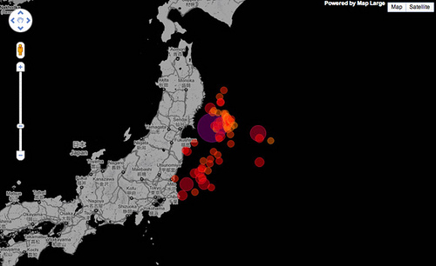
Thematic Maps - Dot Density Maps
Use dots to express the volume and density of a geographic feature
Dots can represent statistics such as population density, or the frequency of phenomena
Map shown is the volume of earthquakes in Japan following the 2011 Tohoku Earthquake

Slide 25
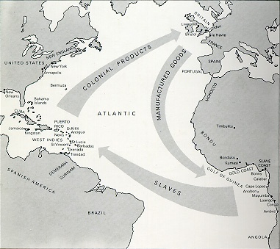
Thematic Maps - Flow-line Maps
Use lines of varying thickness to show the direction and volume of a particular geographic movement pattern
Map shown is Triangular Trade

Slide 26
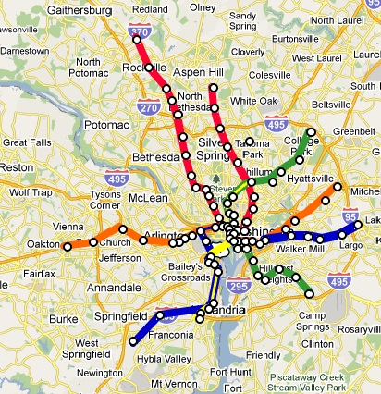
Thematic Maps - Cartograms
Use simplified geometries to represent real-world places
More about the data expressed than about landscape
Often used in subway systems

Slide 27
Projections
A map projection's level of accuracy is based upon two concepts
Area preservation
Shape preservation

Slide 28
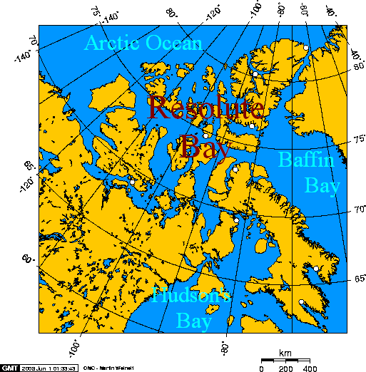
Equal-area Projections
Attempt to maintain the relative spatial science and the areas on the map
These projections can distort the shape of polygons
EX: Lambert Projection
Distorted size of northern Canadian islands

Slide 29
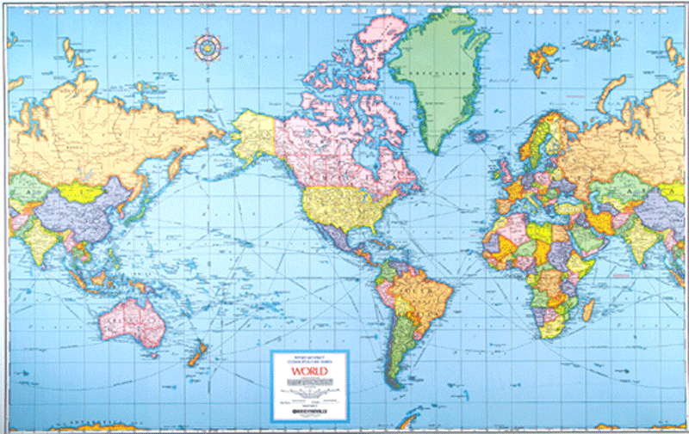
Conformal Projections
Attempt to maintain the shape of polygons on the map
Downside= distorts the relative area from one part of the map to another
EX: Mercator projection
Distorts Greenland’s size

Slide 30
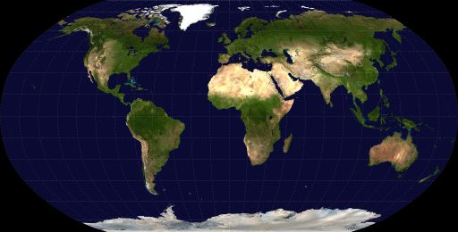
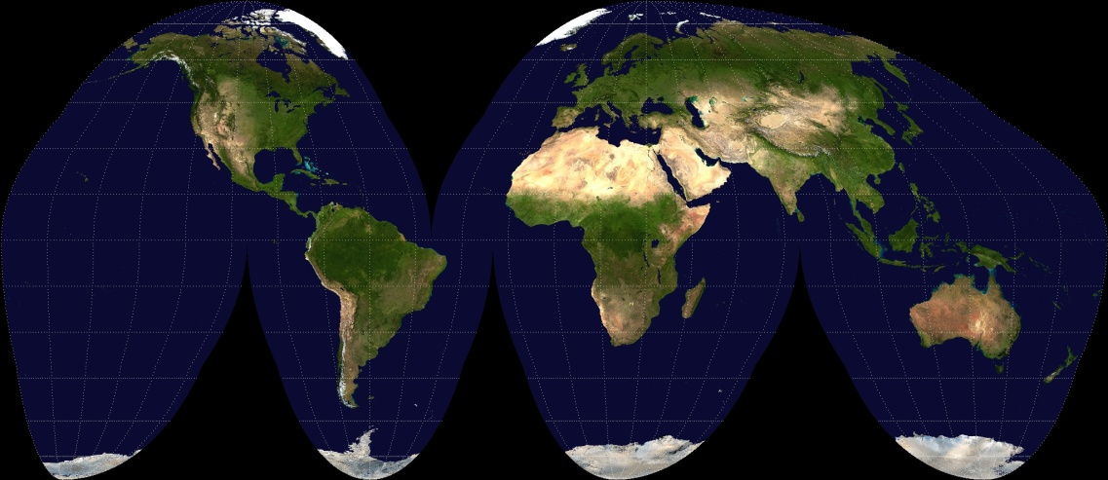
Other Projections
Some map projections attempt to balance area and form
EX: Robinson Projection(top)
EX2: Goode’s homolosine projection(bottom)

Slide 31
Geographic Technology - Geographical Information Systems(GIS)
Uses one or more data layers in a computer program capable of spatial analysis and mapping
Data layers are numerical, coded, or textual data that is attributed to specific geographic coordinates or areas
Date between layers can be analyzed spatially
Used when calling 911

Slide 32
Geographic Technology - Global Positioning Systems(GPS)
Utilizes a worldwide network of satellites
A GPS receiver is able to triangulate a coordinate location and display map data for the user

Slide 33
Geographic Technology - Remote Sensing
Aerial photography and satellite-based remote sensing make up a large amount of the geographic and GIS data used today
Remote sensing can record data from the earth’s surface
Data not only includes visual light wavelengths, but infrared and radar information
Commonly used by local governments to record property data and set tax assessments
Aerial photographs can also be used to revise topographic map data without sending out a survey team to gather new data
Infrared satellite imagery is commonly used to determine the health of vegetation on the earth’s surface
Helps to maintain stable prices for farm goods such as milk, eggs, and bread

