Slide 1
Population Geography

Slide 2
Key Issues
Where is the world population distributed?
Why is global population increasing?
Why does population growth vary among regions?
Why do some regions face health threats?

Slide 3
Where Is the World’s Population Distributed?
Population Concentrations
2/3 of the world’s people are clustered in four regions.
East Asia
South Asia
Southeast Asia
Europe
Site and Situation of Population Clusters
Low-lying areas with fertile soil and temperate climate
Near an ocean or near a river with easy access to an ocean.

Slide 4
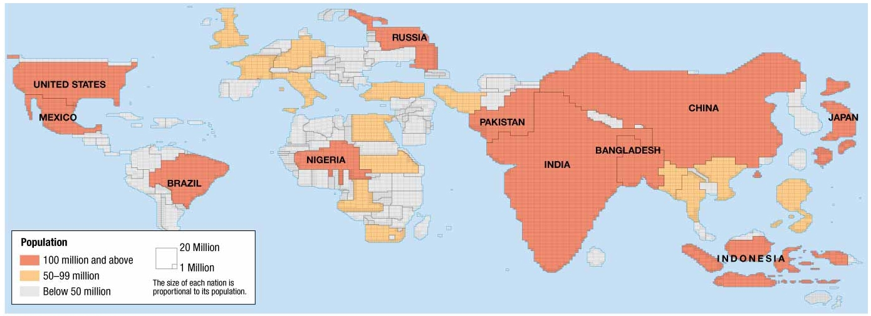
POPULATION CARTOGRAM - In a cartogram, countries are displayed by size of population rather than land area.

Slide 5
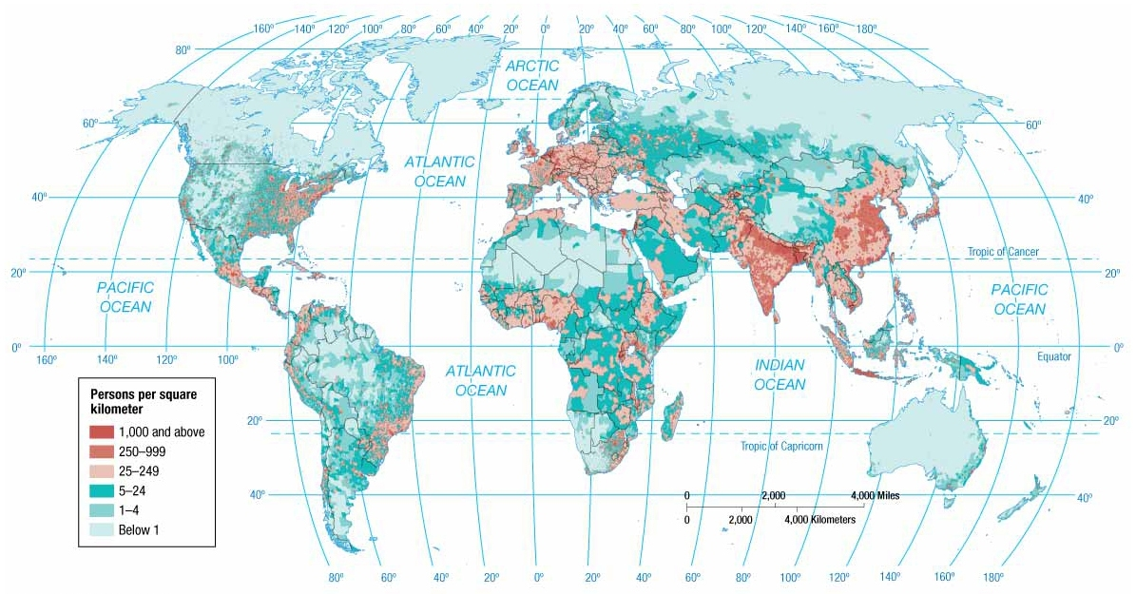
Notes:
FIGURE 2-3 POPULATION DISTRIBUTION People are not distributed uniformly across Earth’s surface.

Slide 6
The Ecumene
Sparsely Populated Regions
Humans avoid clustering in certain physical environments.
Dry Lands
Wet Lands
Cold Lands
High Lands
Places considered too harsh for occupancy have diminished over time.
Places of permanent human settlement are termed the ecumene.

Slide 7
Where Is the World’s Population Distributed?
Population Density
Density can be computed in up to three ways for a place.
Arithmetic Density
Total number of objects in an area
Computation: Divide the population by the land area
Physiological Density
Number of people supported by a unit area of arable land
Computation: Divide the population by the arable land area
Agricultural Density
Ratio of the number of farmers to amount of arable land
Computation: Divide the population of farmers by the arable land area

Slide 8
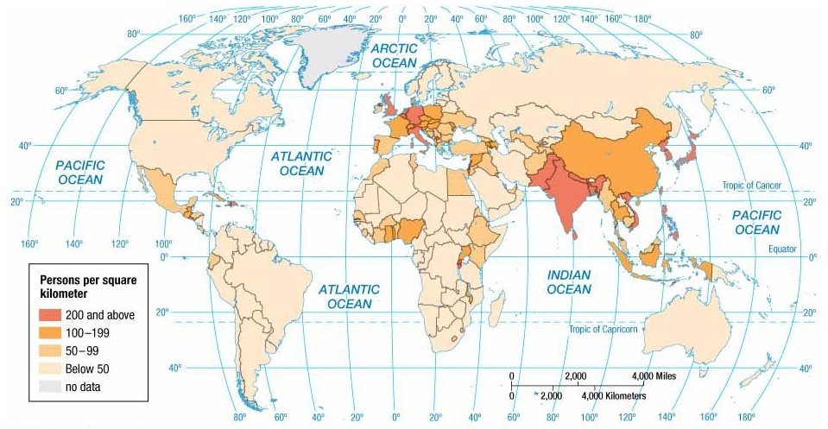
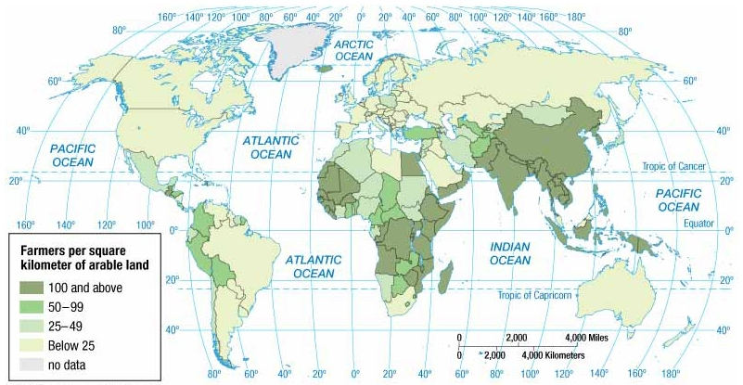
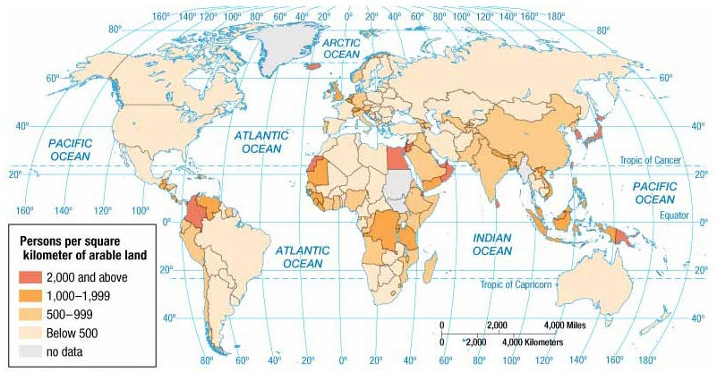
Arithmetic Density
Agricultural Density
Physiological Density
The highest arithmetic densities are found in Asia, Europe, and Central America.
The lowest are in North and South America and South Pacific.
Physiological density provides insights into the relationship between the size of a population and the availability of resources in a region.

Slide 9
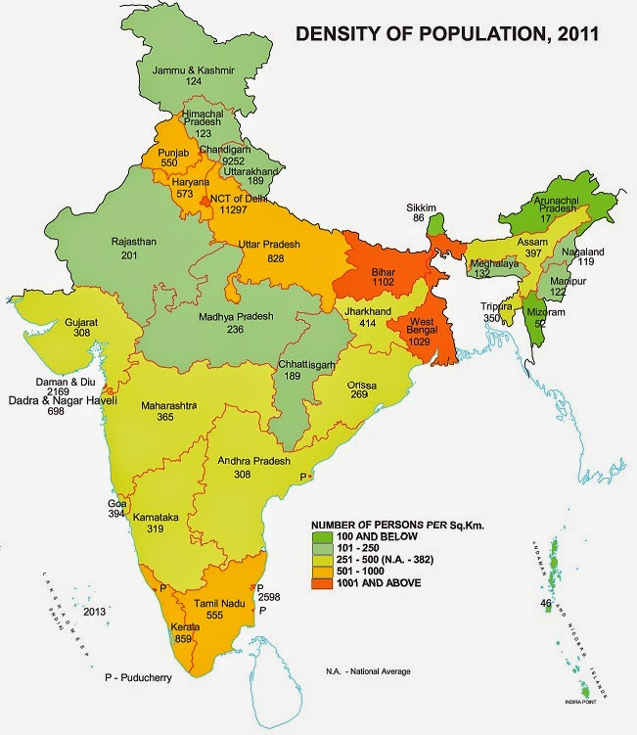
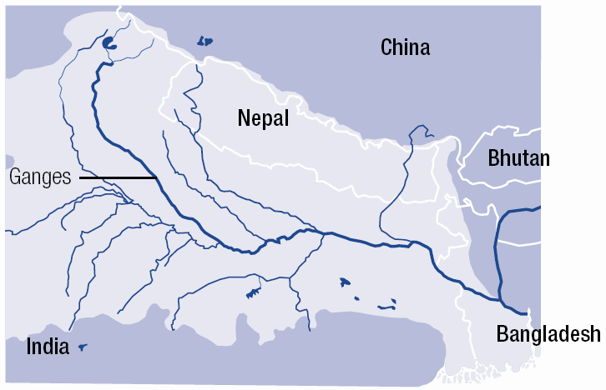
Key Issues – Example Question
What factors have contributed to the historically high population densities in the Nile Valley and Ganges Valley?

Slide 10
Why Is Global Population Increasing?
Basic Population Statistics (must-know terms)
Birth Rate (CBR)
Death Rate (CDR)
Rate of Natural Increase (RNI or NIR)
Doubling Time
Total Fertility Rate (TFR)
Replacement Rate
Infant Mortality Rate (IMR)
Some key abbreviations:
MDCs – more developed countries
LDCs – less developed countries

Slide 11
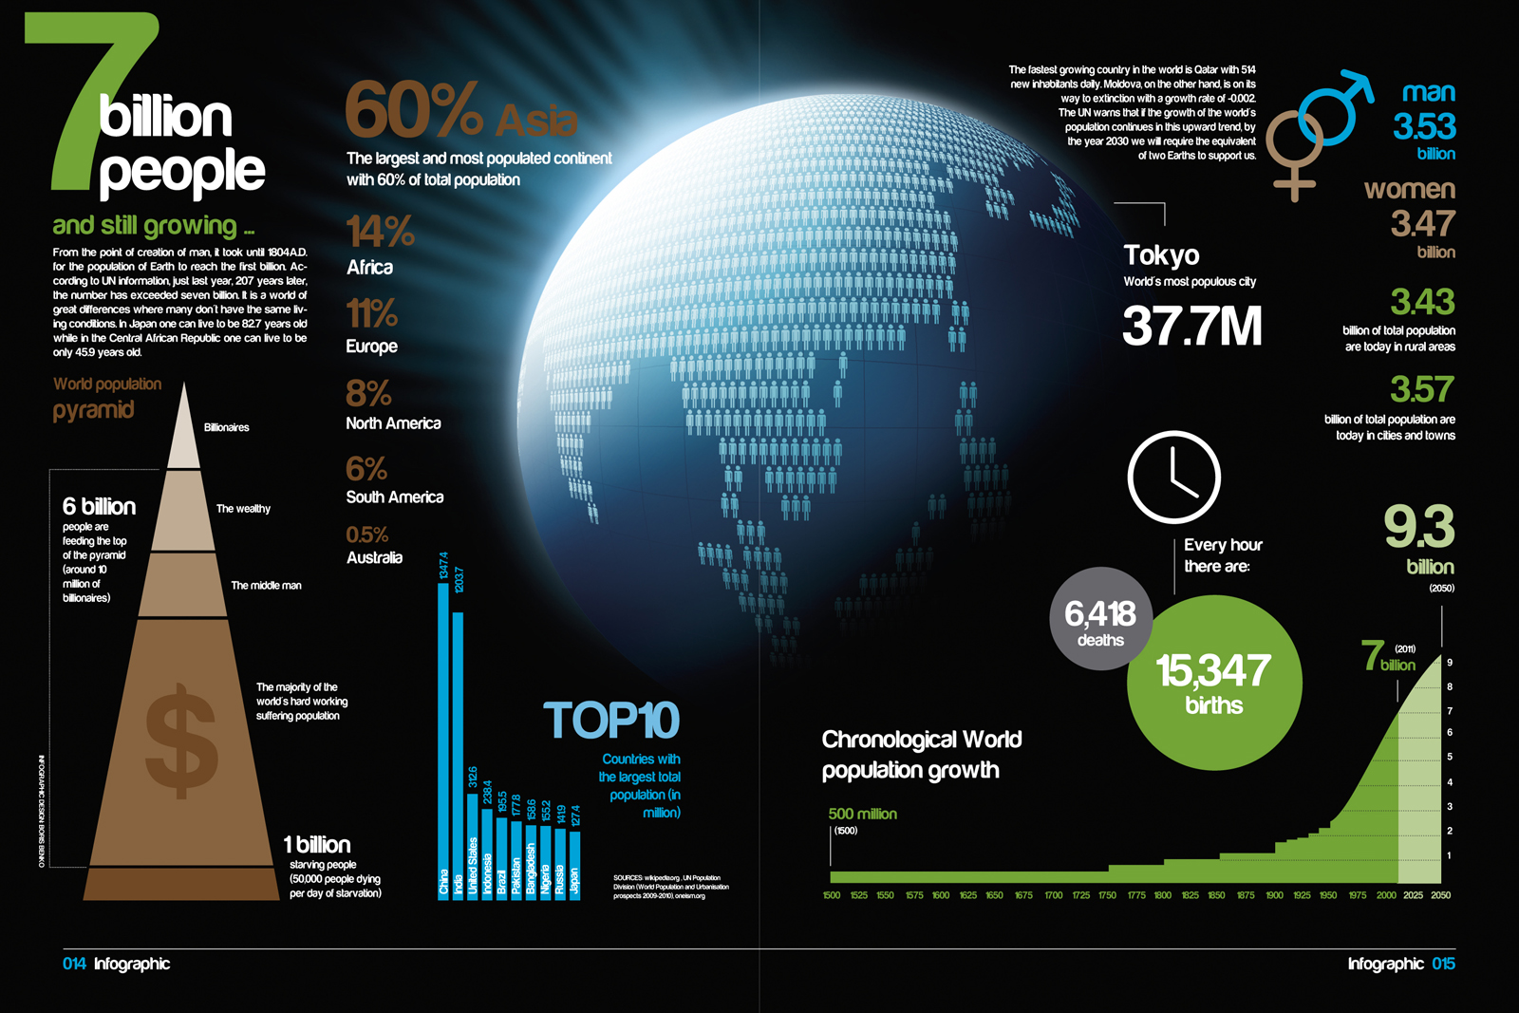

Slide 12
Birth Rate
Also called crude birth rate or CBR
Annual statistic that measures the total amount of infants born living in one calendar year
This number is divided by 1,000 to receive a small integer number for the birth rate
The 1,000 represents 1,000 members of the population
This makes the data easier to work with.
Birth Rate Formula:
Live Births
Population/1,000

Slide 13
Birth Rate Patterns
High birth rates (18-50) are found in rural LDCs with economies based on agriculture
Low birth rates (8-17) are found in urbanized MDCs

Slide 14
Death Rate
Also called crude death rate or CDR
Annual statistic
Calculated the same way the birth rate is
Death Rate Formula:
Deaths
Population/1,000

Slide 15
More Info on Death Rate
A high death rate can show whether a country is experiencing war, disease, or famine
LDCs typically have a high CDR due to a combination of poverty, epidemics, and a lack of medical care
These lead to a low life expectancy, which results in a higher death rate
However, thanks to the Green Revolution, hygiene, health care, and life expectancy have increased resulting in lower death rates in LDCs

Slide 16
The Rate of Natural Increase
Rate of Natural Increase(RNI)
Sometimes referred to as the natural increase rate(NIR)
The RNI is the annual percentage of population growth of that country for a one-year period
Includes % sign in answer
Rate of Natural Increase Formula:
Birth Rate – Death Rate
10

Slide 17
Negative RNI
It is possible to have a negative RNI if the death rate is more than the birth rate
If an RNI is negative, that means that the population in that country has decreased during that year it was measured
RNI is negative if an event such as a natural disaster has occurred or vicious epidemics hit the country
EX: Haiti(2010)- RNI: -7.39%
Reason: 2010 Earthquake in Haiti

Slide 18
Shrinkage in RNI
Another explanation of a negative RNI is in MDCs that are highly urbanized and where their role of women in society is improving.
If a woman is engaged in business, political activity, or urban social networks, she is less likely to have children
Double-income no-kid(DINK) households are more common as well as single parent-single child homes

Slide 19
A Flaw in the ‘Natural’ Increase
Does not account for immigration or emigration
A country with a high RNI can have a low long-term population if there is a large amount of emigration
A country with a low RNI could grow if there was high immigration
Statistics state that new immigrant populations have much higher fertile rates than the general population already living in the country
EX: The United States; population growth isn’t necessarily from immigrants crossing the border, but the fact that they will have children in the United States after they have settled

Slide 20
Doubling Time
Doubling Time Formula:
70
Rate of Natural Increase
This formula is considered an estimate since emigration is not taken into consideration when calculating the RNI
Without accounting for emigration, population would be lower than actually predicted

Slide 21
The Net Migration Rate
Net Migration Rate Formula:
(# of Immigrants - # of Emigrants)
Population/1,000
This statistic can be negative due to push factors such as disease

Slide 22
Total Fertility Rate
Components of Population Growth
Fertility
Total Fertility Rate (TFR)
Measure also used by geographers to measure number of births in a society.
Defined as the average number of children a woman will have throughout her childbearing years (15–49)
TFR for world is 2.5.
TFR exceeds 5 in sub-Saharan Africa, while 2 or less in nearly all European countries.

Slide 23
The Replacement Rate
The Replacement Rate for TFR is 2.1
2 Parents to replace themselves=2 kids
Why the .1?
Called “error factor”
Some part of the population will die before reaching adulthood
Epidemics
Accidents

Slide 24
Why Is Global Population Increasing?
Components of Population Growth
Mortality
Infant Mortality Rate (IMR)
Measure used by geographers to better understand death rates in a society
Defined as the annual number of deaths of infants under one year of age, compared with total live births
Usually expressed per 1,000 births rather than a percentage
IMR is 5 in developed countries and 80 in sub-Saharan Africa.

Slide 25
Summary of Spatial Patterns
Developed Countries
Lower rates of…
Natural increase
Crude birth
Total fertility
Infant mortality
Developing Countries
Higher rates of…
Natural increase
Crude birth
Total fertility
Infant mortality

Slide 26
Population Structure
Fertility and mortality vary not only spatially but also temporally within a country.
A special bar graph known as a population pyramid can visually display a country’s distinctive population structure.
X-axis
Percent male displayed to the left of zero
Percent female displayed to the right of zero
Y-axis
Age cohorts typically grouped in 5-year intervals
Youngest displayed at bottom and oldest at top

Slide 27
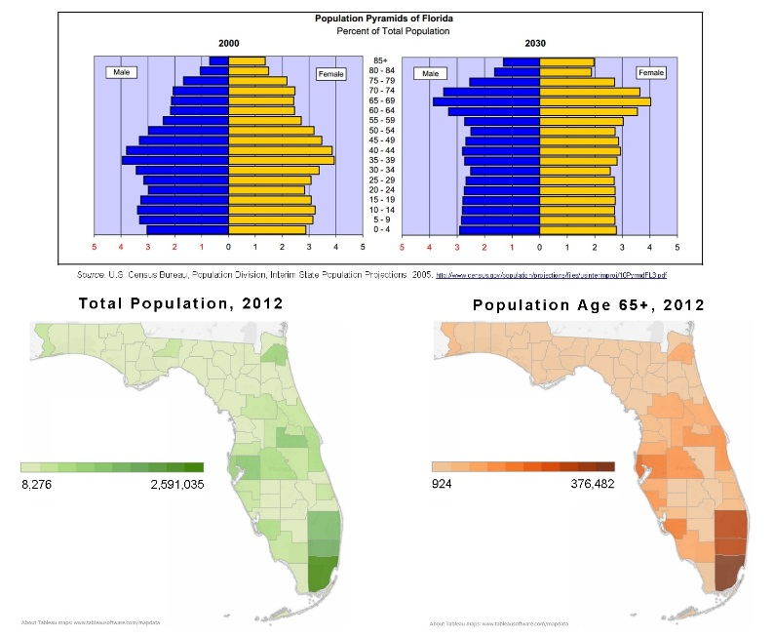
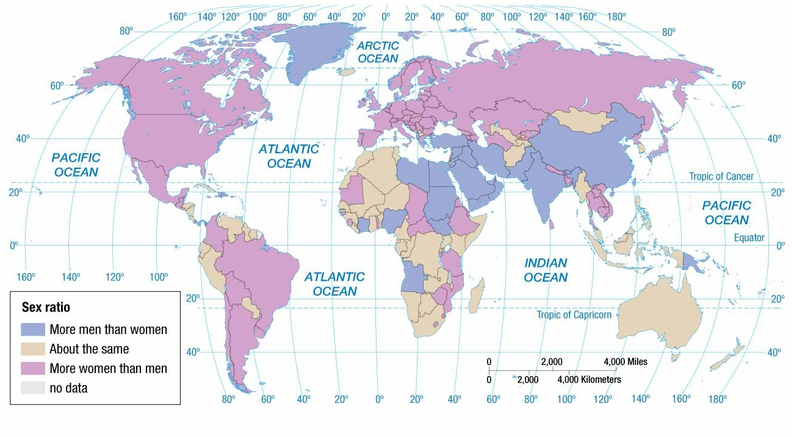
Gainesville, FL
Dependency Ratio
Defined as the number of people who are too young or too old to work, compared to the number of people in their productive years.
People aged 0 to 14 and over 65 years old are considered dependents.
Sex Ratio
Defined as the number of males per 100 females in the population
Developed countries have more females than males, because they tend to live 7 years longer.
Larger dependency ratios imply greater financial burden on the working class.
85 percent in sub-Saharan Africa, while 47 percent in Europe.

Slide 28
Why Does Population Growth Vary among Regions?
The Demographic Transition
It is a model consisting of four stages that helps to explain the rising and falling of natural increase over time in a country.
Historically, no country has ever reverted back to a previous stage.
Thus, the model can be thought to have a beginning, middle, and an end.

Slide 29
The Demographic Transition Model
The demographic transition model consists of four stages.

Slide 30
The Demographic Transition Model
The Demographic Transition
Stage 1: Low Growth
Marked by very high birth and death rates.
No long-term natural increase
No country presently is in Stage 1
Stage 2: High Growth
Marked by rapidly declining death rates and very high birth rates
High natural increase
Europe and North America entered stage 2, as a result of the industrial revolution (~1750).
Africa, Asia, and Latin America entered stage 2 around 1950, as a result of medical revolution-improved medical care.

Slide 31
The Demographic Transition Model
The Demographic Transition
Stage 3: Moderate Growth
Marked by rapid decline in birth rates and steady decline in death rates
Natural increase is moderate.
Gap between CBR and CDR is narrower in stage 3 countries than stage 2 countries.
Population grows, because CBR is still greater than CDR.
Most European countries and North America transitioned to stage 3, during first half of twentieth century.

Slide 32
The Demographic Transition Model
The Demographic Transition
Stage 4: Low Growth
Marked by very low birth and death rates
No long-term natural increase and possibly a decrease
Country reaches stage 4 when population gains by CBR are diminished by losses because of CDR.
Condition known as zero population growth (ZPG)
Demographers more precisely define ZPG as the TFR that produces no population change.
Population change results from immigration.

Slide 34
Why Does Population Growth Vary among Regions?
Declining Birth Rates
Two Successful Strategies for Lowering Birth Rates
Improving Education and Health Care
Emphasizes improving local economic conditions so that increased wealth is allocated to education and health programs seeking to lower birth rates.
Contraception
More immediate results reaped than previous approach
Met with greater resistance, because it goes against cultural or religious beliefs of some.
Roman Catholics, fundamentalist Protestants, Muslims, and Hindus.

Slide 35
WOMEN USING FAMILY PLANNING More than two-thirds of couples in developed countries use a family-planning method. Family-planning varies widely in developing countries. China reports the world’s highest rate of family planning; the lowest rates are in sub-Saharan Africa.

Slide 36
Why Does Population Growth Vary among Regions?
Malthus on Overpopulation
Theory and Reality
Food production has increased over last 50 years faster than Malthus predicted.
His model predicted world population to quadruple over the course of 50 years.
Not even in India has population growth outpaced food production.

Slide 37
Why Does Population Growth Vary among Regions?
Population Futures
Demographic Transition Possible Stage 5: Decline
Characterized by…
Very low CBR
Increasing CDR
More elderly people than young persons
Negative NIR
Over time, few young women in child-bearing years
Contributing to ever falling CBR
Several European countries already have negative NIR.
Russia is most notable hosting a negative NIR for 50 years.

Slide 38
Key Issues – Example Question
Why is global population increasing?
Understand how to measure population growth through the nature increase rate.
Understand how to measure births and deaths through CBR and CDR.
Understand how to read a population pyramid.

Slide 39
Key Issues
Why does population growth vary among regions?
Describe the four stages of the demographic transition.
Summarize two approaches to reducing birth rates.
Summarize Malthus’s argument about the relationship between population and resources.
Summarize the possible stage 5 of the demographic transition.

Slide 40
Key Issues
Why do some regions face health threats?
Summarize the four stages of the epidemiologic transition.
Summarize the reasons for a possible stage 5 of the epidemiologic transition.
Understand reasons for variations in health care.

Slide 41
Why Do Some Regions Face Health Threats?
Epidemiologic Transition
Medical researches have identified an epidemiologic transition that focuses on distinct health threats in each stage of the demographic transition.
Stage 1: Pestilence and Famine (High CDR)
Principal cause of death: infectious and parasitic diseases
Ex. black plague (bubonic plague)
Epidemiology is the branch of medical science concerned with the incidents, distribution, and control of diseases that are prevalent among the population at a special time and are produced by some special causes not generally present in the affected locality.

Slide 42
Why Do Some Regions Face Health Threats?
Epidemiologic Transition
Stage 2: Receding Pandemic (Rapidly Declining CDR)
Pandemic is a disease that occurs over a wide geographic area and affects a very high proportion of the population.
Factors that reduced spread of disease, during the industrial revolution
Improved sanitation
Improved nutrition
Improved medicine
Famous cholera pandemic in London in mid nineteenth century.

Slide 43
SIR JOHN SNOW’S CHOLERA MAP In 1854, Dr. John Snow mapped the distribution of cholera victims and water pumps to prove that the cause of the infection was contamination of the pump near the corner of Broad and Lexington streets.

Slide 44
Why Do Some Regions Face Health Threats?
Epidemiologic Transition
Stage 3: Degenerative Diseases (Moderately Declining CDR)
Characterized by…
Decrease in deaths from infectious diseases.
Increase in chronic disorders associated with aging.
Cardiovascular diseases
Cancer
Stage 4: Delayed Degenerative Diseases (Low but Increasing CDR)
Characterized by…
Deaths caused by cardiovascular diseases and cancer delayed because of modern medicine treatments.

Slide 45
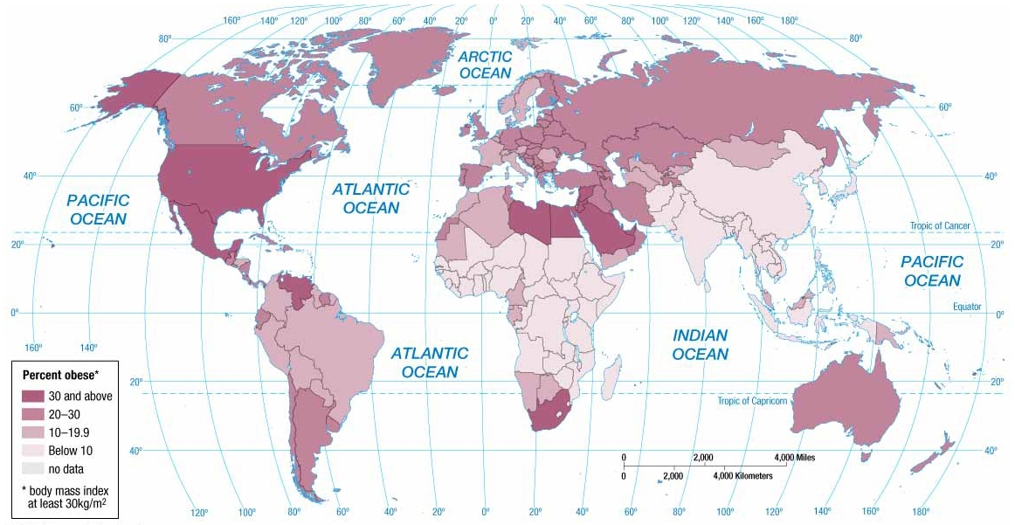
Obesity is a health problem in the United States and in Southwest Asia.
Cancer is an example of a cause of death for men that is higher in developed countries than in developing ones.
Infectious Diseases
Reasons for Possible Stage 5
Evolution
Infectious disease microbes evolve and establish a resistance to drugs and insecticides.
Antibiotics and genetic engineering contributes to the emergence of new strains of viruses and bacteria.
Poverty
Infectious diseases are more prevalent in poor areas because of presence of unsanitary conditions and inability to afford drugs needed for treatment.
Increased Connections
Advancements in modes of transportation, especially air travel, makes it easier for an individual infected in one country to be in another country before exhibiting symptoms.
Why Do Some Regions Face Health Threats?

Slide 46
Why Do Some Regions Face Health Threats?
Health Care
Health conditions vary around the world, primarily, because countries possess different resources to care for people who are sick.
Expenditures on Health Care
More than 15 percent of total government expenditures in Europe and North America.
Less than 5 percent in sub-Saharan Africa and South Asia.

Slide 47
Summary
Global population is concentrated in a few places that are not too wet, too dry, too cold, or too mountainous.
Nearly all NIR is concentrated in developing countries.
Developed countries have a stable population, if not slightly declining.
Population growth varies among regions, because not all countries are in the same stage of the demographic transition model
Intimately connected to the demographic transition model is the epidemiologic transition model that helps to explain why different regions face varying health threats.

