Slide 1
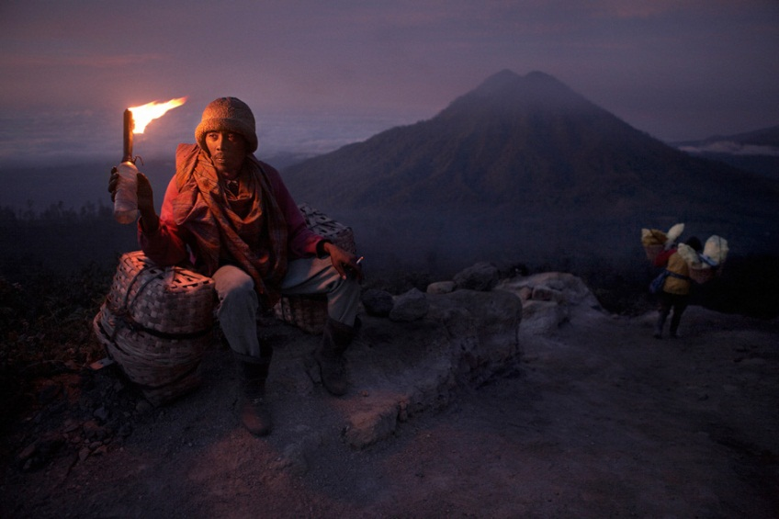
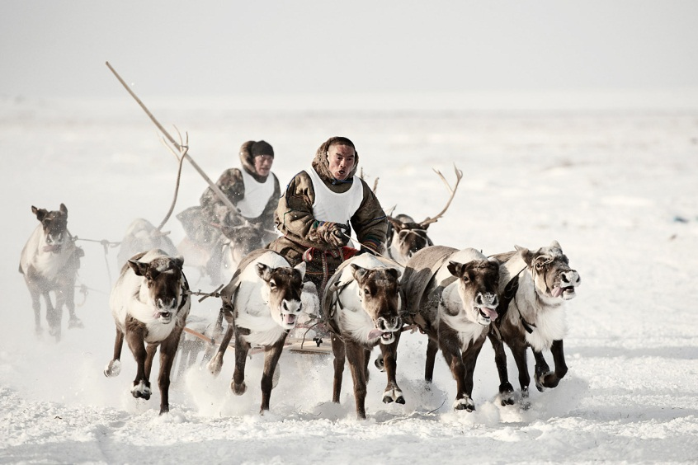
Migration

Slide 2
Movement
Mobility is a generalized term that refers to all types of movements
Journeying each day to work or school
Weekly visits to local shops
Annual trips to visit relatives who live in a different state
Short-term and repetitive acts of mobility are referred to as circulation.
Ex. College students moving to college each fall and returning home each spring

Slide 3
Migration
A permanent move to a new location constitutes migration.
Emigration is migration from a location.
Immigration is migration to a location.
Place “A” can have individuals migrating away from and to it.
Emigrant: Place A → Place B
Immigrant: Place B → Place A
The difference between the number of immigrants and number emigrants is known as net migration.

Slide 4
Why do people migrate?
Migration can be divided into two categories.
International Migration- permanent move from one country to another
Voluntary
Forced
Internal Migration- permanent move within the same country
Interregional
Intraregional

Slide 5
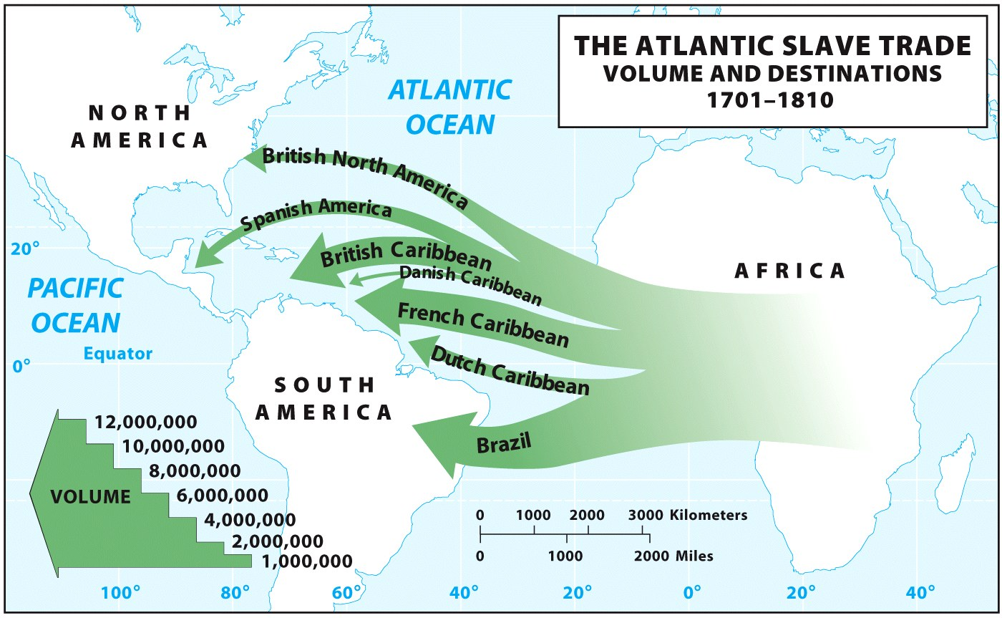
Forced Migration
The Atlantic slave trade - the largest and most devastating forced migration in the history of humanity
Forced migration still happens today.
Example: countermigration, in which governments detain migrants who enter or attempt to enter their countries illegally and return the migrants to their home countries.

Slide 6
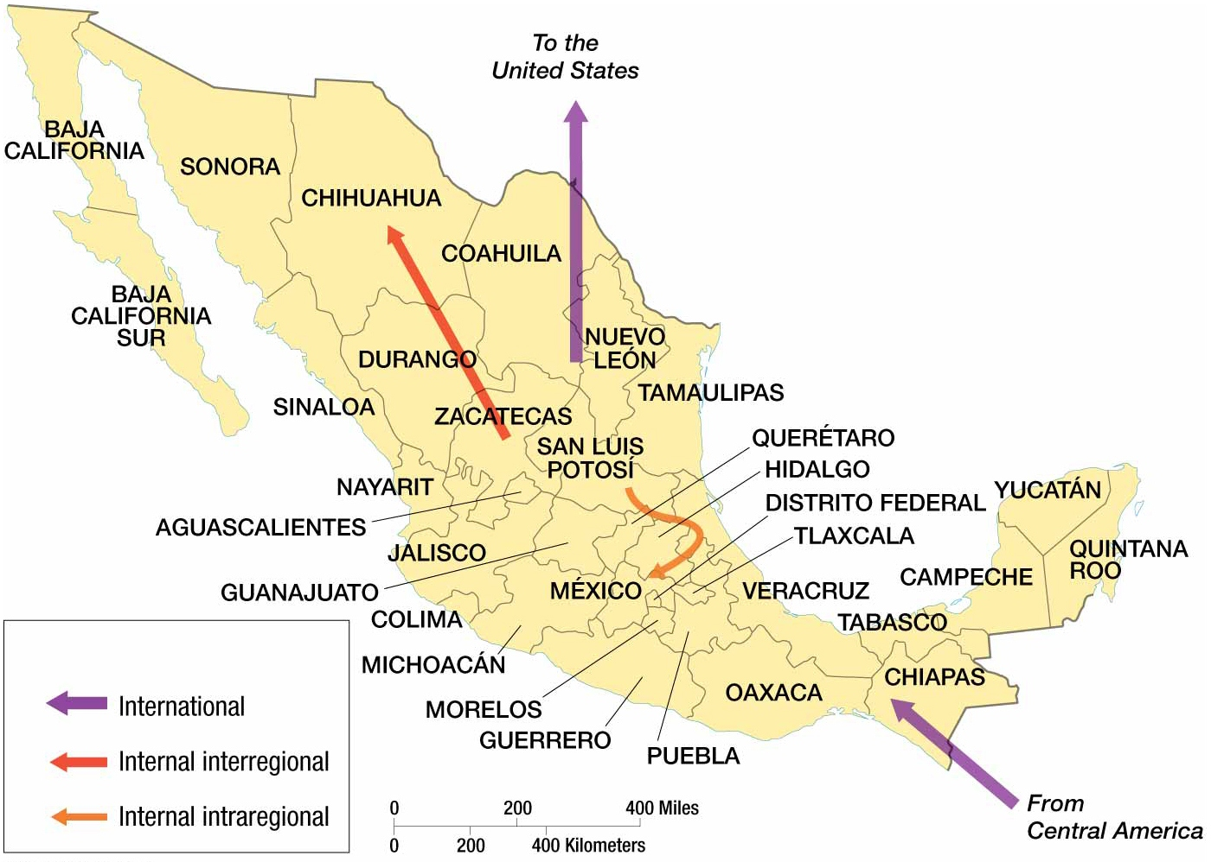
Types of Migration

Slide 7
Push and Pull Factors in Voluntary Migration
Push factors are the conditions and perceptions that help the migrant decide to leave a place.
They include individual considerations such as work or retirement conditions, cost of living, personal safety and security, and, for many, environmental catastrophes or even issues like weather and climate.
Pull factors are the circumstances that effectively attract the migrant to certain locales from other places, the decision of where to go.
They tend to be vaguer and may depend solely on perceptions construed from things heard and read rather than on experiences in the destination place.
Three major types of push and pull factors
Political
Environmental
Economic

Slide 8
Political Migrants
United Nations High Commissions for Refugees recognizes three groups of forced political migrants.
A refugee has been forced to migrate to avoid a potential threat to his or her life, and he or she cannot return for fear of persecution.
An internally displaced person (IDP) is similar to a refugee, but he or she has not migrated across an international border.
An asylum seeker is someone who has migrated to another country in hope of being recognized as a refugee.

Slide 9
Refugees in 2012

Slide 10
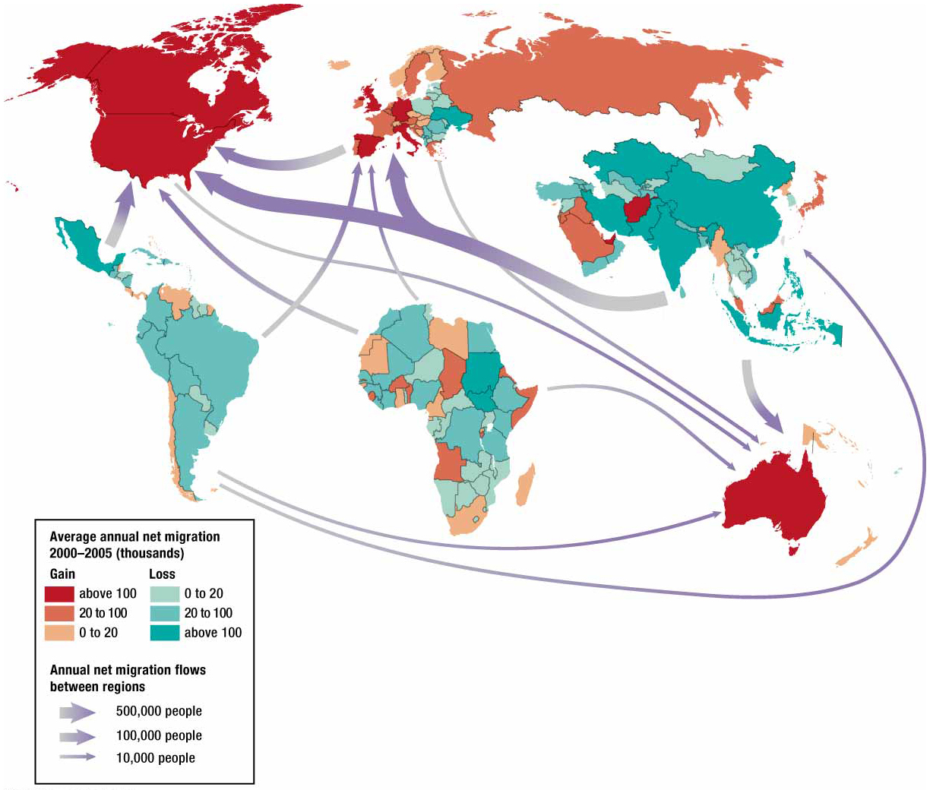
International Migration Patterns
Approximately 9 percent of the world’s people are international migrants.
Global pattern reflects migration tendencies from developing countries to developed countries.
Net Out-Migration
Asia, Latin America, and Africa
Net In-Migration
North America, Europe, and Oceania

Slide 11
Economic Migrants
Most people migrate for economic reasons.
Push factor: migrate away from places with few jobs
Pull factor: migrate to places where jobs seem to be available
U.S. and Canada have been prominent destinations for economic migrants.
Historically individuals migrated from Europe.
More recently Latin America and Asia are primary senders.

Slide 12
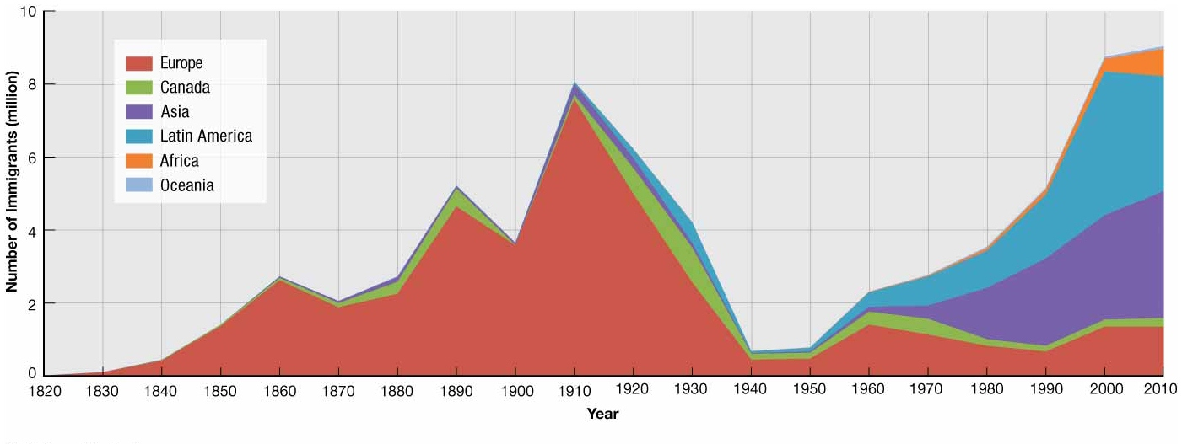
US Immigration Patterns
U.S. has more foreign-born residents than any other country: approximately 43 million as of 2010—growing by 1 million annually.
Three main eras of immigration in the U.S.
Colonial settlement in seventeenth and eighteenth centuries
Mass European immigration in the late 19th and early twentieth centuries
Asian and Latin American integration in the late Twentieth and early twenty-first centuries

Slide 13
Quotas
More seek admission to the U.S. than is permitted by the quotas, thus preferences are shown toward:
Family Reunification
About ¾ of immigrants
Skilled Workers
Approximately ¼ of immigrants
Sending countries alleged preference for skilled workers contributes to brain drain- a term for the disproportionate amount of highly skilled and intelligent citizens migrating away from sending countries.
Diversity
A few immigrants admitted, because their sending country historically has sent very few migrants

Slide 14
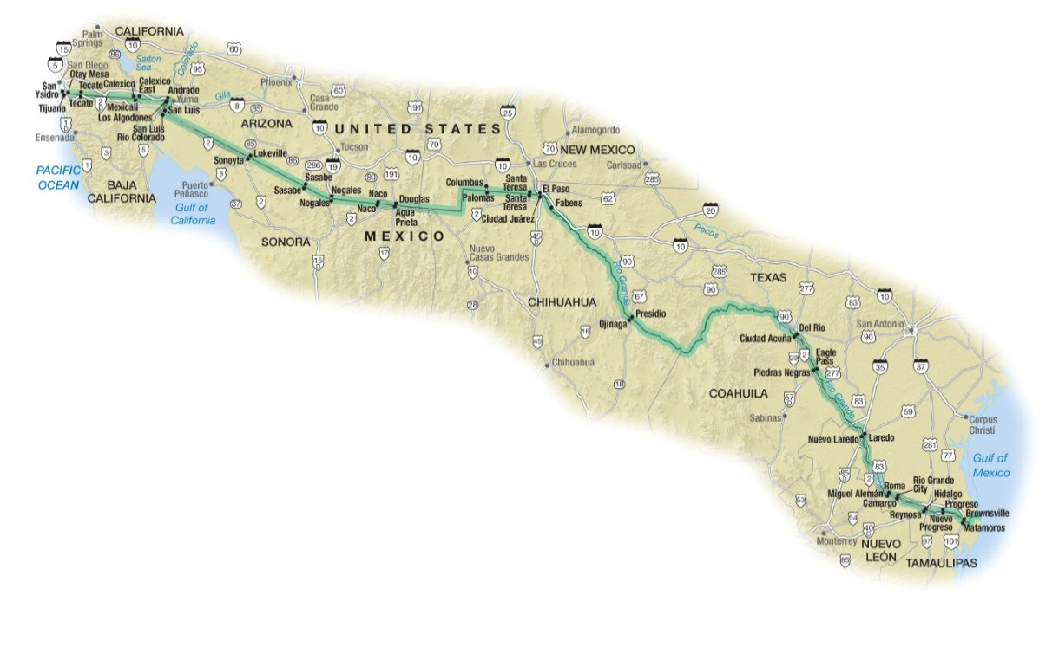
Unauthorized Immigrants
Unauthorized immigrants are those who enter a country without proper documents.
Characteristics of unauthorized immigrates in the U.S.
Source Country
Roughly 58 percent emigrate from Mexico
Children
Of estimated 11.2 million unauthorized immigrants, nearly 1 million are children.
Unauthorized immigrants have given birth to 4.5 million children on U.S. soil making the children U.S. citizens.
Years in the U.S.
Duration of residency has increased for unauthorized immigrants.
In 2010, 35 percent of adults had been in U.S. for at least 15 years.
Labor Force
Approximately 8 million unauthorized immigrants are employed in the U.S.
Distribution
Texas and California have largest number of unauthorized immigrants

Slide 15
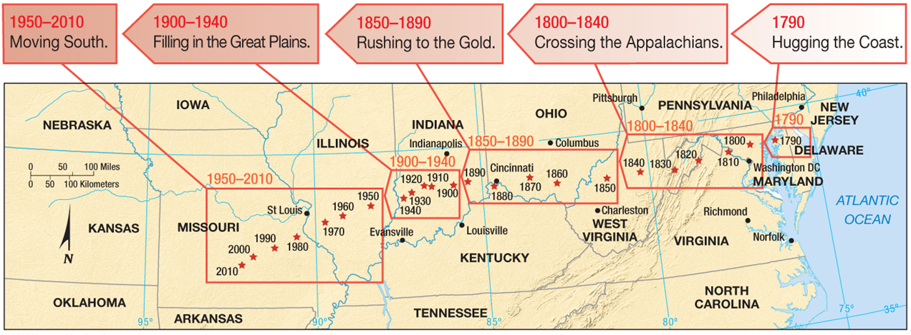
Where Do People Migrate within a Country?
Interregional Migration
Perceived economic betterment typically compels individuals to make interregional migrations.
Historically- enticement of abundant available land on the American Frontier.
Presently- most jobs, especially in services, are clustered in urban areas.
Westward expansion contributed to a shift in the center of population.
“Center of population gravity”

Slide 16
Migration and its Theories
Since Industrial Revolution began in Europe in nineteenth century, a global trend for individuals to migrate from rural to urban areas. Percentage of urbanized population in U.S:
1800: 5 percent
1920: 50 percent
2010: 80 percent
Motivated by economic advancement
Ernst Ravenstein proposed laws of migration:
Every migration flow generates a return or countermigration.
The majority of migrants move a short distance.
Migrants who move longer distances tend to choose big-city destinations.
Urban residents are less migratory than inhabitants of rural areas.
Families are less likely to make international moves than young adults.

Slide 17
Distance decay: Prospective migrants are likely to have more complete perceptions of nearer places than of farther ones.
Step migration:
Migration streams consist of a series of stages.
Intervening opportunity:
Many migrants encounter an opportunity along their migration stream that keeps them from getting to the metropolis that impelled them to move in the first place.

Slide 18
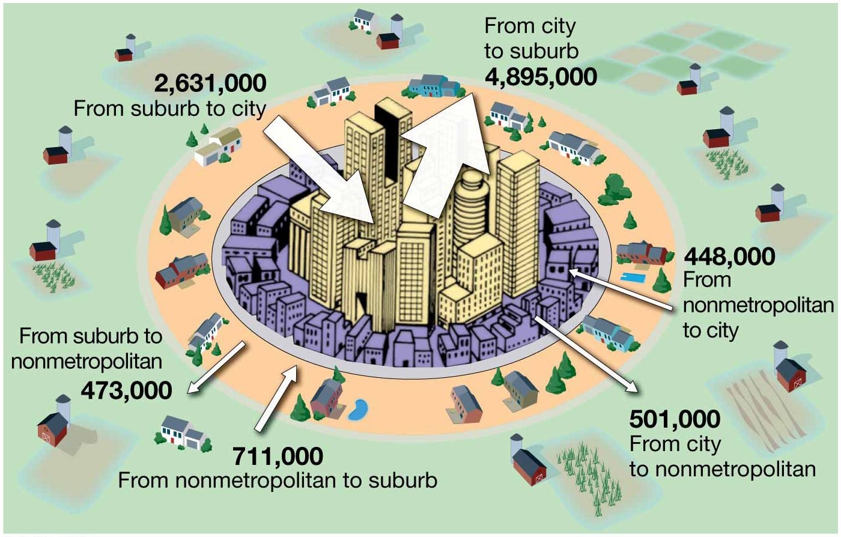
Connectivity
Kinship links: Communication strengthens their role of push/pull factors.
Chain migration: flows along and through kinship links.
Chains of migration built upon each other create immigration waves or swells in migration from one origin to the same destination.

