Slide 1
Levels of Development

Slide 2
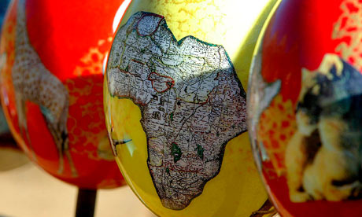
What is Development?
Development is the process of economic growth.
Indicators include Gross Domestic Product (GDP).
Growth in diffusion of and access to resources, knowledge, and technology.
It is a continuous process and each country falls somewhere on the continuum between more-developed (MDC) and less-developed (LDC).
Productivity is a measure of economic efficiency
Measured by the value added per capita
MDCs are more productive than LDCs

Slide 3
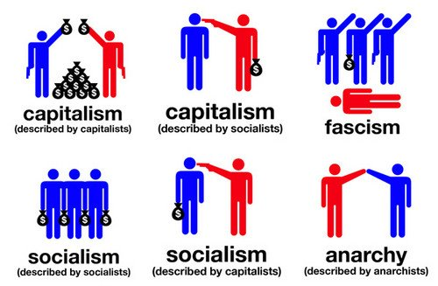
What is an Economy?
A system by which a society manages its scarce resources.
Three main economic systems
Capitalism - process of letting a competitive market determine the price of goods. Creates winners and losers and poverty is a heated debate in capitalistic societies.
Socialism - governmental control of basic items in an economy such as food, transportation and energy so everyone can benefit from these services.
Communism - Total government control of all prices in a society, ranging from bread to utilities. Everyone is paid the same salary and the government dictates your profession based upon assessment skills.

Slide 4
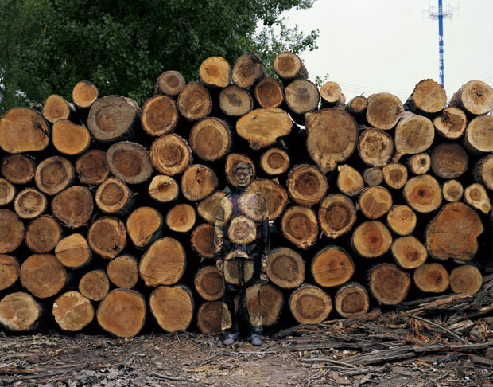
Sectors of Economic Activity
Primary – Harvest or extraction activities such as mining and farming.
It is the main form of economic activity in LDCs or periphery countries.
Secondary – Manufacturing and assembly and it forms the main economic activity in semi-periphery countries.
Tertiary – Service industry as well as selling, moving and trading goods produced from secondary activities.
Quaternary – Information exchange – teaching, banking, tourism. FIRE activities as well – finance, insurance and real eastate.
Quinary – governmental research and highest-levels of decision making and research – Legislatures, think-tanks etc.

Slide 5
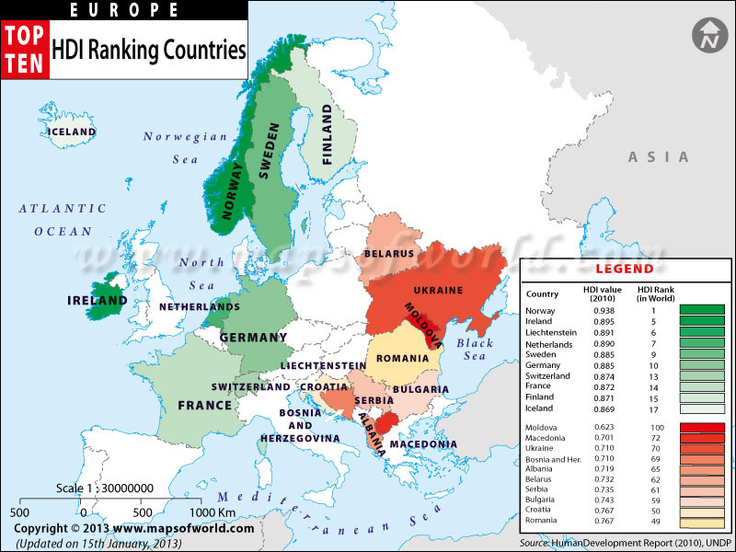
The Human Development Index
The Human Development Index (HDI) uses four factors used to assess a country’s level of development:
Economic = (1) gross domestic product (GDP) per capita
Social = (2) literacy (literacy rate) and (3) amount of education
Demographic = (4) life expectancy – diet and access to healthcare are key variables
Other demographic indicators:
Infant mortality
Natural increase
Crude birth rate

Slide 6
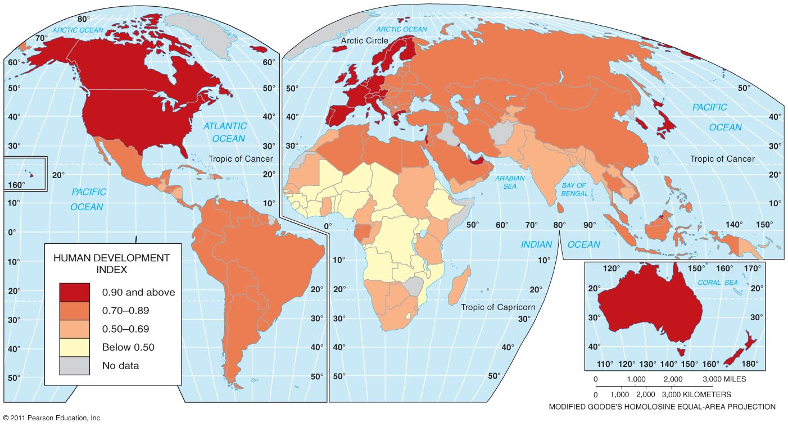

Slide 7
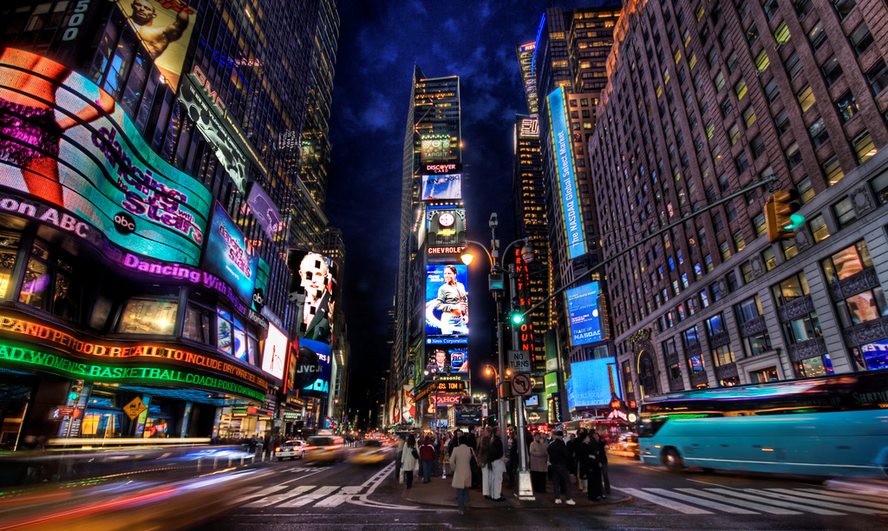
The More-Developed Countries (MDCs)
Five regions have been identified by the HDI as more developed.
More developed regions
North America and Europe
Other MDCs with high HDI = Russia, Japan, Australia, and New Zealand

Slide 8
The Less-Developed Countries (LDCs)
Six regions have been identified as less-developed.
Less developed regions
Latin America = highest HDI among LDCs
Southwest Asia, Southeast Asia, Central Asia = similar HDI
South Asia and sub-Saharan Africa = low levels of development

Slide 9
The Gender-Related Development Index (GDI)
A country with complete gender equality would score 1.0.
Four measures (similar to HDI):
Per capita female incomes as a percentage of male per capita incomes
Number of females enrolled in school compared to the number of males
Percent of literate females to literate males
Life expectancy of females to males
The Gender Empowerment Measure (GEM).
Uses economic and political indicators:
Per capita female incomes as a percentage of male per capita incomes
Percentage of technical and professional jobs held by women
Percentage of administrative jobs held by women
Percentage of women holding national office

Slide 10
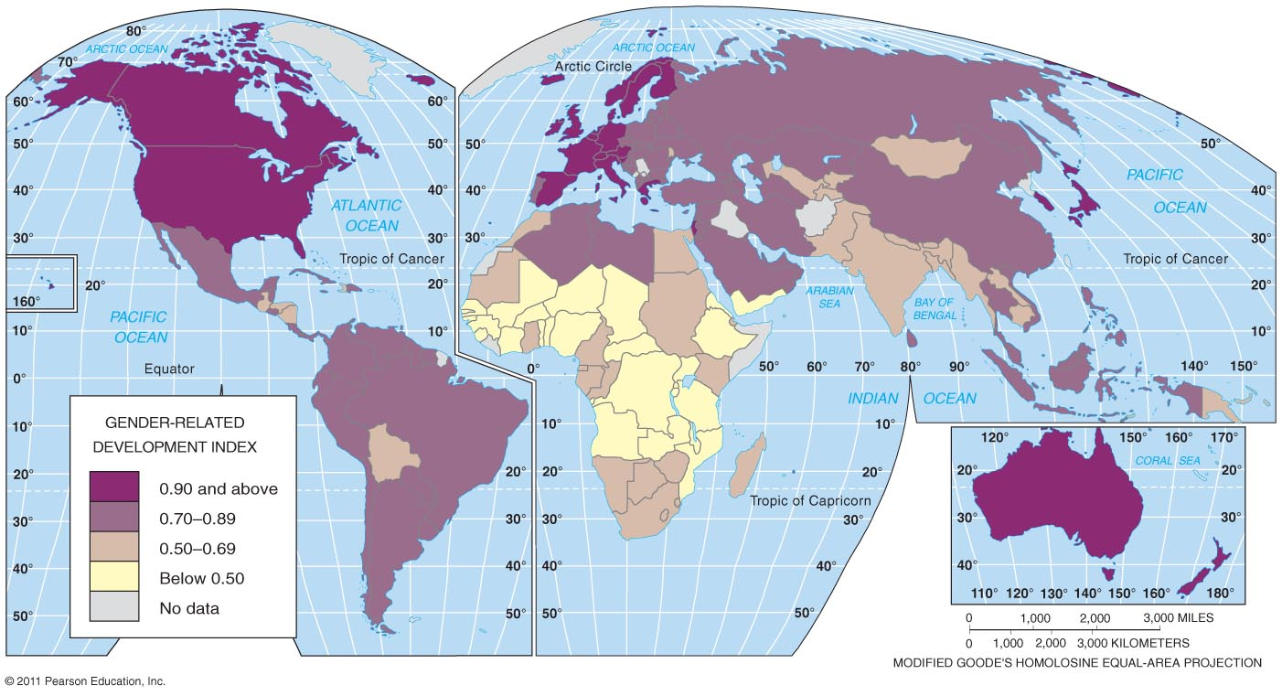

Slide 11
W.W. Rostow’s Model of Development
Modernization Model (a “liberal” model) - Walt Whitman Rostow – 1960s.
Countries undergo 5 stages of development in order
Model does not account for factors which may cause a country to progress out of the 5 steps: Global politics, colonialism, physical geography, war, culture, and ethnic conflicts

Slide 12
Stage 1 -- Traditional Society
The economy is dominated by subsistence activity where output is consumed by producers rather than traded.
Any trade is carried out by barter where goods are exchanged directly for other goods.
Agriculture is the most important industry and production is labor intensive using only limited quantities of capital.
Limited technology, static society
Resource allocation is determined chiefly by traditional methods of production.

Slide 13
Stage 2 -- Transitional Stage (the preconditions for takeoff)
Increased specialization generates surpluses for trading.
External trade also occurs concentrating on primary economic activity products.
Commercial agriculture
Emergence of a transport infrastructure to support trade.
Entrepreneurs emerge.

Slide 14
Stage 3 -- Take Off
Industrialization increases, with workers switching from the agricultural sector to the manufacturing sector.
Growth is uneven and concentrated in a few regions of the country and in one or two manufacturing industries.
Physical infrastructure improves: roads, railways
The level of investment increases to over 10% of GNP.
The economic transitions are accompanied by the evolution of new political and social institutions that support the industrialization. (political & social elites)
The growth is self-sustaining as investment leads to increasing incomes in turn generating more savings to finance further investment.

Slide 15
Stage 4 -- Drive to Maturity
The economy is diversifying into new areas. (International trade, Leaving “the Gap” that Barnett talked about)
Technological innovation is providing a diverse range of investment opportunities.
The economy is producing a wide range of goods and services and there is less reliance on imports.

Slide 16
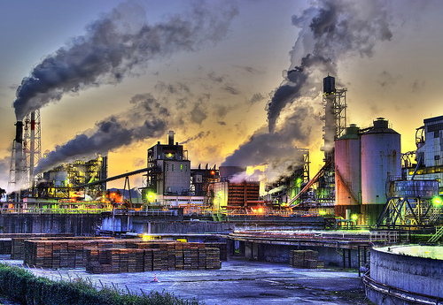
Stage 5 -- High Mass Consumption
The economy is geared towards mass consumption.
The service sector becomes increasingly dominant.
Chief criticisms:
Does consumption = development?
What about deindustrialization?

Slide 17
Dependency Theory
Core-Periphery Model, Wallerstein’s World-Systems Theory
Core – regions with concentrations of employment, capital & economic control; develops with agglomeration.
Attracts new investment through:
Backward linkages – supplies firms with components & services
Forward linkages – help firms find uses & markets for their products
Ancillary industries – firms providing services for other corporations
Investment into infrastructure & technology

Slide 18
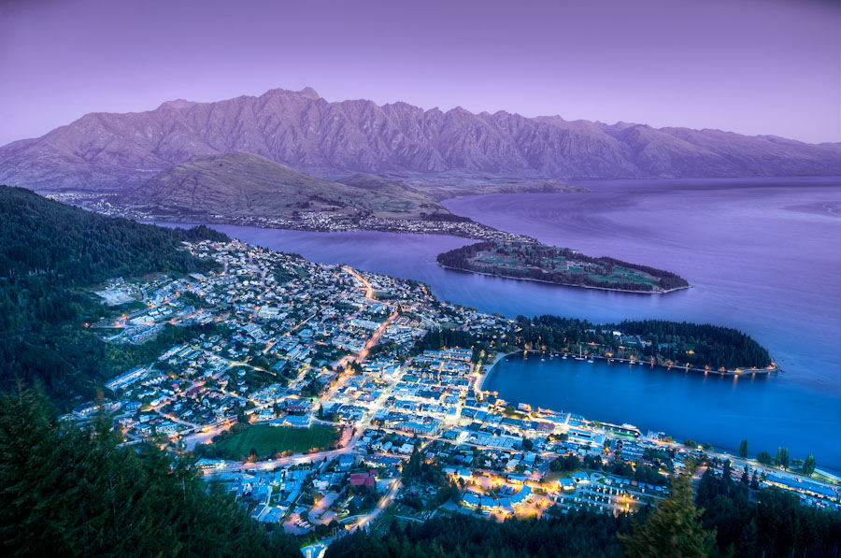
Dependency Theories
Political and economic relationships between countries and regions control and also limit the developmental possibilities of less well-off areas
(e.g. Imperialism caused colonies to be dependent – this helps sustain the prosperity of dominant areas and poverty of other regions)
Elites in society prosper at the expense of lower classes.

Slide 19
The International Trade Approach
Development through international trade
Rostow’s model of development
Examples of international trade approach
The “four Asian dragons”
Petroleum-rich Arabian Peninsula states
Three major problems:
Uneven resource distribution
Increased dependence on MDCs
Market decline

Slide 20
International Trade Approach Successes
International trade approach success stories
The path most commonly selected by the end of the twentieth century
Countries convert because evidence indicates that international trade is the most effective path toward development

Slide 21
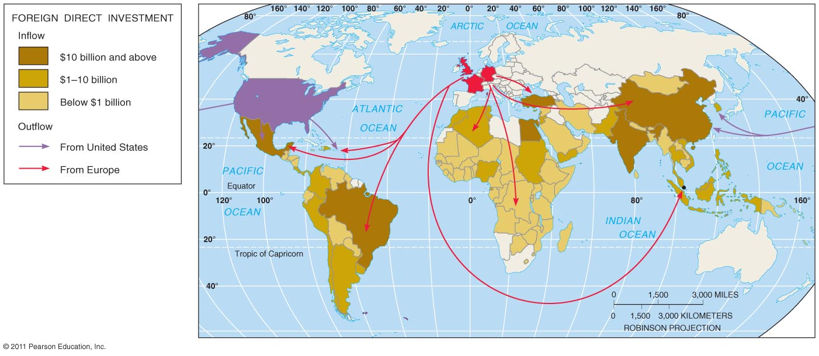
Obstacles to Development
Financing development
LDCs require money to fund development
Two sources of funds:
Loans
The World Bank and the IMF
Structural adjustment programs
Foreign direct investment from transnational corporations

