Slide 1
Foundations of Political Geography
“The worst illiterate is the political illiterate, he doesn’t hear, doesn’t speak, nor participates in the political events. He doesn’t know the cost of life, the price of the bean, of the fish, of the flour, of the rent, of the shoes and of the medicine, all depends on political decisions. The political illiterate is so stupid that he is proud and swells his chest saying that he hates politics. The imbecile doesn’t know that, from his political ignorance is born the prostitute, the abandoned child, and the worst thieves of all, the bad politician, corrupted and flunky of the national and multinational companies.” – Bertolt Brecht

Slide 2
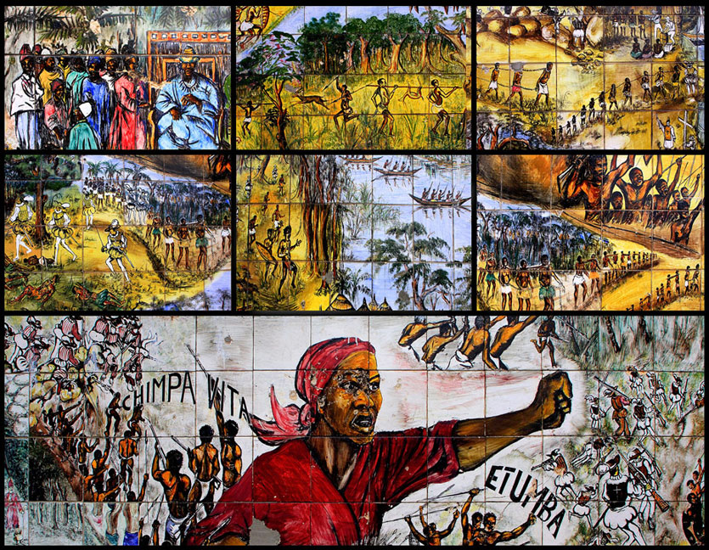
What is Political Geography?
Political geography is concerned with the study of the way governments organize and administer space on Earth’s surface, and especially the geographic dimensions of conflict.
One of Earth’s most fundamental cultural characteristics is the division of our planet’s surface into a collection of spaces occupied by individual countries, also called states.

Slide 3
The Political Organization of Space
Four qualities of a state or country:
Occupies defined territory
Maintains a permanent population
Has an independent government
It then must be recognized as a state by other states
Territoriality
A learned cultural response rooted in European history that produced external bounding or delimiting and internal territorial organization
Territory is treated as a fixed element of political identification, and states define exclusive, non-overlapping territories.

Slide 4
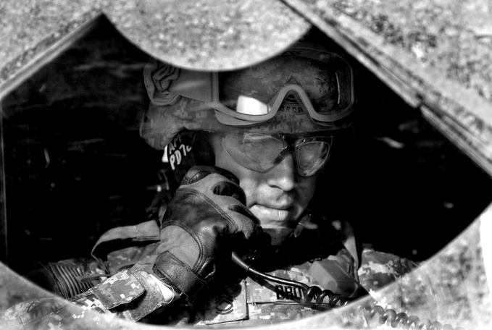
My Space!
A state has sovereignty:
independence from control of its domestic affairs by other states
recognized right to control its territory both politically and militarily.
Under international law states are sovereign and have the right to defend their territorial integrity against incursion from other states crossing their boundaries.
Sovereignty implies having the ‘last say’ politically and militarily within a state.

Slide 5
Borders and Boundaries
A state is separated from its neighbors by a boundary, an invisible line the marks the extent of a state’s territory.
Historically, frontiers, which are a zone where no state exercises complete political control, rather than boundaries separated states from each other.
Relic boundaries are boundaries no longer politically recognized but still visible in the cultural landscape.
Examples include the Berlin Wall and the Great Wall of China.

Slide 6
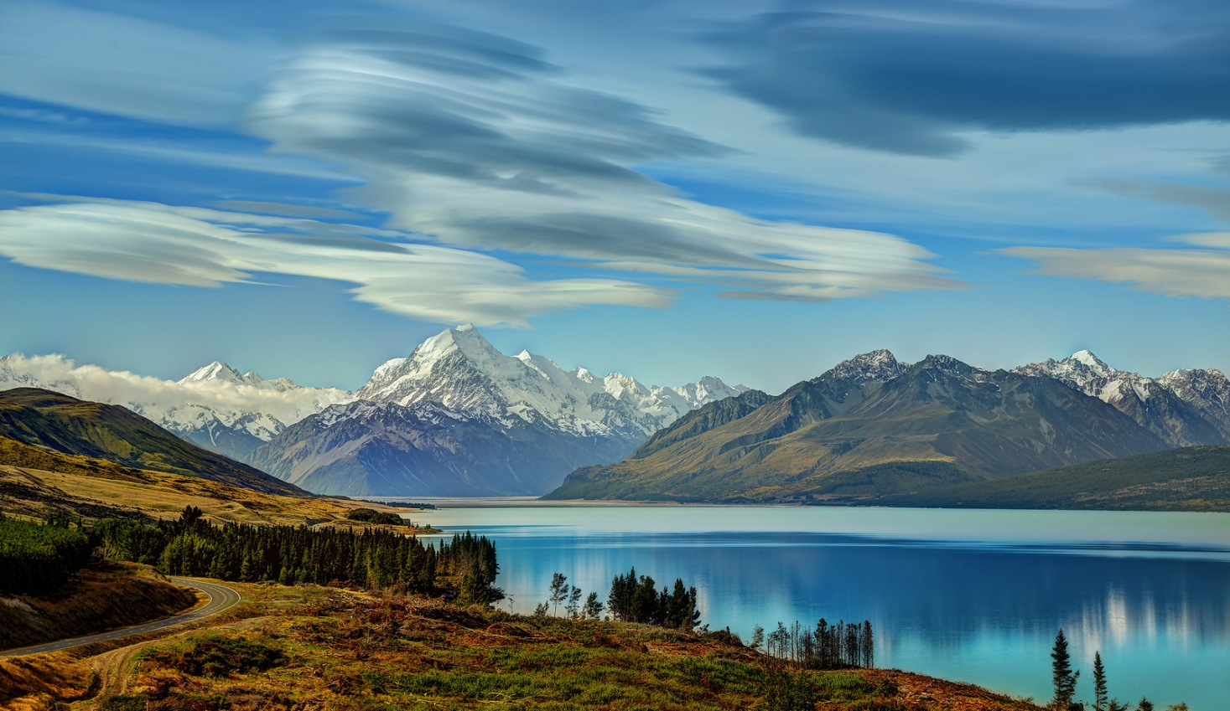
Three Main Types of Boundaries
Natural Boundaries
Political borders that follow some feature of the natural environment.
Examples include the Pyrenees (Spain/France)
Ethnographic or Cultural Boundaries
Boundary coincides with differences in ethnicity or culture, especially language and religion.
Examples include the India/Pakistan border.
Geometric Boundaries
Borders that when drawn on a map look like straight lines.
Examples include the 2,100-kilometer (1,300-mile) straight line along 49º north latitude that separates the U.S. and Canada.

Slide 7
Three types of physical elements serve as boundaries between states:
Desert Boundary - Effectively divides two states, because deserts are hard to cross and sparsely inhabited.
Mountain Boundary - Effectively divides two states, if the mountains are difficult to cross.
Useful boundaries because of their permanent quality and tendency to be sparsely populated.
Water Boundary - Examples include rivers, lakes, and oceans.
Potentially more problematic than mountain boundaries, because of the tendencies of bodies of water and river channels to move over time.
Natural Boundaries

Slide 8
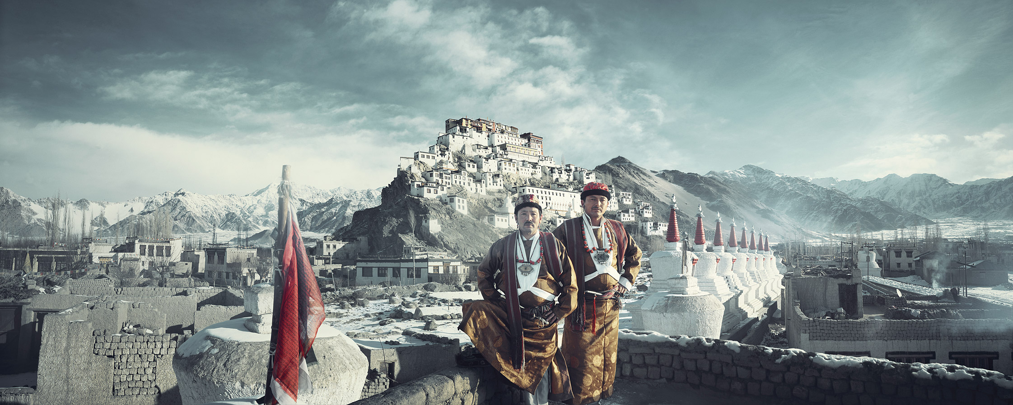
Borderline Boundaries
Pseudo-boundaries
Buffer State
An independent but small and weak country between two powerful countries. Examples are Mongolia and Nepal.
Satellite State
A small, weak country dominated by one powerful neighbor to the extent that some of its independence is lost.

Slide 9
Nations and Nation-States
A nation is a culturally defined term, and few people agree on exactly what it means.
The term was originally meant to refer to a group of people who think of themselves as one based on a sense of shared culture and history, and who seek some degree of political-territorial autonomy.
A nation-state is a politically organized area in which nation and state occupy the same space.
All nations are ultimately mixtures of different peoples.

Slide 10
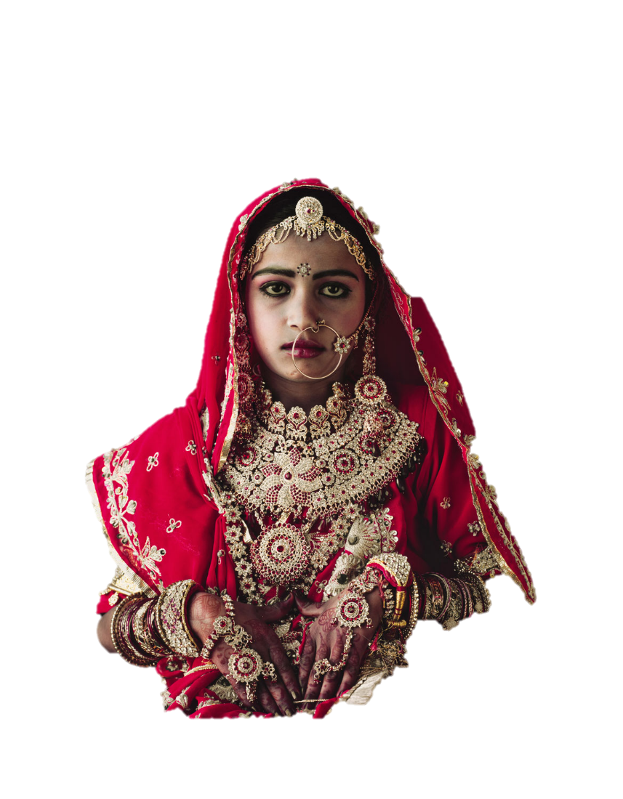
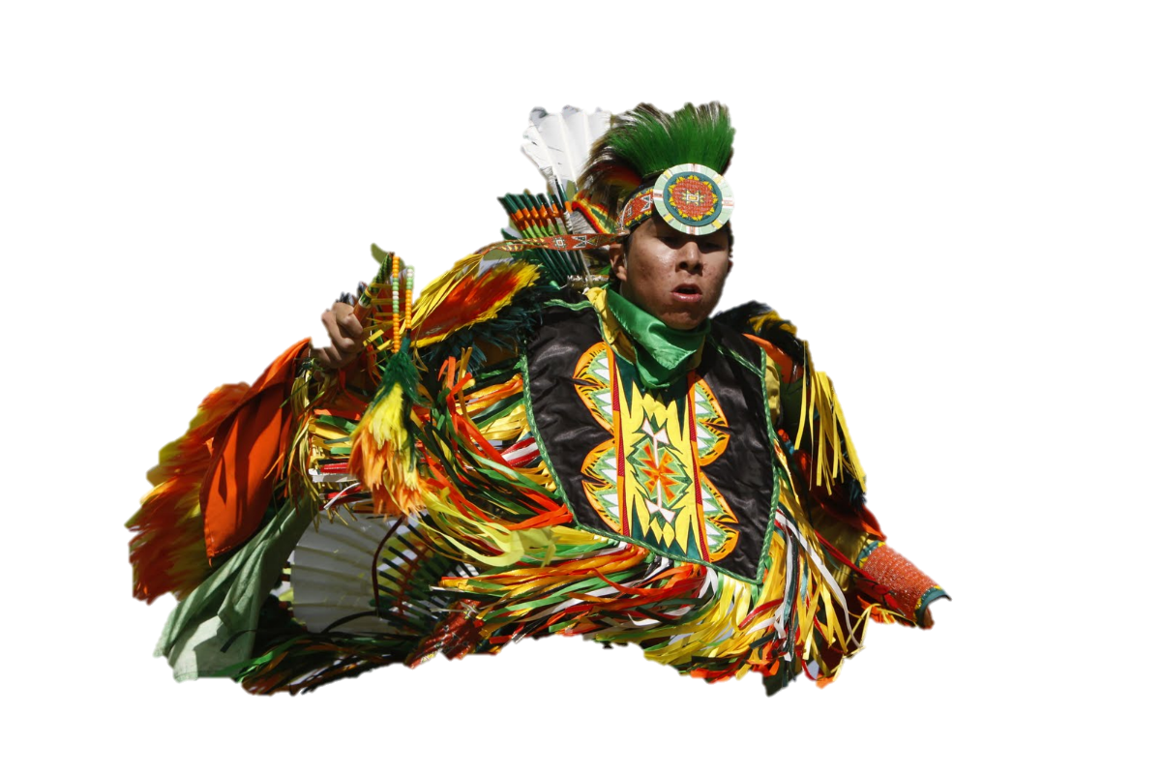
Nations and States
Nation
State
When people have a strong sense of nationalism, they have a loyalty to and a belief in the nation itself.
A state, in contrast, seeks to promote a sense of nationhood that coincides with its own borders.
To help people within the borders relate to the dominant national ideal, states provide security, infrastructure, and goods and services for their citizens.

Slide 11
States in a Real-World Context
Multinational States
Nearly every state in the world is a multinational state, a state with more than one nation inside its borders.
Multi-ethnic states are another variation on the multinational state concept.
Multistate Nations
When a nation stretches across borders and across states, the nation is called a multistate nation.
When multiple nations or states attach claims to the same piece of territory, the potential for conflict is significant.

Slide 12
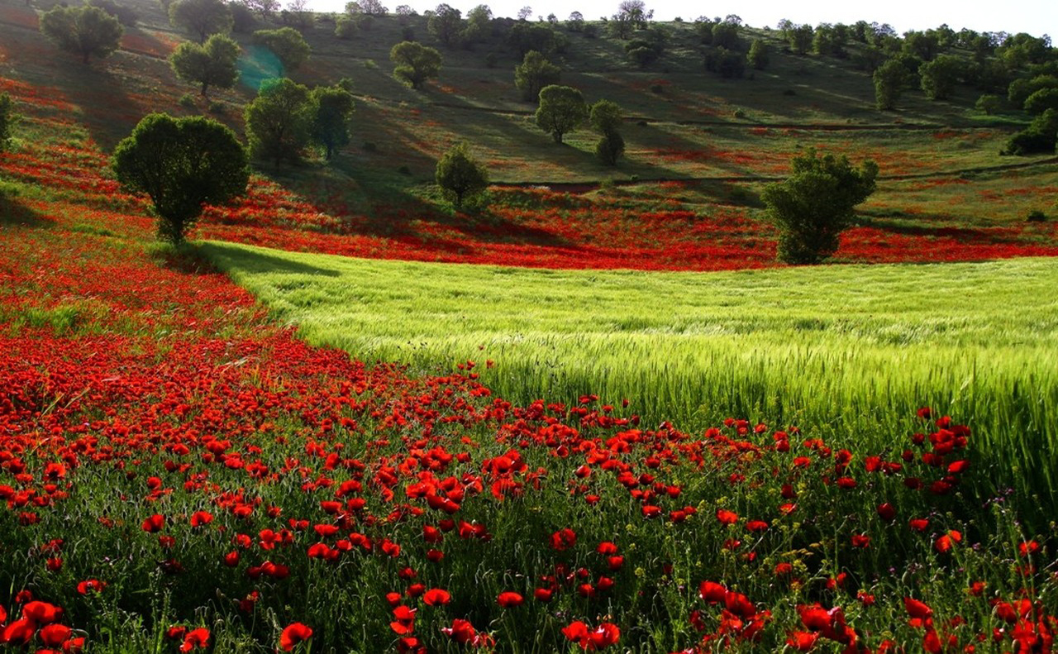
To Be or Not to Be
One complication that arises from the lack of alignment between nations and states is that some nations do not have a state; they are stateless nations.
Examples include the Kurds.

Slide 13
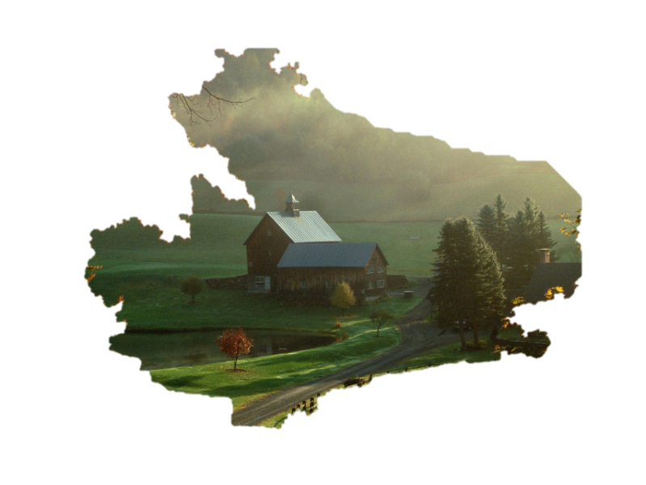
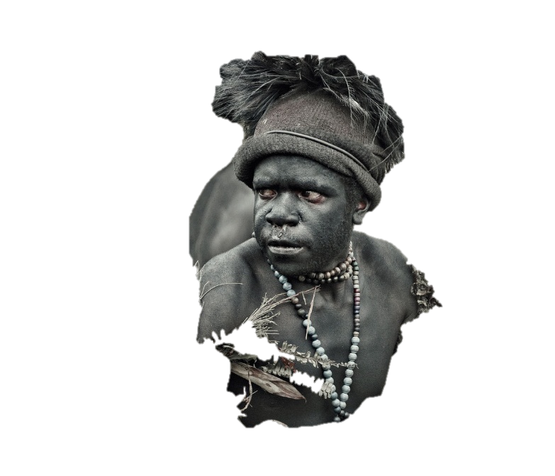
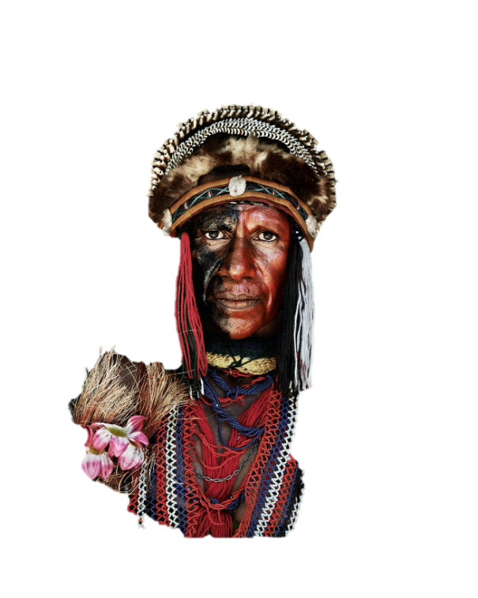
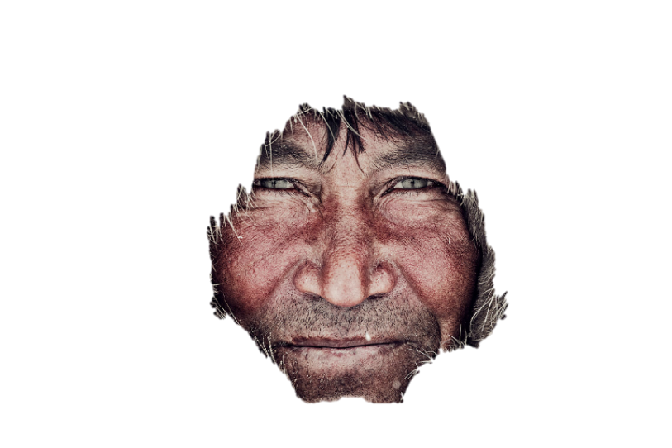
The Form of the State
The ideal form of the state is compact.
Other less ideal forms are:
Fragmented – Indonesia, Philippines
Perforated – South Africa, Italy
Elongated – Chile, Russia
A country wholly located within the borders of another country is known as an enclave.
Examples include Lesotho.
An exclave is a piece of national territory separated from the main body of a country by the territory of another country.
Examples include Alaska.

Slide 14
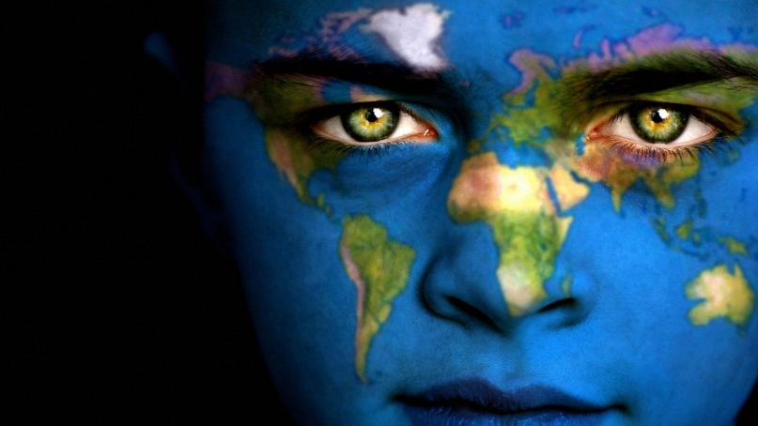
A colony is a separate territory from the sovereign state but it is legally tied to the sovereign state and thus not completely independent.
Sovereign state may run only its military and foreign policy or it may choose to control its internal affairs.
European powers exported their concepts of the state, sovereignty, and the ideal of nation-states to much the world through two waves of colonialism.
During the heyday of colonialism, imperial powers exercised ruthless control over their domains and organized them for maximum economic exploitation.
Colonialism

Slide 15
Why Colonize?
European colonialism was motivated by three reasons.
Promote Christianity
Extract useful resources and to acquire large markets for goods
Establish relative power though the number of their colonies.
Relative power usually meant their own rank and power in comparison to other European countries.
COLONIAL POSSESSIONS, 1914 At the outbreak of World War I in 1914, European states held colonies in much of the world, especially in Africa and Asia.

Slide 16
Colonial Possessions, 2012

Slide 17
Be able to answer these questions!
How might a physical geographic feature in a state, or influencing a state, contribute to centrifugal political forces within a state?
What kinds of states might be more vulnerable to such forces?
What is the difference between patriotism and nationalism?
What areas of the USA are most impacted by centrifugal forces? Identify what these forces are in each region.
What areas of the USA exert the most centripetal forces and how would you identify or characterize those forces?

Slide 18
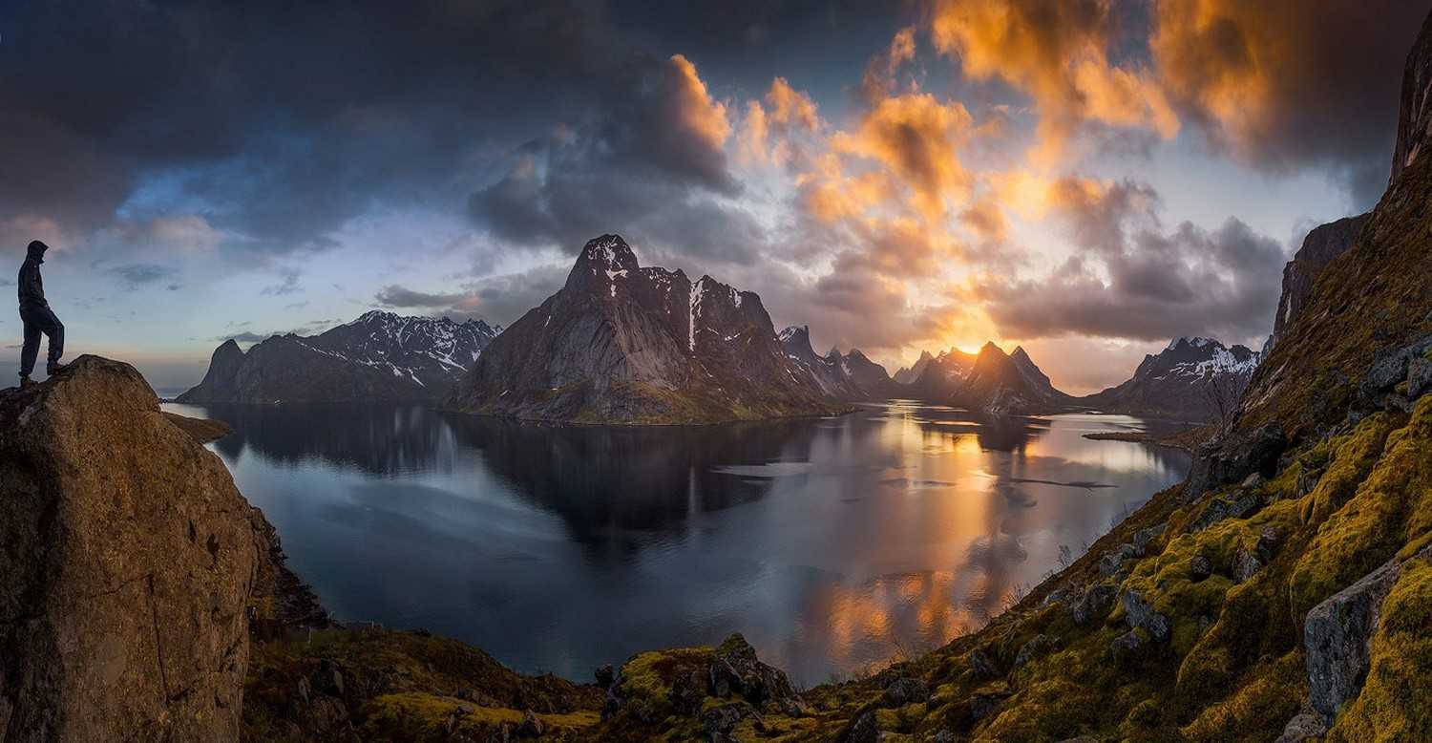

Slide 19
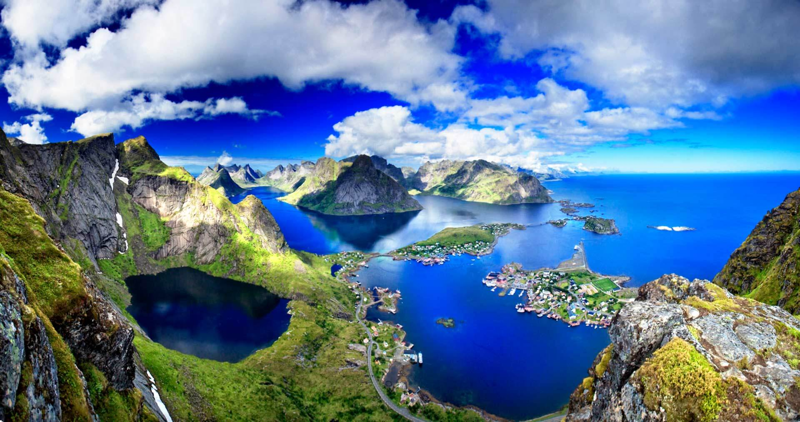
Reine, Lofoten Islands, Norway

Slide 20
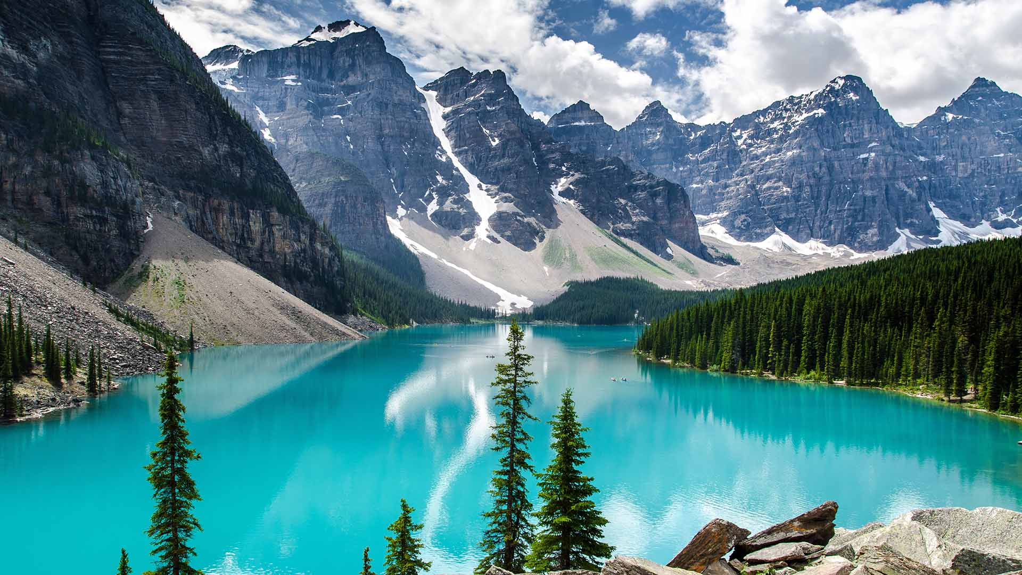
Moraine Lake, Canada

