Slide 1
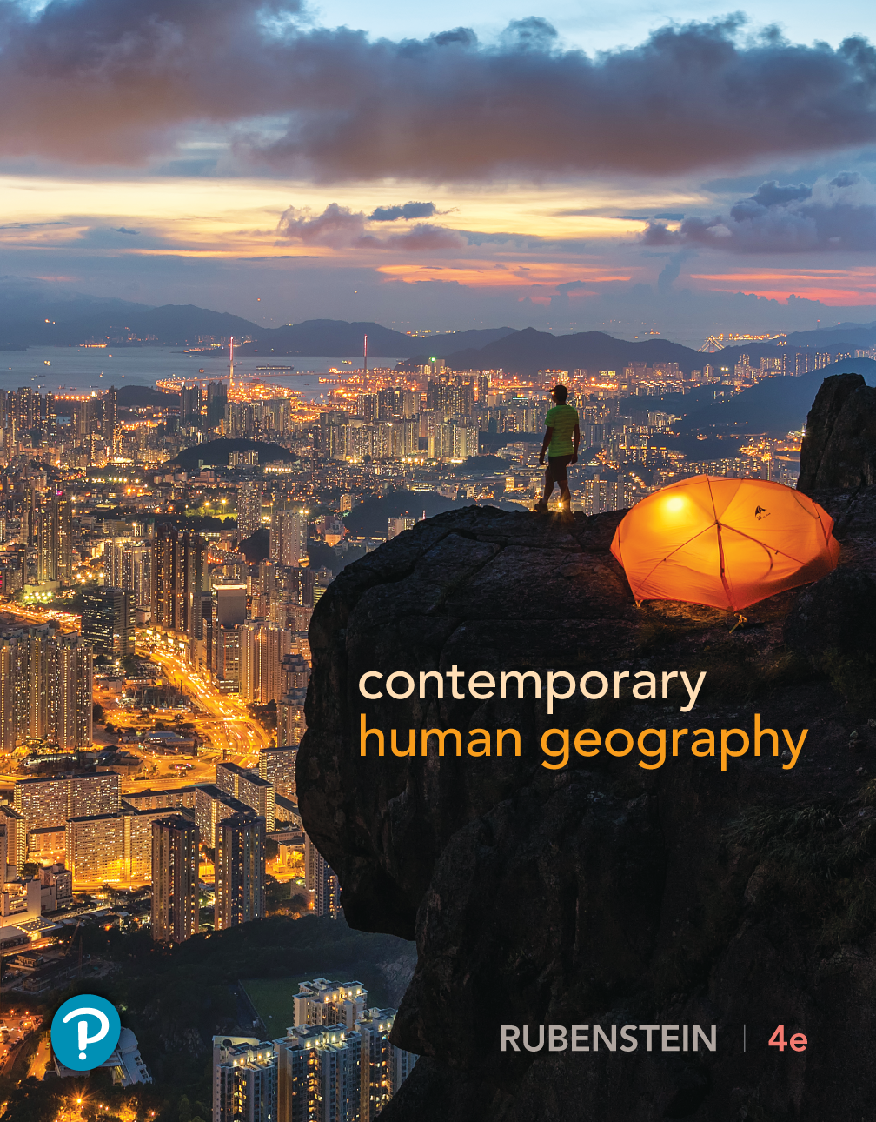
Contemporary Human Geography
Fourth Edition
Chapter 9
Food & Agriculture
Lecture Presentation by
Neusa McWilliams
University of Toledo
Copyright © 2019 Pearson Education, Inc. All Rights Reserved
Notes:
If this PowerPoint presentation contains mathematical equations, you may need to check that your computer has the following installed:
1) MathType Plugin
2) Math Player (free versions available)
3) NVDA Reader (free versions available)

Slide 2
Chapter 9 Key Issues
9.1 How did agriculture originate? Origin of Agriculture
9.2 How did agriculture originate? Subsistence & Commercial Agriculture
9.3 What do people eat? Diet
9.4 What do people eat? Food Security
9.5 Where is agriculture distributed? Agricultural Regions
9.6 Where is agriculture distributed? Agriculture in Developing Regions
9.7 Where is agriculture distributed? Fishing
9.8 Where is agriculture distributed? Agriculture in Developed Regions
9.9 What challenges do farmers face? Trade in Food & Agriculture
9.10 What challenges do farmers face? Agricultural Productivity
9.11 What challenges do farmers face? Biotechnology & Sustainability

Slide 3
9.1 Origin of Agriculture (1 of 5)
Agriculture is deliberate modification of Earth’s surface through cultivation of plants and raising of animals for sustenance or economic gain.
The word cultivate means “to care for,” and a crop is any plant cultivated by people.

Slide 4
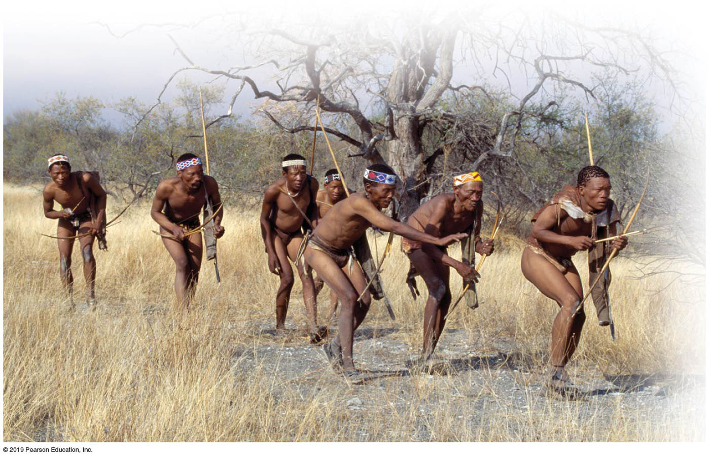
9.1 Origin of Agriculture (2 of 5)
Hunters and Gatherers
  Before the invention of agriculture, all humans probably obtained the food they needed for survival through hunting for animals, fishing, or gathering plants.
  The direction and frequency of migration depended on the movement of game and the seasonal growth of plants at various locations.
  Today, only about 0.005% of the world’s people survive on hunting and gathering.
Notes:
Figure 9.1.1 HUNTING AND GATHERING
San people of Namibia.

Slide 5
9.1 Origin of Agriculture (3 of 5)
Agricultural Revolution
  The time when human beings first domesticated plants and animals and no longer relied entirely on hunting and gathering was the agricultural revolution.
  Scientists do not agree on whether the agricultural revolution originated primarily because of environmental factors or cultural factors.
  Environmental factors include climate change and receding ice, and cultural factors include the preference to stay in one place as they learned how to farm.

Slide 6
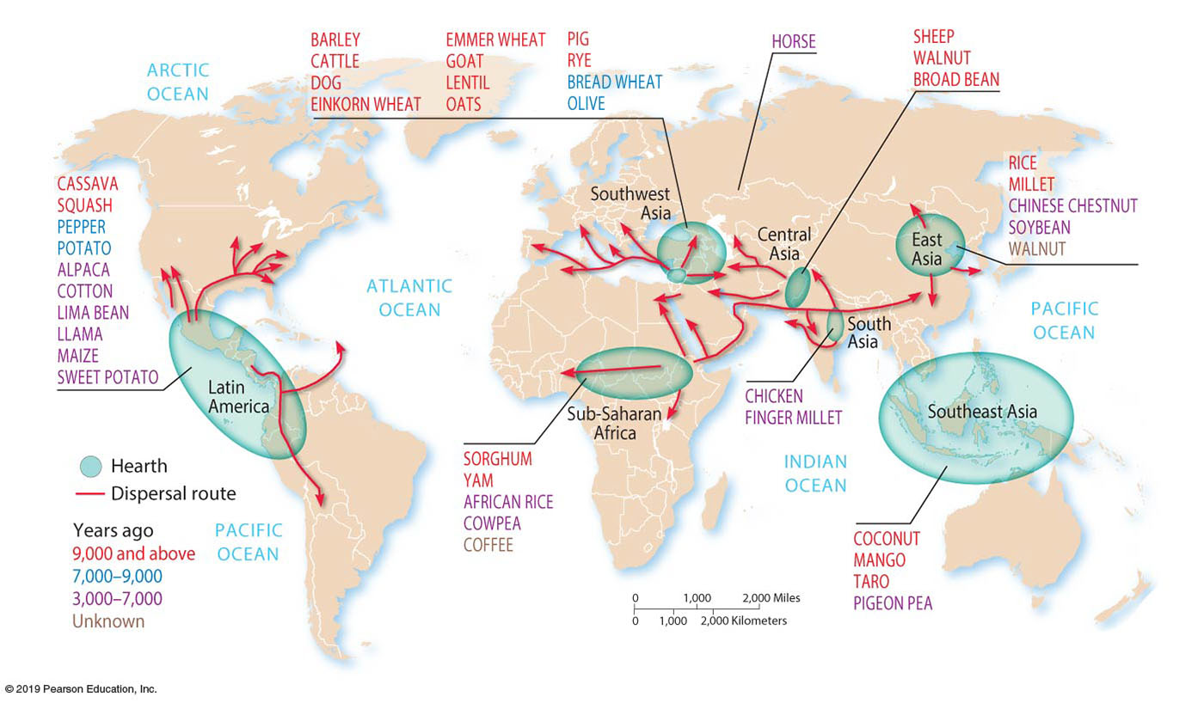
9.1 Origin of Agriculture (4 of 5)
Agriculture Hearths
  Scientists agree that agriculture originated in multiple hearths around the world: Southwest Asia, East Asia, sub-Saharan Africa, and Latin America.
Notes:
Figure 9.1.2 AGRICULTURE HEARTHS

Slide 7
9.1 Origin of Agriculture (5 of 5)
Agricultural Hearth
  Southwest Asia: Crops were domesticated in Southwest Asia around 10,000 years ago, where also many of the most important animal domestications first occurred.
  East Asia: Rice is now thought to have been domesticated in East Asia more than 10,000 years.
  Central and South Asia: Chickens are thought to have diffused from South Asia around 4,000 years ago. The horse was domesticated in Central Asia.
  Sub-Saharan Africa: Sorghum was domesticated in central Africa around 8,000 years ago. Yams may have been domesticated even earlier.
  Latin America: Beans, cotton, potatoes, and corn were domesticated in Latin America.

Slide 8
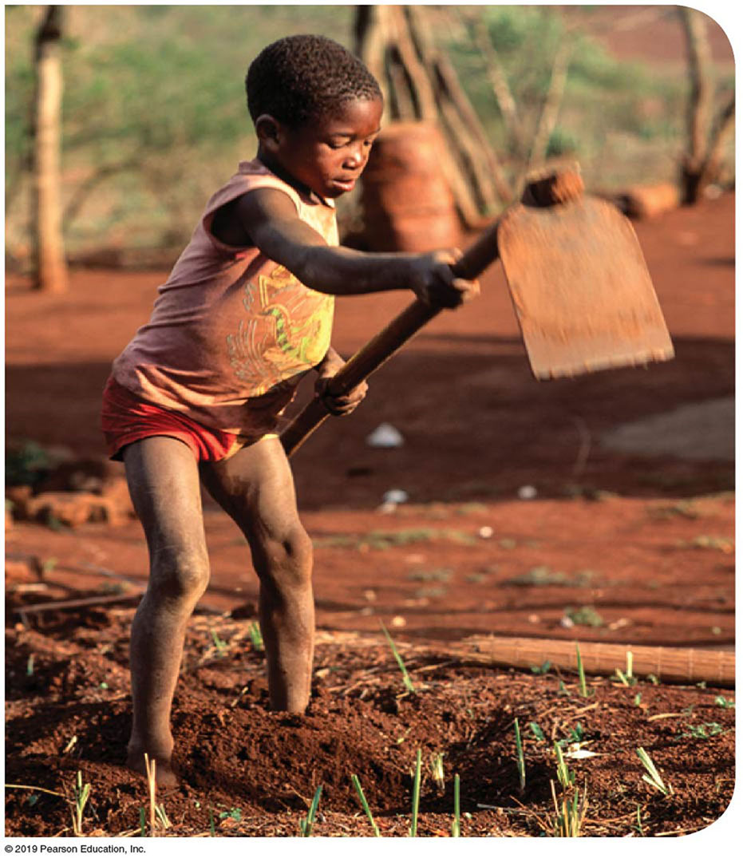
9.2 Subsistence & Commercial Agriculture (1 of 3)
Subsistence agriculture, found in developing countries, is the production of food primarily for consumption by the farmer’s family.
Commercial agriculture, found in developed countries, is the production of food primarily for sale off the farm.
Notes:
Figure 9.2.1 SUBSISTANCE AGRICULTURE
Lomahasha, Swaziland.

Slide 9
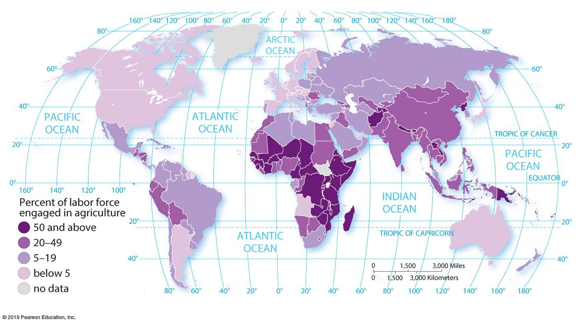
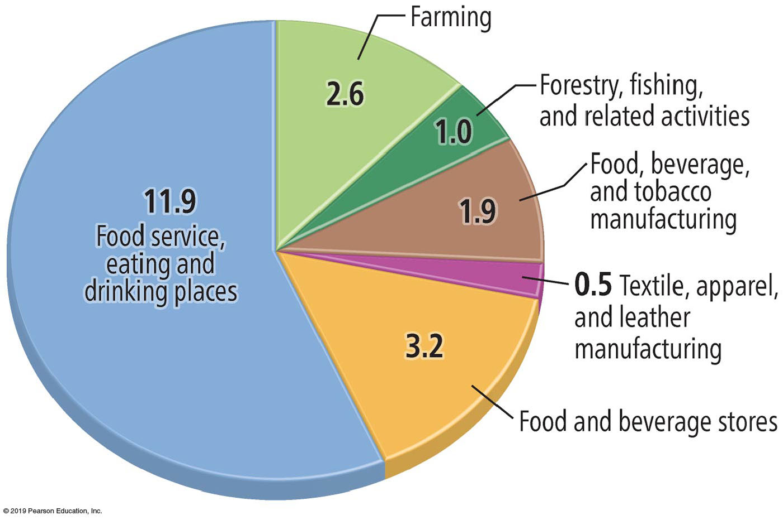
9.2 Subsistence & Commercial Agriculture (2 of 3)
Farmers: Fewer Grow More
  In developed countries, around 3 percent of workers are engaged directly in farming, compared to around 42 percent in developing countries.
  Although farmers account for only 1 percent of U.S. jobs, 10 percent of U.S. jobs are in other elements of the food industry, primarily in restaurants and supermarkets.
Notes:
Figure 9.2.2 AGRICULTURAL WORKERS
The percentage of the workforce engaged in agriculture is much higher in developing countries with subsistence agriculture than in developed countries with commercial agriculture.
Figure 9.2.3 U.S. EMPLOYMENT IN FOOD AND AGRICULTURE
Figures are in millions of jobs. Employment in food and agriculture total 21 million jobs and represent 11 percent of all U.S. employment. Most of the jobs are in restaurants and stores, rather than on farms.

Slide 10
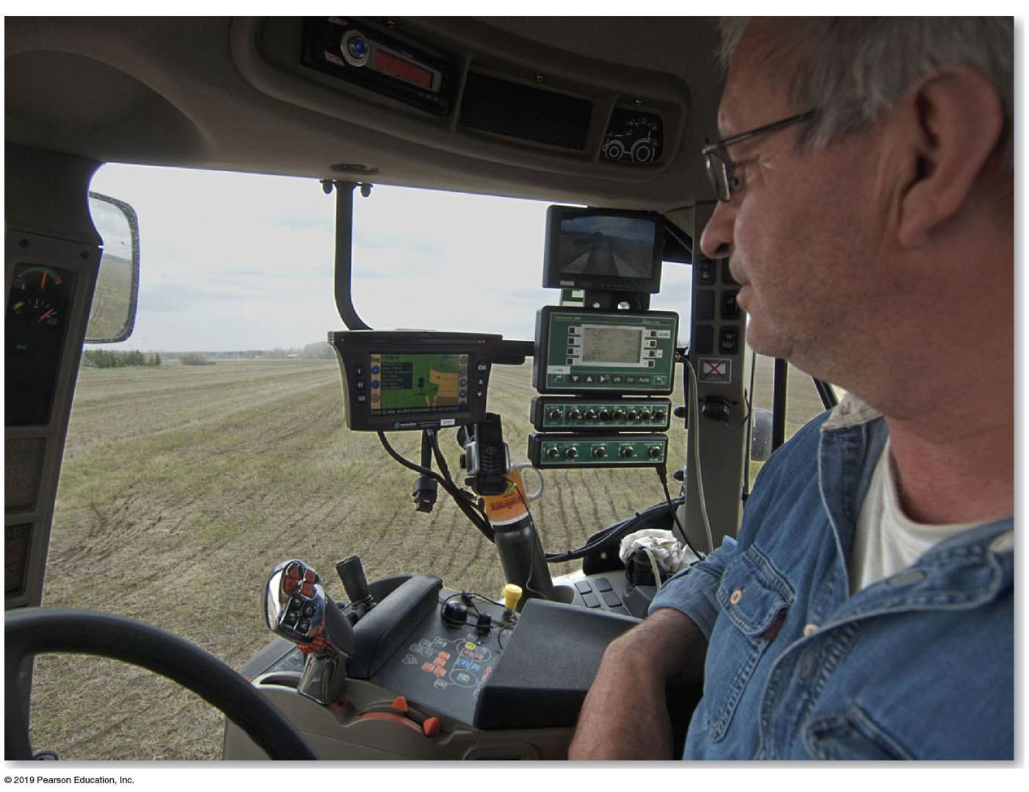
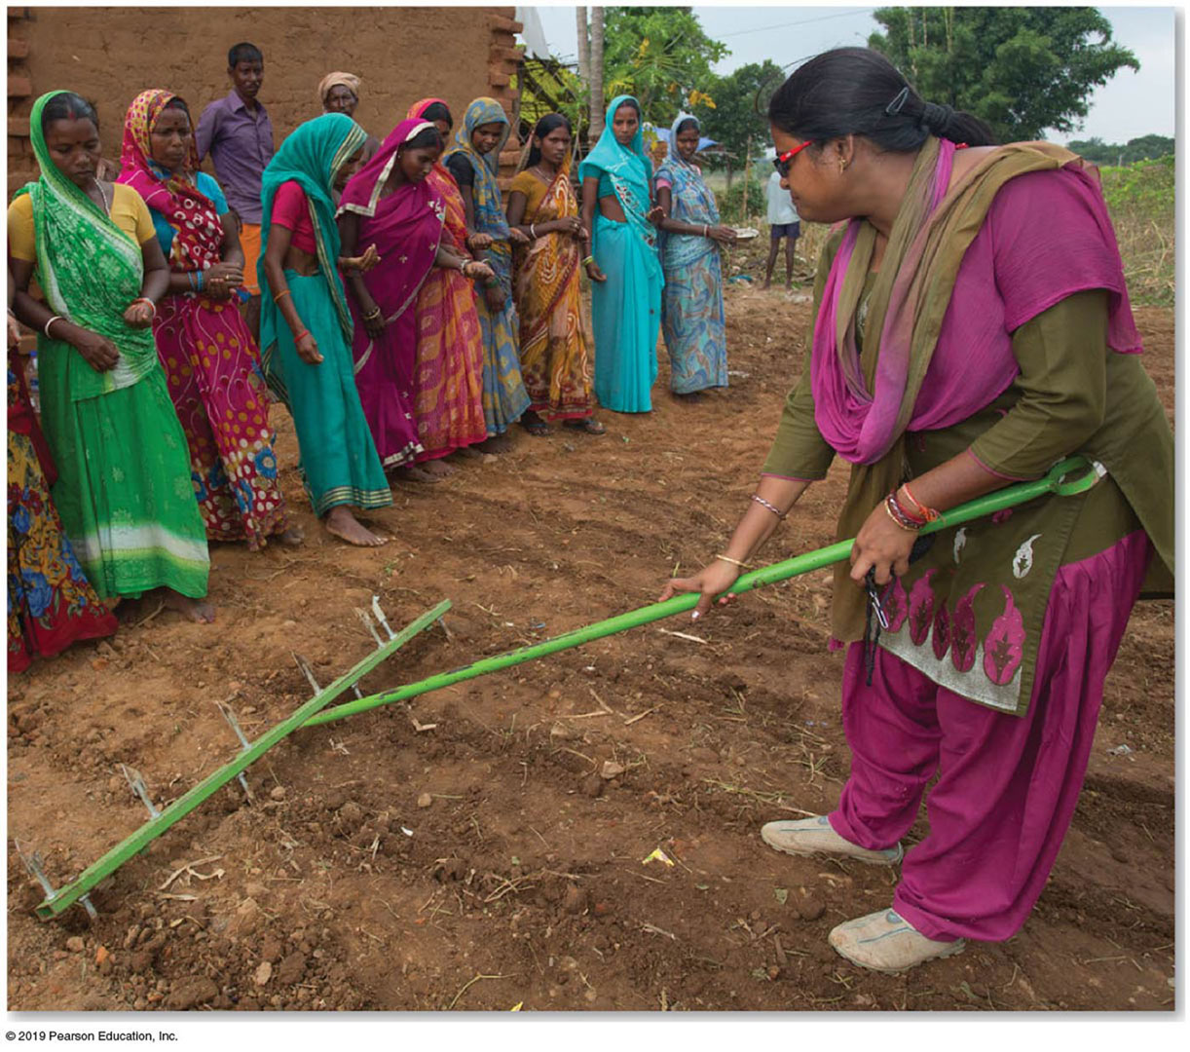
9.2 Subsistence & Commercial Agriculture (3 of 3)
Technology: Agriculture’s Game Changer
  In developed countries, a small number of commercial farmers can feed many people because they rely on machinery, fertilizers, herbicides, hybrid plants, access to scientific information, G P S, and many other innovations.
Notes:
Figure 9.2.4 TECHNOLOGY: COMMERCIAL AGRICULTURE
A British farmer uses electronics mounted in his tractor to control and monitor planting operations.
Figure 9.2.5 TECHNOLOGY: SUBSISTENCE AGRICULTURE
Demonstrating the use of a row-scoring rake, Bihar, India.

Slide 11
9.3 Diet (1 of 3)
Consumption of food varies around the world, both in total amount and source of nutrients. The variation results from a combination of:
  Level of development: People in developed countries tend to consume more food and from different sources.
  Physical conditions: Climate is important in influencing what can be most easily grown and therefore consumed in developing countries.
  Cultural preferences: Some food preferences and avoidances are expressed without regard for physical and economic factors.

Slide 12
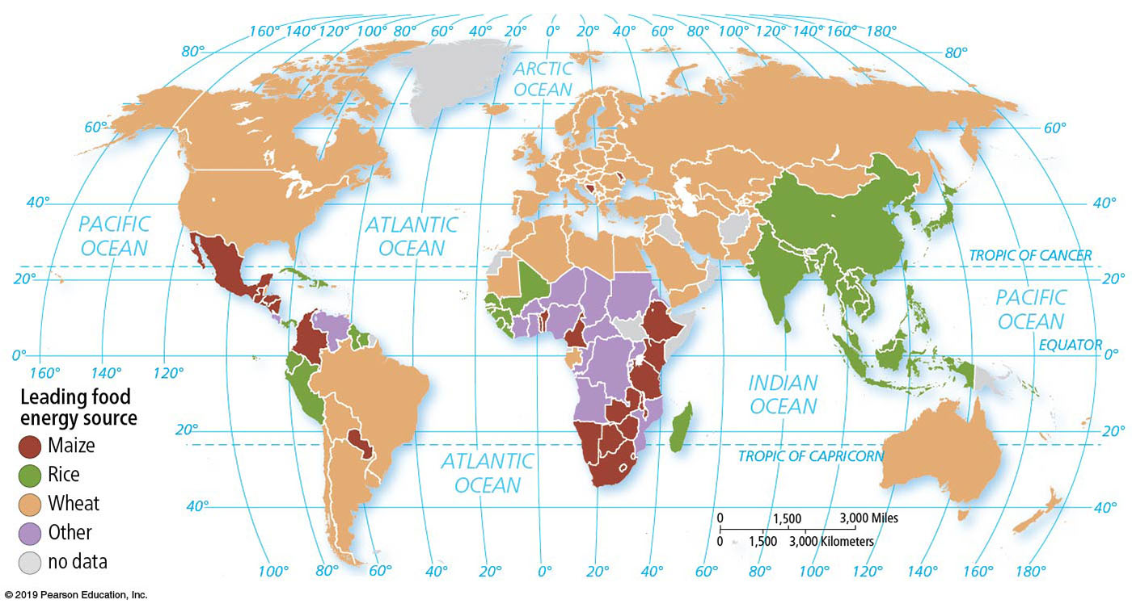
9.3 Diet (2 of 3)
Total Consumption of Food
  Dietary energy consumption is the amount of food that an individual consumes. Most humans derive most of their kilocalories through consumption of cereal grains, which is a grass that yields grain for food, such as wheat, rice, and maize.
Notes:
Figure 9.3.2 DIETARY ENERGY BY SOURCE
Wheat is the principal cereal grain consumed in the developed regions of Europe and North America through bread, pasta, cake, and many other forms. Rice is the principal cereal grain consumed in the developing regions of East, South, and Southeast Asia. Maize (called corn in North America) is grown primarily as animal feed.

Slide 13
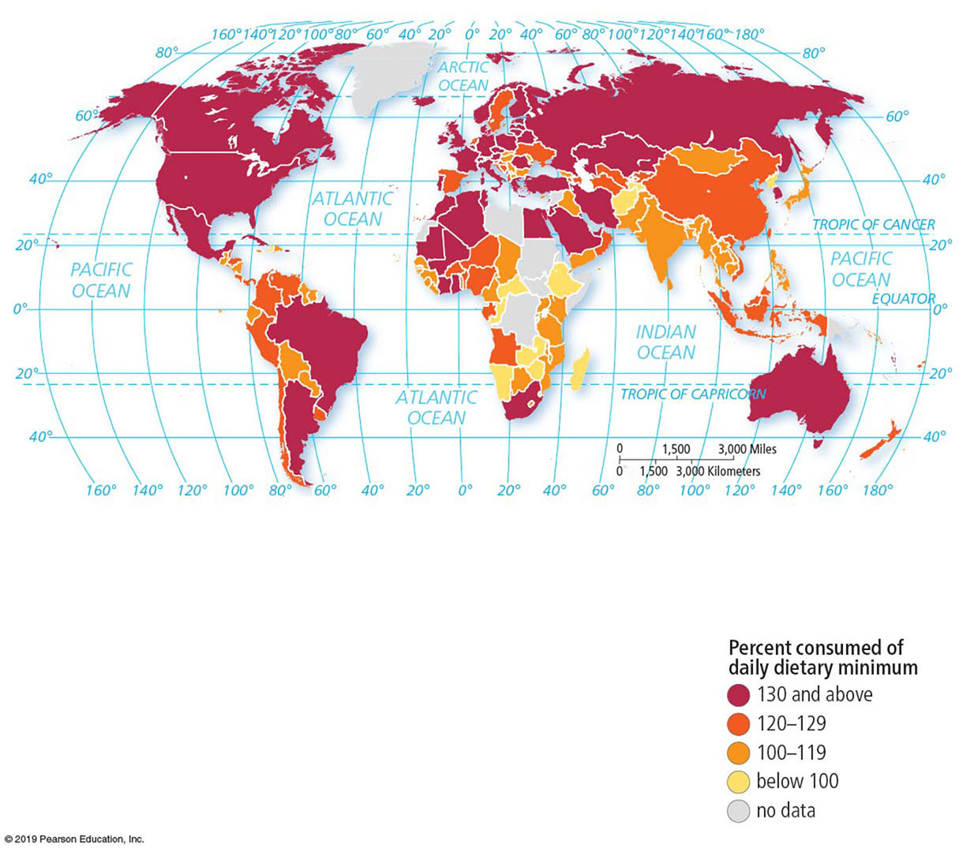
9.3 Diet (3 of 3)
Dietary Energy Needs
  The average consumption worldwide is 2,902 kcal per day, with the U N established minimum necessary consumption of 1,844 kcal.
  The average in sub-Saharan Africa is only 2,400, an indication that a large percentage of Africans are not getting enough to eat.
  The United States has the problem of too much average caloric intake that contributes to obesity.
Notes:
Figure 9.3.3 ADEQUACY OF AVERAGE DIETARY ENERGY SUPPLY (%)

Slide 14
9.4 Food Security (1 of 4)
The United Nations defines food security as physical, social, and economic access at all times to safe and nutritious food sufficient to meet dietary needs and food preferences for an active and healthy life.
  By this definition, around 10 percent of the world’s inhabitants do not have food security.

Slide 15
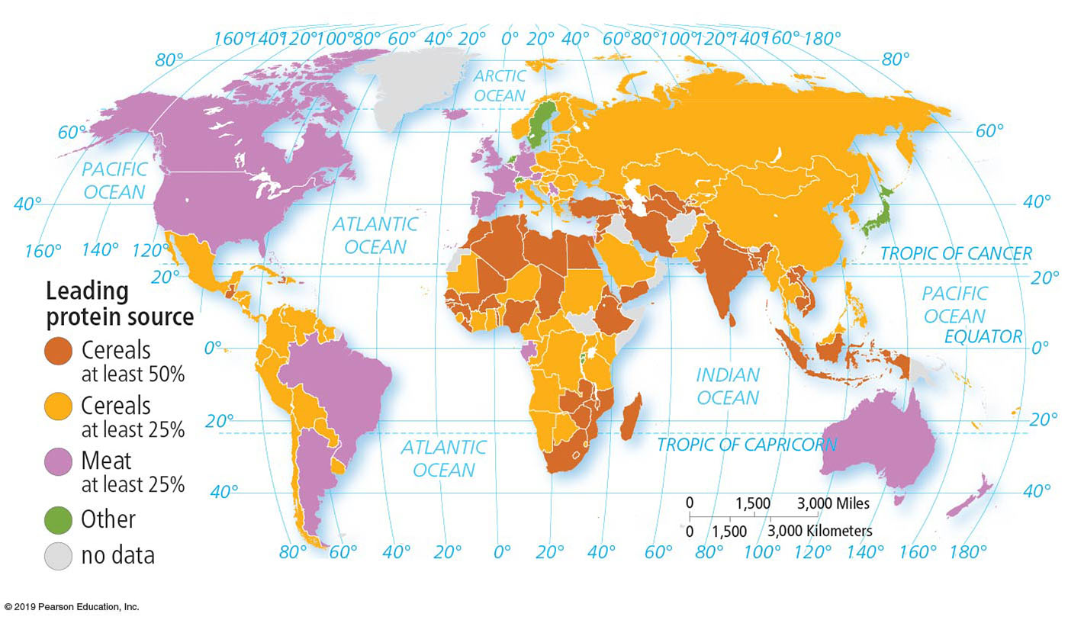
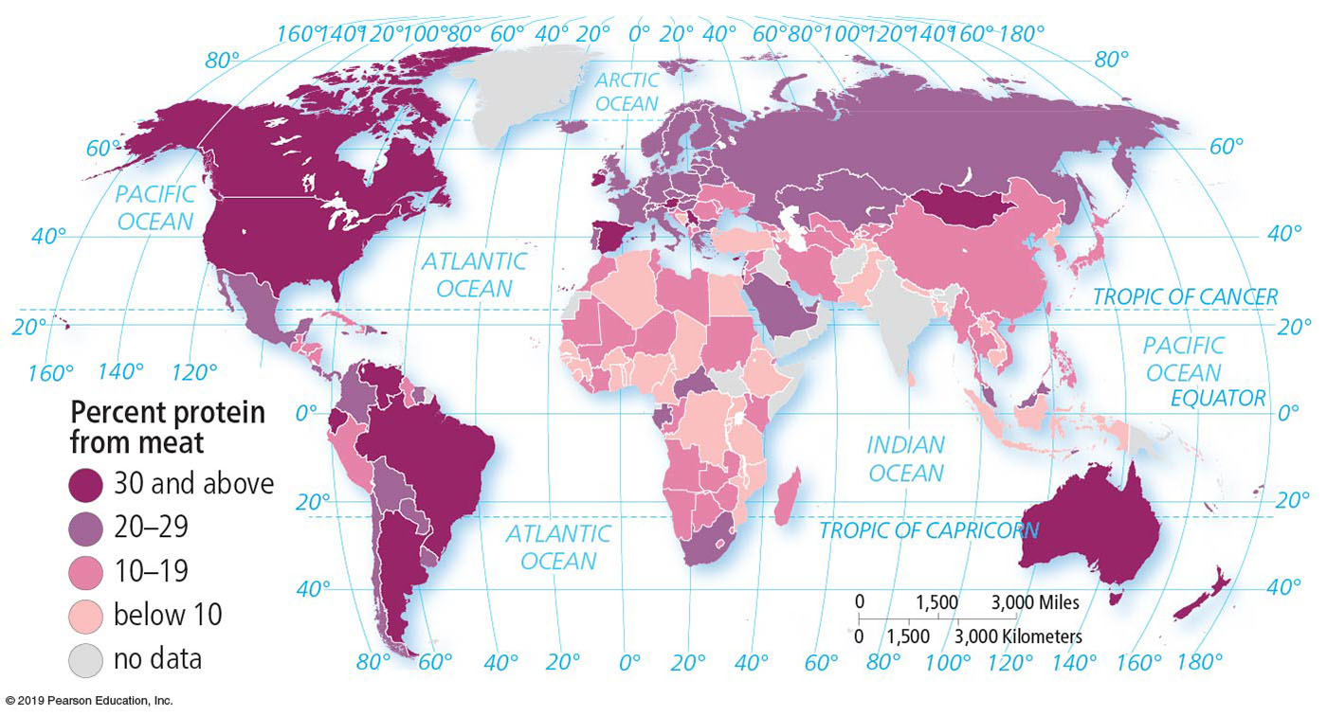
9.4 Food Security (2 of 4)
Source of Nutrients
  Many food sources provide protein of varying quantity and quality. One of the most fundamental differences between developed and developing regions is the primary source of protein.
  The leading source of protein in developed countries is meat products and for most developing countries it is cereal grains.
Notes:
Figure 9.4.1 PROTEIN BY SOURCE
People get most of their protein from meat in developed countries and from cereals in developing countries.
Figure 9.4.2 PROTEIN FROM MEAT
The percentage of protein from meat is much higher for people in developed countries than for those in developing countries.

Slide 16
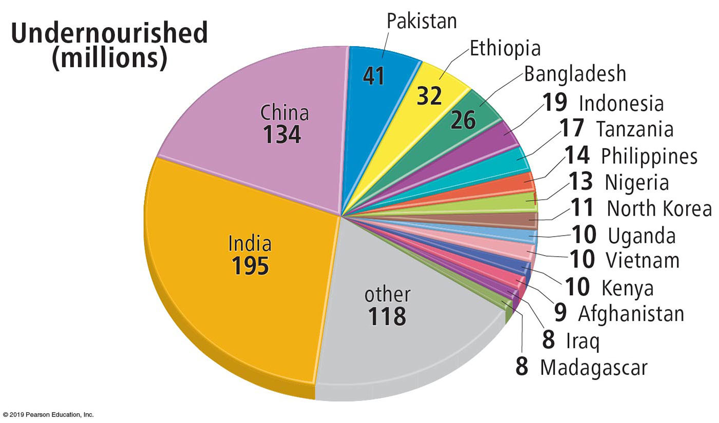
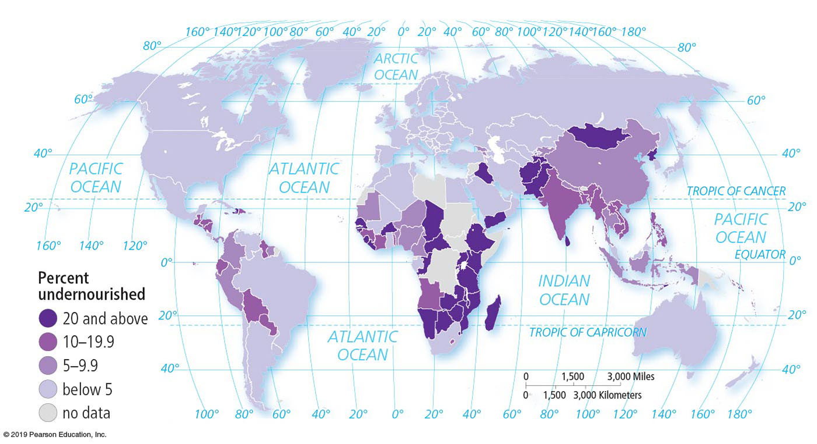
9.4 Food Security (3 of 4)
Undernourishment
  The level of dietary energy consumption that is continuously below the minimum requirement for maintaining a healthy life and carrying out light physical activity is called undernourishment.
  98 percent of the world’s undernourished people are in developing countries.
Notes:
Figure 9.4.5 DISTRIBUTION OF UNDERNOURISHMENT
Figure 9.4.6 PERCENTAGE OF POPULATION UNDERNOURISHED

Slide 17
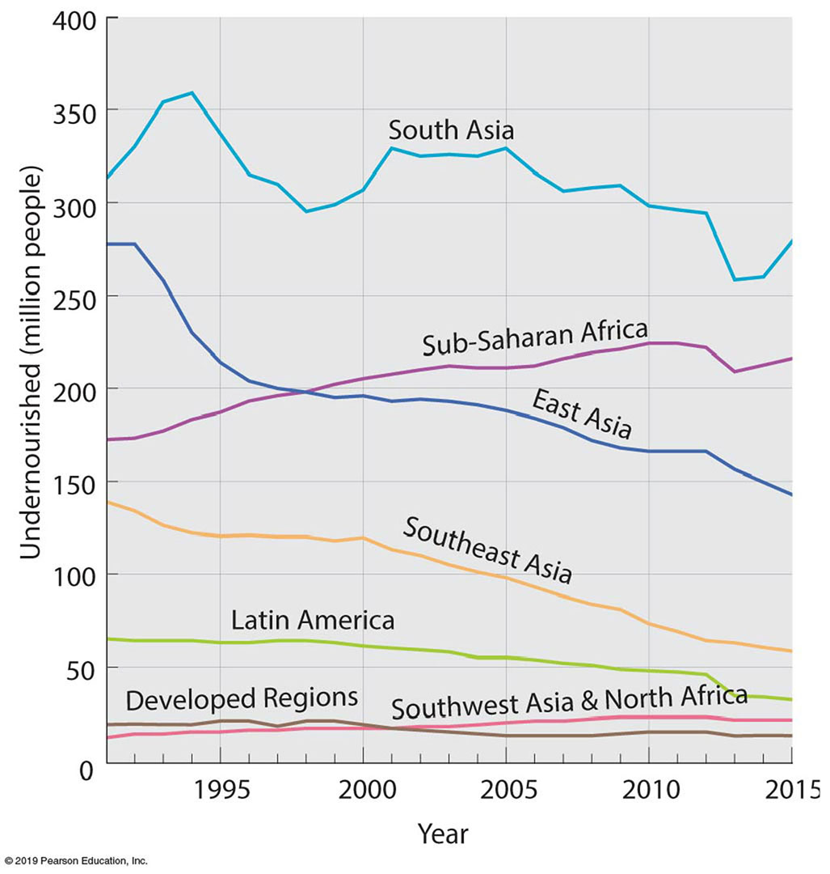
9.4 Food Security (4 of 4)
Undernourishment
  Between 2000 and 2015, the number of undernourished people declined from 924 million to 793 million.
  East Asia, led by China, has had by far the largest decrease in the number and percentage undernourished.
Notes:
Figure 9.4.7 CHANGE IN UNDERNOURISHMENT

Slide 18
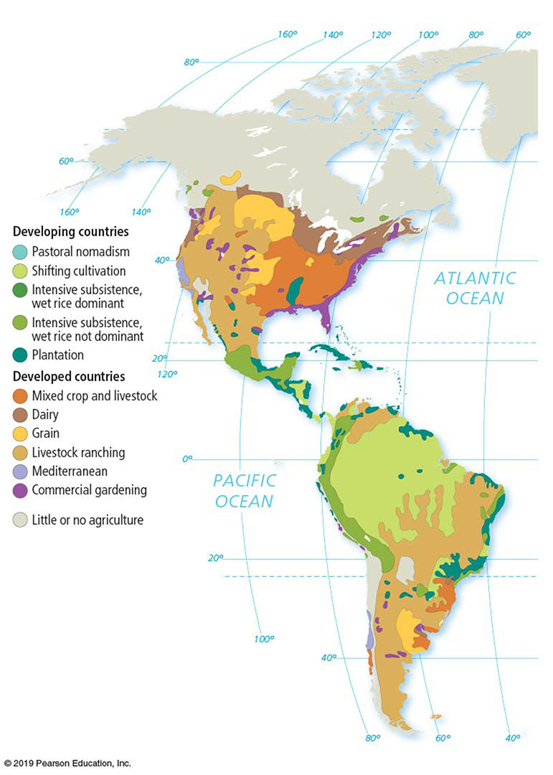
9.5 Agricultural Regions (1 of 5)
Agricultural Regions Map
  The most widely used map of world agricultural regions is based on work done by geographer Derwent Whittlesey in 1936.
  Whittlesey’s 11 regions are divided between 5 that are important in developing countries and 6 that are important in developed countries.
Notes:
Figure 9.5.1 AGRICULTURAL REGIONS

Slide 19
9.5 Agricultural Regions (2 of 5)
Developing and Developed Agriculture Regions
  Intensive subsistence, wet rice dominant: The large population concentrations of East Asia and South Asia.
  Intensive subsistence, crops other than rice dominant: The large population concentrations of East Asia and South Asia, where growing rice is difficult.
  Pastoral nomadism: The drylands of Southwest Asia and North Africa, Central Asia, and East Asia.
  Shifting cultivation: The tropical regions of Latin America, sub-Saharan Africa, and Southeast Asia.
  Plantation: The tropical and subtropical regions of Latin America, sub-Saharan Africa, South Asia, and Southeast Asia.

Slide 20
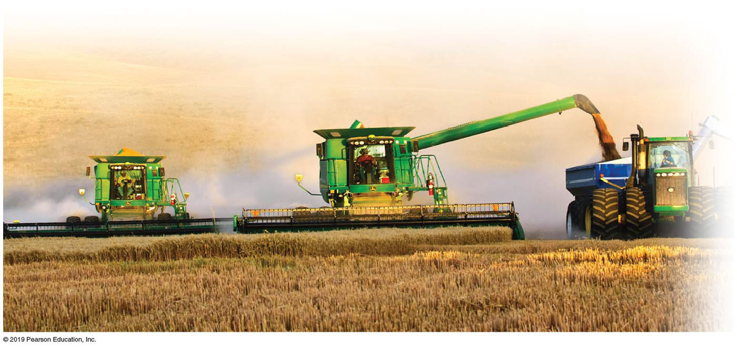
9.5 Agricultural Regions (3 of 5)
Economic Reasons
  Mixed crop and livestock: The U.S. Midwest and central Europe.
  Dairying: Near population clusters in the northeastern United States, southeastern Canada, and northwestern Europe.
  Grain: The north-central United States, south-central Canada, and Eastern Europe.
  Ranching: The drylands of western North America, southeastern Latin America, Central Asia, sub-Saharan Africa, and the South Pacific.
  Mediterranean: Lands surrounding the Mediterranean Sea, the western United States, the southern tip of Africa, and Chile.
  Commercial gardening: The southeastern United States and southeastern Australia.
Notes:
Figure 9.5.2 GRAIN FARMING, WASHINGTON STATE

Slide 21
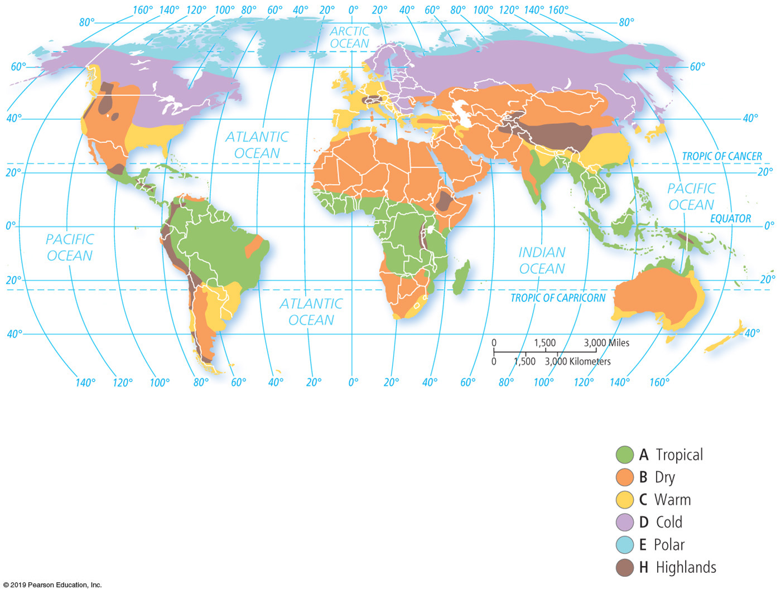
9.5 Agricultural Regions (4 of 5)
Agricultural Regions and Climate
  Similarities between the agriculture and climate maps are striking. Pastoral nomadism is the predominant type of agriculture in Southwest Asia and North Africa, which has a dry climate, whereas shifting cultivation is the predominant type of agriculture in sub-Saharan Africa, which has a tropical climate.
Notes:
Figure 9.5.3 CLIMATE REGIONS

Slide 22
9.5 Agricultural Regions (5 of 5)
Agricultural Regions and Climate
  In the United States, much of the West is distinguished from the rest of the country according to climate (dry) and agriculture (livestock ranching).
Notes:
Figure 9.5.3 CLIMATE REGIONS

Slide 23
9.6 Agriculture in Developing Regions (1 of 6)
Intensive Subsistence, Wet Rice Dominant
  A form of subsistence agriculture in which farmers expend a relatively large amount of effort to produce the maximum feasible yield from the land is known as intensive subsistence.
Notes:
Figure 9.6.1 FLOODED RICE FIELDS, INDIA

Slide 24
9.6 Agriculture in Developing Regions (2 of 6)
Intensive Subsistence, Wet Rice Dominant
  Four main steps are involved in growing wet rice:
  The field is prepared, typically with a plow drawn by water buffalo or oxen, hillsides are terraced.
  The field is flooded with water. The flooded field is called a sawah in Indonesia.
  Rice seedlings grown for the first month in a nursery are transplanted into the flooded field.
  Rice plants are harvested with knives. The chaff (husks) are separated from the seeds by threshing.

Slide 25
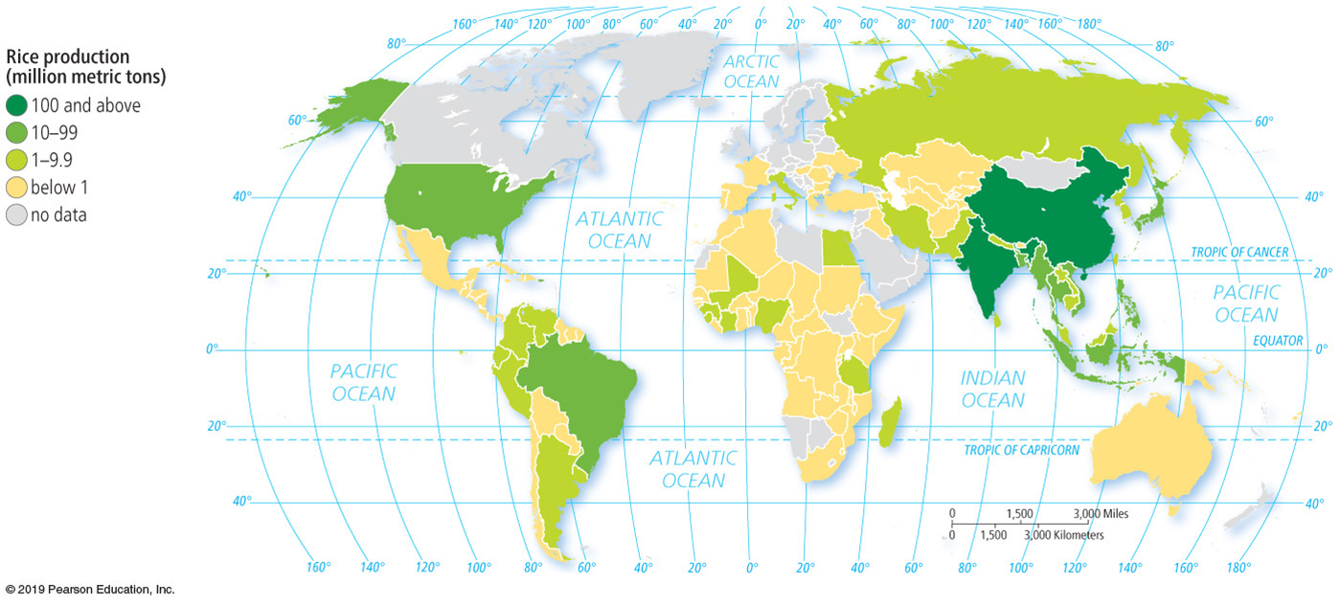
9.6 Agriculture in Developing Regions (3 of 6)
Intensive Subsistence, Wet Rice Not Dominant
  Agriculture in much of the interior of India and northeastern China is devoted to crops other than wet rice, because the climate is too harsh to grow wet rice. Wheat and barley are the most important crops.
Notes:
Figure 9.6.2 RICE PRODUCTION

Slide 26
9.6 Agriculture in Developing Regions (4 of 6)
Pastoral Nomadism
  A form of subsistence agriculture based on the herding of domesticated animals is known as pastoral nomadism. It is adapted to dry climates, where planting crops is impossible.
  Like other subsistence farmers, pastoral nomads consume mostly grain rather than meat. Their animals are usually not slaughtered.
  Governments force groups to give up pastoral nomadism because they want the land for other uses.

Slide 27
9.6 Agriculture in Developing Regions (5 of 6)
Shifting cultivation is where farmers shift farming from one piece of land to another.
  Slash and burn. Farmers clear land for planting by slashing vegetation and burning the debris; rain washes the ashes into the soil to provide needed nutrients.
  Frequent relocation. Farmers grow crops on a cleared field for only a few years, until soil nutrients are depleted.

Slide 28
9.6 Agriculture in Developing Regions (6 of 6)
Plantation Farming
  A plantation is a large commercial farm in a developing country that specializes in one or two crops.
  Most plantations are located in the tropics and subtropics, especially in Latin America, Africa, and Asia.
  Although generally situated in developing countries, plantations are often owned or operated by Europeans or North Americans.
Notes:
Figure 9.6.3 BANANA PLANTATION, COSTA RICA

Slide 29
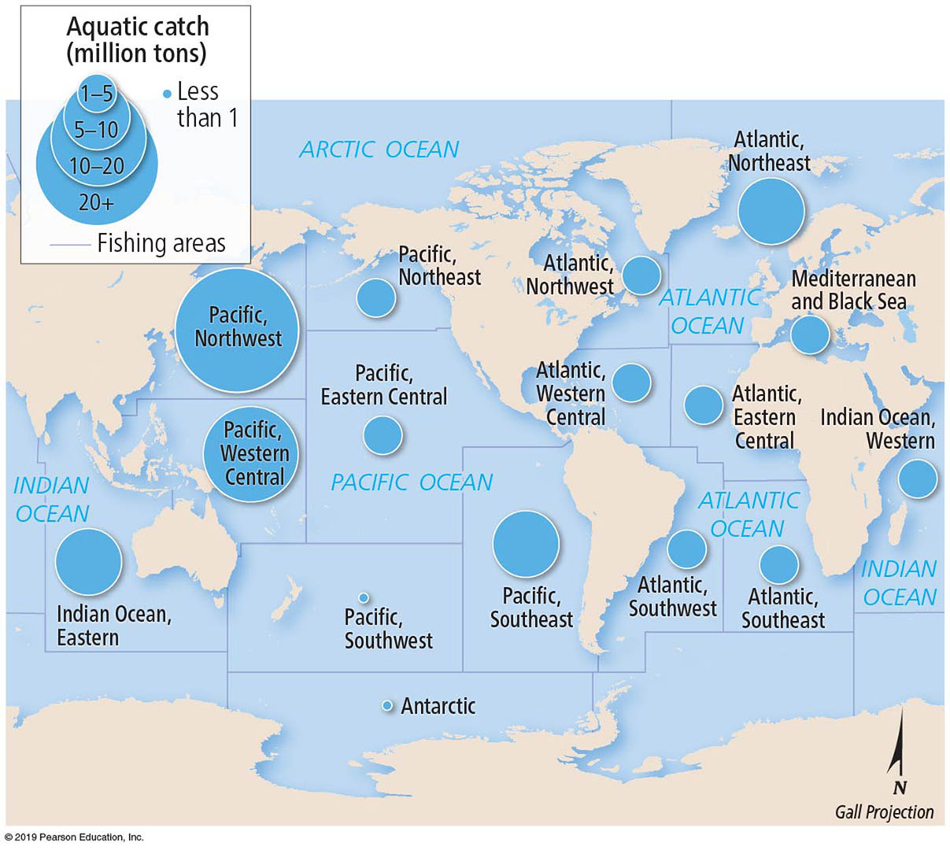
9.7 Fishing (1 of 4)
Fish Production
  Water-based food is acquired in two ways. Fishing is the capture of wild fish and other seafood living in the waters. Aquaculture is the cultivation of seafood under controlled conditions.
  The world’s oceans are divided into 16 major fishing regions.
Notes:
Figure 9.7.1 WILD SALMON FISHING, BRITISH COLUMBIA
Figure 9.7.2 MAJOR FISHING REGIONS

Slide 30
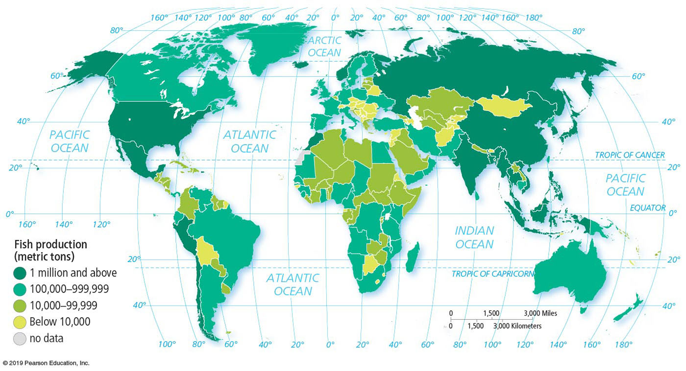
9.7 Fishing (2 of 4)
Fish Production
  The fishing regions with the largest yields are Pacific Northwest, Atlantic Northeast, and Indian Eastern.
  China is responsible for one-third of the world’s yield of fish.
Notes:
Figure 9.7.3 FISH CAPTURE

Slide 31
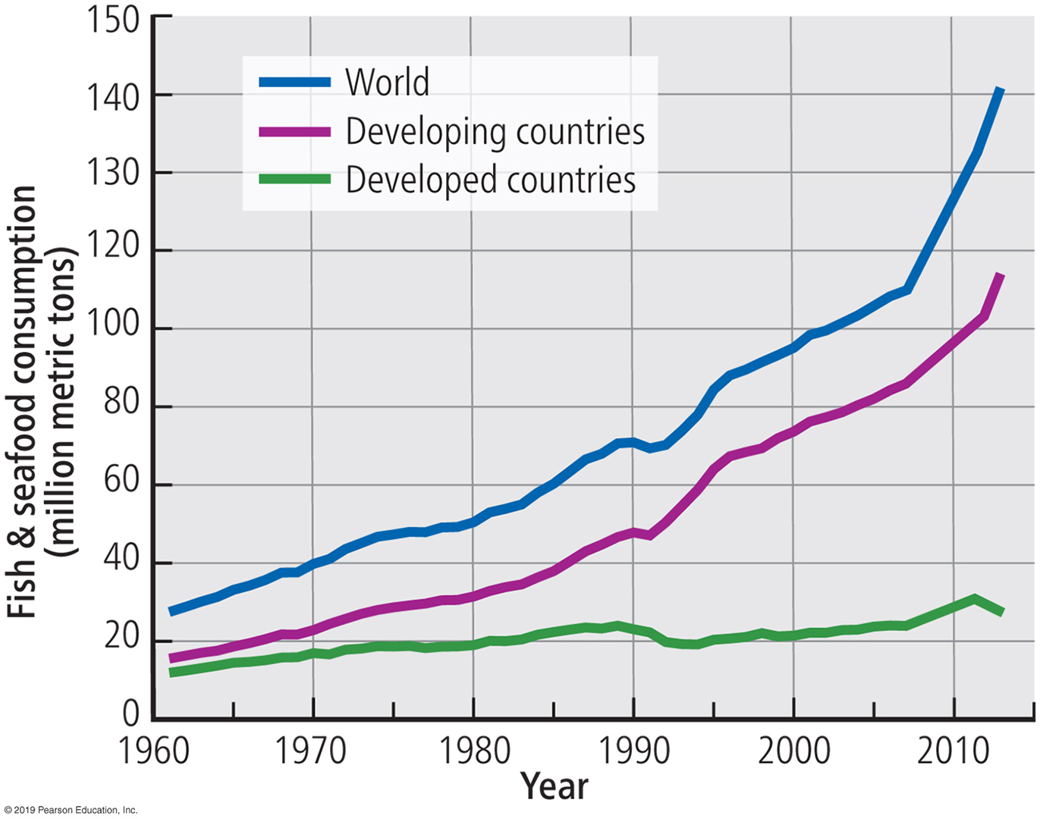
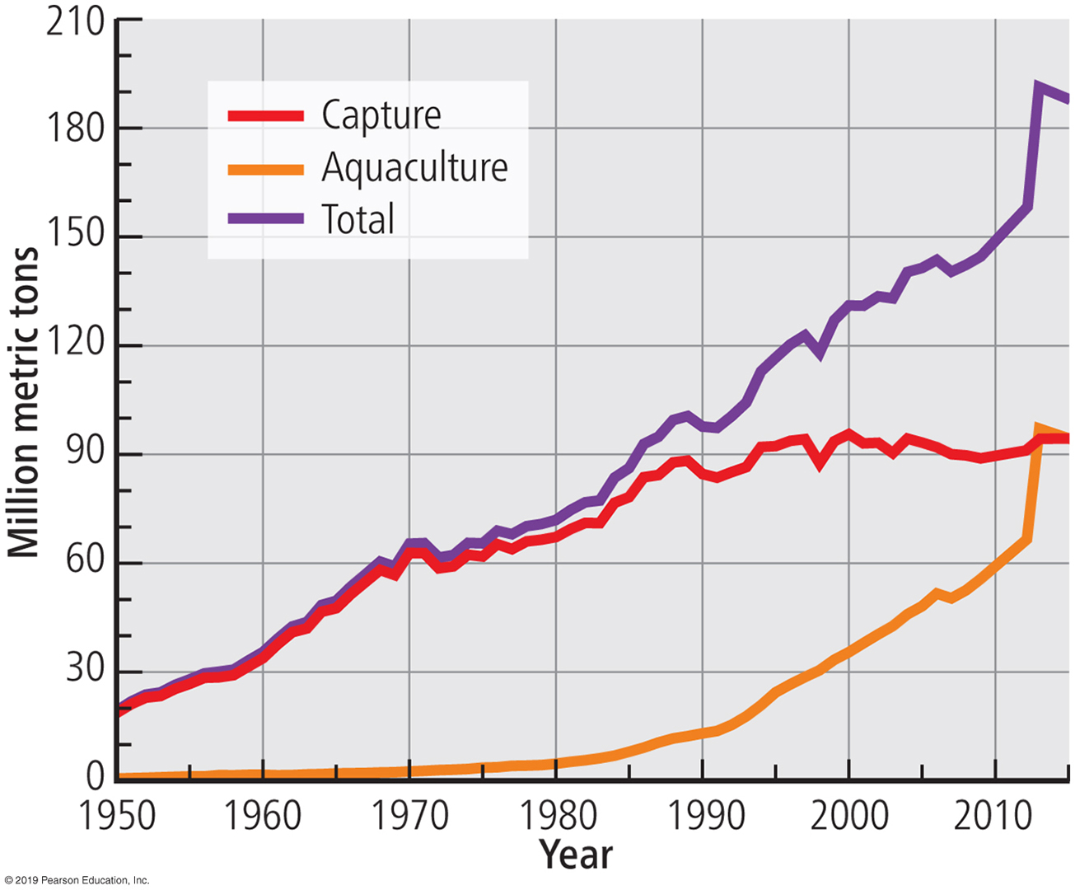
9.7 Fishing (3 of 4)
Fish Consumption
  Human consumption of fish and seafood has increased from 27 million metric tons in 1960 to 132 million metric tons in 2012. Fish production has increased even more rapidly than fish consumption. The growth results entirely from expansion of aquaculture.
Notes:
Figure 9.7.4 GROWTH IN HUMAN CONSUMPTION OF FISH
Figure 9.7.5 GROWTH IN FISH PRODUCTION

Slide 32
9.7 Fishing (4 of 4)
Overfishing
  The population of some fish species in the oceans and lakes has declined because of overfishing, which is capturing fish faster than they can reproduce.
  Overfishing has reduced the population of tuna and swordfish by 90 percent in the past half-century.
Notes:
Figure 9.7.4 GROWTH IN HUMAN CONSUMPTION OF FISH
Figure 9.7.5 GROWTH IN FISH PRODUCTION

Slide 33
9.8 Agriculture in Developed Regions (1 of 8)
Agribusiness
  The system of commercial farming found in developed countries is called agribusiness because farming is integrated into a large food-production industry.
  Commercial agriculture in developed countries can be divided into six main types. Each type is predominant in distinctive regions, depending somewhat on climate.

Slide 34
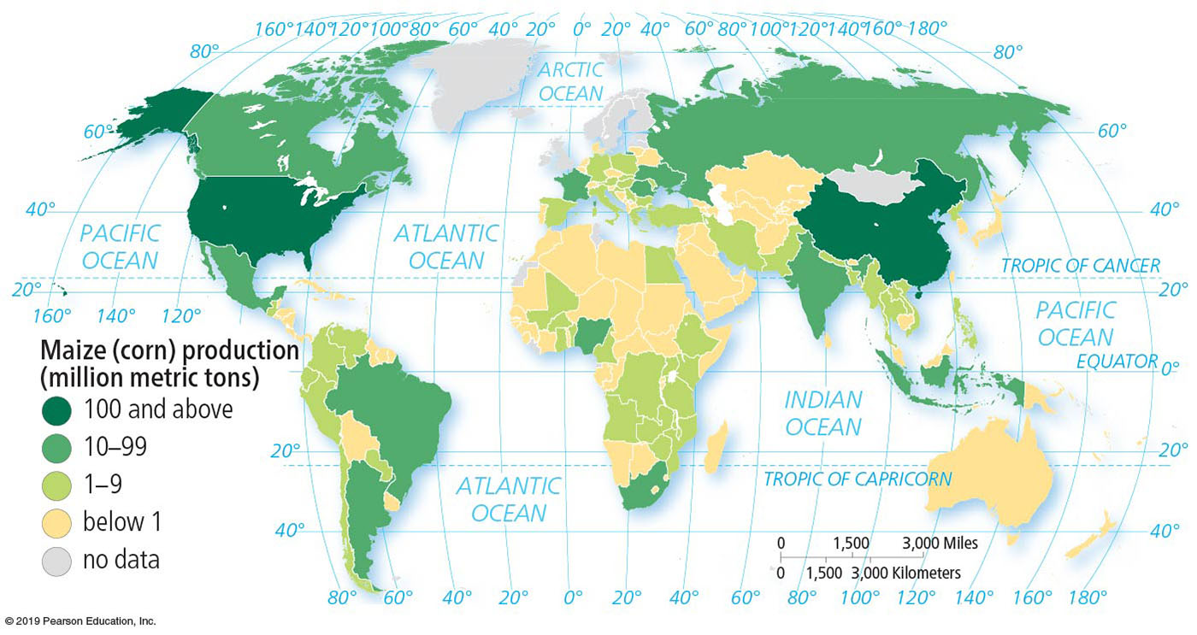
9.8 Agriculture in Developed Regions (2 of 8)
Mixed Crop and Livestock
  The form of commercial farming called mixed crop and livestock is characterized by the integration of crops and livestock.
  Most of the crops are fed to animals rather than consumed directly by humans.
  Maize (corn) is the crop most frequently planted, followed by soybeans.
Notes:
Figure 9.8.1 MAIZE (CORN) PRODUCTION

Slide 35
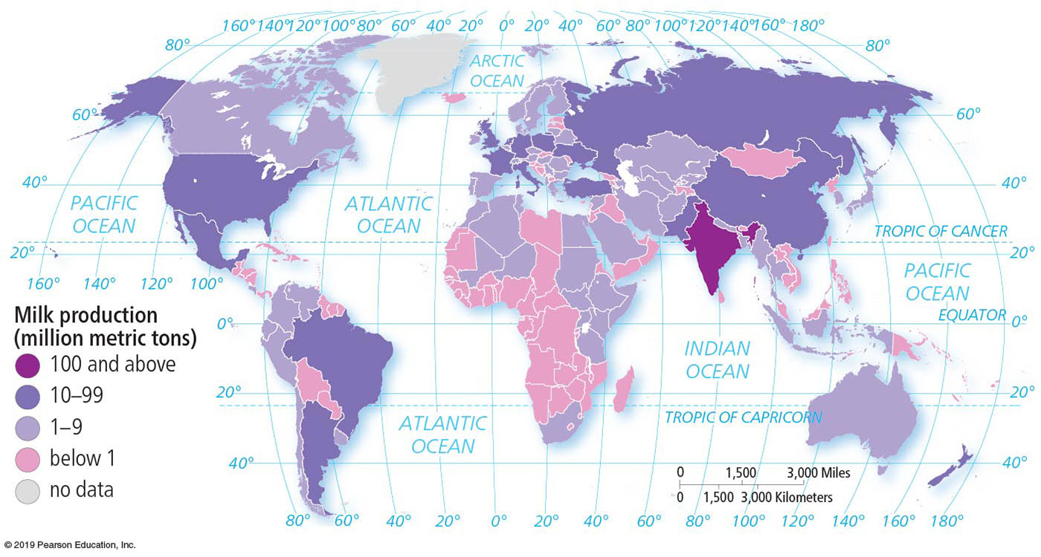
9.8 Agriculture in Developed Regions (3 of 8)
Dairy Farming
  The most important agriculture practiced near large urban areas in developed countries is dairy farming.
  Dairy farms must be closer to their markets than other products because milk is highly perishable. The ring surrounding a city from which milk can be supplied without spoiling is known as the milkshed.
Notes:
Figure 9.8.2 MILK PRODUCTION

Slide 36
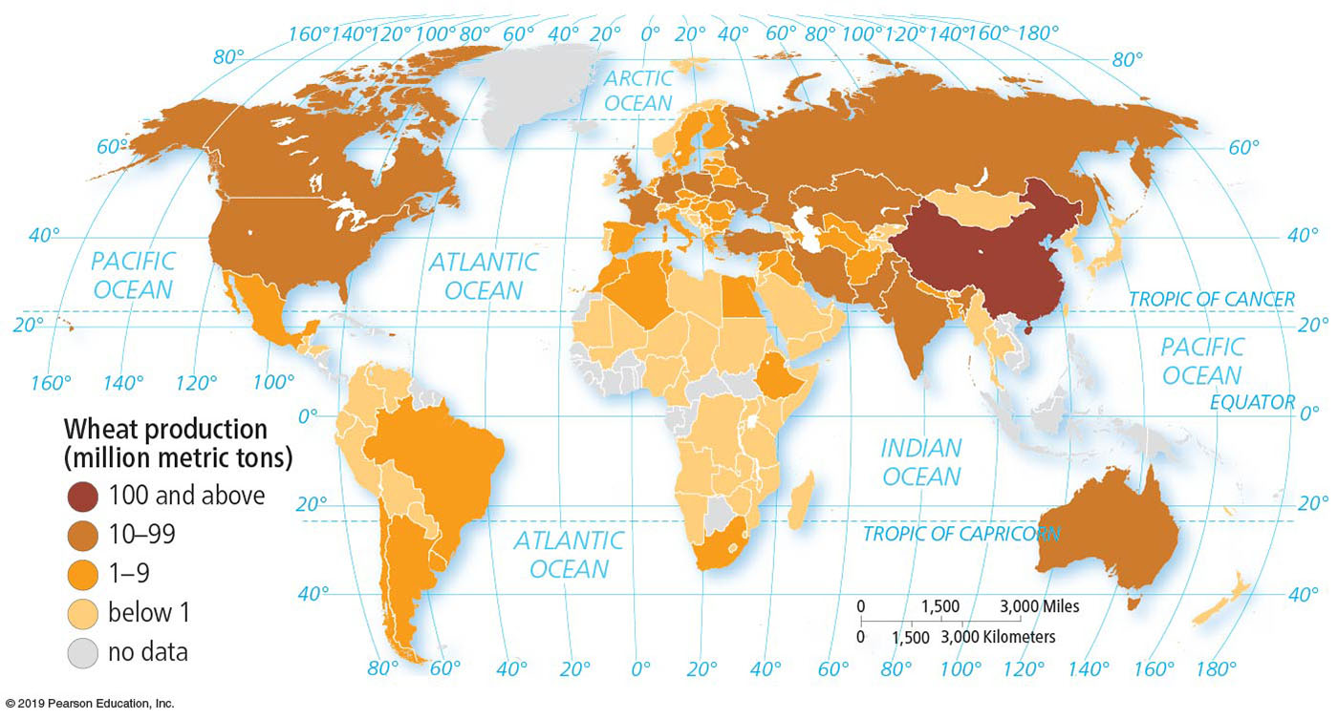
9.8 Agriculture in Developed Regions (4 of 8)
Grain Farming
  Commercial grain farms tend to be located in regions that are too dry for mixed crop and livestock, such as North America’s Great Plains.
  Crops on a grain farm are grown primarily for consumption by humans.
Notes:
Figure 9.8.4 WHEAT PRODUCTION

Slide 37
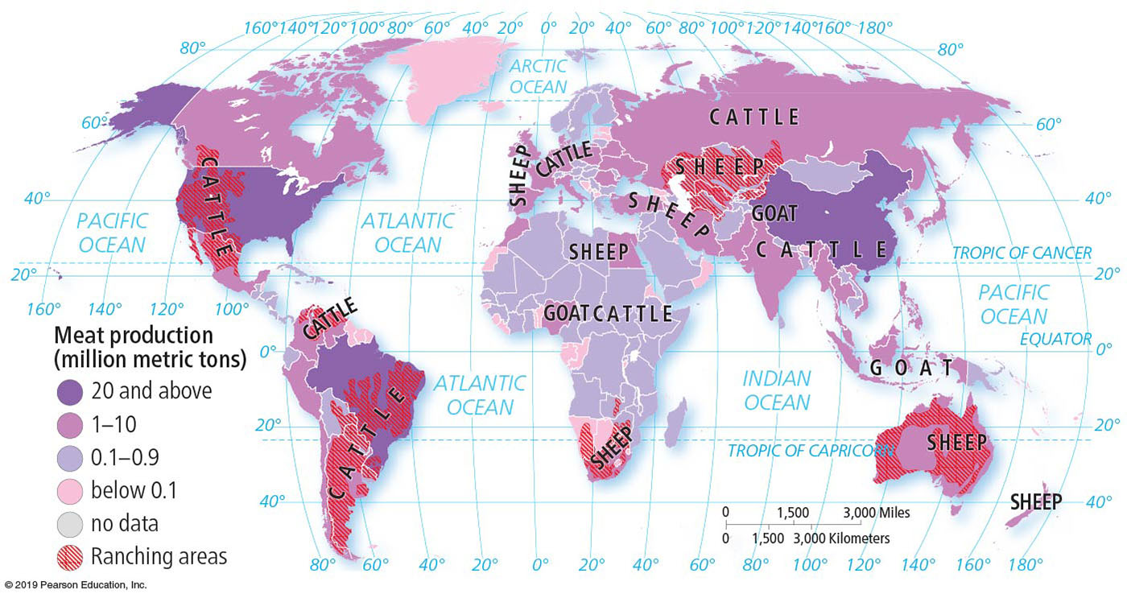
9.8 Agriculture in Developed Regions (5 of 8)
Livestock Ranching
  The commercial grazing of livestock over an extensive area is called ranching.
  This form of agriculture is adapted to semiarid or arid land and is practiced in developed countries where the vegetation is too sparse and the soil too poor to support crops.
Notes:
Figure 9.8.5 MEAT PRODUCTION

Slide 38
9.8 Agriculture in Developed Regions (6 of 8)
Commercial Gardening and Fruit Farming
  Commercial gardening and fruit farming are the predominant types of agriculture in the U.S. Southeast. The region has a long growing season and humid climate and is accessible to the large markets in the big cities along the East Coast.
  It is frequently called truck farming.
  Truck farms grow many of the fruits and vegetables that consumers demand in developed countries, such as lettuce, peaches, and tomatoes.

Slide 39
9.8 Agriculture in Developed Regions (7 of 8)
Mediterranean Agriculture
  Mediterranean agriculture exists primarily on lands that border the Mediterranean Sea and other places with a similar physical geography, such as California and central Chile.
  The land is very hilly, and mountains frequently plunge directly to the sea, leaving very little flat land. The two most important crops are olives (primarily for cooking oil) and grapes (primarily for wine).

Slide 40
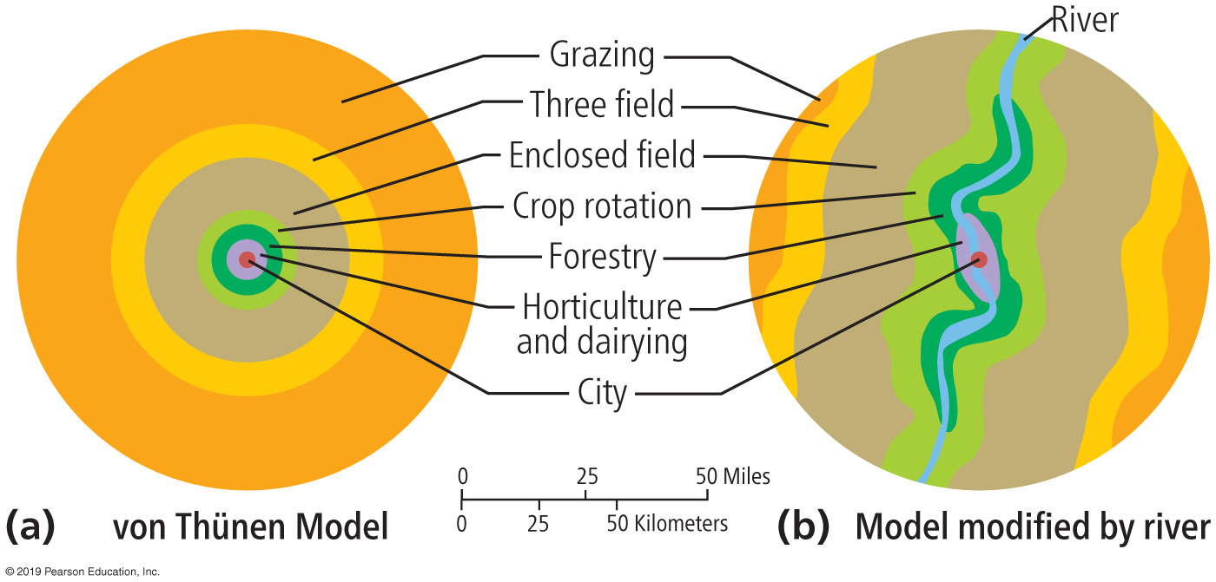
9.8 Agriculture in Developed Regions (8 of 8)
Von Thünen Model
  Because the purpose of commercial farming is to sell produce off the farm, the distance from the farm to the market influences the choice of crop to plant.
  Geographers use the von Thünen model to help explain the importance of proximity to market in the choice of crops on a commercial farm.
Notes:
Figure 9.8.6 VON THÜNEN MODEL

Slide 41
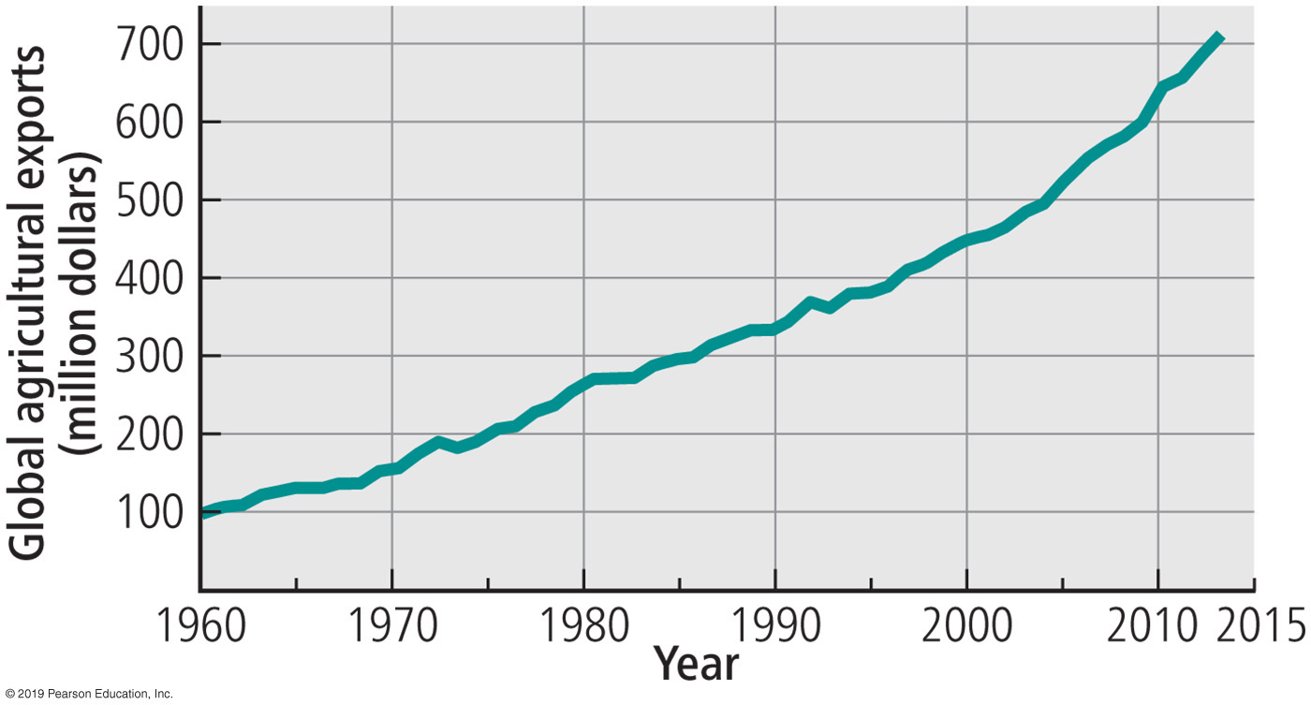
9.9 Trade in Food & Agriculture (1 of 5)
Food Trade
  On a global scale, agricultural products are moving primarily from the Western Hemisphere to the Eastern Hemisphere.
  Latin America, led by Brazil and Argentina, is by far the leading region for export of agricultural products; China, Japan, and the United Kingdom are the leading net importers.
Notes:
Figure 9.9.2 GLOBAL AGRICULTURAL EXPORTS

Slide 42
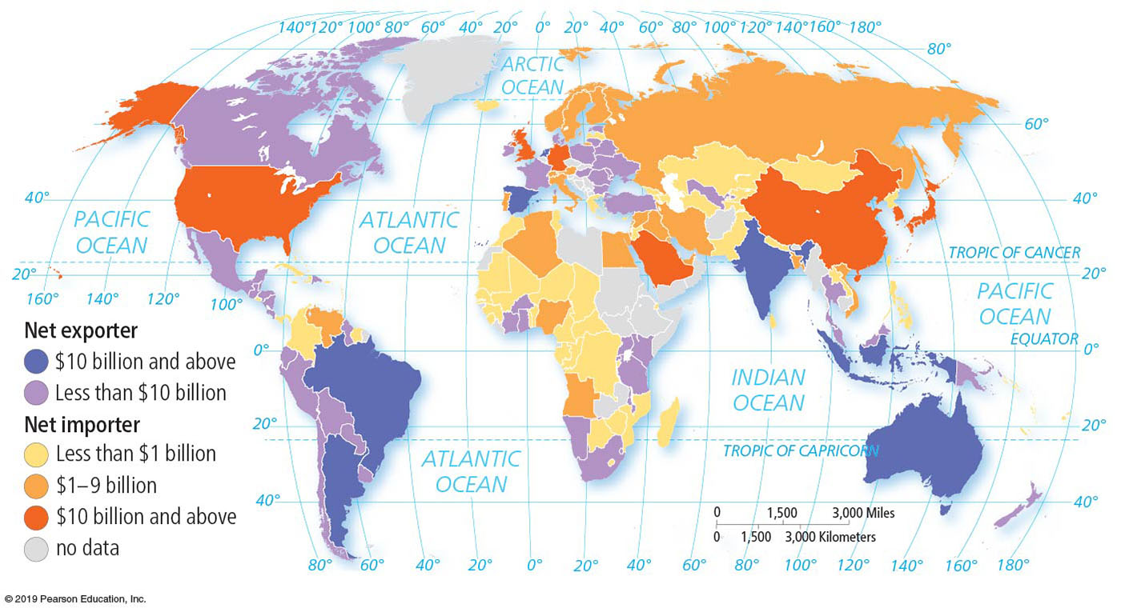
9.9 Trade in Food & Agriculture (2 of 5)
Food Trade
  To expand agricultural production in developing countries, subsistence farmers need higher-yield seeds, fertilizer, pesticides, and machinery. These supplies are typically imported from other countries.
Notes:
Figure 9.9.3 TRADE IN AGRICULTURE

Slide 43
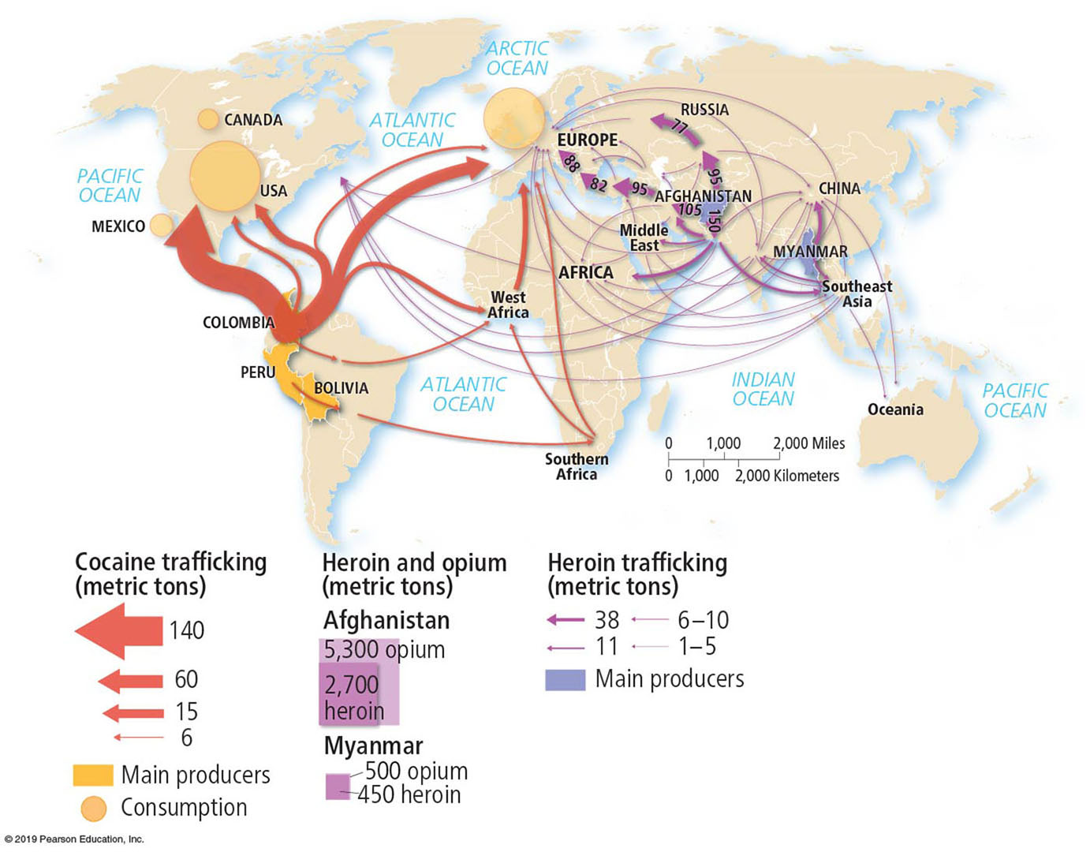
9.9 Trade in Food & Agriculture (3 of 5)
Drug Trade
  Export crops grown in some developing countries are those that can be converted to drugs, especially cocaine, heroin, and marijuana.
  Cocaine is derived from coca leaf, most of which is grown in Colombia. Heroin is derived from raw opium gum, which is produced by the opium poppy plant. Afghanistan is the source of nearly 90 percent of the world’s opium.
Notes:
Figure 9.9.4 INTERNATIONAL DRUG TRAFFICKING

Slide 44
9.9 Trade in Food & Agriculture (4 of 5)
Government Policies
  The U.S. government has three agriculture policies designed to improve the financial position of farmers.
    Farmers are encouraged to avoid producing crops that are in excess supply.
    The government pays farmers when certain commodity prices are low.
    The government buys surplus production and sells or donates it to foreign governments.
    The United States has averaged about $20 billion a year on farm subsidies in recent years. Europe’s levels are even higher.

Slide 45
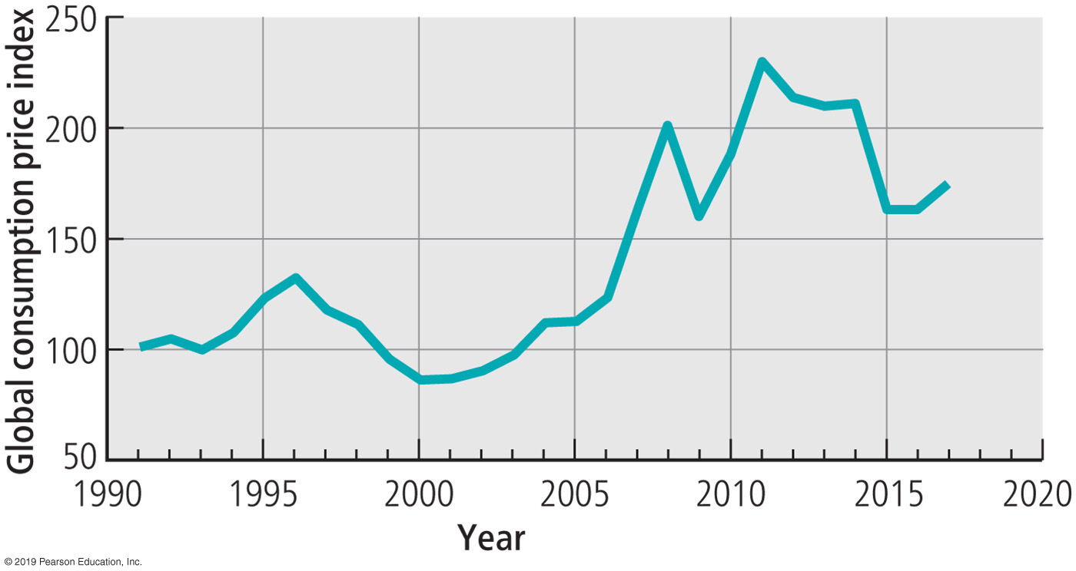
9.9 Trade in Food & Agriculture (5 of 5)
Food Prices
  The greatest challenge to world food supply in the twenty-first century has been food prices rather than food supply. Food prices more than doubled between 2006 and 2008.
  The U.N. attributes the record high food prices to four factors: Poor weather, high demand, small growth in productivity, and the use of crops for biofuels.
Notes:
Figure 9.9.5 GLOBAL FOOD PRICE INDEX

Slide 46
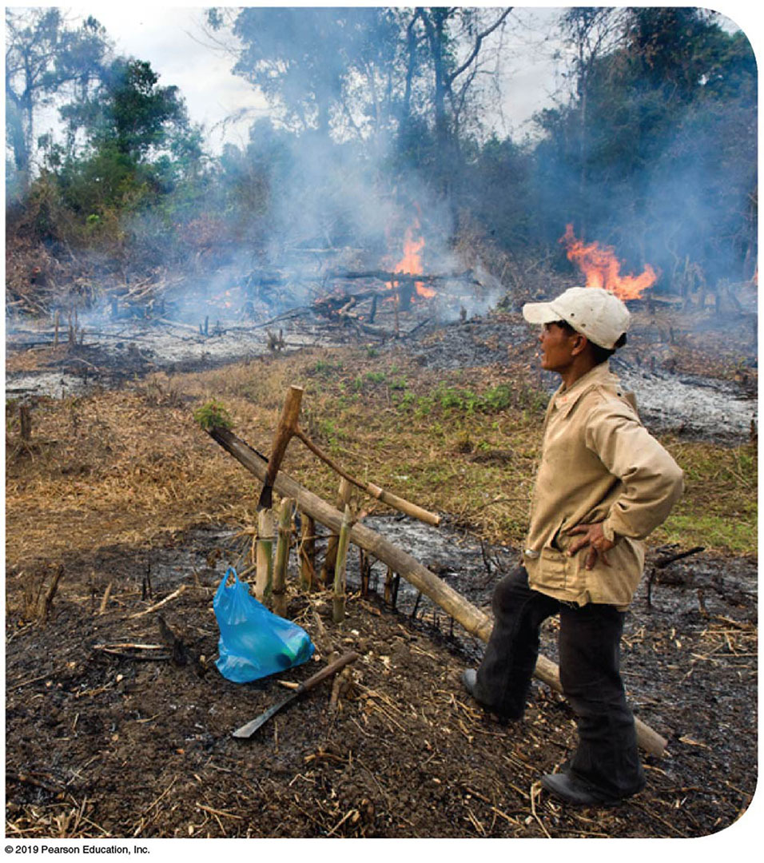
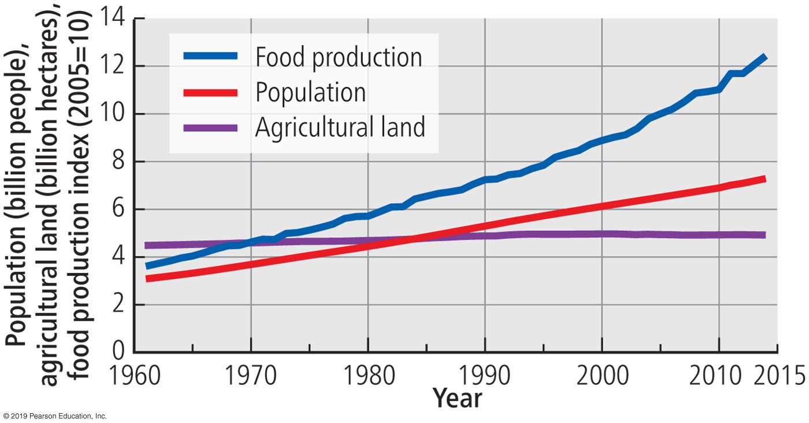
9.10 Agricultural Productivity (1 of 4)
Supply of Agricultural Land
  Historically, world food production increased primarily by expanding the amount of land devoted to agriculture.
  Today few scientists believe that further expansion of agricultural land can feed the growing world population. In recent decades, population has increased much more rapidly than agricultural land.
Notes:
Figure 9.10.1 SHIFTING CULTIVATION, LAOS
Figure 9.10.2 WORLD POPULATION GROWTH, AGRICULTURAL LAND, AND FOOD PRODUCTION

Slide 47
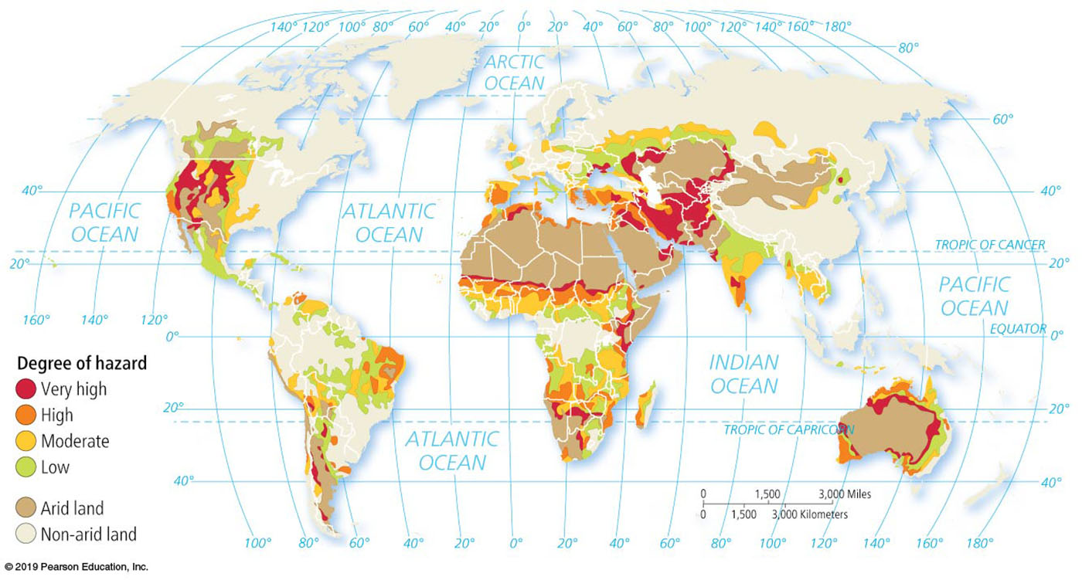
9.10 Agricultural Productivity (2 of 4)
Supply of Agricultural Land
  The Earth Policy Institute estimates that 2 billion hectares (5 million acres) of land have been degraded around the world.
  Overgrazing is thought to be responsible for 34 percent, deforestation for 30 percent, and agricultural use for 28 percent.
Notes:
Figure 9.10.3 DESERTIFICATION (SEMIARID LAND DEGRADATION)

Slide 48
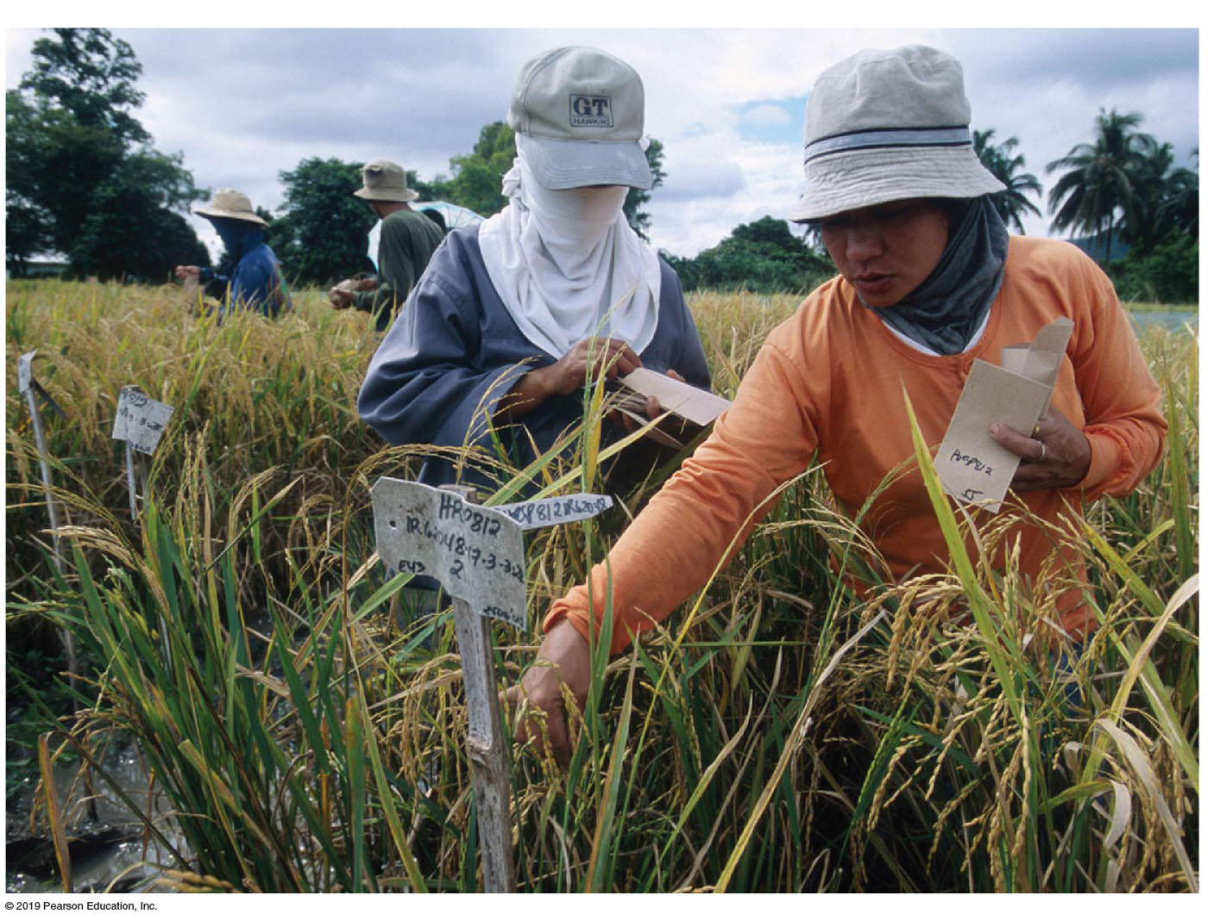
9.10 Agricultural Productivity (3 of 4)
The Green Revolution
  The invention of more productive agricultural techniques during the 1970s and 1980s is called the green revolution, which uses higher-yield seeds and the expanded use of fertilizers.
  Scientists began an intensive series of experiments during the 1950s to develop a higher-yield wheat. A decade later, the “miracle wheat seed” was ready.
  The International Rice Research Institute, established in the Philippines by the Rockefeller and Ford foundations, worked to create a miracle rice seed.
Notes:
Figure 9.10.4 INTERNATIONAL RICE RESEARCH INSTITUTE, THE PHILIPPINES

Slide 49
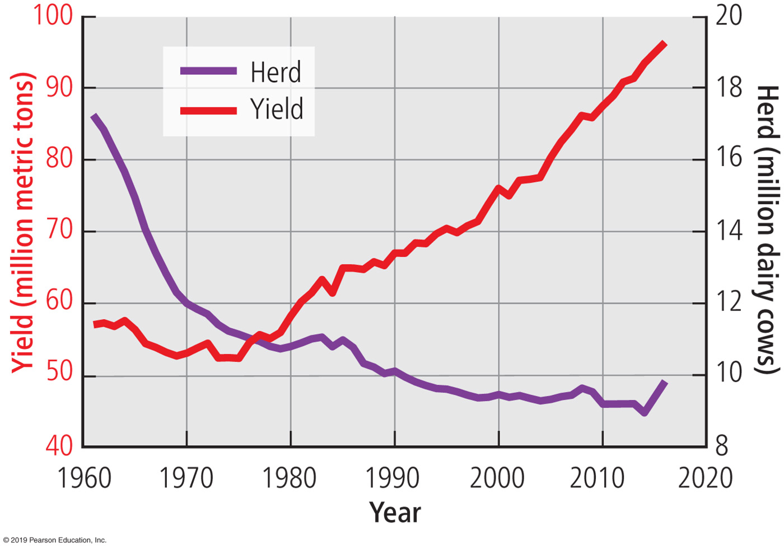
9.10 Agricultural Productivity (4 of 4)
Commercial Agriculture Productivity
  Productivity has also increased among commercial farmers in recent years. New seeds, fertilizers, pesticides, equipment, and management practices have enabled commercial farmers to obtain greatly increased yields per area of land.
  The number of dairy cows in the United States decreased from 10.8 million to 9.3 million between 1980 and 2016. But milk production increased from 58 to 96 million metric tons.
Notes:
Figure 9.10.5 U.S. DAIRY PRODUCTIVITY

Slide 50
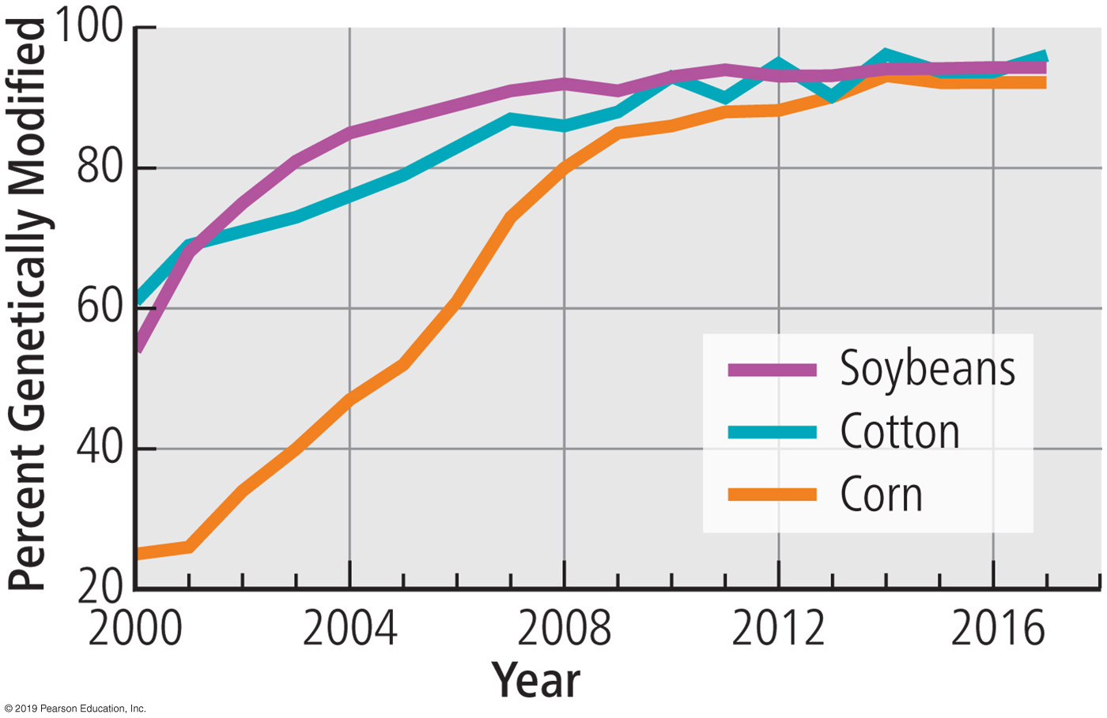
9.11 Biotechnology & Sustainability (1 of 3)
Genetically Modified Organism (G M O)
  A G M O is a living organism that possesses a novel combination of genetic material obtained through the use of biotechnology.
  G M O seeds are genetically modified to survive when herbicides and insecticides are sprayed on fields to kill weeds and insects.
  Many countries have made it difficult to sell G M O foods due to the possibility that they reduce the effectiveness of antibiotics and may destroy longstanding ecological balances in local agriculture, and pose a threat to human health.
Notes:
Figure 9.11.1 GENETICALLY MODIFIED CROPS IN THE UNITED STATES

Slide 51
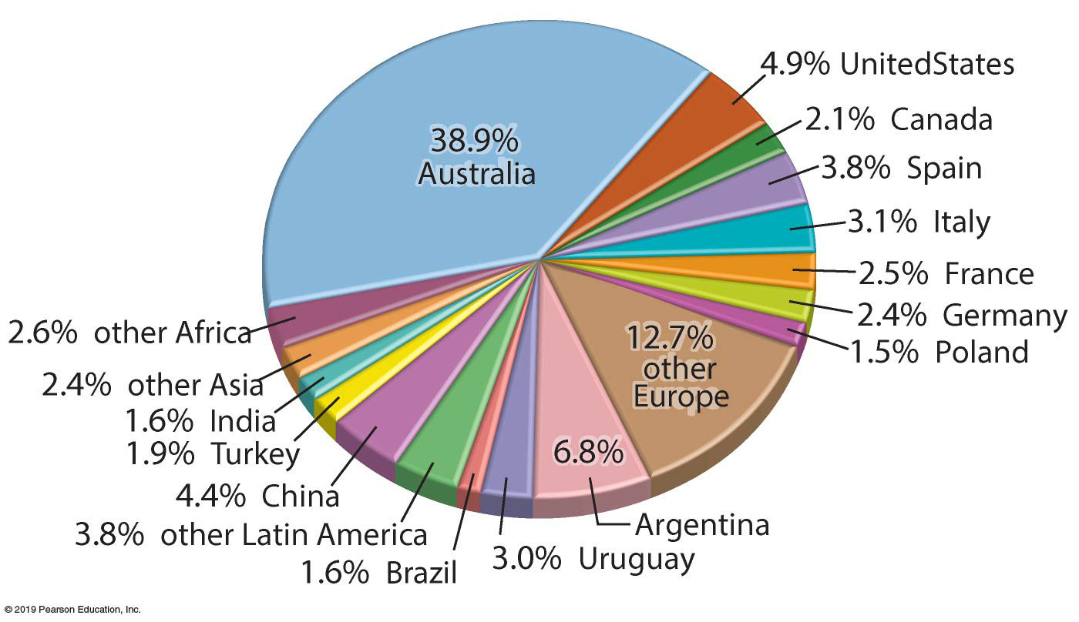
9.11 Biotechnology & Sustainability (2 of 3)
Organic Farming
  The most rapid growth in demand has been for organic food.
  Worldwide, the U.N. classified 44 million hectares or 1 percent of farmland, as organic in 2014.
  Organic farming is sensitive to the complexities of biological and economic interdependencies between crops and livestock.
  In organic farming, crops are grown without application of herbicides and pesticides to control weeds. G M O seeds are not used.
Notes:
Figure 9.11.4 ORGANIC FARMING

Slide 52
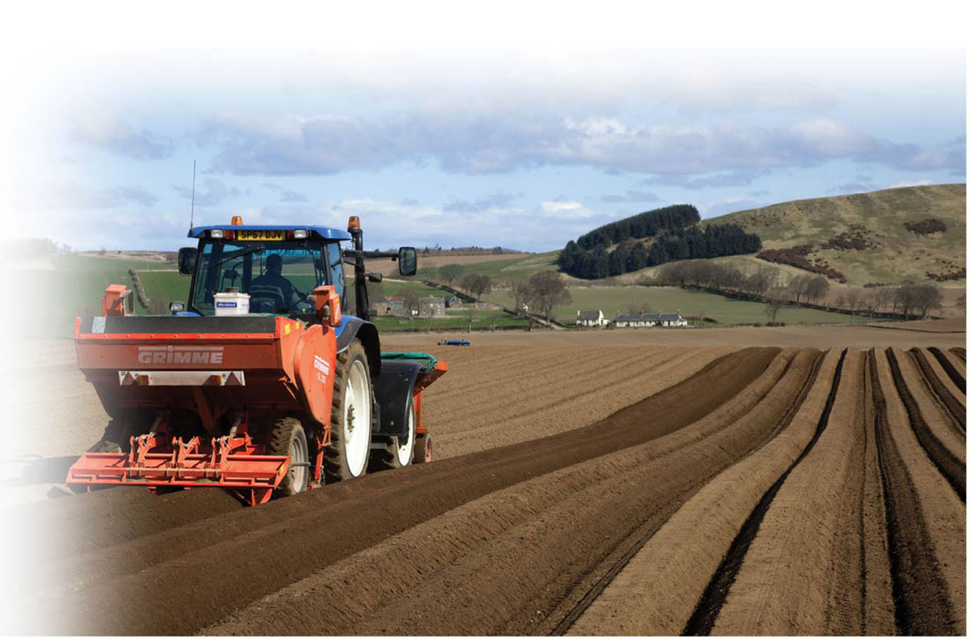
9.11 Biotechnology & Sustainability (3 of 3)
Sustainable Land Management
  After harvesting, conventional farming clears away crop residue, such as corn stalks. The soil is churned up or tilled before the next year’s seeds are planted. This practice is not good in terms of erosion.
  Under conservation tillage, some or all of the previous harvest is left on the fields through the winter. No tillage, as the name implies, leaves all of the soil undisturbed. Ridge tillage is a system of planting crops on ridge tops.
Notes:
Figure 9.11.5 RIDGE TILLAGE, SCOTLAND

Slide 53
Review Summary (1 of 2)
Key Issue 1 Before the invention of agriculture, humans were hunters and gatherers. Agriculture originated in multiple hearths and diffused to numerous places independently. Subsistence agriculture is the production of food primarily for consumption by the farmer’s family. Commercial agriculture is the production of food primarily for sale off the farm. Commercial agriculture involves larger farms, fewer farmers, and more mechanization than does subsistence agriculture.
Key Issue 2 What people eat is influenced by a combination of level of development, cultural preferences, and environmental constraints. Most humans derive most of their dietary energy from grains, but the amount consumed varies widely. People in developed countries consume more protein through animal products. One in 10 humans is undernourished, though the percentage has been declining.

Slide 54
Review Summary (2 of 2)
Key Issue 3 The principal forms of subsistence agriculture are intensive subsistence, pastoral nomadism, and shifting cultivation. Commercial agriculture in developed countries includes three principal crop-based forms (grain, Mediterranean, and commercial gardening and fruit farming) and three principal animal-based forms (mixed crop and livestock, dairy, and ranching). The distribution of major agricultural regions is closely related to the distribution of climate regions.
Key Issue 4 Subsistence and commercial farmers are challenged to produce food in sustainable ways. The global food production system is expanding and feeding more people. The green revolution has increased production in subsistence agriculture through higher-yield seeds and expanded use of fertilizers. At the same time, demand is increasing for local and organic foods.

