Slide 1
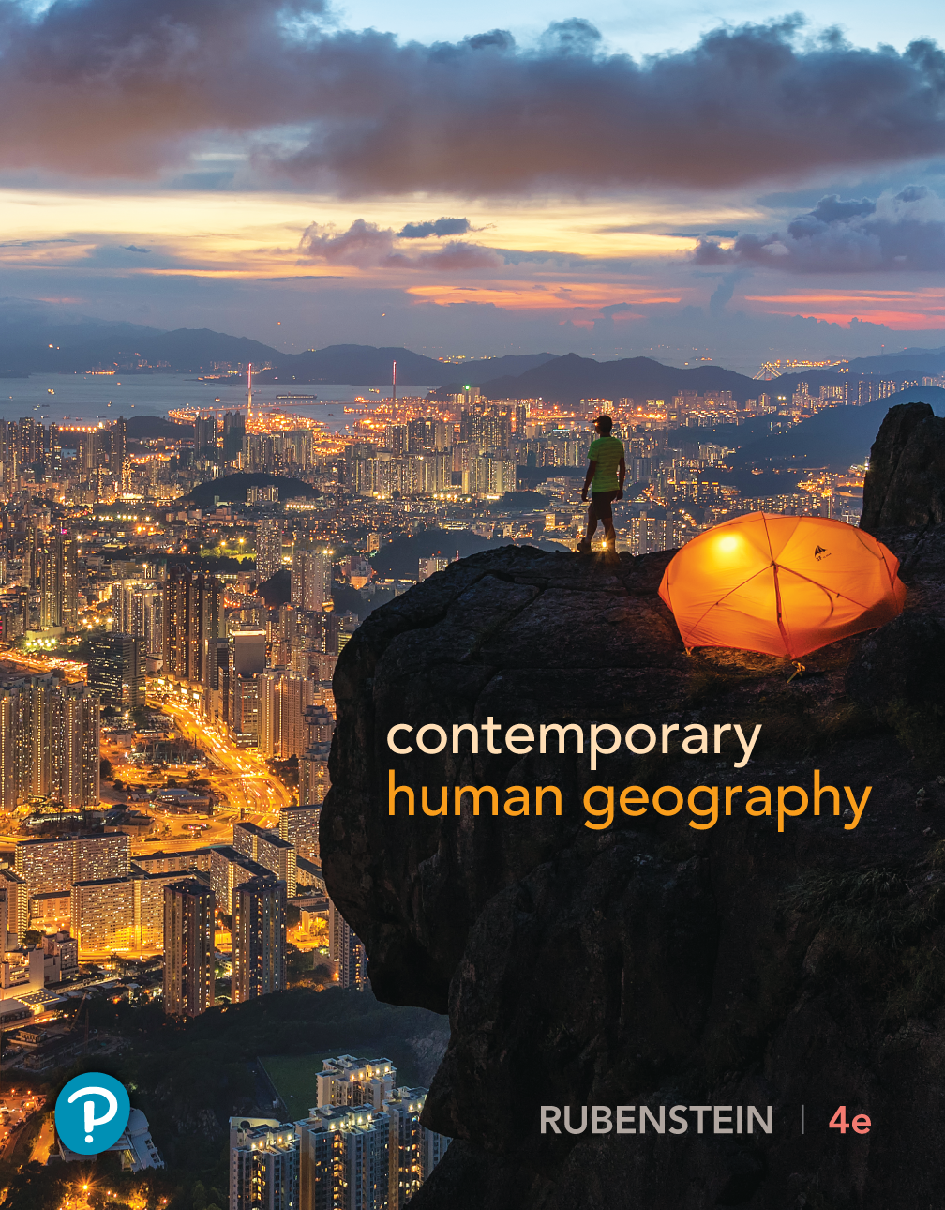
Contemporary Human Geography
Fourth Edition
Chapter 10
Development
Lecture Presentation by
Neusa McWilliams
University of Toledo
Copyright © 2019 Pearson Education, Inc. All Rights Reserved
Notes:
If this PowerPoint presentation contains mathematical equations, you may need to check that your computer has the following installed:
1) MathType Plugin
2) Math Player (free versions available)
3) NVDA Reader (free versions available)

Slide 2
Chapter 10 Key Issues
10.1 How does development vary among countries? Development Regions
10.2 How does development vary among countries? A Decent Standard of Living
10.3 How does development vary among countries? Access to Knowledge and Health
10.4 What inequalities are found in development? Unequal & Uneven Development
10.5 What inequalities are found in development? Gender Inequality
10.6 What inequalities are found in development? Gender Empowerment & Employment
10.7 How do countries become more developed? Two Paths to Development
10.8 How do countries become more developed? World Trade
10.9 How do countries become more developed? Financing Development
10.10 What progress towards development are countries achieving? Fair Trade
10.11 What progress towards development are countries achieving? Progress in Development

Slide 3
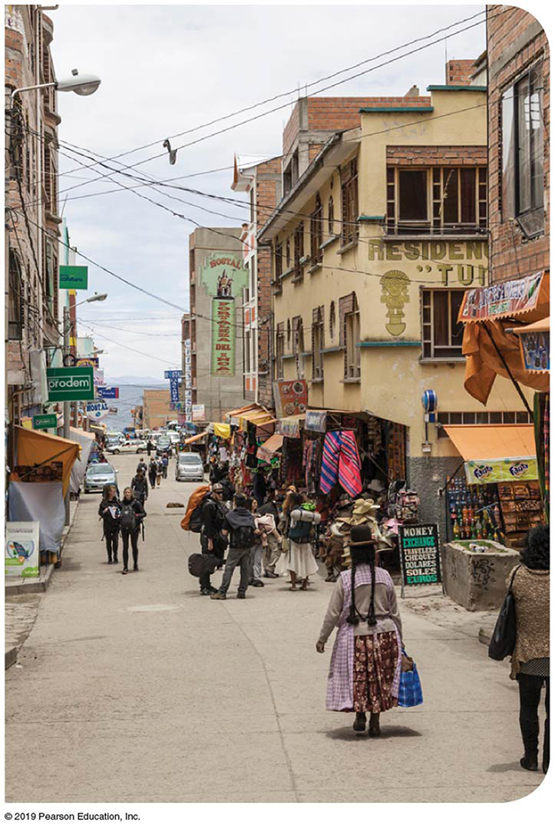
10.1 Development Regions (1 of 3)
Earth’s nearly 200 countries can be classified according to their level of development, which is the process of improving the material conditions of people through diffusion of knowledge and technology.
  A developed country, also known as a more developed country (M D C) and by the U N as a very high developed country, has progressed further along the development continuum.
  A developing country, also frequently called a less developed country (L D C), has made some progress toward development, though less than the developed countries.
Notes:
Figure 10.1.1 A DEVELOPING COUNTRY: BOLIVIA

Slide 4
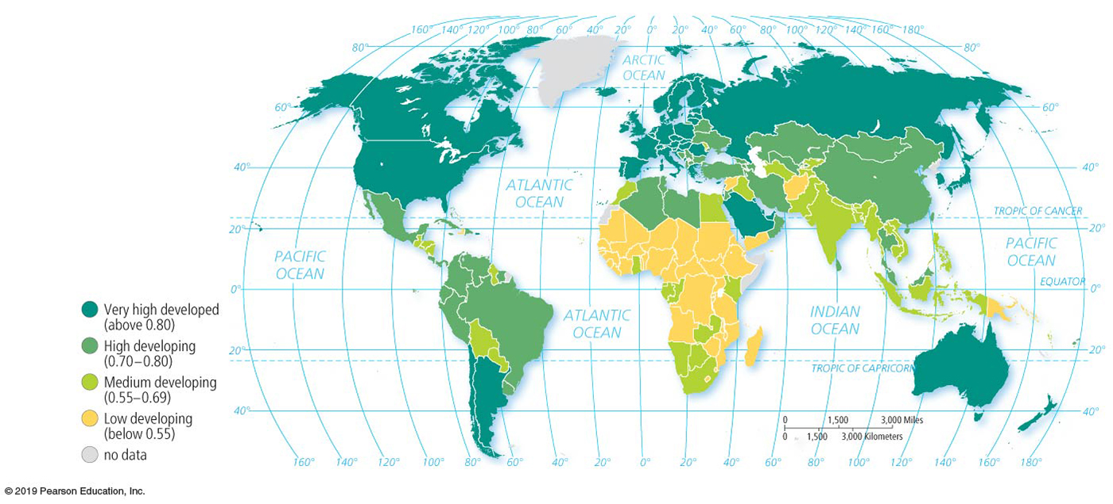
10.1 Development Regions (2 of 3)
Human Development Index
  To measure the level of development of every country, the U N has created the Human Development Index (H D I).
  The highest H D I possible is 1.0. The H D I considers development to be a function of three factors: a decent standard of living, a long and healthy life, and access to knowledge.
Notes:
Figure 10.1.2 HUMAN DEVELOPMENT INDEX (HDI)

Slide 5
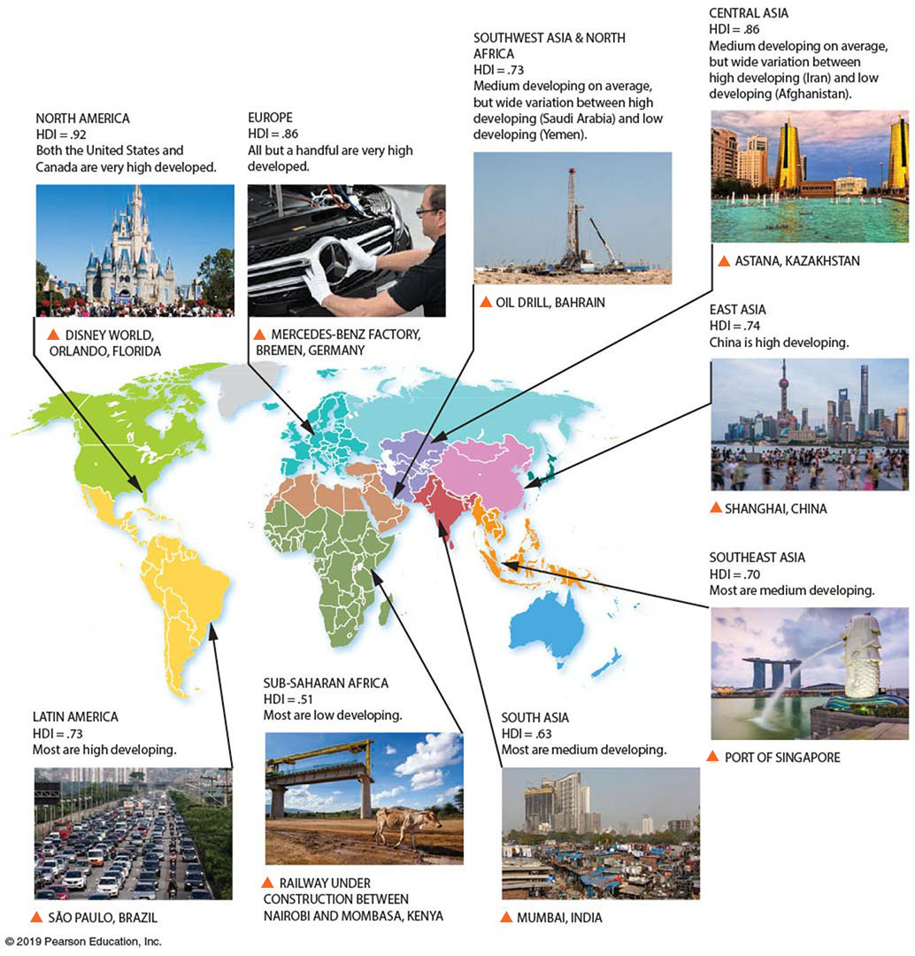
10.1 Development Regions (3 of 3)
Regional Differences in Development
  Geographers divide the world into two developed and seven developing regions:
Notes:
Figure 10.1.3 DEVELOPMENT REGIONS
The nine world regions are shown with their regional HDI score.

Slide 6
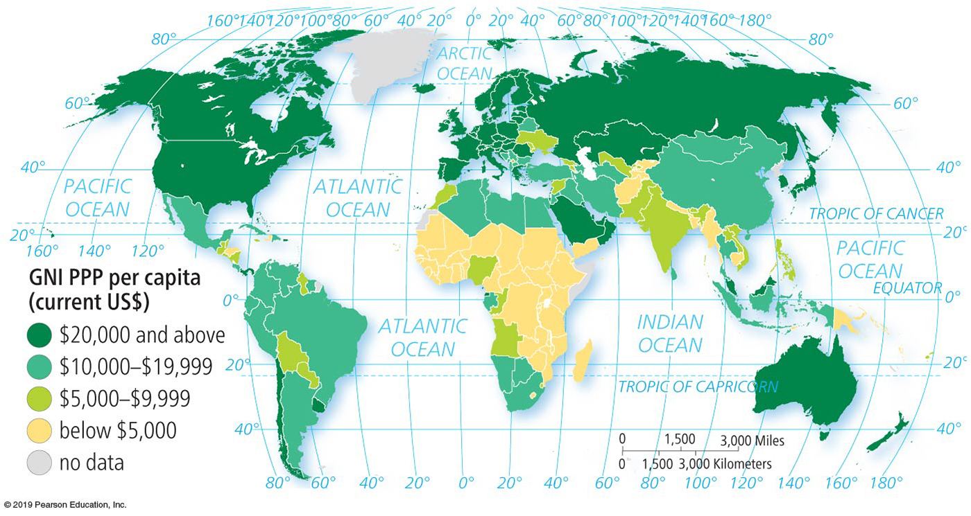
10.2 A Decent Standard of Living (1 of 3)
Income
  Gross national income (G N I) is the value of the output of goods and services produced in a country/year.
  Purchasing power parity (P P P) is an adjustment made to the G N I to account for differences among countries in the cost of goods.
  Gross domestic product (G D P) also measures the value of the output of goods and services produced in a country/year, but it does not account for money that leaves and enters the country.
Notes:
Figure 10.2.1 INCOME
GNI per capita PPP is highest in developed countries. The lowest figures are in sub- Saharan Africa and South Asia.

Slide 7
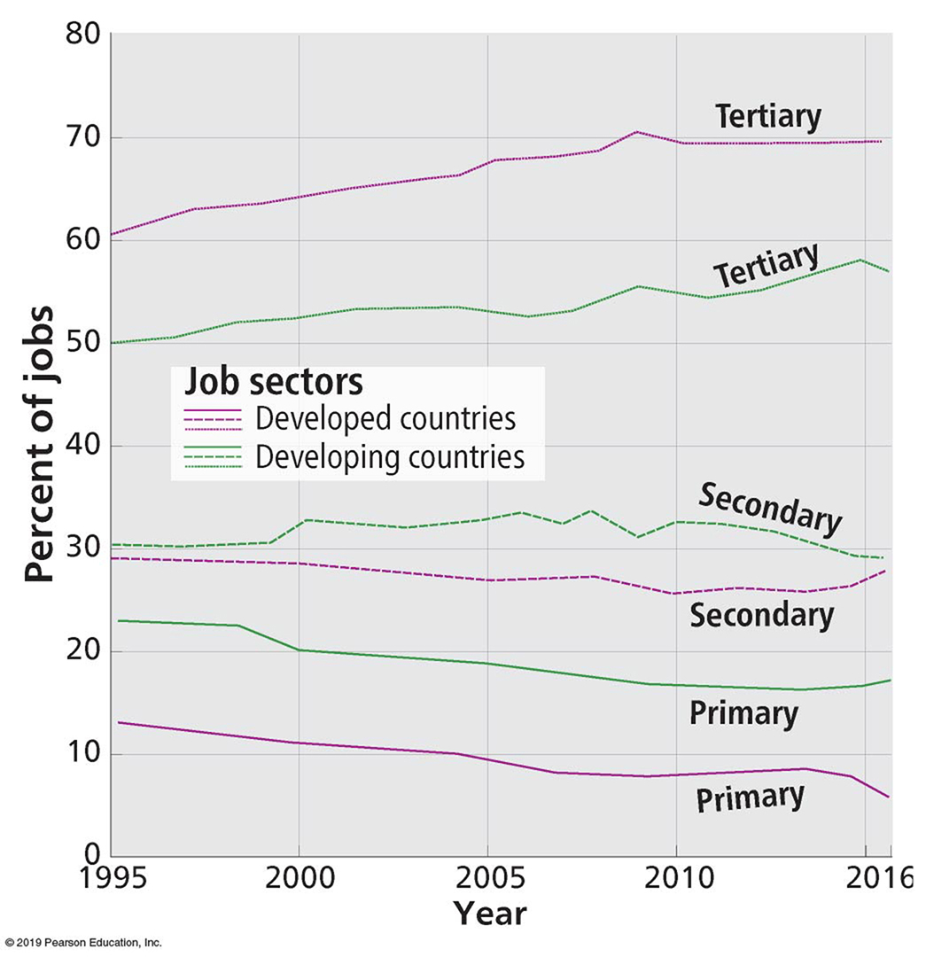
10.2 A Decent Standard of Living (2 of 3)
Economic Structure
  Jobs fall into three categories
    Primary sector: Directly extracting materials from Earth through agriculture or through mining, fishing, and forestry.
    Secondary sector: Manufacturing raw materials into products.
    Tertiary sector: Providing goods and services to people in exchange for payment.
Notes:
Figure 10.2.2 ECONOMIC STRUCTURE
The graph shows the changing contribution to GNI by the three sectors of jobs.

Slide 8
10.2 A Decent Standard of Living (3 of 3)
Productivity
  Workers in developed countries are more productive than those in developing countries. Productivity is the value of a particular product compared to the amount of labor needed to make it.
  Productivity can be measured by the value added per capita. The value added in manufacturing is the gross value of a product minus the costs of raw materials and energy.

Slide 9
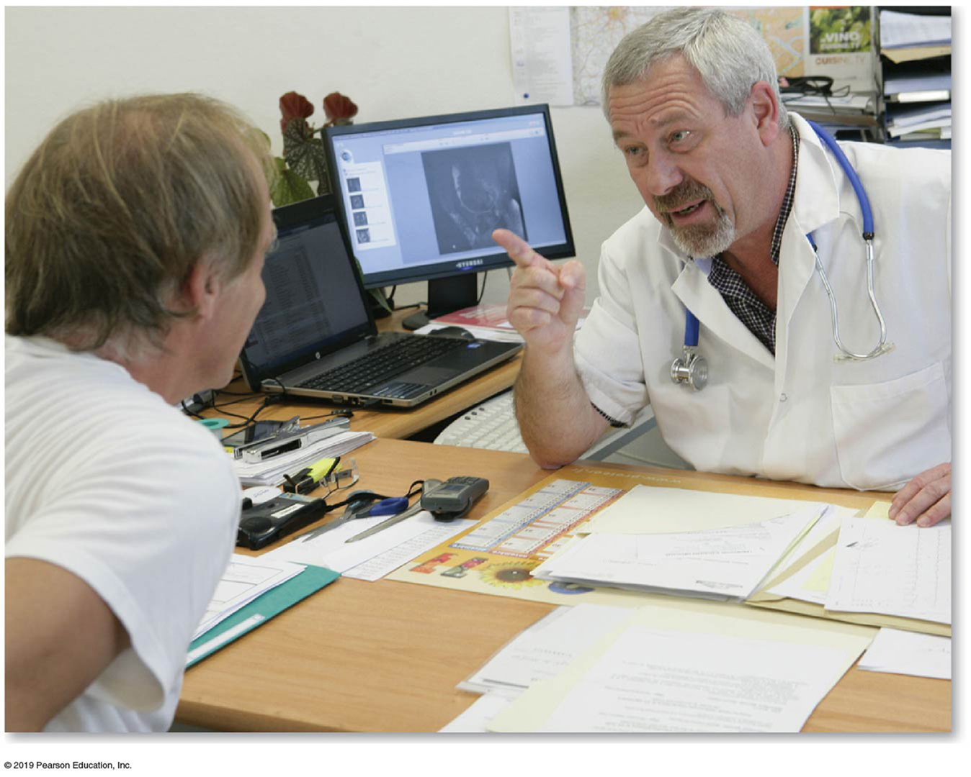
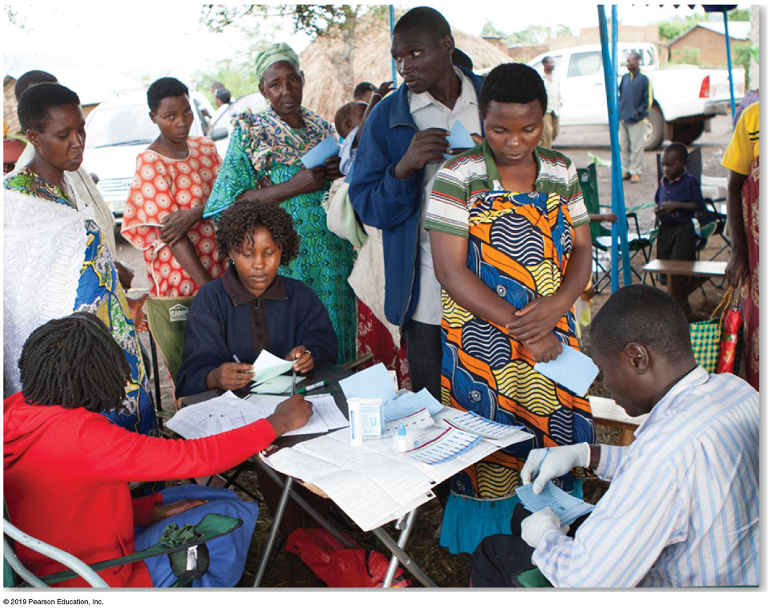
10.3 Access to Knowledge and Health (1 of 5)
Health
  The U N considers good health to be as an important a measure of development as wealth and knowledge.
  A goal of development is to provide the nutrition and medical services needed for people to lead long and healthy lives.
Notes:
Figure 10.3.1 MEDICAL SERVICES, DEVELOPED COUNTRY: FRANCE
Figure 10.3.2 MEDICAL SERVICES, DEVELOPING COUNTRY: UGANDA

Slide 10
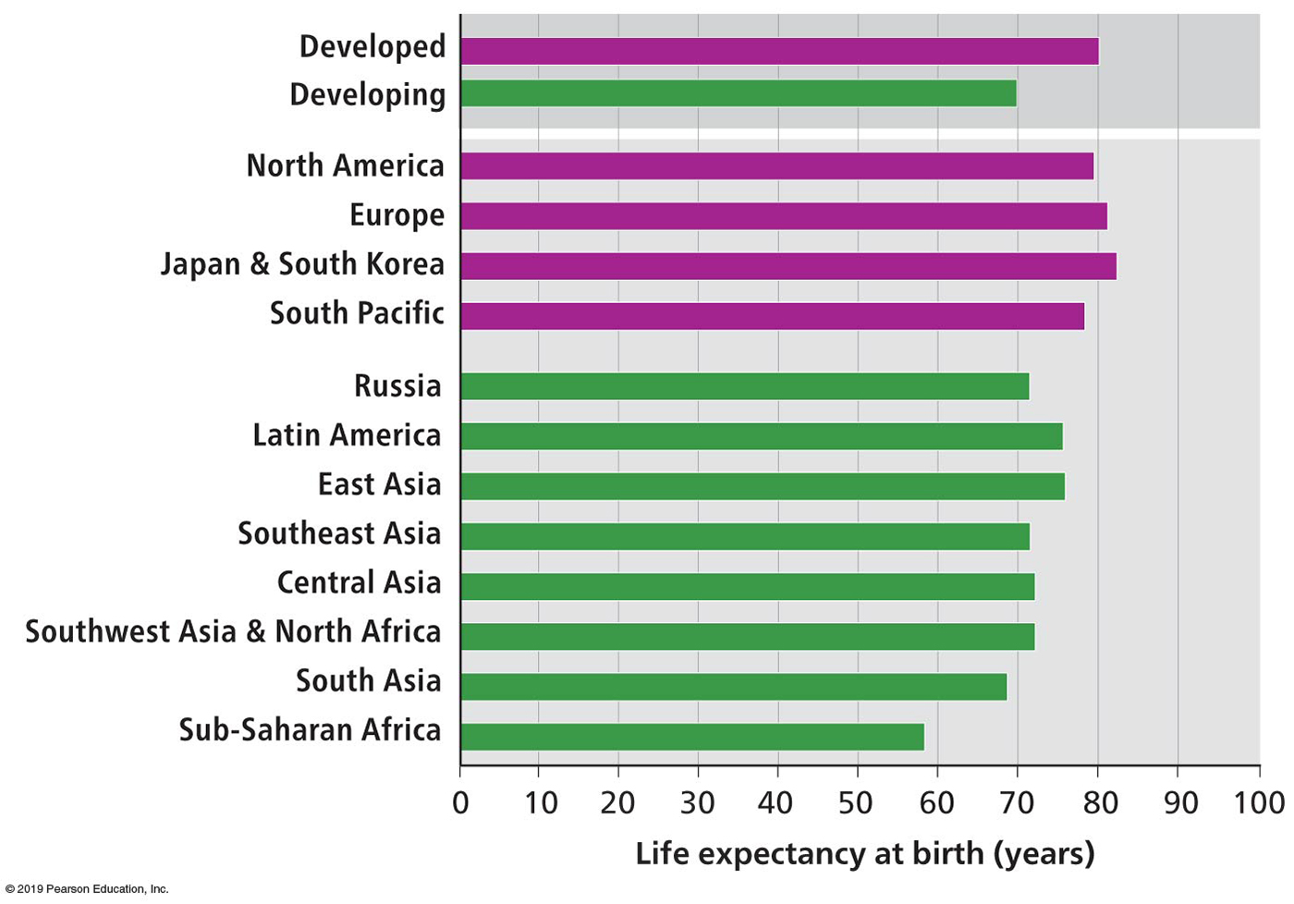
10.3 Access to Knowledge and Health (2 of 5)
Health
  From the many health and medical indicators, the U N has selected life expectancy at birth as the contributor to the H D I.
  A baby born this year is expected to live on average until age 71 worldwide, until 80 in developed countries, and to only 57 in sub-Saharan Africa.
Notes:
Figure 10.3.3 LIFE EXPECTANCY AT BIRTH BY DEVELOPMENT REGION
The highest life expectancy among the nine development regions is in North America, and the lowest is in sub-Saharan Africa.

Slide 11
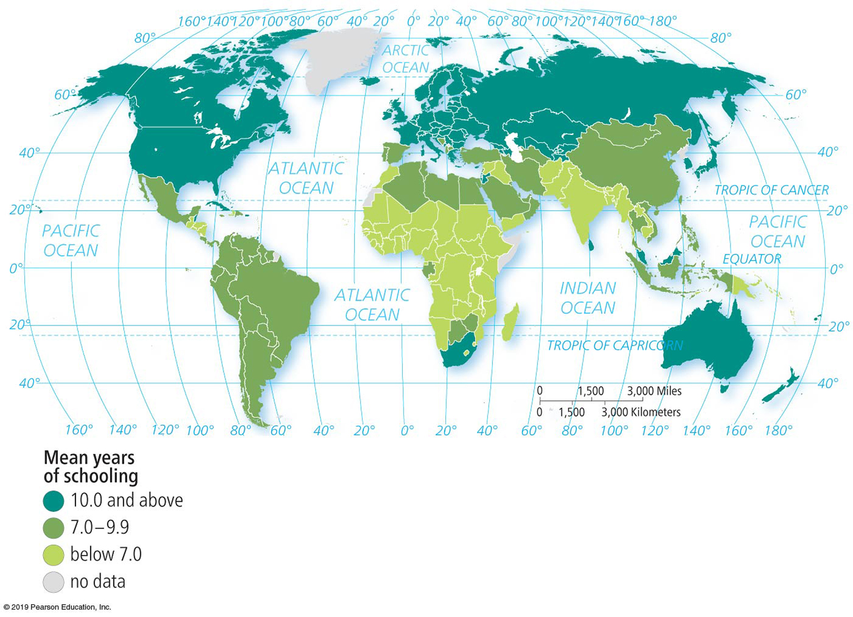
10.3 Access to Knowledge and Health (3 of 5)
Education
  The U N considers years of schooling to be the most critical measure of the ability of an individual to gain access to knowledge needed for development.
  Years of schooling for today’s adults. The number of years that the average person aged 25 or older in a country has spent in school.
Notes:
Figure 10.3.4 MEAN YEARS OF SCHOOLING

Slide 12
10.3 Access to Knowledge and Health (4 of 5)
Education
  Expected years of schooling for today’s youth. The number of years that the U N forecasts an average 5-year-old will spend in school.
  Roughly half of today’s 5-year-olds will graduate from college in developed countries.
  On the other hand, the expected average is 9.3 years in sub-Saharan Africa and 10.2 years in South Asia.

Slide 13
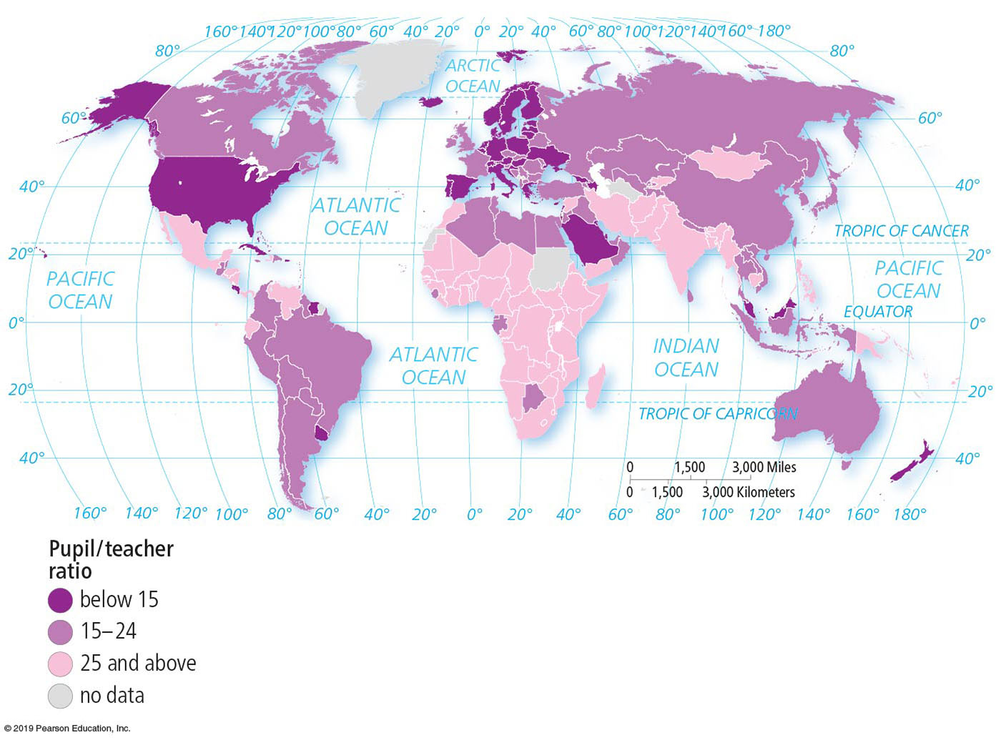
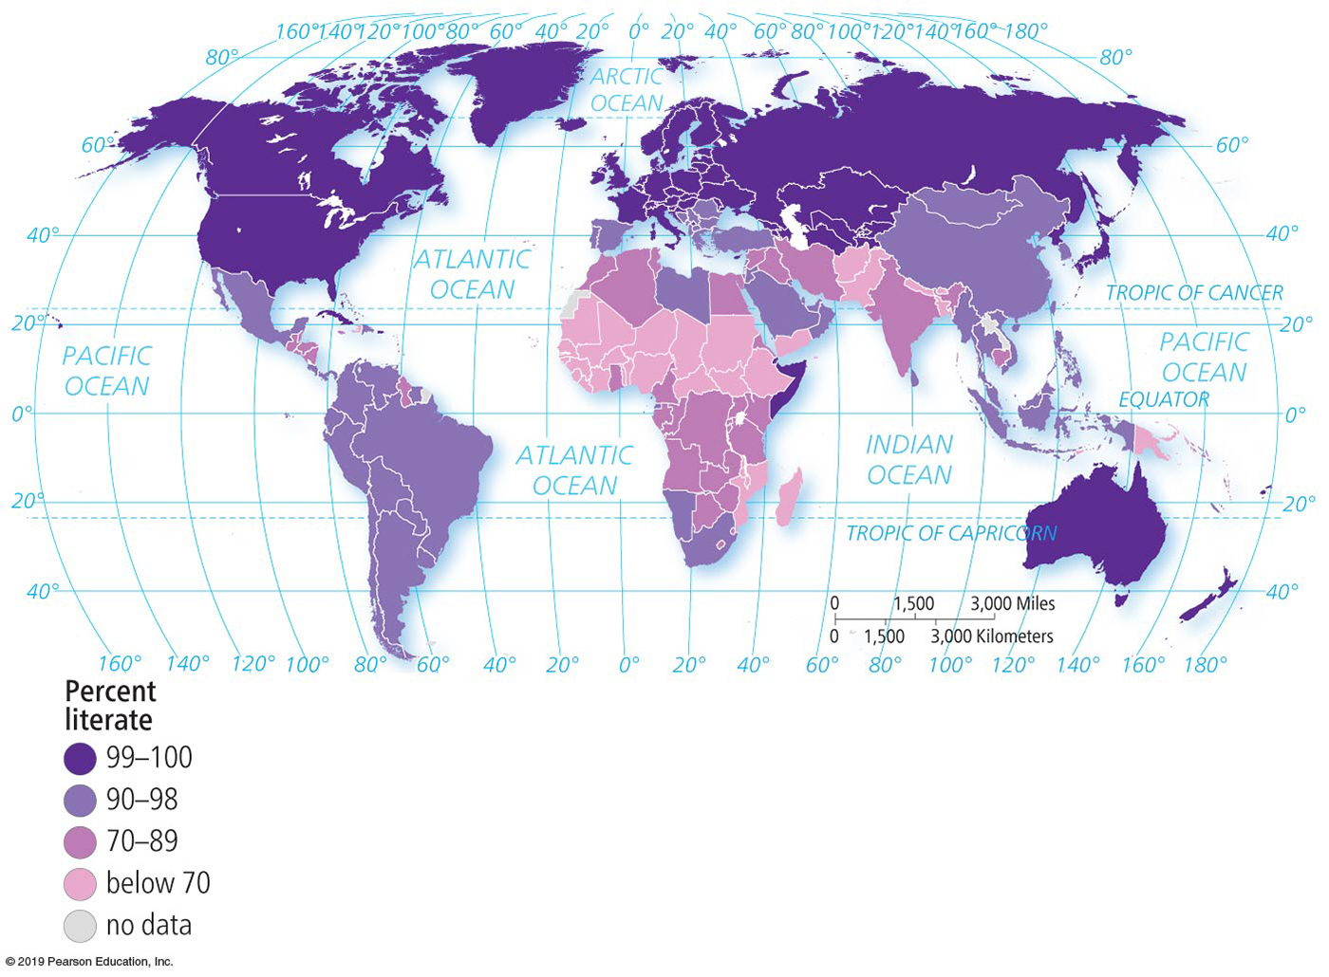
10.3 Access to Knowledge and Health (5 of 5)
Education
  Pupil/teacher ratio. The fewer pupils a teacher has, the more likely that each student will receive effective instruction.
  Literacy rate. The literacy rate is the percentage of a country’s people who can read and write.
Notes:
Figure 10.3.5 PUPIL/TEACHER RATIO, PRIMARY SCHOOL
Figure 10.3.6 LITERACY RATE

Slide 14
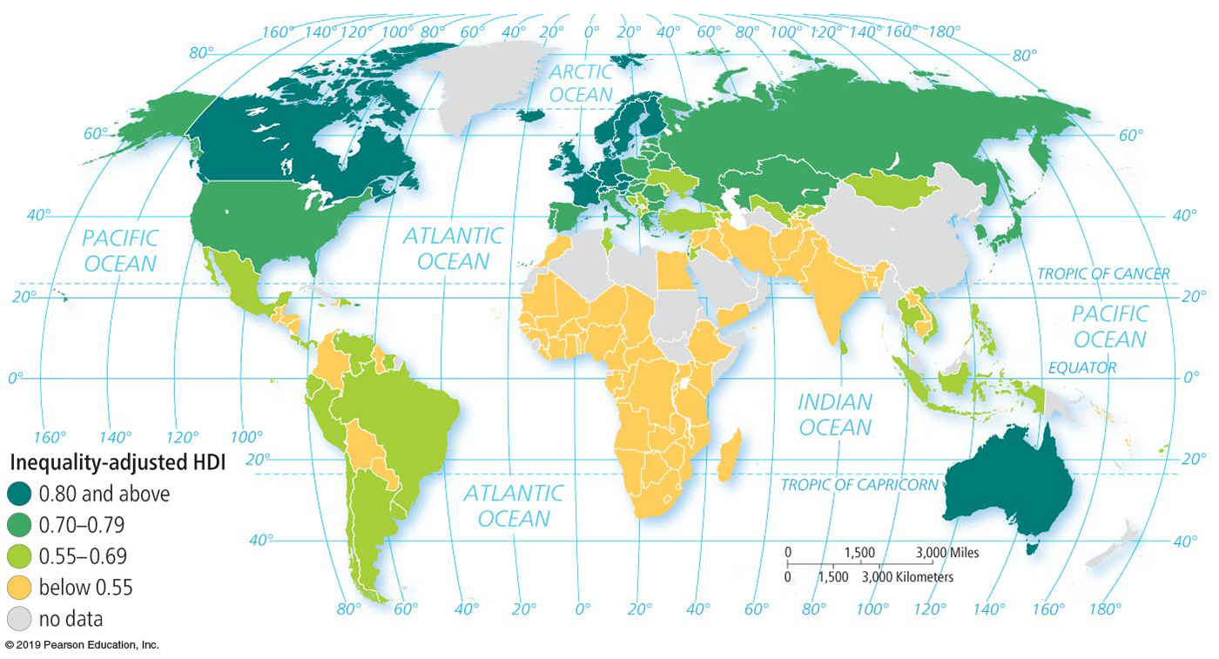
10.4 Unequal & Uneven Development (1 of 3)
Inequality-adjusted H D I
  To measure the extent of inequality, the U N has created the inequality-adjusted H D I (I H D I). The I H D I modifies the H D I to account for inequality within a country. Under perfect equality, the H D I and the I H D I are the same.
  If the I H D I is lower than the H D I, the country has some inequality; the greater the difference in the two measures, the greater the inequality the same.
Notes:
Figure 10.4.1 INEQUALITY-ADJUSTED HDI
The lower the score, the greater the inequality. Europe has the highest score, hence the least inequality. South Asia and sub-Saharan Africa have the lowest scores and therefore the greatest degree of inequality.

Slide 15
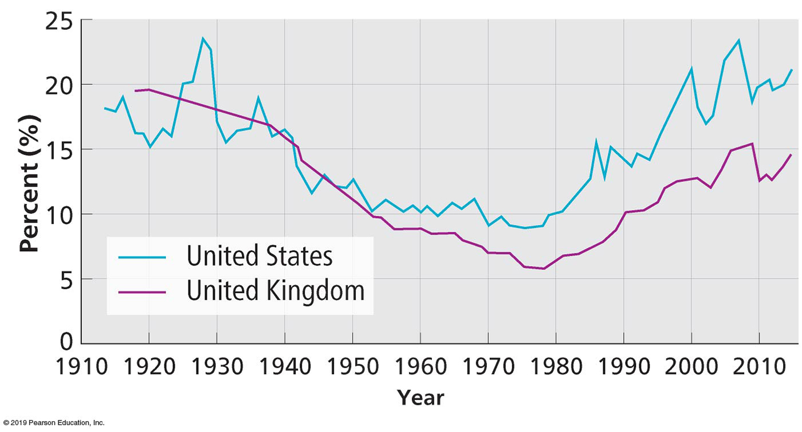
10.4 Unequal & Uneven Development (2 of 3)
Widening Inequality within Developed Countries
  Through most of the twentieth century, the gap between rich and poor narrowed in developed countries.
  Since 1980, however, inequality has increased in most developed countries, including the United States and the United Kingdom.
  Question: Was there a change in how the U.S. and U.K. governments used their wealth?
Notes:
Figure 10.4.2 WIDENING INEQUALITY IN THE U.S. AND U.K.
The share of total national income received by the richest 1 percent declined in the United States and the United Kingdom for most of the twentieth century but has increased in recent decades.

Slide 16
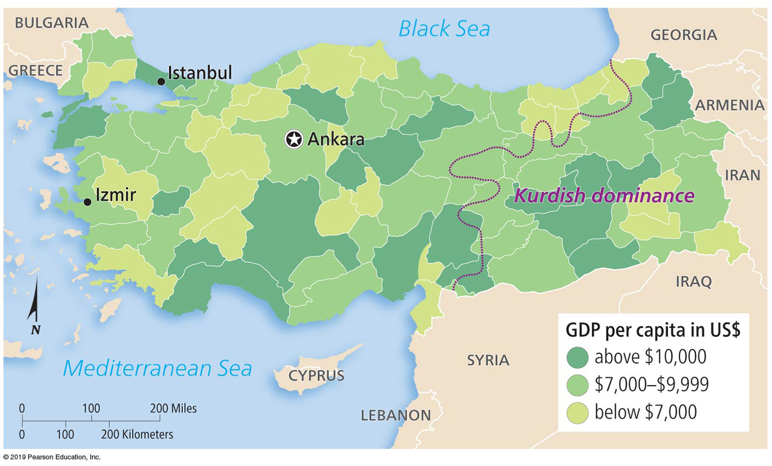
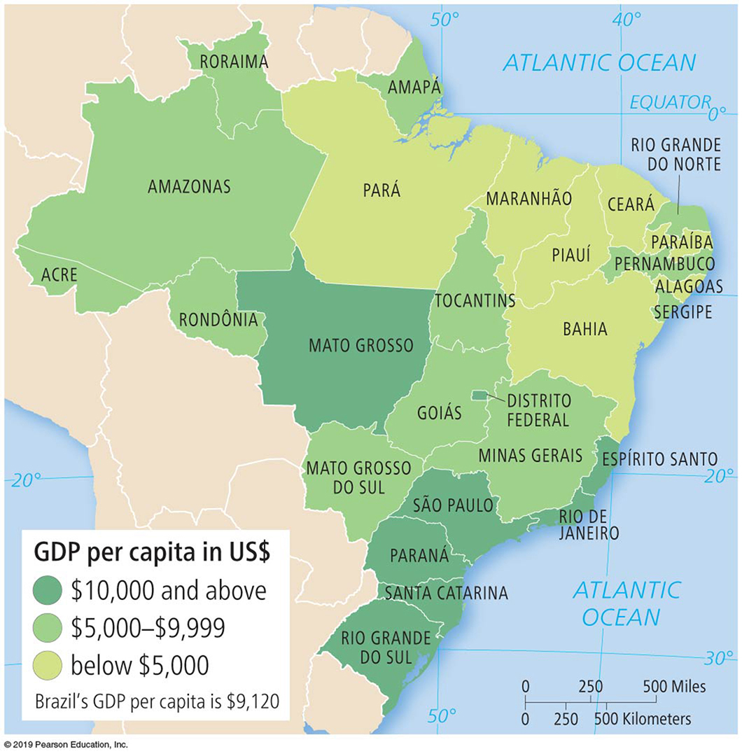
10.4 Unequal & Uneven Development (3 of 3)
Inequality within Developing Countries
  Brazil and Turkey—The extent of inequality within these countries can be seen in two ways:
  The difference between the H D I and I H D I.
  Inequality can also be seen through differences in G D P per capita among states or provinces within the countries.
Notes:
Figure 10.4.3 INEQUALITY WITHIN TURKEY
Figure 10.4.4 INEQUALITY WITHIN BRAZIL

Slide 17
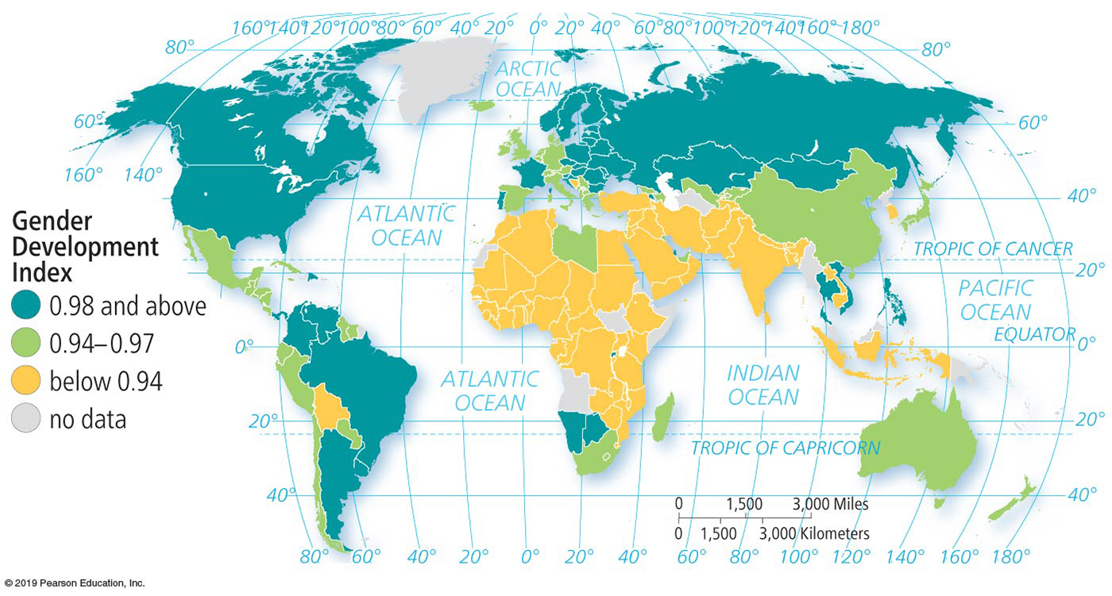
10.5 Gender Inequality (1 of 3)
Gender-related Development Index
  The U.N. combines Human Development Index data on income, education, and life expectancy in a measure of the gender gap called the Gender-related Development Index (G D I).
  If females and males had the same levels of income, education, and life expectancy, the G D I would be 1.000.
Notes:
Figure 10.5.2 GENDER-RELATED DEVELOPMENT INDEX

Slide 18
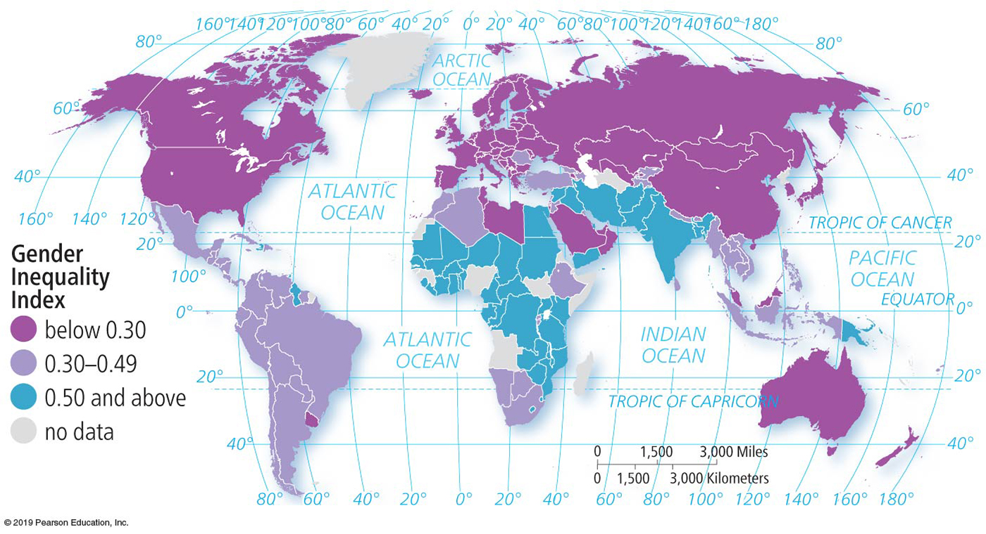
10.5 Gender Inequality (2 of 3)
Gender Inequality Index
  The U.N. combines data on reproductive health, empowerment, and the labor market in a measure of the gender gap called the Gender Inequality Index (G I I).
  A score of 0 would mean that men and women fare equally.
  The G I I is higher in developing countries than in developed ones.
  Reproductive health is the largest contributor to gender inequality in some developing regions.
Notes:
Figure 10.5.3 GENDER INEQUALITY INDEX

Slide 19
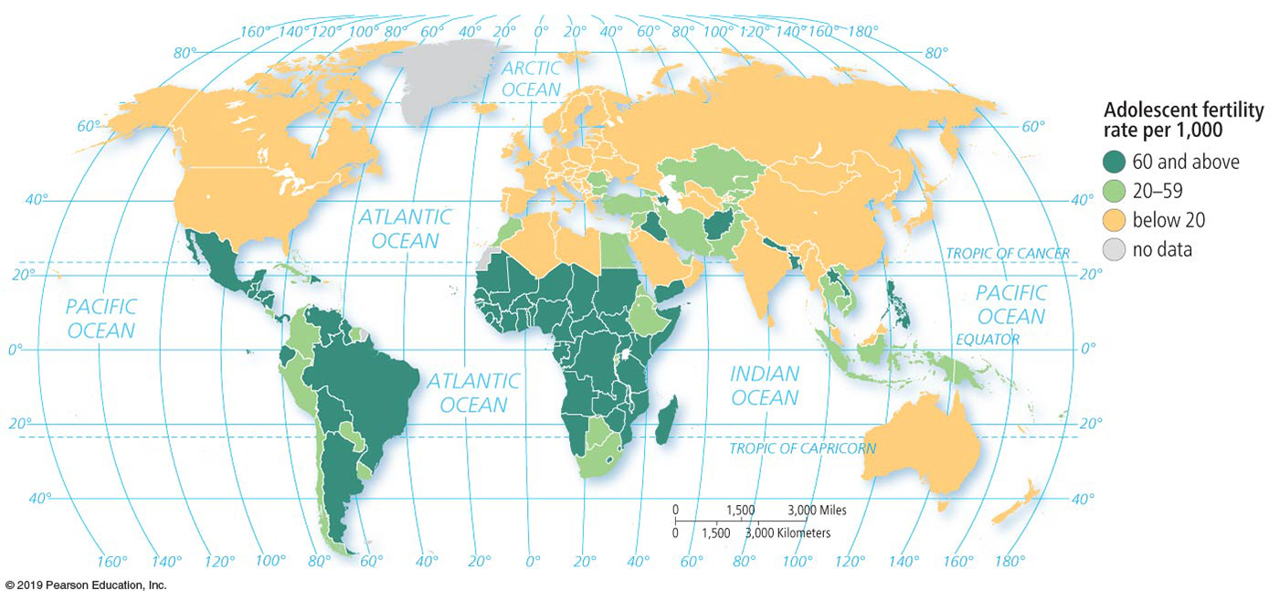

10.5 Gender Inequality (3 of 3)
Reproductive Health
  The maternal mortality rate is the number of women who die giving birth per 100,000 births.
  The adolescent fertility rate is the number of births per 1,000 women ages 15–19. The teenage pregnancy rate is below 10 per 1,000 in most European countries, where most couples use some form of contraception.
  The U.N. includes reproductive health as a contributor to G I I because in countries where effective control of reproduction is universal, women have fewer children, and maternal and child health are improved.
Notes:
Figure 10.5.5 ADOLESCENT FERTILITY RATE
Figure 10.5.6 CHILD CARE: DEVELOPED COUNTRY
Nursery school children wear high visibility jackets as they are escorted on a walk, London, United Kingdom.

Slide 20
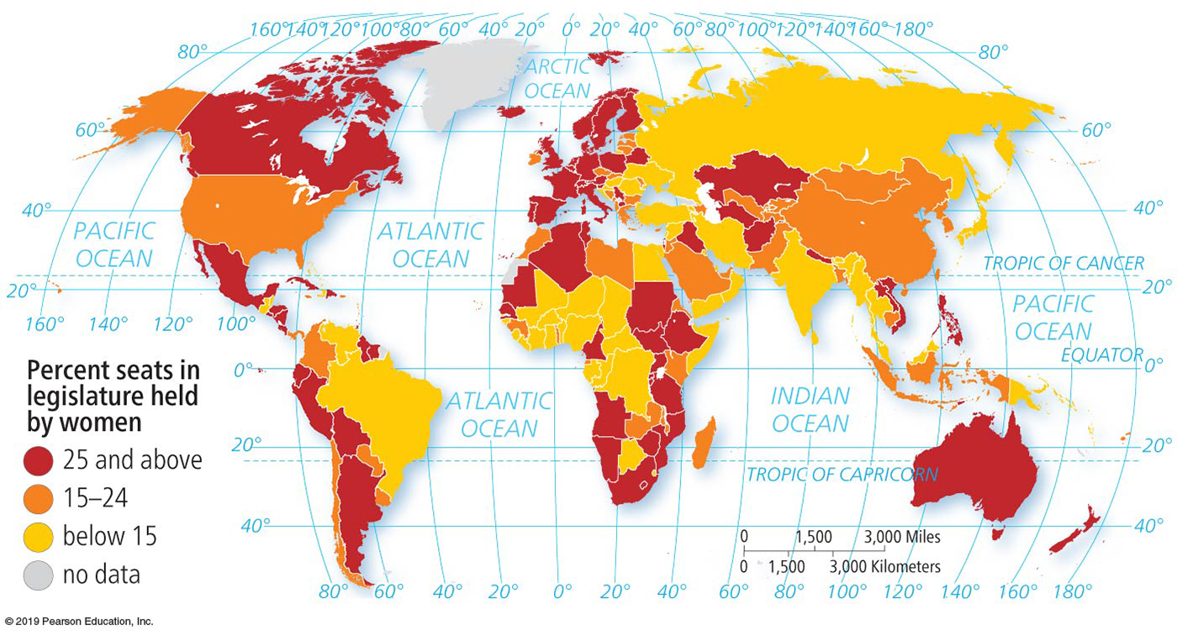
10.6 Gender Empowerment & Employment (1 of 3)
Empowerment
  In the context of gender inequality, empowerment refers to the ability of women to achieve improvements in their own status—that is, to achieve economic and political power.
  The empowerment dimension of GII is measured by two indicators:
    National Legislature: In every country of the world, more men than women hold position of political power.
Notes:
Figure 10.6.1 WOMEN IN THE NATIONAL LEGISLATURE
The highest percentages are in Europe, and the lowest are in Southwest Asia and North Africa.

Slide 21
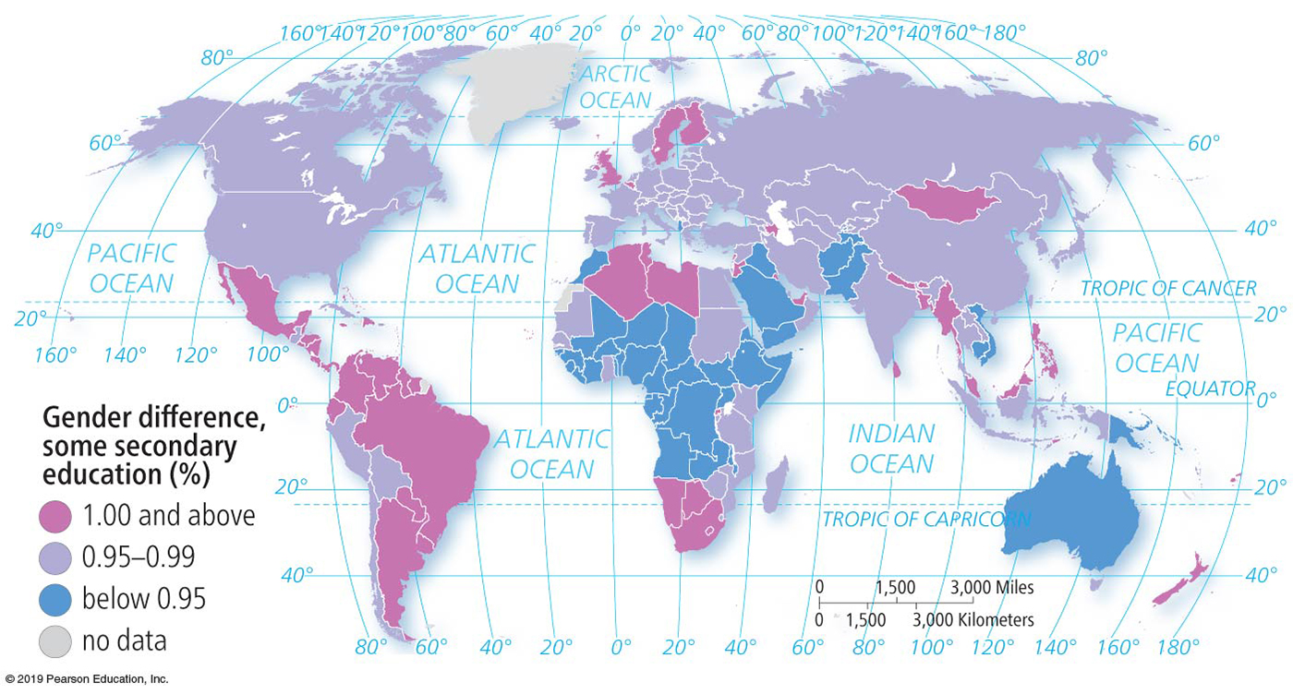
10.6 Gender Empowerment & Employment (2 of 3)
Empowerment
    Secondary School: Worldwide, 54 percent of women have completed some secondary (high) school, compared to 64 percent of men.
      For every 10 boys who attend high school in developing countries, only 6 girls attend.
Notes:
Figure 10.6.2 GENDER DIFFERENCES IN SECONDARY SCHOOL
A figure above 1.00 means that more girls than boys have some secondary school.

Slide 22
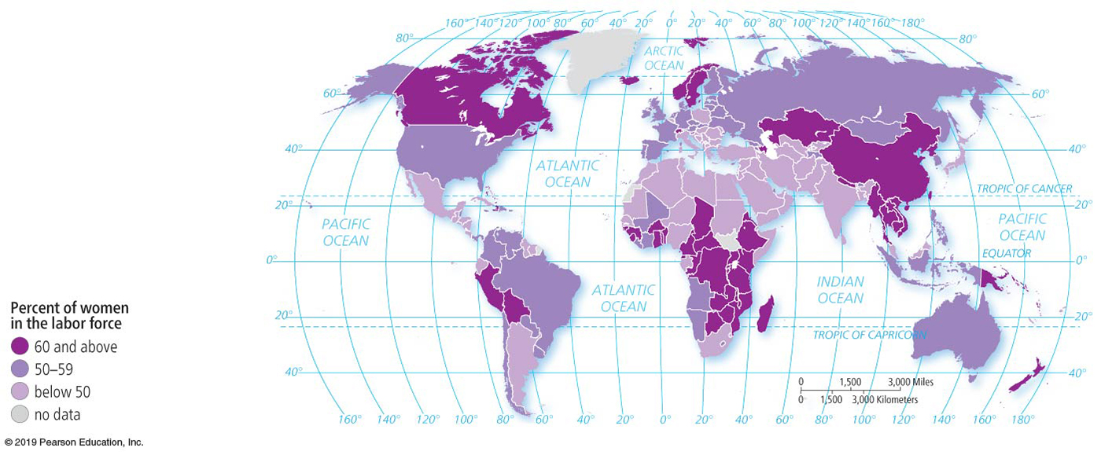
10.6 Gender Empowerment & Employment (3 of 3)
Employment
  The female labor force participation rate is the percentage of women holding full-time jobs outside the home. Worldwide, 51 percent of women work outside the home.
  South Asia and Southwest Asia and North Africa have substantial gaps between male and female labor participation, whereas East Asia and sub-Saharan Africa have smaller gaps.
Notes:
Figure 10.6.2 GENDER DIFFERENCES IN SECONDARY SCHOOL
A figure above 1.00 means that more girls than boys have some secondary school.

Slide 23
10.7 Two Paths to Development (1 of 5)
Self-sufficiency. Countries encourage domestic production of goods, discourage foreign ownership of businesses and resources, and protect their businesses from international competition.
International trade. Countries open themselves to foreign investment and international markets.
For most of the twentieth century, self-sufficiency was the more popular of the development alternatives. International trade became more popular beginning in the late twentieth century.

Slide 24
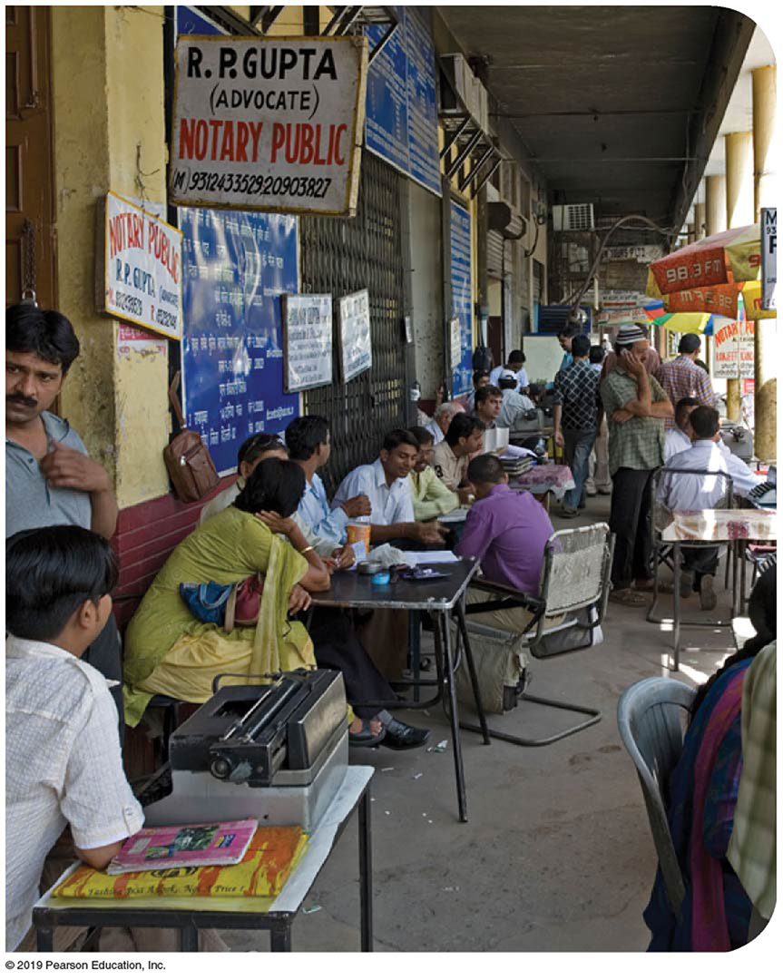
10.7 Two Paths to Development (2 of 5)
Self-sufficiency example: India
  Key elements of the self-sufficiency path to development include the following:
    Balanced growth. Investment is spread as equally as possible across all sectors of a country’s economy and in all regions.
    Import barriers. The import of goods is limited through barriers, including setting high taxes (tariffs) on imported goods.
Notes:
Figure 10.7.1 SELFSUFFICIENCY IN INDIA: BUREAUCRACY
Bureaucrats lacking office space work on the sidewalk in Delhi.

Slide 25
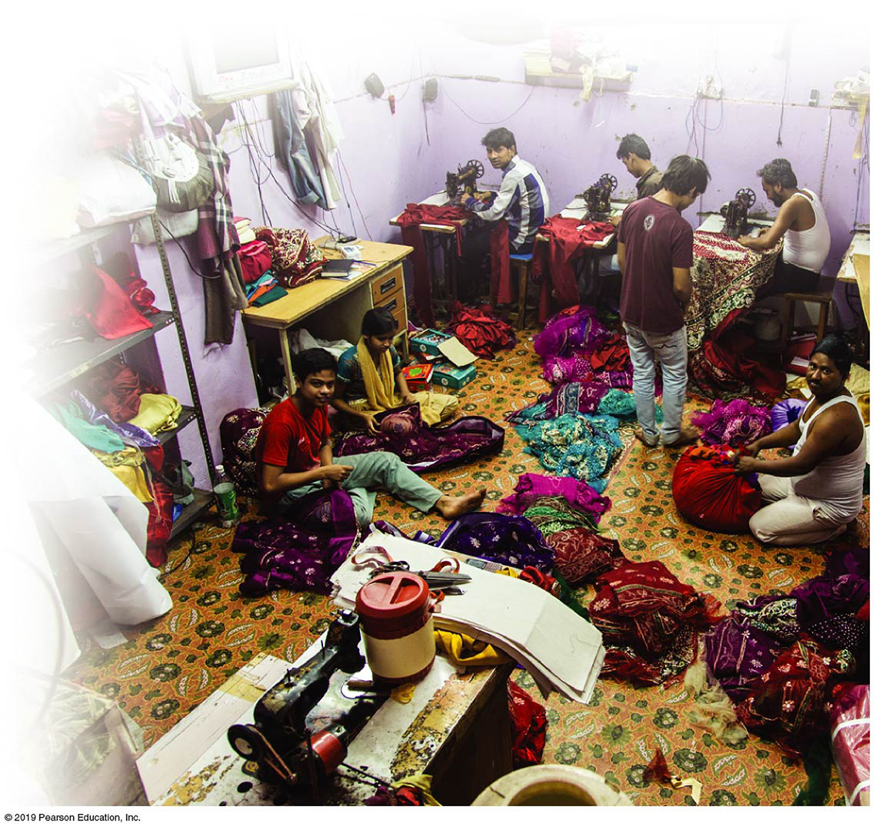
10.7 Two Paths to Development (3 of 5)
Self-sufficiency example: India
  Import licenses. To import goods into India, a company needed a license, which was hard to get because several dozen government agencies had to approve the request.
  Quotas. Companies with import licenses were severely restricted by the government in the quantities they could import.
  Taxes. The government imposed heavy taxes on imported goods, which doubled or even tripled the prices to consumers.
  Also export limits, currency restrictions, permits, subsidies, and government ownership.
Notes:
Figure 10.7.1 SELFSUFFICIENCY IN INDIA: BUREAUCRACY
Bureaucrats lacking office space work on the sidewalk in Delhi.
Figure 10.7.2 SELF-SUFFICIENCY IN INDIA: INEFFICIENCY
Textile manufacturing, Delhi.

Slide 26
10.7 Two Paths to Development (4 of 5)
International Trade Path
  The international trade model of development calls for a country to identify its distinctive or unique economic assets.
  What animal, vegetable, or mineral resources does the country have in abundance that other countries are willing to buy?
  The international trade path derives from a five step model proposed by W.W. Rostow in 1960. Each country is thought to be in one of these five stages.

Slide 27
10.7 Two Paths to Development (5 of 5)
International Trade Path
The traditional society. A very high percentage of people engaged in agriculture and a high percentage of national wealth allocated to what Rostow called “nonproductive” activities, such as the military and religion.
The preconditions for takeoff. An elite group of well-educated leaders initiates investment in technology and infrastructure.
The takeoff. Rapid growth is generated in a limited number of economic activities.
The drive to maturity. Modern technology.
The age of mass consumption. The economy shifts from production of heavy industry.

Slide 28
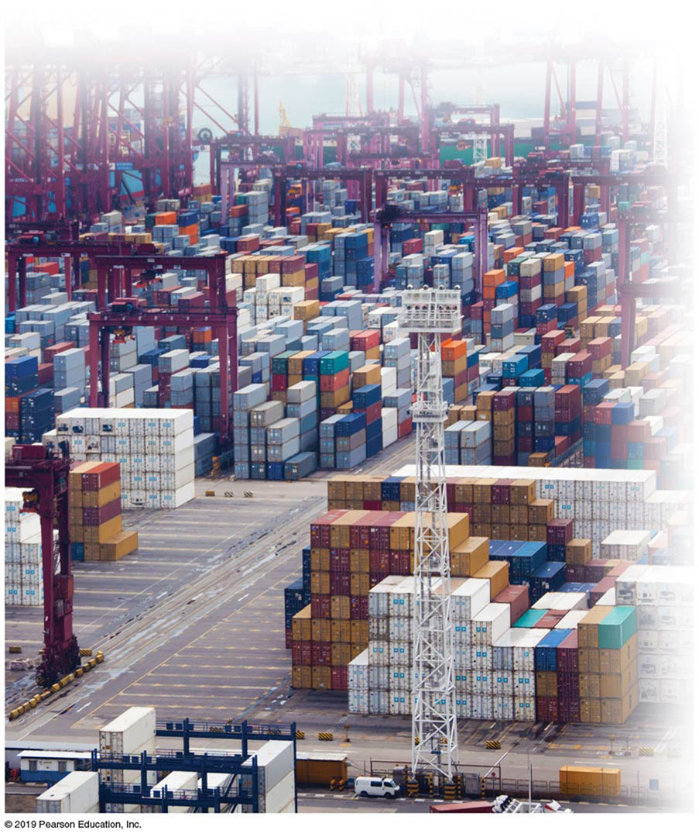
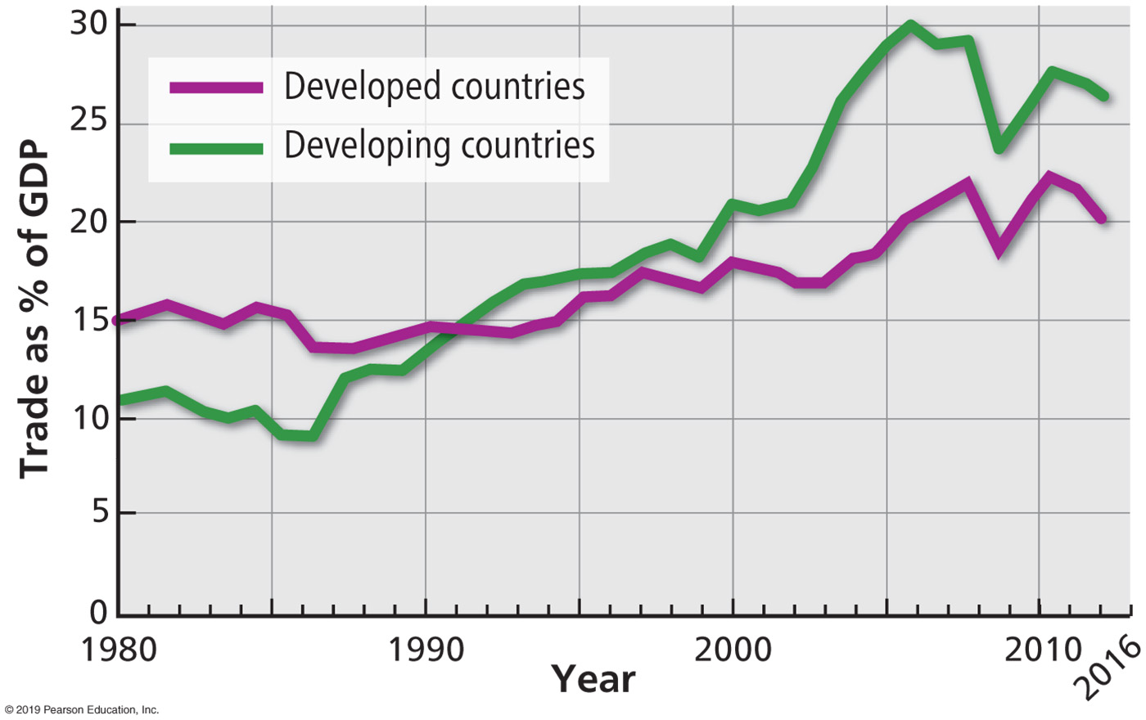
10.8 World Trade (1 of 5)
Shortcomings of Self-sufficiency
  During the late twentieth and early twenty-first centuries trade increased more rapidly than wealth (as measured by G D P), an indication of the growing importance of the international trade approach.
Notes:
Figure 10.8.1 INTERNATIONAL TRADE AS A PERCENTAGE OF INCOME
Figure 10.8.2 INTERNATIONAL TRADE: HONG KONG
The world’s fifth busiest port.

Slide 29
10.8 World Trade (2 of 5)
Shortcomings of Self-sufficiency
  Self-sufficiency was rejected for a number of reasons:
    Inefficient industries. Businesses could sell all they made, at high government-controlled prices.
    Lack of competitiveness. Companies protected from international competition were not pressured to keep abreast of rapid technological changes.
    Corruption. A large, complex bureaucracy administered rules and processed documents for permits.
    Black market. Ambitious businessmen found that struggling to produce goods was less rewarding than illegally importing goods.

Slide 30
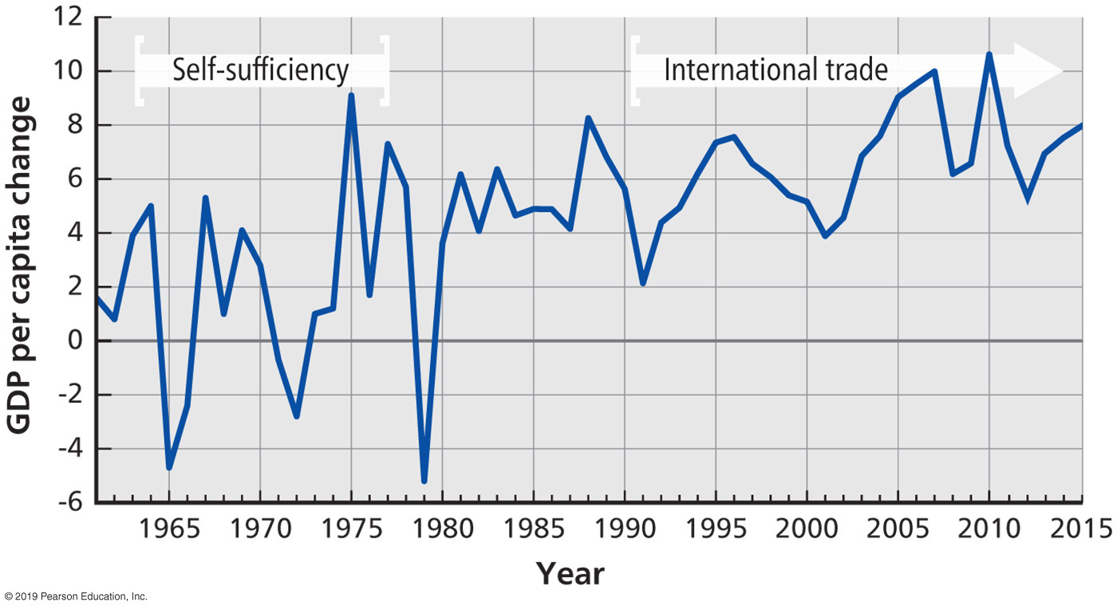
10.8 World Trade (3 of 5)
Transition to International Trade
  International trade attracted many developing countries during the late twentieth century. International trade exposes a country’s people and businesses to the demands, needs, and preferences of people and businesses in other countries.
  India, for example, dismantled many of its barriers to international trade through the following changes: became liberal with permits, reduced taxes and tariffs, and eliminated monopolies.
Notes:
Figure 10.8.3 GDP PER CAPITA CHANGE IN INDIA
The graph shows the percentage change in GDP from the previous year.

Slide 31
10.8 World Trade (4 of 5)
World Trade Organization
  Countries representing 97 percent of world trade established the World Trade Organization (W T O) in 1995.
  The W T O enforces agreements designed to reduce barriers to international trade.
  Through the W T O, countries agree to reduce or eliminate restrictions on the trade of manufactured goods, such as unfair subsidies, quotas, and tariffs.

Slide 32
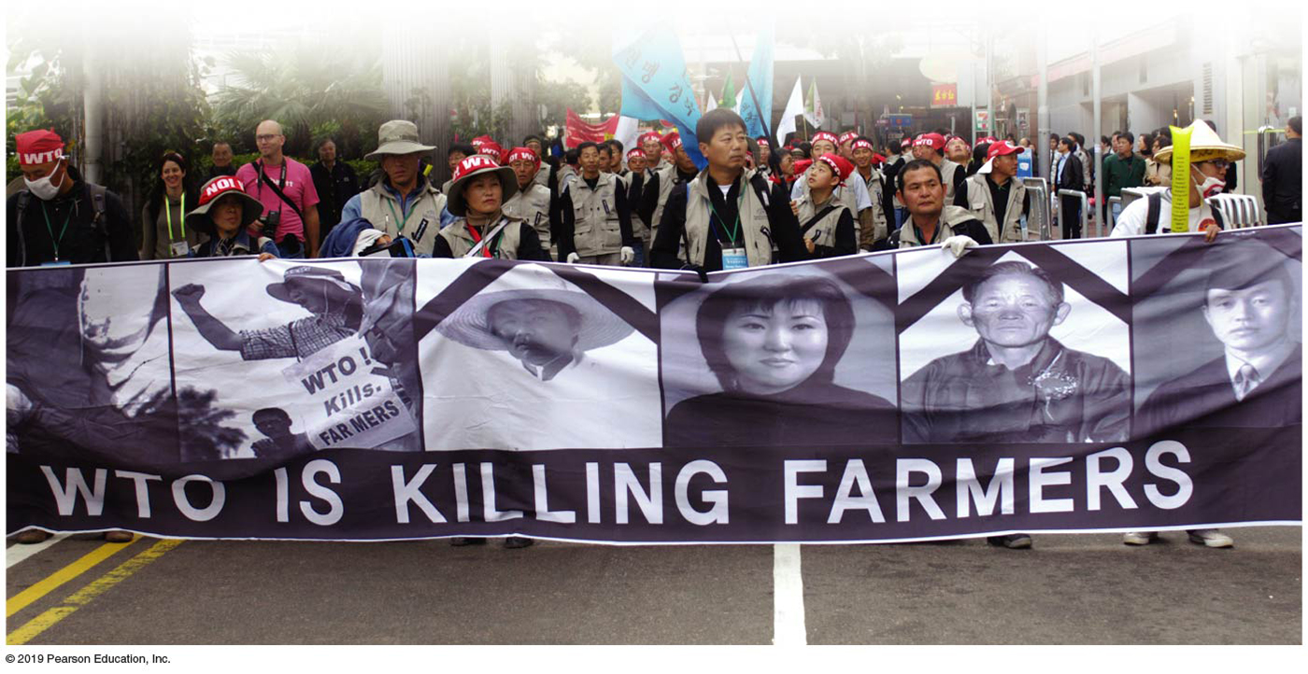
10.8 World Trade (5 of 5)
International Trade Critics
  Critics have sharply attacked international trade. Progressive critics charge that international trade promotes the interests of large corporations rather than poor people.
  Conservatives charge that international trade compromises the power and sovereignty of individual countries by transferring authority to organizations like the W T O.
Notes:
Figure 10.8.4 SOUTH KOREAN FARMERS PROTEST AGAINST THE WTO

Slide 33
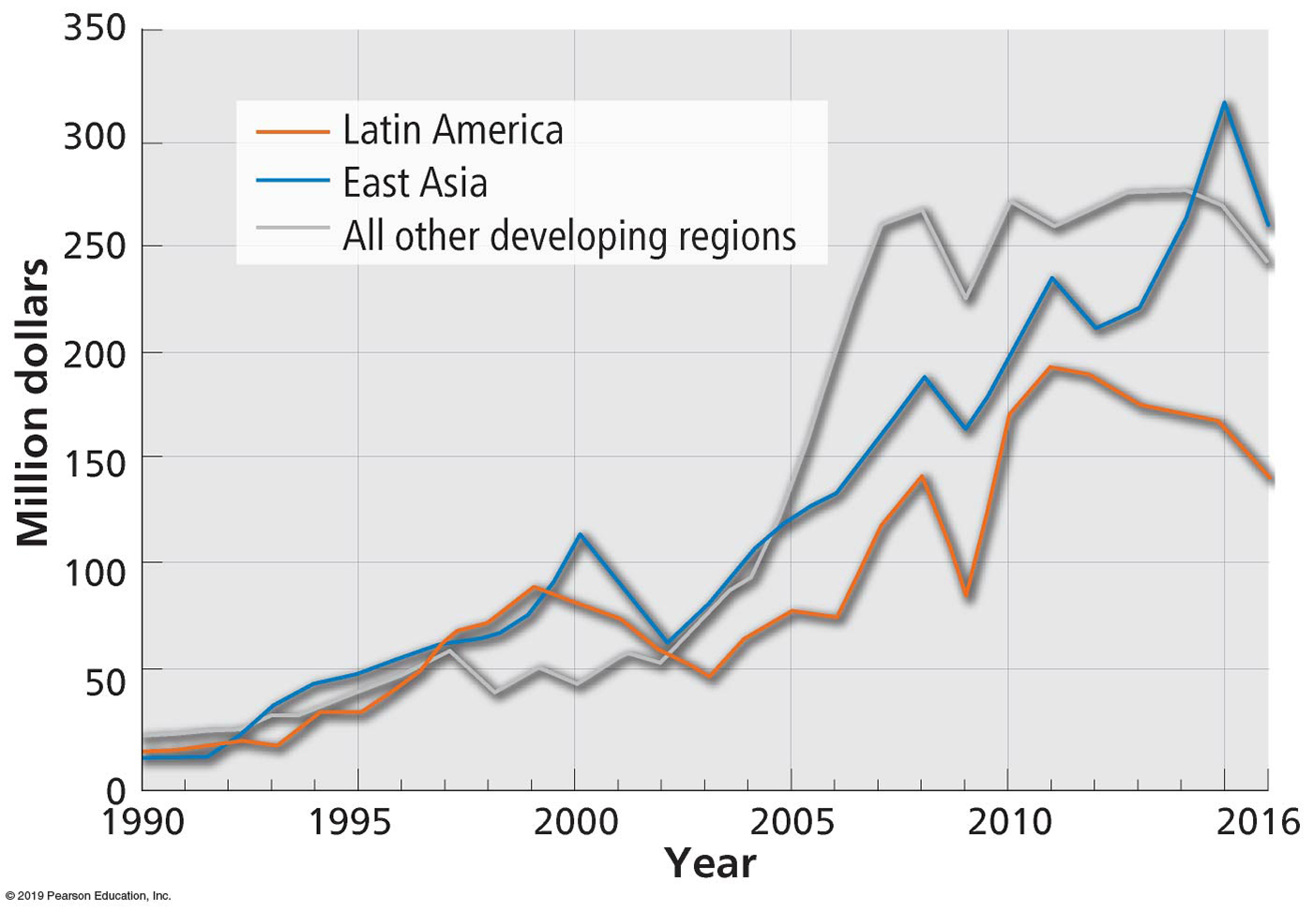
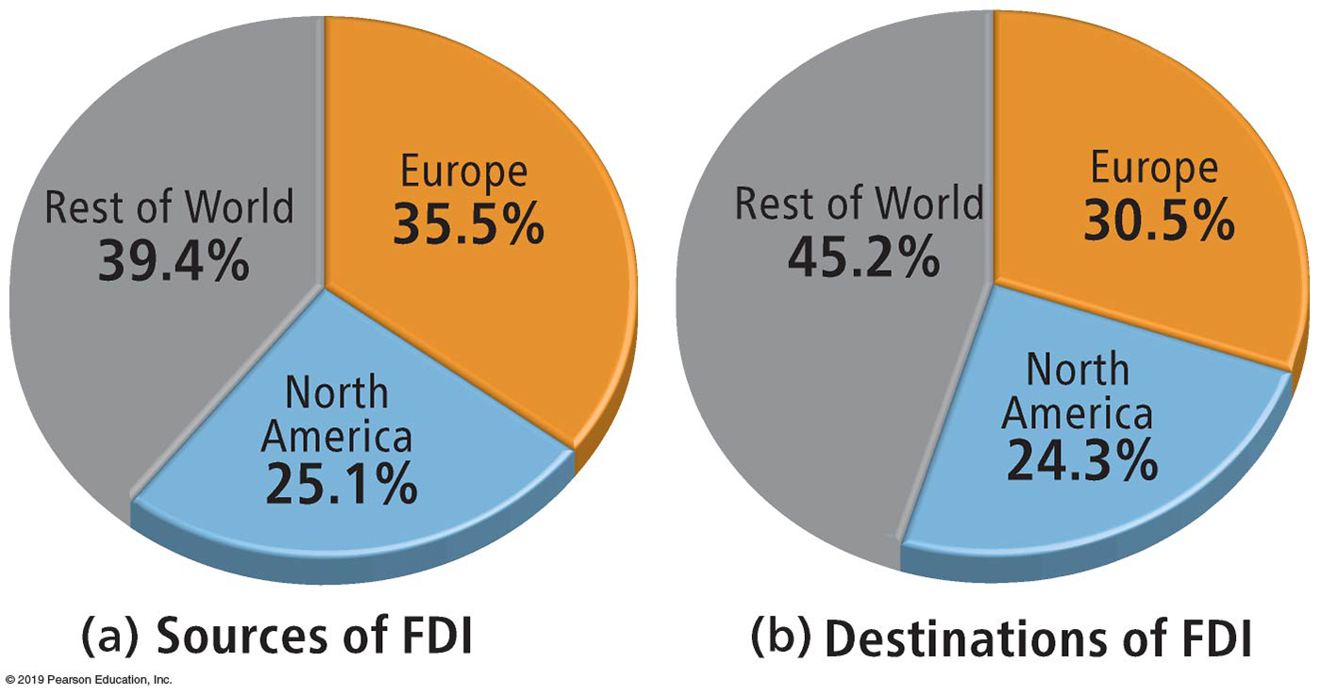
10.9 Financing Development (1 of 4)
Foreign Direct Investment
  Investment made by a company based in one country in the economy of another country is known as foreign direct investment (F D I).
  Foreign direct investment grew from $172 billion in 2002 to $646 billion in 2016.
  F D I does not flow equally around the world.
Notes:
Figure 10.9.1 GROWTH IN FDI
East Asia and Latin America have received the most FDI.
Figure 10.9.2 SOURCES AND DESTINATIONS OF FDI

Slide 34
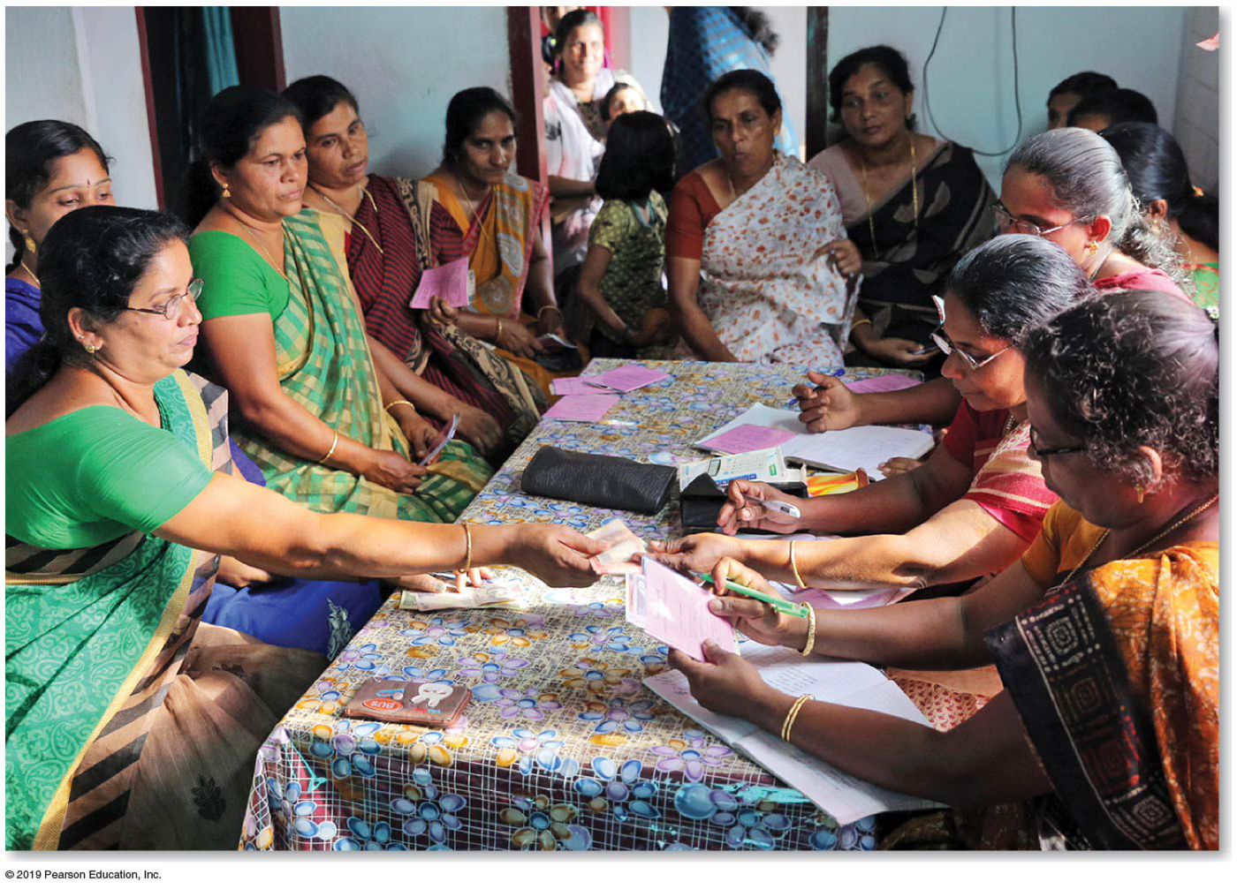
10.9 Financing Development (2 of 4)
Foreign Direct
  The major sources of F D I are transnational corporations that invest and operate in countries other than the one in which the company headquarters are located.
  An alternative source of loans is microfinance, which is provision of small loans and other financial services to individuals and small businesses in developing countries
Notes:
Figure 10.9.3 MICROFINANCE
The Peermade Development Society, Kerala, India, makes microloans to women trying to start small businesses.

Slide 35
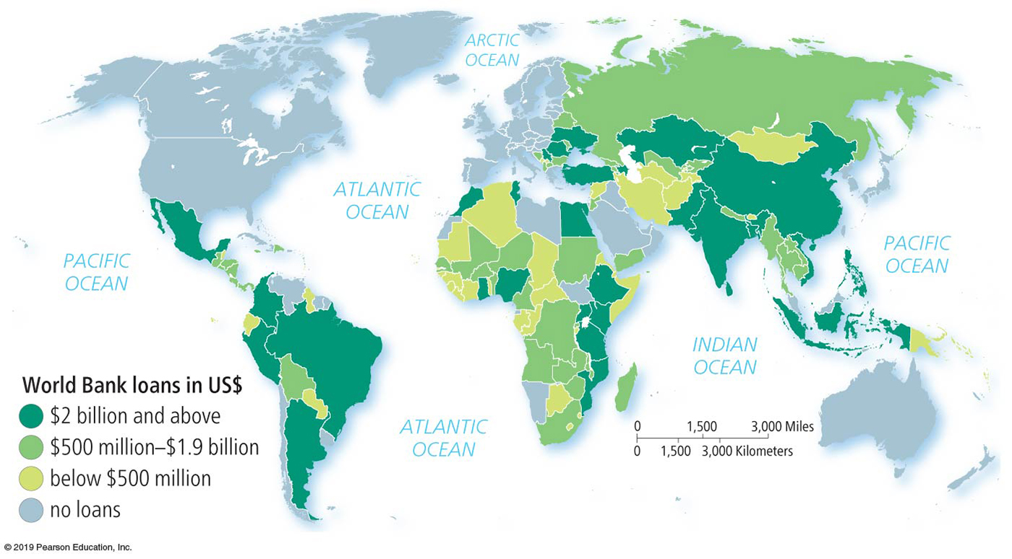
10.9 Financing Development (3 of 4)
Loans
  The two major lenders to developing countries are the World Bank and the International Monetary Fund (I M F).
  Developing countries borrow money to build new infrastructure, and in theory this will make conditions more favorable for domestic and foreign businesses.
  Half of the loans have gone to seventeen countries, including nine in Africa.
Notes:
Figure 10.9.4 WORLD BANK LOANS

Slide 36
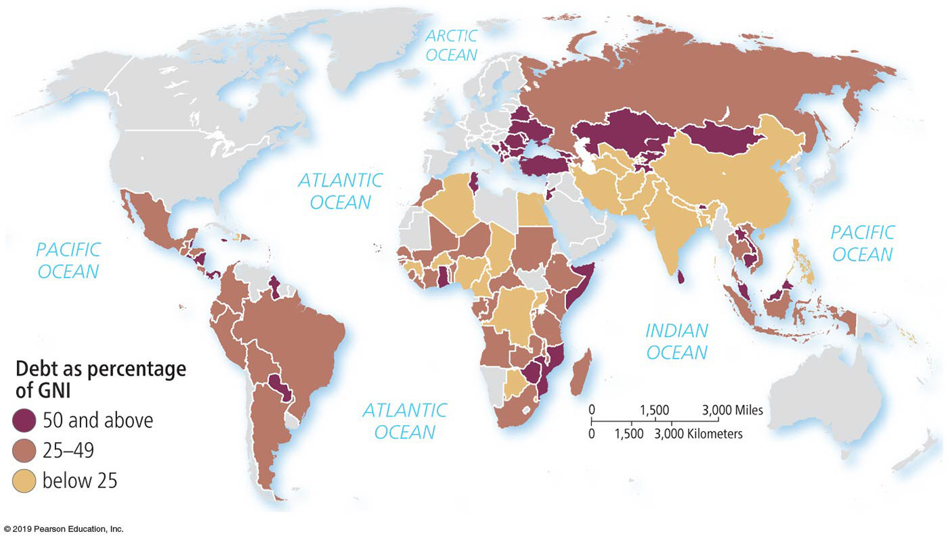
10.9 Financing Development (4 of 4)
Structural Adjustment Programs
  Some countries have had difficulty repaying their loans, especially those countries with very high debt compared to their G N I.
  To apply for debt relief, a developing country is required to prepare a Policy Framework Paper (P F P). The P F P outlines a structural adjustment program, a detailed plan of economic reforms (or “adjustments”).
Notes:
Figure 10.9.5 DEBT AS PERCENTAGE OF GNI

Slide 37
10.10 Fair Trade (1 of 4)
Fair Trade Producer Standards
  Fair trade is international trade that provides greater equity to workers and small businesses in developing countries.
  Critics of international trade charge that only a tiny percentage of the price a consumer pays for a good reaches the individual in the developing country who is responsible for making or growing it.
  In contrast, fair trade returns on average one-third of the price to the producer in the developing country.
Notes:
Figure 10.10.1 FAIR TRADE COFFEE BEANS, LAOS

Slide 38
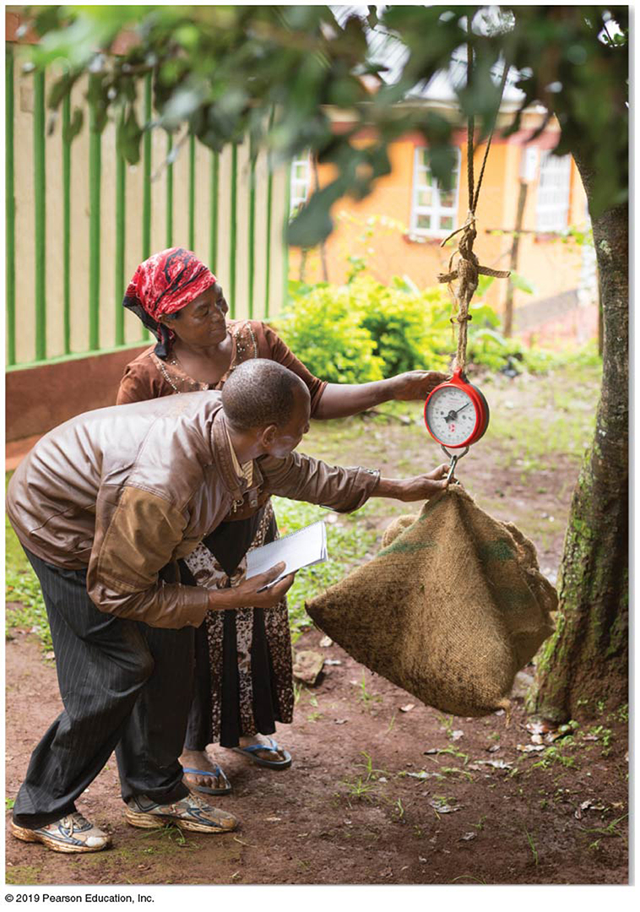
10.10 Fair Trade (2 of 4)
Fair Trade Producer Standards
  Fair Trade is a set of business practices designed to advance a number of economic, social, and environmental goals. These include:
    Raising the incomes of small-scale farmers and artisans by eliminating some of the middlemen.
    Promoting safe and sustainable farming methods as well as working conditions.
    Distributing the profits and risks to all in the supply chain.
    Increasing the entrepreneurial and management skills of the producers.
Notes:
Figure 10.10.2 FAIR TRADE MACADAMIA NUTS, KENYA

Slide 39
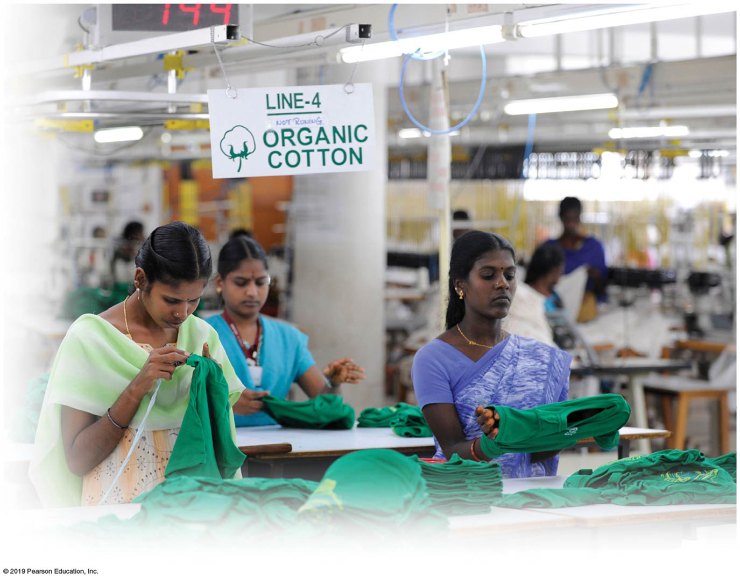
10.10 Fair Trade (3 of 4)
Fair Trade Worker Standards
  Fair trade requires that workers be:
    Paid fair wages, at least enough to cover food, shelter, education, health care, and other basic needs.
    Permitted to organize a union and to have the right to collective bargaining.
    Protected by high environmental and safety standards.
Notes:
Figure 10.10.3 FAIR TRADE TEXTILE FACTORY, TIRUPPUR, INDIA

Slide 40
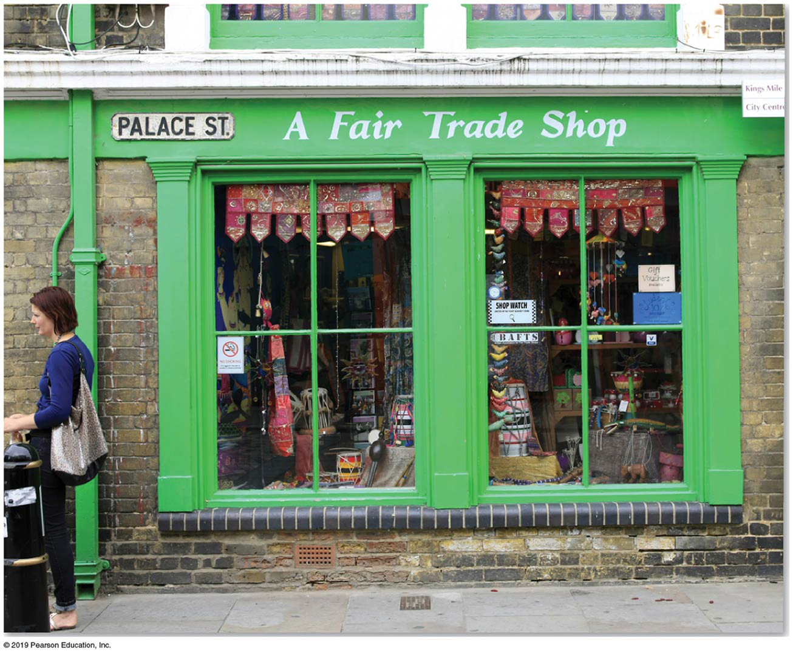
10.10 Fair Trade (4 of 4)
Fair Trade and Consumers
  Most fair trade sales are in food, including coffee, tea, banana, chocolate, cocoa, juice, sugar, and honey products.
  Buying fair trade products helps consumers connect more directly with the producers of the food, clothing, and household items that they buy.
  Fair trade products do not necessarily cost the consumer more than conventionally grown or produced alternatives.
Notes:
Figure 10.10.4 SHOP SELLING FAIR TRADE PRODUCTS, CANTERBURY, UNITED KINGDOM

Slide 41
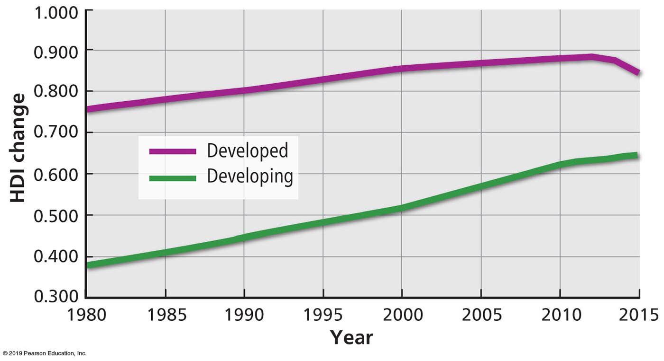
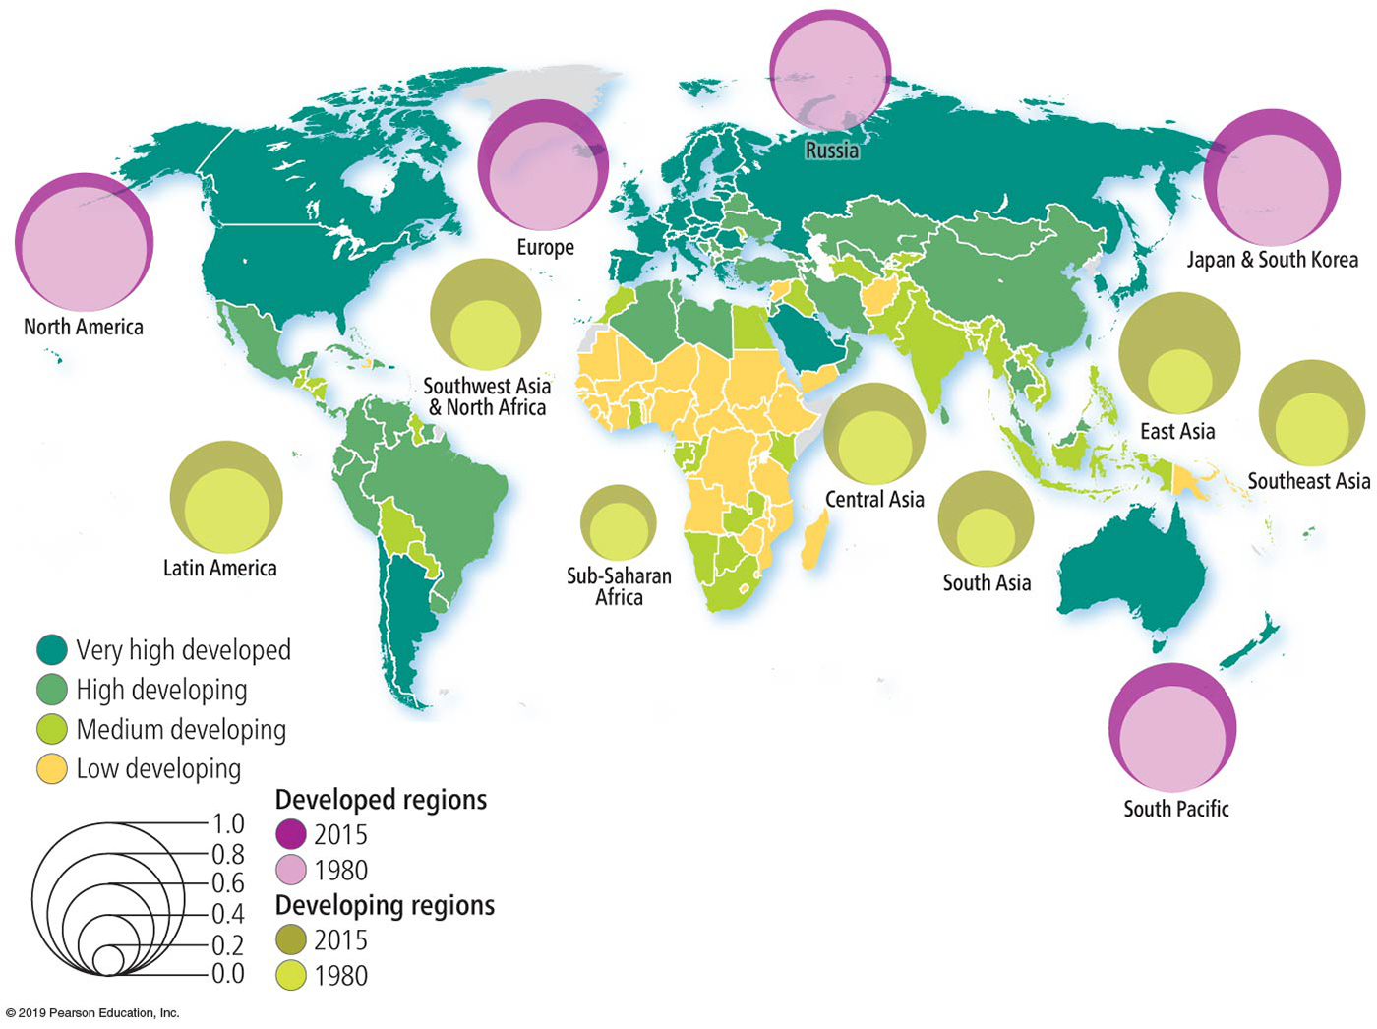
10.11 Progress in Development (1 of 2)
World Trade Organization
  The overall H D I score has increased by about the same level in developed countries and in developing countries.
  All regions have increased their H D I scores.
Notes:
Figure 10.11.1 CHANGE IN HDI
Figure 10.11.2 HDI CHANGE BY REGION

Slide 42
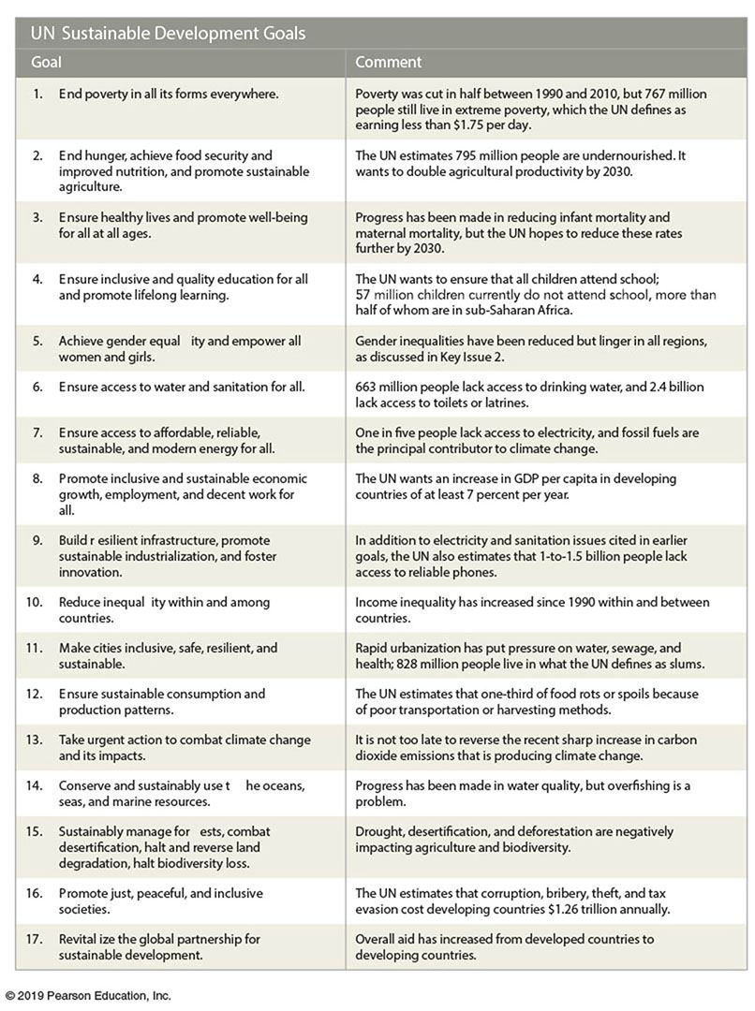
10.11 Progress in Development (2 of 2)
Sustainable Development Goals
  To reduce disparities between developed and developing countries, the 193 members of the United Nations in 2015 adopted 17 Sustainable Development Goals.
  The Sustainable Development Goals replaced eight Millennium Development Goals adopted in 2002.
Notes:
Figure 10.11.4 UN SUSTAINABLE DEVELOPMENT GOALS

Slide 43
Review Summary (1 of 2)
Key Issue 1 The U N’s Human Development Index (H D I) measures the level of development of every country. The H D I is based on three factors: a decent standard of living, a long and healthy life, and access to knowledge.
Key Issue 2 At least some degree of gender and economic inequality is found in every country. The inequality-adjusted H D I (I H D I) modifies the H D I to account for inequality within a country. The G D I measures the gender gap in the level of achievement for the three dimensions of the H D I. The G I I measures the gender gap in the level of achievement in terms of reproductive health, empowerment, and the labor market.

Slide 44
Review Summary (2 of 2)
Key Issue 3 To promote development, developing countries choose between self-sufficiency and international trade paths. In recent years, both developed and developing countries have expressed increasing concern with some of the consequences of the international trade path.
Key Issue 4 Most countries have a higher H D I now than in the twentieth century. The gap between developing and developed countries in life expectancy has narrowed, but the gap in income has increased. The U N has adopted 17 Sustainable Development Goals that it hopes all countries will achieve by 2030.

Slide 45

Copyright

