Slide 1
Analyzing Cultural Geography

Slide 2
Components of Culture
Art
Architecture
Language
Music
Film and Television
Food
Clothing
Social Interaction
Religion
Folklore
Land Use

Slide 3
Cultural Landscape
Signs and symbols can be seen within the different components of culture and can be used to understand that place’s cultural background and heritage
Most things in the cultural landscape are products of cultural synthesis (syncretism)
The blending together of two or more cultural influences

Slide 4
Art
Different art forms are signs of a cultural imprint on the landscape
Art can be an identifier of groups of people or as a source of local pride

Slide 5
Architectural Concepts
Modern and contemporary architecture
Architecture developed in the 20th century that expresses geometric designs
Contemporary architecture can feature green energy technologies, recycled materials, or non-traditional building materials
Traditional architecture
Two patterns in building type
Commercial buildings - Expresses the efficiency and simplicity of modern architecture in standard building design with square walls using traditional building materials
Housing - New homes today often incorporate more than one element of folk house design

Slide 6
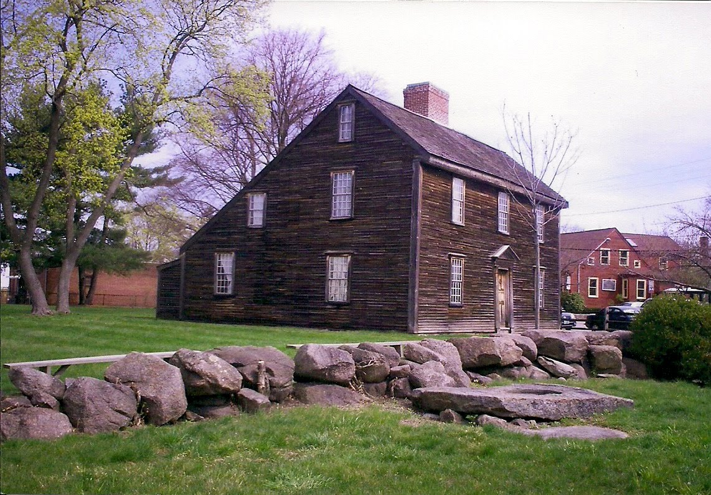
Housing Types - New England
Small one-story pitched roof “Cape Cod” style or the irregular roof “Salt Box” with one long pitched roof in front and a low-angle roof in back

Slide 7
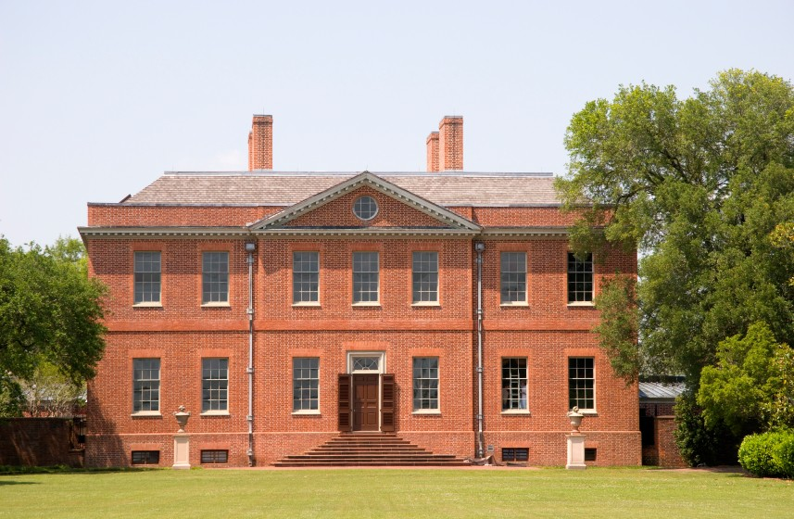
Housing Types - Federalist or Georgian
Housing style of the late 1700s and early 1800s in Anglo-America
Often two to three story urban townhomes connected to one another
Windows and rooflines feature classical Greek and Roman designs and stone carvings
Symmetrical homes with central doorways and equal numbers of windows on each side of the house

Slide 8
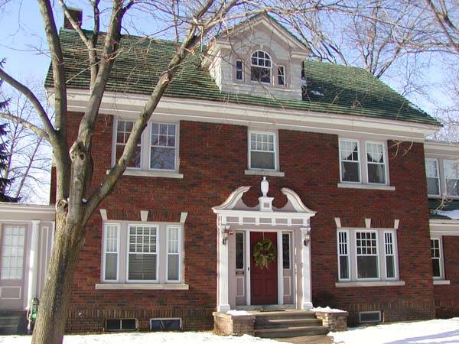
Housing Types - The I-House
A loose form of Federalist and Georgian influence on the average family home in the United States and Canada
Central door with one window on each side of the home’s front and three symmetrical windows on the second floor
As the style diffused westward, the rectangular shape and symmetry was lost
Later I-houses have the door moved to the side and have additions on the side of the house
Example of relocation diffusion
I-Houses have fireplaces on each end of the house and an even-pitched roof

Slide 9
Religious Architecture Covered
Christian
Hindu
Buddhist
Islamic
Judaic

Slide 10
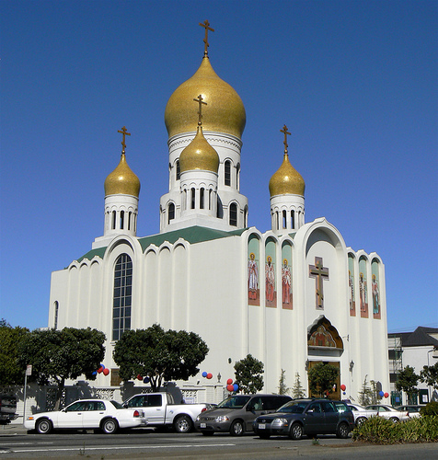
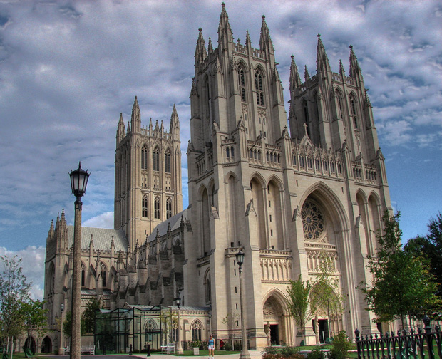
Christian Architecture
Usually have a central steeple or two high bell towers in the front of the building
Steeple is typical of smaller churches
Bell tower is typical of larger churches
Older churches, cathedrals, and basilicas feature a cross-shaped floor plan

Slide 11
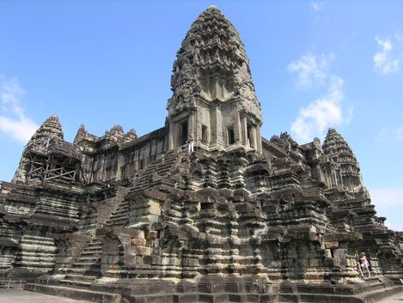
Hindu Architecture
Rectangular-shaped main body and have one or more short towers of carved stone
Often feature stepped sides and display carvings of the heads and faces of deities

Slide 12
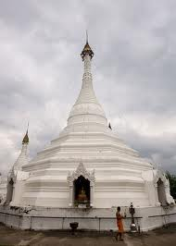
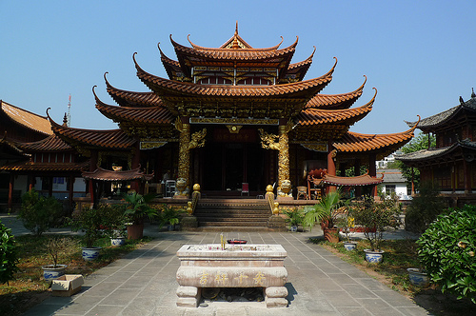
Buddhist Architecture
Temples and shrines vary depending on which Buddhist tradition is followed in the region
In Nepal and Tibet, a temple can be a stupa, with a dome or tower featuring a pair of eyes
In East Asia, the tower-style pagoda with several levels that each feature winged roofs extending outward is common
In China and Shinto Japan, there are one and two story buildings with large, curved, winged roofs
Temples are often guarded by large lion statues
Temples in Southeast Asia have several towers with thin pointed spires that point outwards at an angle

Slide 13
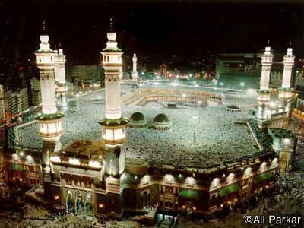
Islamic Architecture
Many mosques have central domes
A mosque has one or more minarets, narrow towers that are pointed on the top
Almost all mosques are built on an angle that places the main prayer area toward Mecca

Slide 14
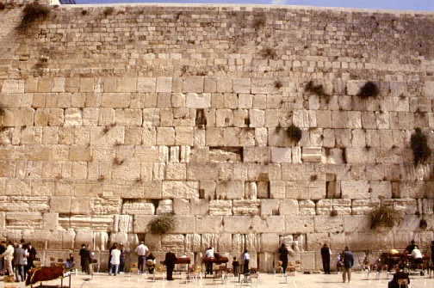
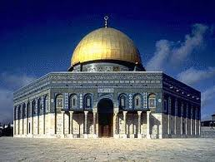
Judaic Architecture
There is not a common architectural design of synagogues
Most holy place in Judaism is the Western Wall(Wailing Wall) next to the Dome of the Rock

Slide 15
Language
The United States does not have an official language. Some states have English-only laws and provisions
Much of the United States is monolingual
Some states such as California have a large multilingual population and have made provisions to provide services in multiple languages
Canada is bilingual
English and French
The Netherlands and South Africa are examples of multilingual nations
Netherlands- Dutch, English, French, German
South Africa- English, Afrikaans, and one or more native African languages(Xhosa, Sotho, Zulu, etc…)
In a linguistic region, the way a language is spoken can sound different
English in Australia; same language, but different word sounds and vocabulary
Within countries, dialect can change from region to region

Slide 16
Cockney English
Cockney English is the language of the working-class areas of the East London docklands and surrounding neighborhoods
Thought to be very influential in the formation of Australian English
Cockney rhyming slang is an odd but humorous use of code phrases to describe everyday situations
“going up the apples” means going up the stairs; stairs rhymes with pears, apples and pears, therefore stairs is replaced with apples
I don’t know why!

Slide 17
Pidgin and Creole
Pidgin languages are simplified versions of the language that use key vocabulary words and limited grammar
Can evolve into their own language groups over time
French Creole in Haiti; incorporates French with African dialectal sounds and vocabulary
Pidgin and Creole are syncretic language forms that integrate both colonial and indigenous language forms

Slide 18
Lingua Franca
French has been a language used to bridge the linguistic gap between people of different national heritage
That is why “franca” is used
The global lingua franca is English as all media is dominated by the English language

Slide 19
Major Language Families and Dynamics
Indo-European(2.5 billion people)
Sino-Tibetan(1.4 billion people)
Afro-Asiatic(284 million people)
Austronesian(244 million people)
Dravidian(203 million people)
Niger-Congo(172 million people)
Altaic(128 million people)
Japanese(122 million people)
Korean(67 million people)
Each language family can be broken down into language groups
Some can be broken down into language subfamilies and then into smaller language groups
The Indo-European language family is originated from prehistoric migrations from the Indian subcontinent into Europe

Slide 20
The Anatolian and Kurgan Theories
Two competing theories regarding the origins of European language
Each have a hearth, or originating point
Anatolian Theory
A group of migrants from the Indian subcontinent and their language were concentrated in the peninsula that makes up most of present-day Turkey, known as Asia Minor or Anatolia
From there, a large migration crossed Hellespont into continental Europe and spread outward into Europe
Kurgan Theory
The same group of migrants from the Indian subcontinent instead made their way into Central Asia, and then migrated across the Eurasian steppe into Central and Western Europe
Almost all Europeans are genetically derived from populations that lived in the Indian subcontinent

Slide 21
Food
Continental cuisine is the formal food tradition that emerged from mainland Europe in the 1800s
Nouvelle cuisine is the contemporary form of the continental styles mainly from France, Spain, and Italy
Fusion cuisine is when more than one global tradition is incorporated in a dish

Slide 22
Religion
Also referred to as “belief systems” by social scientists
Universalizing religions accept followers from all ethnicities worldwide
Ethnic religions only accept members of a specific culture group
All organized religions have one or more books or scripture, said to be written of divine origin
Compromising religions have the ability to reform or integrate other beliefs into their doctoral practices
Fundamentalist religions have little or no interest in compromising their beliefs or doctrine and strictly adhere to scriptural dictates

Slide 23
World Religions
Three major traditions of belief systems-
Animist Tradition: Various ethnic, tribal, and forms of nature worship
Geographically unrelated and have common themes, worship practices, and morality tales
Hindu-Buddhist Tradition: Hinduism, Buddhism, Jainism
Began with Hinduism 5,000 years ago and polytheistic denominations spread through Asia by the 1200s C.E.
Many levels of existence, the highest being nirvana, where a being could achieve total consciousness or enlightenment
One’s soul is reincarnated repetitively into different forms
Karma determines the outcome of reincarnation into a lower, similar, or higher form of existence in the next life
Abrahamic Tradition: Judaism, Christianity, Islam
Share similar scriptural descriptions of the earth’s genesis and the story of Abraham as a morality tale of respect for the will of God or Allah
Monotheistic; can be sub-deities such as saints, angels, and archangels
Prophecy that predicts the coming or return of a messianic figure that defeats the forces of a satanic evil for souls of followers

Slide 24
Animistic Religions
Native American
Voodoun(Voodoo)

Slide 25
Native American
Who?
The pre-Columbian civilizations in the Americas
When?
From 18,000 years ago(last period of glaciation)
Where?
From Alaska to the Tierra del Fuego
Scripture
None
Spiritual interpretations are delivered by shamans(“medicine men”) who lead worship and religious rites
Doctrine
Depends upon tribal following
Prayers to sun, moon, and spirits are common
Denominations
Hundreds of different tribal interpretations
Historical Diffusion
By migration diffusion through the Americas

Slide 26
Voodoun(Voodoo)
Who?
West African; Afro-Brazilian and Afro-Caribbean descendants
When?
Prehistory to present
Where?
Nigeria, Benin, Ghana, Haiti, Cuba, etc…
Scripture
None
Based upon multiple deities that control various functions of the real world
Like Native American Animism, shamanism is part of the system of worship
Doctrine
Common practices attempt to bring worshippers in contact with deities and ancestors through various ceremonies, dance, and sacrificial practices
Denominations
Different depending on religion and influence from Christian worship by Voodoun followers
Historical Diffusion
From West Africa relocation diffusion by forced migration under European slavery

Slide 27
Hindu-Buddhist Religions
Jainism
Buddhism
Hinduism

Slide 28
Jainism
Who?
A fundamentalist interpretation of Hinduism
When?
2,900 years ago to present
Where?
Western India
Scripture
Several texts collectively under the name “Svetambara.” Most commonly cited is the Tattvartha Sutra
Doctrine
Complete respect for all animal life
Every living soul is potentially a divine god
Followers are strict vegetarian and often wear face masks to prevent inhalation of insects
Denominations
Three main groups
Historical Diffusion
Some Jain relocated to places such as Great Britain during the colonial period(1830s-1940s)
Mohandas Gandhi’s mother was a devout Jain
Her compassion for life influenced her son’s civil rights and peace activism

Slide 29
Buddhism
Who?
Ideological following that rejected the caste system and other Hindu practices
When?
2,500 years before present
Where?
Hearth in the Gangetic Plain of North Central India and spread throughout Asia
Scripture
Early Hindu texts combined with the Tipitaka(Pali Canon)
Tipitaka contains the life and teaching of Siddhartha Gautama, the founder of Buddhism
Doctrine
Different doctrinal texts including Tao Te Ching
Main difference from Hinduism is the belief that nirvana can be achieved in one lifetime
This is through an understanding of the effects of suffering on human life and the following of a “Middle Way” or non-extremist pathway toward enlightenment

Slide 30
Buddhism(continued…)
Denominations
Three distinct traditions broken into smaller regional and philosophical denominations
Tibetan(Vajrayana)
Universalizing, accepting westerners into their community but uncompromising in their beliefs
Southeast Asian (Theravada)
Less universalizing, does not compromise their traditions
East Asian(Mahayana)
Both universalizing and compromising
EX: Shinto, Confucianism, and Taoism
Historical Diffusion
Tibetan Buddhism relocated across the Himalayas and Tarim Basin desert to Siberia and Mongolia
Theravada relocated from Sri Lanka across the Bay of Bengal to Southeast Asia
Mahayana across the Himalayas to Eastern China

Slide 31
Hinduism
Who?
South Asians and some Southeast Asians
When?
Earliest forms; 7,500 years ago
Where?
Mainly India, but parts in Indonesia, London, Fiji, and South Africa
Scripture
Vedas, Upanishads, Bhagavad Gita, and other early Sanskrit religious texts
Doctrine
Work continuously with multiple reincarnations to achieve nirvana
Practice of temple based worship and festivals to praise particular supreme gods
Several writings depict historical moral traditions and practices
Denominations
Various are based upon cults to deities
Based on caste system
Historical Diffusion
Expansion diffusion from Hindu hearth in Northern India
Relocation diffusion across the Bay of Bengal to Southeast Asia and to Indonesia

Slide 32
Caste System In India
Hindu scriptures believe in a cosmology(belief in structure of the universe) in which there are several levels of existence, from the lowest animal forms to human forms then higher animal forms which are considered sacred by Hindus, such as cattle, elephants, and snakes
The levels are known as chakras
As a soul is reincarnated it can be elevated to a higher chakra if the soul has a positive karmic balance
Once someone is born into a caste, they are there for life, no matter how rich or poor he becomes
Five levels (Varna) within the human chakra that compose the Hinduistic Caste System

Slide 33
The Caste System
Brahmans
The priestly caste responsible for religious worship
Some can be selected as high government officials, others may become monks
Kshatriyas
The aristocratic and warrior class
Many are land owners, government leaders, or wealthy businessman
Vaisyas
The merchant class
Doctors, lawyers, accountants, etc…
Sudras
Tradespeople and farmer class
Broken up into hundreds of sub-classes or jati
Dalits
The “Untouchables”
Street sweepers, sewer cleaners etc…

Slide 34
Conclusion to the Caste System
Since India gained independence in 1948, its government has initiated efforts to eliminate the caste structure in Indian society
Opening schools to lower caste members, etc…
Caste differences in Indian cities has became minimal, but it is still recognized in rural India
Marriage still has an emphasis on caste, as most traditional parents desire their children to marry according to caste

Slide 35
Abrahamic Religions
Judaism
Christianity
Islam

Slide 36
Judaism
Who?
Jewish community
When?
Over 5,700 years before today. January 1, 2010 is year 5770 on the Hebrew calendar
Where?
Hearth in Israel, peripheral communities in Europe and the United States
Scripture
Torah and Talmud
Doctrine
Varies between groups
Shared between all is the atonement of sins annually during Yom Kippur and Rosh Hashanah
Denominations
Orthodox, Conservative, Reform, and Reconstructionism
Historical Diffusion
The Jewish Diaspora begins in 70 C.E. with the Roman destruction of the temple of Jerusalem, where Jews were forced to other parts of the Empire
Post-WWII era marks the beginning of the Jewish movement to Israel from Europe
Conflicts in 1950s and 1960s caused migrations from North Africa and the Middle East to Israel

Slide 37
Christianity
Who?
Originates in the Roman Empire but not officially recognized until the 4th century with the Edict of Milan
When?
Following begins around 30 C.E.; begins expansion outside the Mediterranean in the 6th century
Where?
Europe, the Americas, Sub-Saharan Africa, Philippines, Austronesia
Scripture
The Bible, divided into the Old Testament and the New Testament
Doctrine
Varies depending on denomination
Usually involve communion practices and baptisms
Denominations
Eastern Orthodox, Armenian, Greek Orthodox, Roman Catholic, Protestant, etc…
Historical Diffusion
From the Mediterranean hearth, Christianity diffused hierarchically to large cities such as Rome and Alexandria
From there missionaries spread the faith to other communities

Slide 38
Islam
Who?
Originates with the people of the Arabian Peninsula along the Red Sea
Particularly Mecca, Median, and Jeddah
When?
Early 600 C.E.
Where?
Asia, the Middle East, West Africa, Oceania
Scripture
Koran, the scriptures received by Muhammad
Doctrine
Haddith, the spoken word of Muhammad
The Five Pillars of Islam
Denominations
Sunni and Shia sects, also further divided
EX: Ismaili Shiite and Wahabi Sunni
Difference is because of the Shia necessity for Imams(religious leaders) that are direct descendants of Muhammad
Historical Diffusion
Islam diffused in all directions quickly
By 700 C.E., all of the Middle East and much of North Africa was adherent to Islam
Further expansion into Europe and Asia during through the 1600s

Slide 39
Islamic States: Theocracy, Sharia, and Secular Governance
Theocracies are where religious leaders hold the higher powers of governance
Some Middle Eastern states are republics or monarchies that abide by Sharia, Islamic law, based on the Koran and Haddith
Other states are secular
The state is not directly governed in a religious manner and instead utilize French or British legal tradition and government structure
A few examples:
Theocracy- Iran
Sharia States- Saudi Arabia, Kuwait, Yemen
Secular States- Jordan, Iraq, Egypt, Turkey

Slide 40
Syncretic Religions
Religions that synthesize the core beliefs from two or more other religions
Examples:
Druze
Christian and Islamic principles
Sikhs
Islam and Hindu principles
Reject caste-system

Slide 41
The Five Pillars of Islam
Moral code for all Muslims
Five Daily Prayers
Call to prayer
Work is stopped and prayer mats are unrolled
Prayer is facing Mecca
Islamic Creed
“There is only one god, Allah, and Muhammad is his prophet.”
Monotheism
Islam believes in the some of the same prophets that Christianity believes in such as Moses, Ishmael, and Jesus
Alms to the Poor
Donate to the poor and sick
Help alleviate poverty, extend health care, and educate children
Observation of Ramadan
A period of spiritual cleansing and repentance for past sins
Fasting during daylight hours
Set on a lunar calendar
The Hajj
The pilgrimage to Mecca that must be completed at leas t once during a Muslim’s lifetime
Popular time is during Ramadan

Slide 42
Folklore
The collected stories, spoken-word histories, and writings that are specific to a culture and tell history and morality tales that define a culture’s ethical foundations

Slide 43
Nation and Ethnicity
A nation is basically a population represented by a single culture; can also be called a culture group
A common identity defines a nation
A complex of genetic heritage and political allegiance embodied in the term ethnicity
Ethnic groups often claim a single identifiable lineage or heritage
Several ethnicities can exist within the same linguistic group
Several languages can exist within the same ethnicity
French Canadians
South Asian Indians
Ethnicity can be modified in migration

Slide 44
Race
Ethnicity represents the national heritage of an individual
Race refers to the physical characteristics of a common genetic heritage
The concept of race was developed by physical anthropologists in the 1800s
Race is a social construct
Researchers categorized racial groups based on a number of variables including skin color, bone structure, and the shape of hair shafts(straight, wavy, curly)
These scientific ideas are the basis of racism

Slide 45
Racial group physiology
Three racial groups emerged from this research
Mongoloid or Asiatic
Tan or yellowish skin tone, small body structure, and straight hair shaft
Caucasian or Indo-European
Light to dark skin tone, medium body type, and wavy hair shaft
Negroid or African
Dark skin tone, medium body shapes, and a curly hair shaft

Slide 46
The Pacific Islands
Four small populations of physical anthropological groups were identified
Melanesians
New Guinea, New Caledonia, and Fiji
Dark skin coloration, thin bodies, curly hair shaft
Polynesians
Tonga, Samoa, New Zealand, Tahiti, and Hawaii
Lighter brown skin color, heavyset body shape, curly hair shaft
Micronesians
Marshalls and Caroline Islands
Light brown skin color, medium body shape, and curly hair shaft
Aboriginals
Australia
Light brown skin, a medium body type, and a wavy hair shaft

Slide 47
Environmental Determinism
Human geographers developed the concept of environmental determinism to explain cultural differences around the world
“The former scientific ideology that states a culture’s traits are defined by the physical geography of its native hearth or cultural region”
Friedrich Ratzel, the father of Human Geography, and his students built a large body of research claiming that all aspects of culture were defined by physical geographic features
Nations were like organisms and territory was a source of nourishment
Different races and culture groups are essentially the same physiologically, and each can survive in a manifold of climates and environments

Slide 48
The Determinism Debate and Possibility
Despite global elimination of slavery in the late 1800s, racism and environmental determination were widely accepted
To change the human perspective, geographers including Carl Sauer opposed the environmental determinists
Possibilism was the revised concept proposed by geographers
This ideology stated that cultures were partially shaped by their environment and resources available to them.
However, cultural groups have the ability to modify their environment!
In many cases, cultures made modifications to the landscape to meet their agricultural needs, thus destroying the natural environment.

Slide 49
Nazism and Determinism
The concepts of Nazism proposed by Hitler in the 1920s and later ratified in the 1930s were partially based on Ratzel’s concept of lebensraum, in which the living space for each distinct nation was based upon the optimal physical geography of the culture group.
Lebensraum = “living space”
Despite Germany’s defeat in WWII, Nazi ideologies still exist among extremist groups in the US and Europe
This Neo-Nazism isn’t based upon lebensraum or ethnicity, but violent racism in the form of xenophobia, the fear of outsiders

Slide 50
Internal and External Identity
Internal identity is used by individuals to express their cultural heritage, ethnicity, or place of origin to people who do share their heritage or place of origin
External identity is used to express cultural heritage, ethnicity, or place of origin to people who do not share a common cultural or geographic background

Slide 51
Ties to Ancient Cultural Hearths
Cultural Hearth | Staple Food | Civilizations
Nile River | Wheat | Ancient Egyptian
Mesopotamia | Wheat | Sumerian, Assyria, Babylon
Indus Valley | Wheat | Harappan
Mesoamerica | Corn | Olmec, Maya, Aztec
The Andean Highlands | Potato | Inca
Northeast China | Rice | Ancient Chinese
West Africa | Yams | Malian, Songhai

Slide 52
Sequent Occupance
A single place or region is occupied by different cultures that replace each other over time
When examining cultural landscapes, remnants of previous cultural influences remain
EX: New York City; once under British colonial rule, under Dutch rule, under Native American rule

Slide 53
Acculturation and Assimilation
Acculturation- the process of adapting to a new culture while keeping some of one’s original culture
Assimilation- the complete change in the identity of a minority cultural group as it becomes part of the majority cultural group

Slide 54
Cultural Survival
National cultures have historically been threatened by outside influences such as invasions, migrations, or decline of the indigenous culture
Indigenous- people who were the original occupants of a place or region
Cultures are in danger of extinction if something is not done to help protect and promote the preservation of cultural heritage
Cultural survival is used to describe the efforts to research, understand, and promote the protection of indigenous cultures
Indigenous cultures are important to their people, representative governments, and researchers

Slide 55
Cultural Globalizations
Influences such as literature, filmography, and the Internet, mainly from English sources diminish and can eliminate the media and culture of other linguistic groups.
When people are fully emerged in globalized culture, they are often ignoring their own culture
Traditions can be forgotten and lost. People are also losing their connection to nature.
This can leave people feeling disconnected to the natural world and humanity, causing social and physiological problems
By protecting national cultures from the negative effects of globalization, a nation can promote its own cultural economy and products from creative arts and media.
Basic level- artistic products can draw tourism
Advanced level- media industries can generate large profits for its country.
EX: Bollywood
Some governments have written laws to lessen the impact of foreign influence on their home culture.
EX: France, Bhutan (limited tourism)

Slide 56
Yugoslavia
Yugoslavia was created as a state during the post-WWI Treaty of Versailles in 1919.
This part of the Balkan peninsula contained many overlapping ethnic regions.
Following the death of Communist leader, Josep Tito, no individual group or person was in control of Yugoslavia.
After his death, Yugoslavians began to revitalize their ethnic and religious arguments.
The Croats are Roman Catholic and the Serbs are Eastern Orthodox.
In 1989, fighting broke out between these groups. Croats forced Serbs out of Serbian enclaves in Croatia and the Serbs did the same to the Croats
This is the first mention of ethnic cleansing
This war was stopped by the Dayton Peace Accords

Slide 57
Genocide
The massive systematic scale of killing people of one ethnic group.
Examples include:
The Holocaust
Rwanda
Darfur

