Slide 1
Visualizing Human Geography: At Home in a Diverse World
Second Edition
Alyson Greiner
Chapter 6
Geographies of Identity: Race, Ethnicity, Sexuality, and Gender

Slide 2
Race and Racism

Slide 3
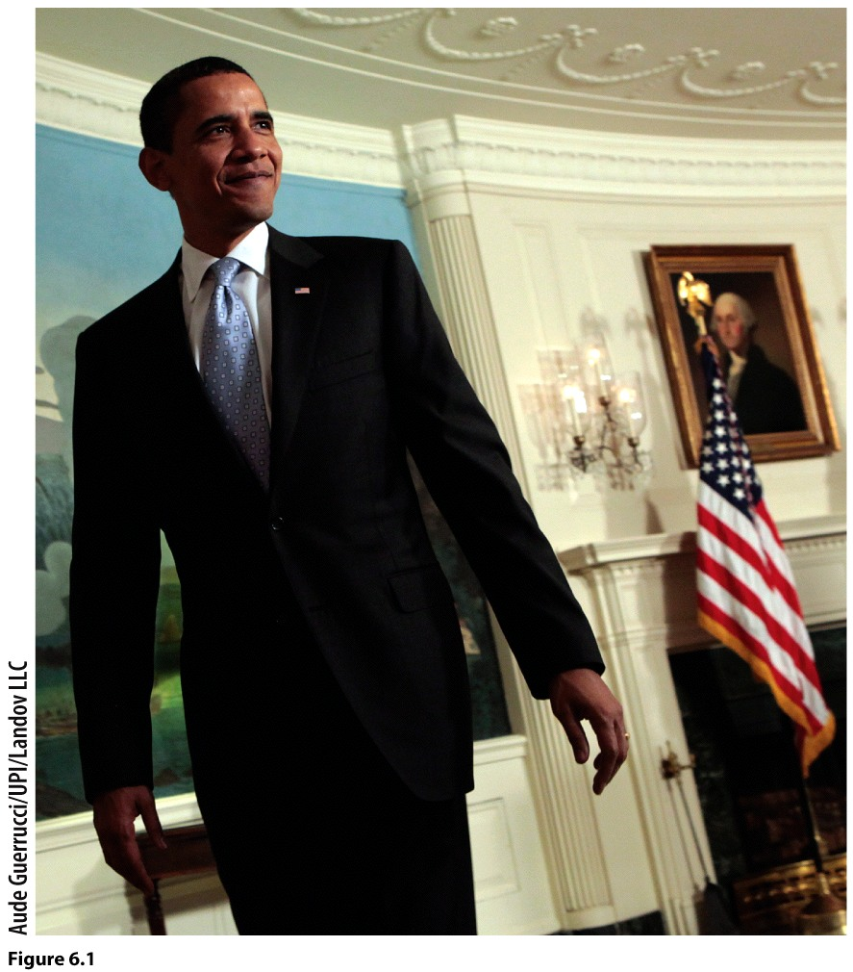
What is Race?
Race: The mistaken idea that one or more genetic traits can be used to identify distinctive and exclusive categories of people; hence, race is today understood to be a social construction.

Slide 4
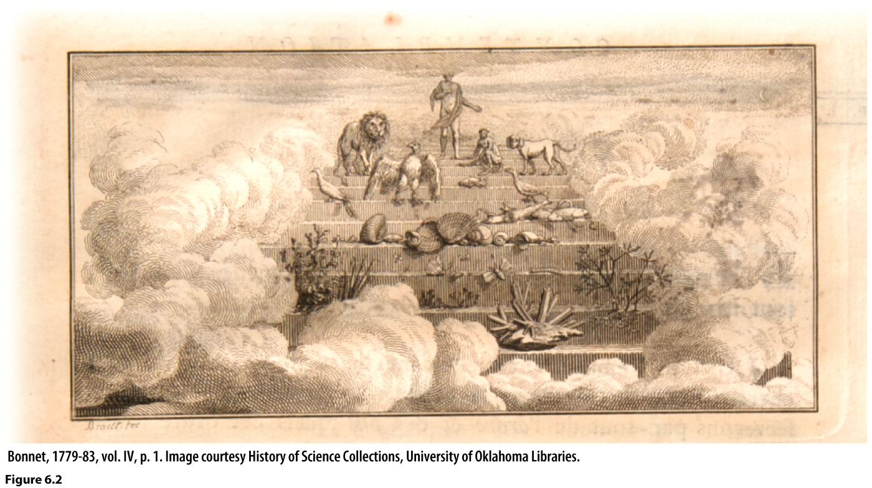
How Has Racism Developed?
Racism: The intolerance of people perceived to be inherently or genetically inferior.
Ideology: A system of ideas, beliefs, and values that justifies the views, practices, or orientation of a group.
The Great Chain of Being
Notes:
The great chain of being is based on the idea that there is a natural and ranked order of life in the world, stretching from aquatic life at the bottom up to the heavens. If the broad classes of living things were ranked, it followed that the members of those classes could be ranked as well. Visible differences including skin color were used to distinguish among different ranks and races of people.

Slide 5
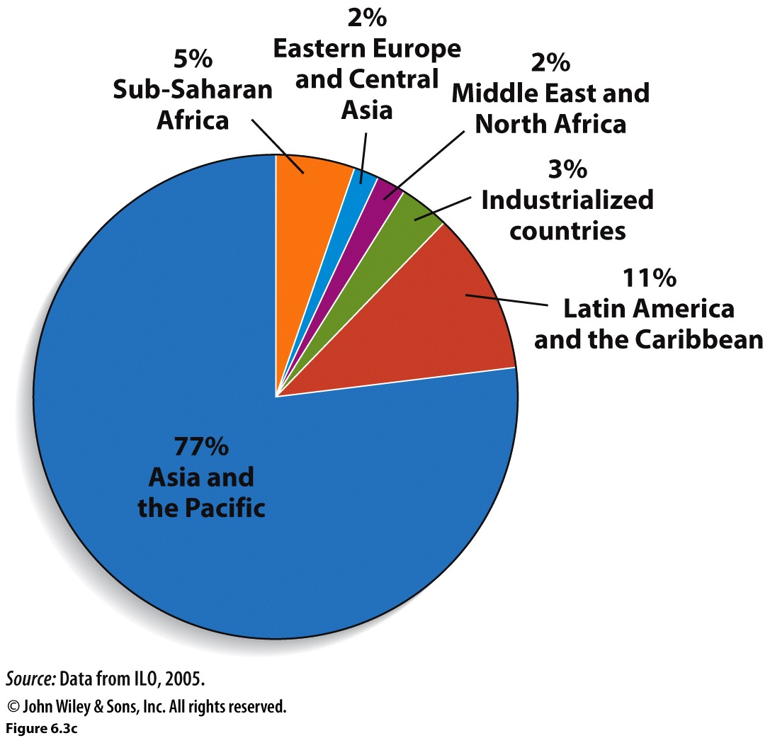
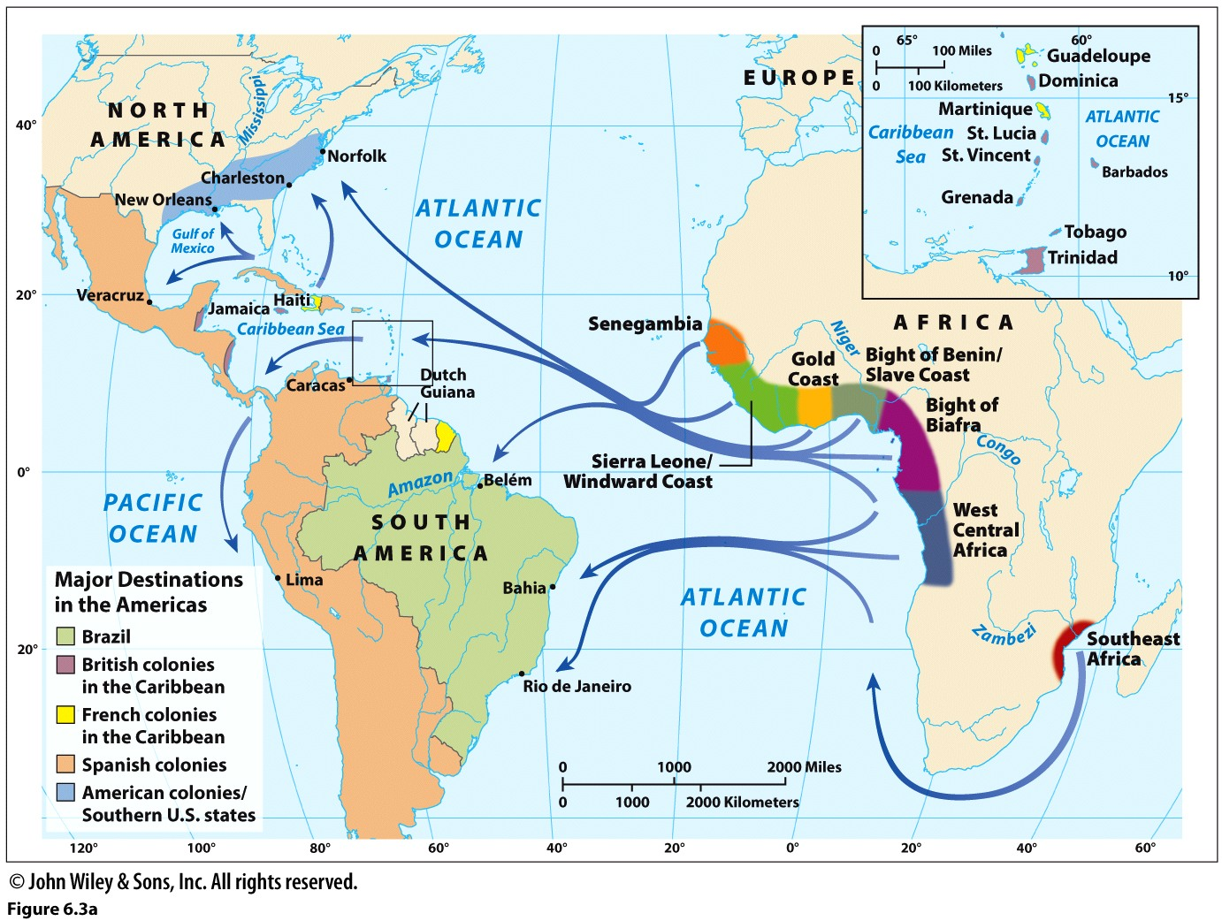
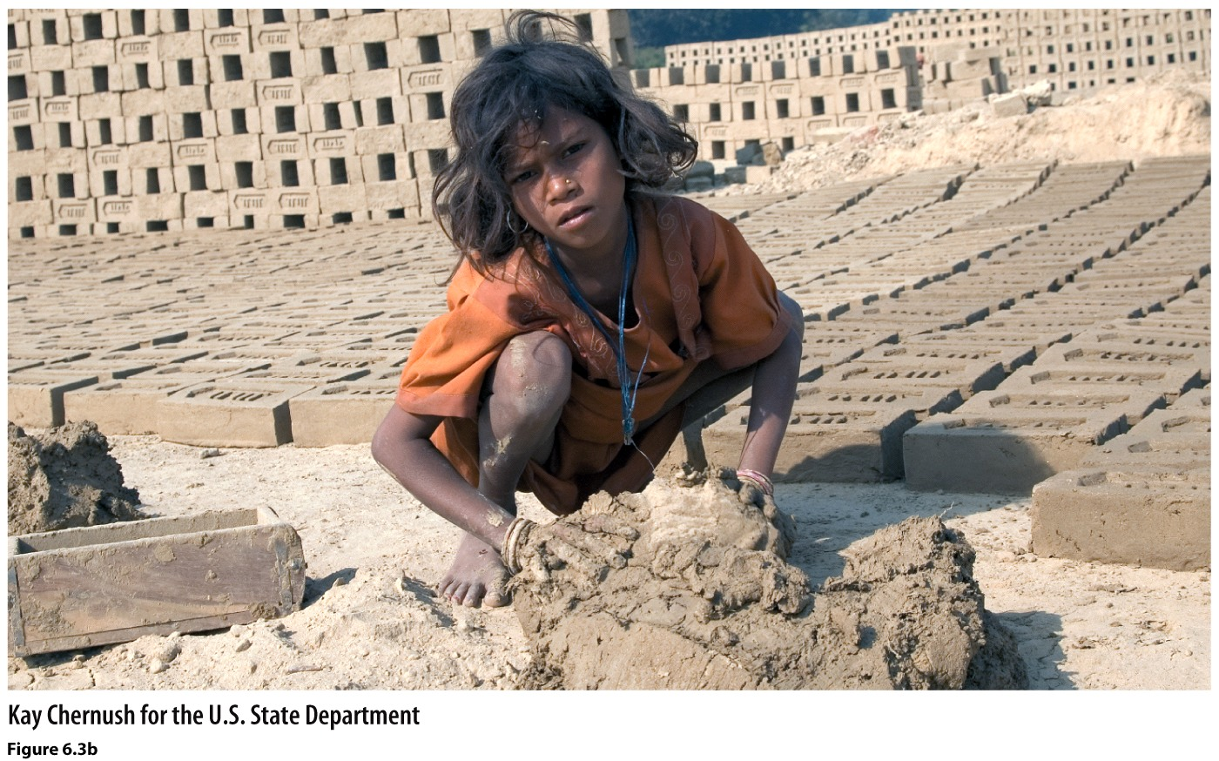
Historical and Contemporary Geographies of Slavery
Human Trafficking
Notes:
(Map) Generalized origins and destinations of African slaves The map, with arrows resembling on- and off-ramps, shows the highway that the Atlantic Ocean became as a result of the slave trade between the 16th and 19th centuries. Brazil and the Caribbean were the leading destinations of African slaves. Two factors that sustained the trans-Atlantic slave trade were the strong demand for labor in the Americas and the increasingly common view that racial categories were natural.
(Chart) Estimated number of forced laborers, by region Forced labor is regionally most prevalent in Asia, in part because of enduring systems of bonded labor. Perhaps 12 million people work as forced laborers worldwide—as many people as were transported to the Americas as slaves. Workers are recruited with the promise of high wages, but once employed those promises are broken and laborers are forced to work with threats of penalty or harm.
(Photo) Bonded and forced labor In India, this young girl and her family were trafficked and work as bonded laborers at a brick-making factory. Bonded labor means that the employer has a long-term lease for your services because of a debt that is owed. Often a family’s debt is passed on from one generation to the next, creating a vicious cycle of debt slavery.

Slide 6
Geographies of Race and Racism
Notes:
6

Slide 7
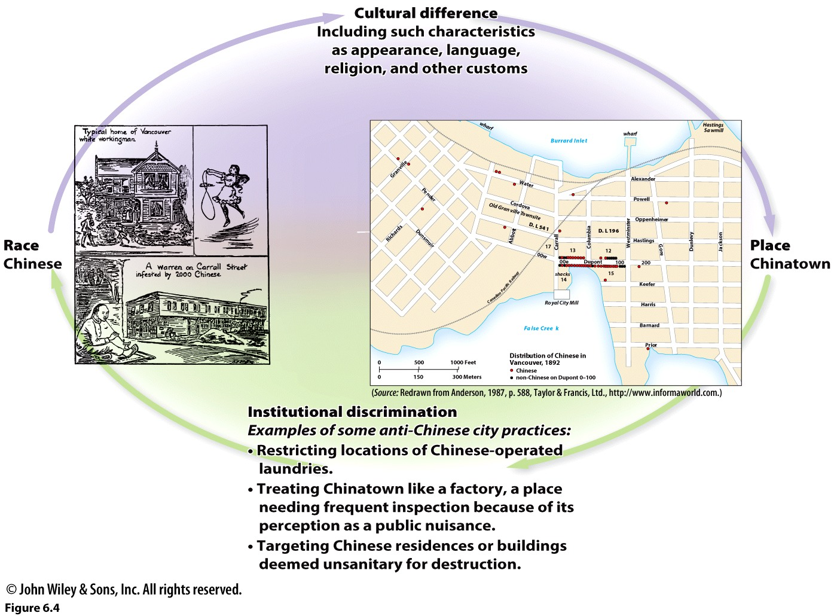
Race and Place in Vancouver’s Chinatown
Institutional Discrimination: A situation in which the policies, practices, or laws of an organization or government disadvantage people because of their cultural differences.
Notes:
One of the key contributions of Kay Anderson’s research on Vancouver’s Chinatown from the 1880s to the 1920s is her demonstration of the mutually reinforcing processes of how race makes place and place makes race. Today, Vancouver’s Chinatown is widely perceived to be a popular destination and downtown attraction.
Race makes place Observable differences reinforced the perceived distance between whites mainly of European descent, and the area where Chinese settled was called Chinatown. This 1907 newspaper illustration depicts Chinatown as an opium den and unsanitary place. In actuality, some Chinese operated laundries, the “business of cleanliness,” according to Anderson (1987, p. 586), and Chinatown was not a center of epidemics.
Place makes race The stigmatization of Chinatown as a socially troubled area influenced the actions of Vancouver’s civic leaders, who sought to contain and control Chinatown’s “problems” through city rules and regulations. To say that place makes race means that perceptions of Chinatown reinforced racialized views of the Chinese as a different breed of people who needed to be spatially separated and monitored.

Slide 8
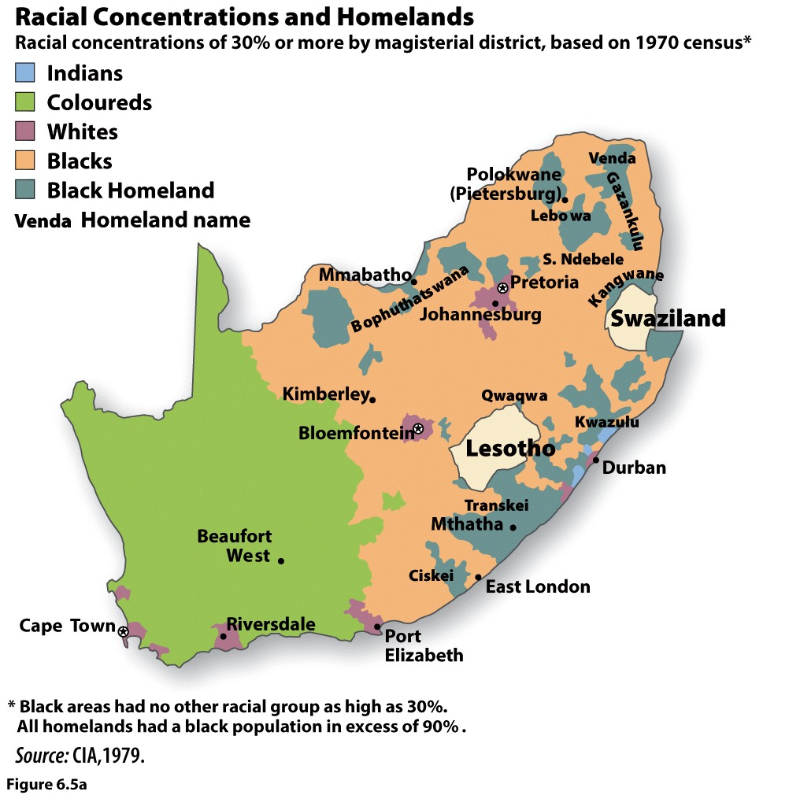
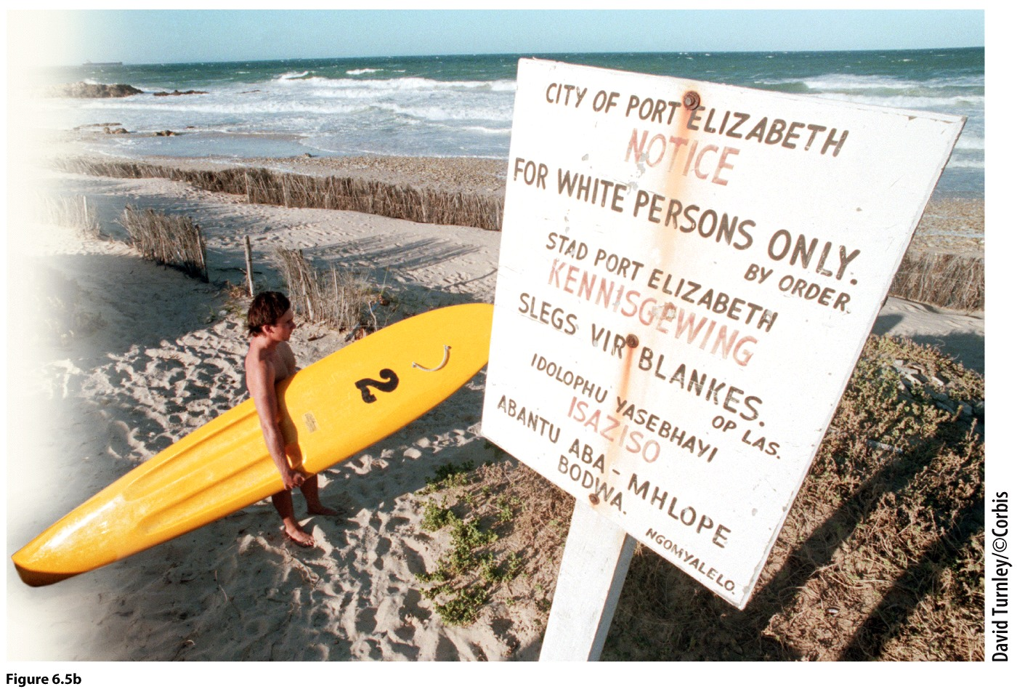
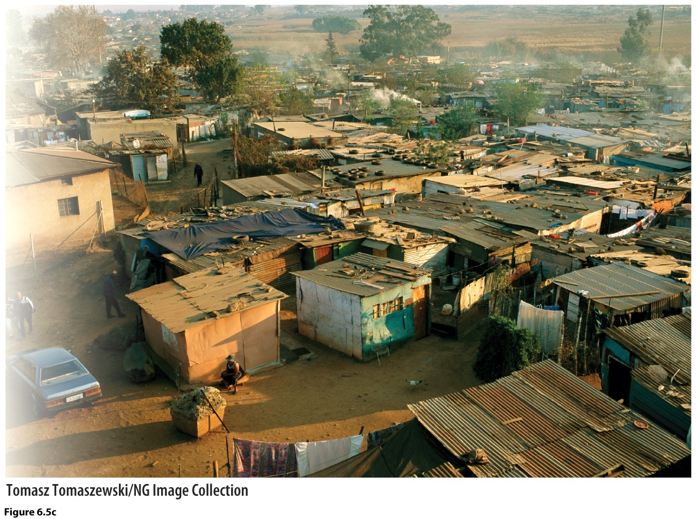
Geographies of Apartheid
Apartheid
Boers, Afrikaners
Coloured
Baskaap
Notes:
(Map) Grand apartheid Designed as a comprehensive system, apartheid operated on two spatial scales. At the national scale there was grand apartheid, intended to separate population groups territorially. Legislation authorized the creation of black homelands, called Bantustans.
(Left) Petty apartheid Petty apartheid operated at the individual scale and resulted in segregated public facilities, including restrooms, drinking fountains, schools, and beaches.
(Right) Townships Achieving complete physical segregation in cities proved to be complicated and unreasonable because of labor needs. Many blacks were employed by whites as housekeepers, while many others worked in construction. Therefore, black residential areas, called townships, formed on the outer edges of South African cities. Still in existence, these townships are, in effect, slums.

Slide 9
What is Ethnicity?
Notes:
9

Slide 10
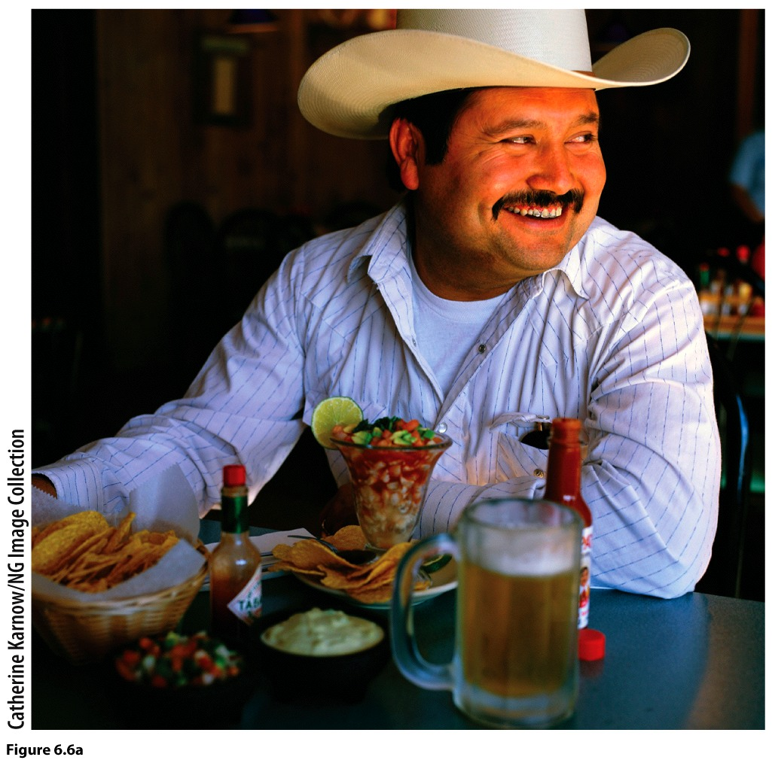
Defining and Characterizing Ethnicity
Othering
Ethnicity: The personal and behavioral basis of an individual’s identity that generates a sense of social belonging.
Nationality vs. Ethnic Group
Ascription
First peoples
Notes:
DISCUSSION QUESTION: To what extent are your food preferences an expression of your ethnicity?

Slide 11
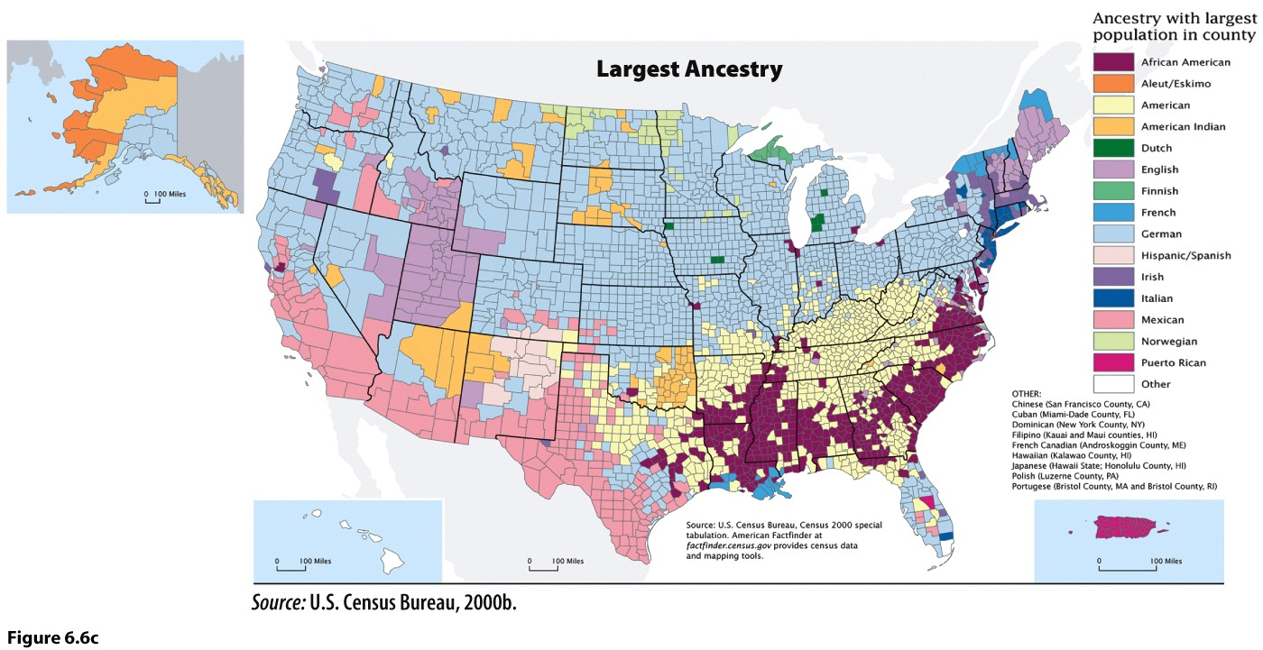
Ethnicity and Ancestry
Notes:
This map shows the ancestral “roots” of the U.S. population based on census data. Note how widespread German ancestry is. Identification of an “American” ancestry may stem from the fact that a person’s forebears have been in the country for several generations, or their ancestors are so diverse that making a selection is impractical or not suitable.

Slide 12
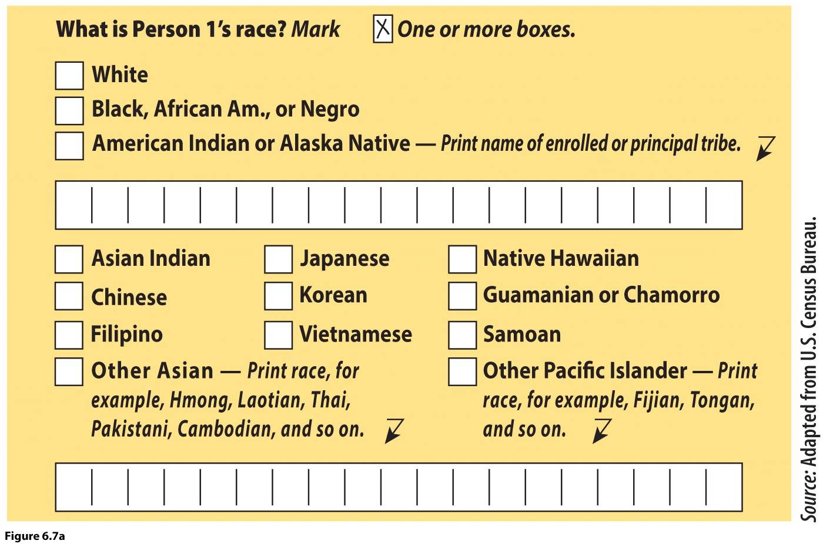
Ethnicity, Race, and the Censuses
Discourse: Communication that provides insight on social values, attitudes, priorities, and ways of understanding the world.
How does the discourse of the U.S. Census reinforce and legitimizes certain ways of thinking about race and ethnicity?

Slide 13
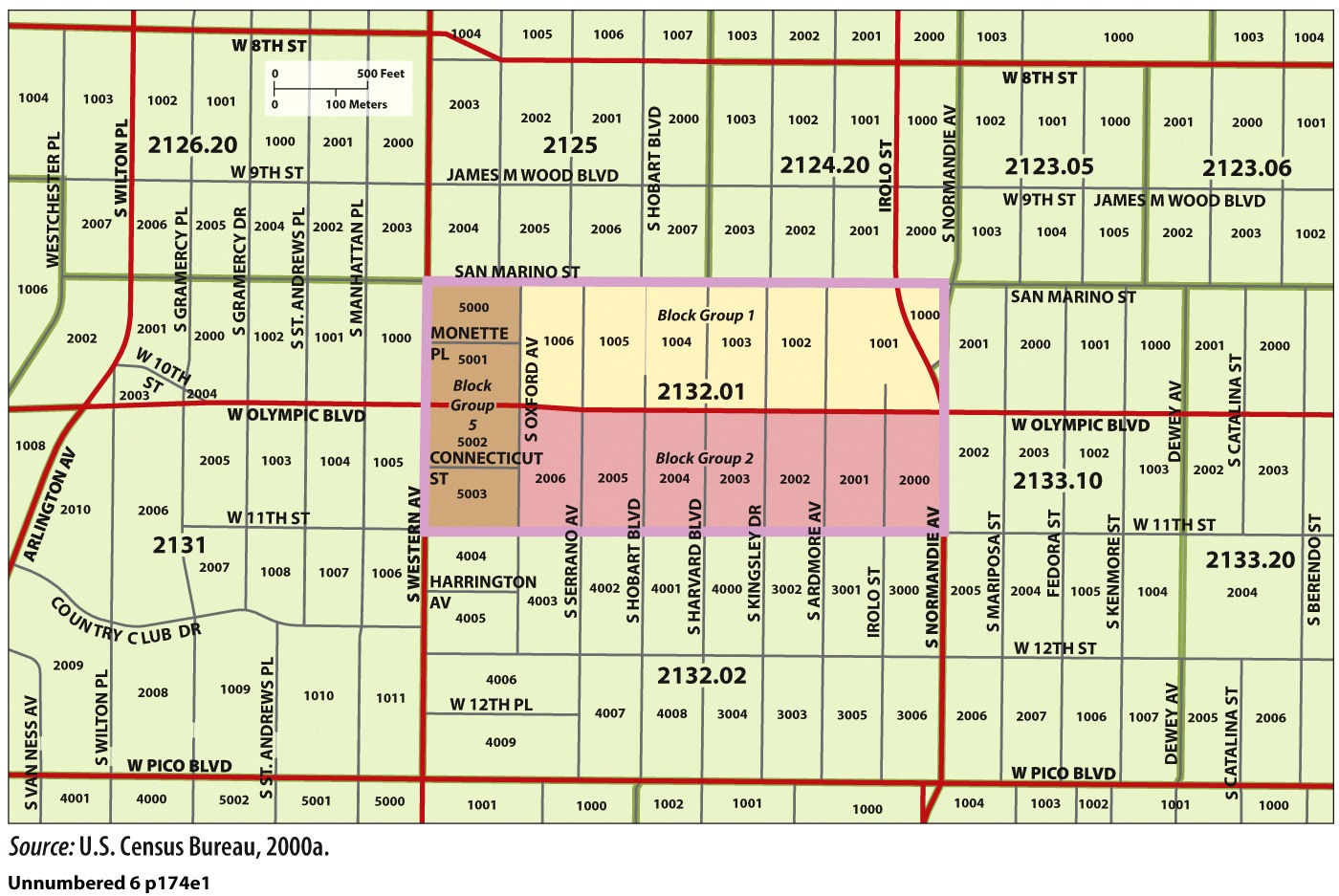
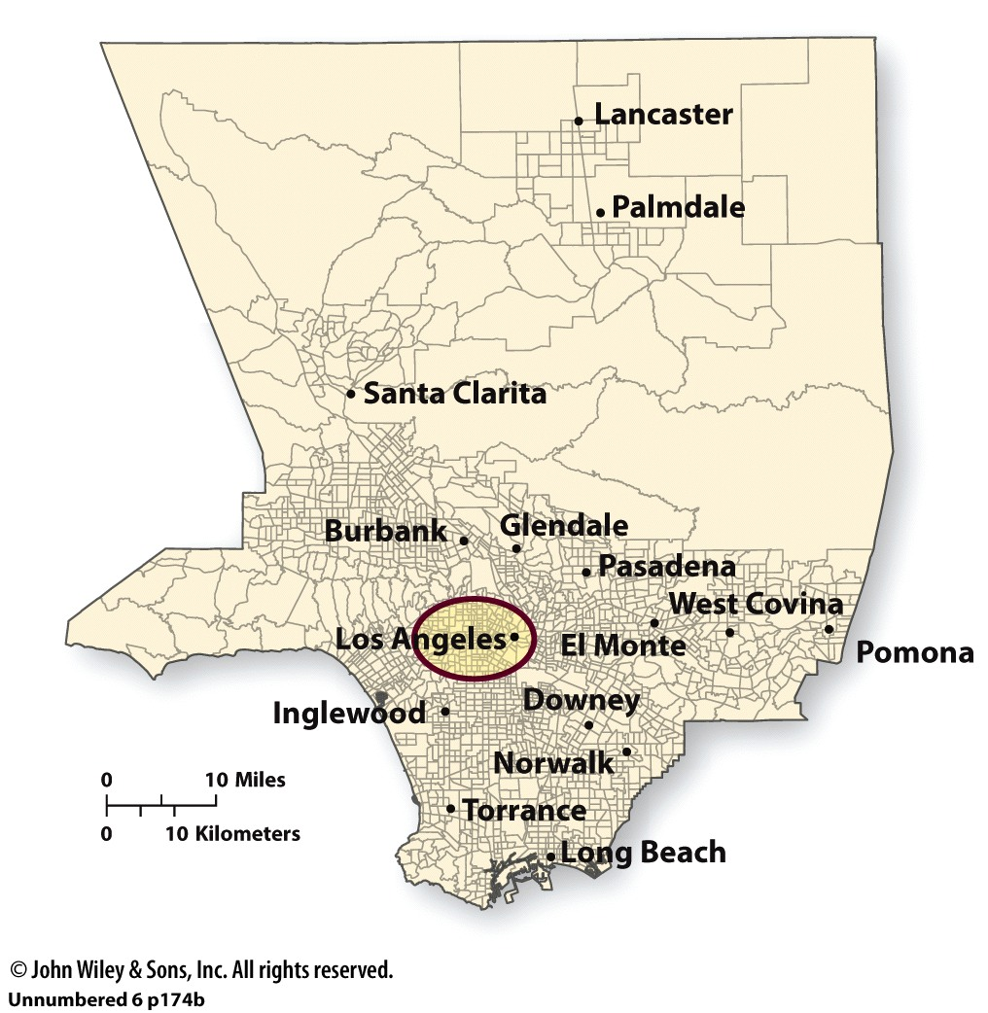
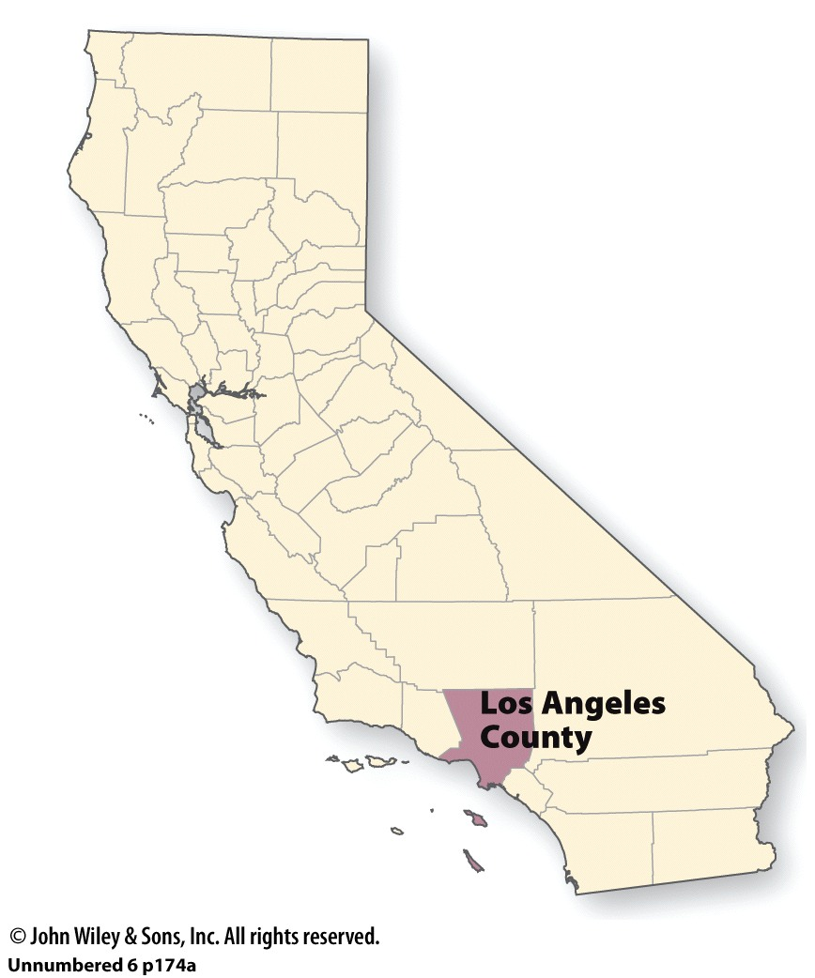
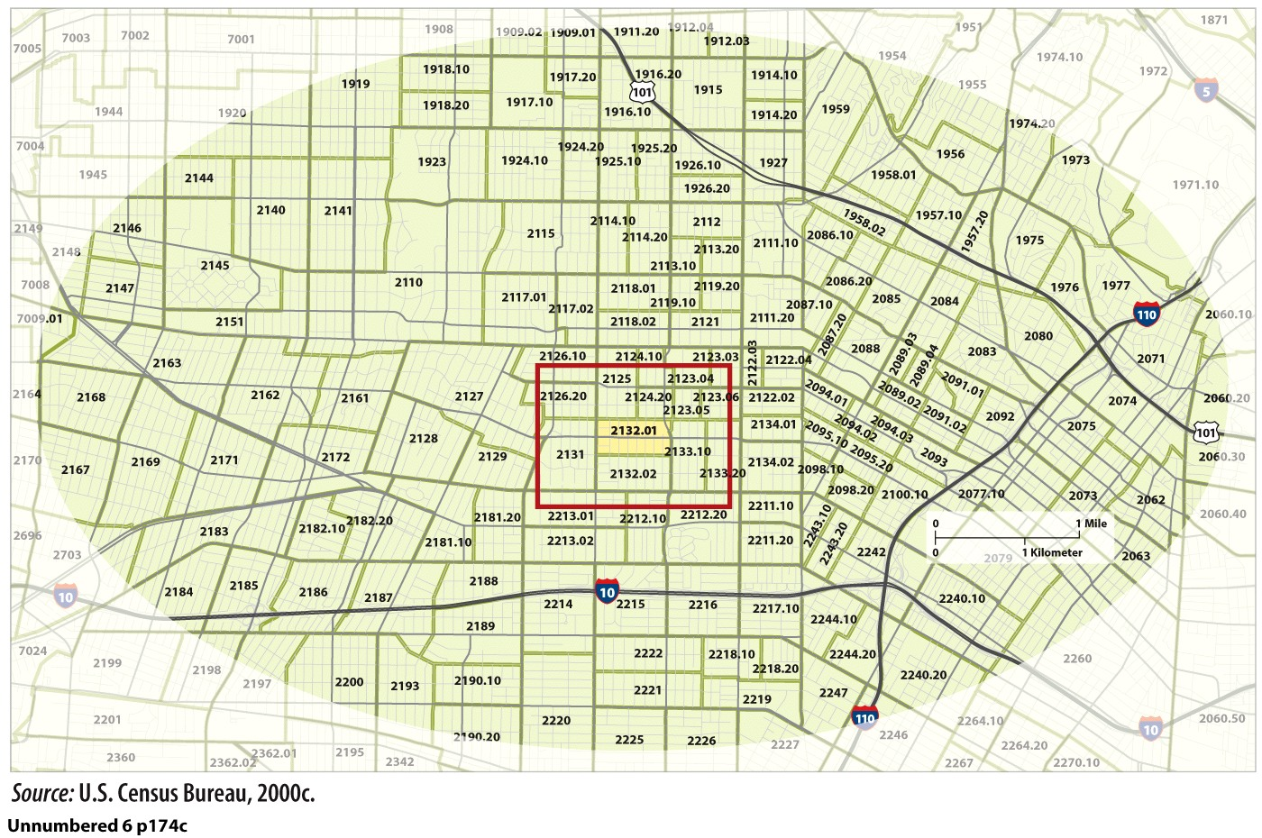
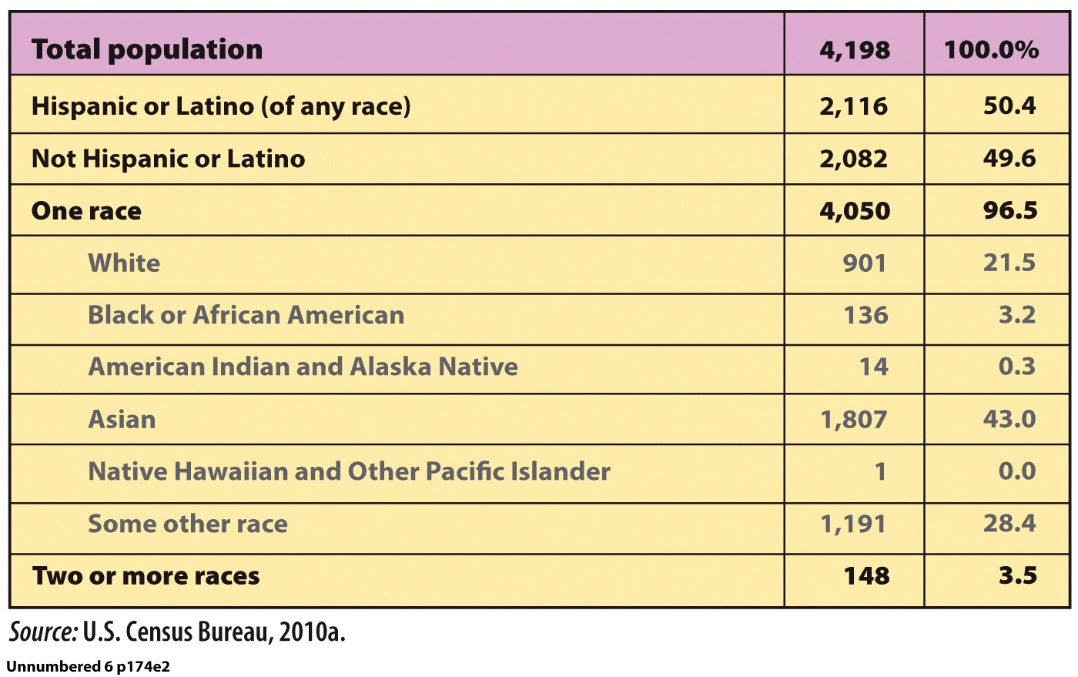
What a Geographer Sees: U.S. Census Geography
Why has the United States historically defined African-Americans and Native Americans by using different criteria?
Notes:
Many geographers use U.S. Census Bureau data in their work. Effective use of this information requires knowledge of the geographic areas for which data are reported. These areas include the following scales: national, state, county (or parish or borough), census tract, and city block. We will start at the state scale and use California as an example.
California counties We’ll look at Los Angeles County, home to 9.8 million people, or approximately 27% of the state’s population.
Census tracts of Los Angeles County Counties are divided into census tracts. Los Angeles County has some 2000 census tracts. The size of a census tract varies, but each contains, on average, 4000 people.
Census tracts near downtown LA Every census tract is assigned a unique number. Census tract 2132.01 is located in the area known as Koreatown. (Source: U.S. Census Bureau, 2000c.)
Census tracts, block groups, and blocks Each census tract consists of one or more block groups. There are three block groups in census tract 2132.01. Block groups are subdivided into blocks, the smallest geographic unit for which census data are reported. The Koreatown Galleria, shown here, is located in Block Group 5, block 5002. (Source: U.S. Census Bureau, 2000a.)
Census tract data This table shows the population composition of census tract 2132.01, by race and ethnicity. (Source: U.S. Census Bureau, 2010a.)

Slide 14
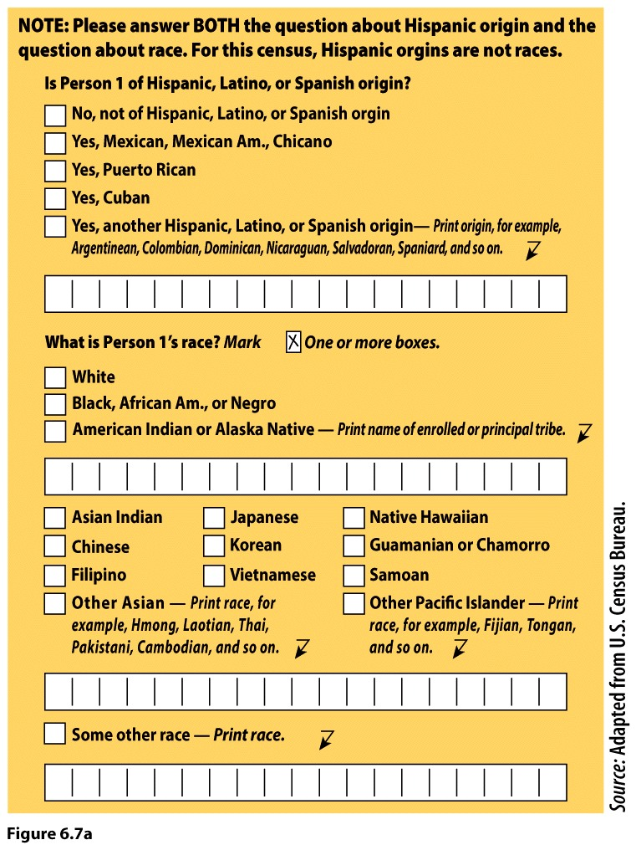
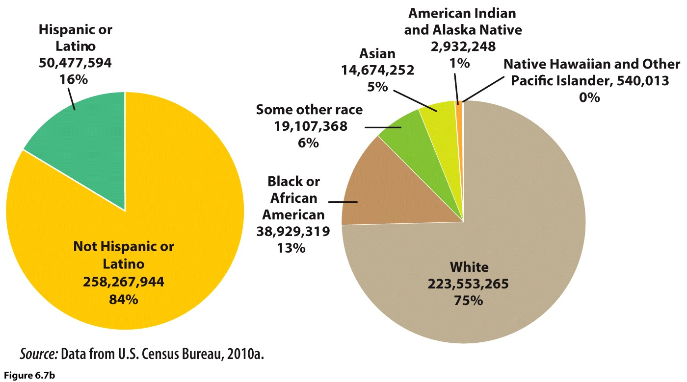
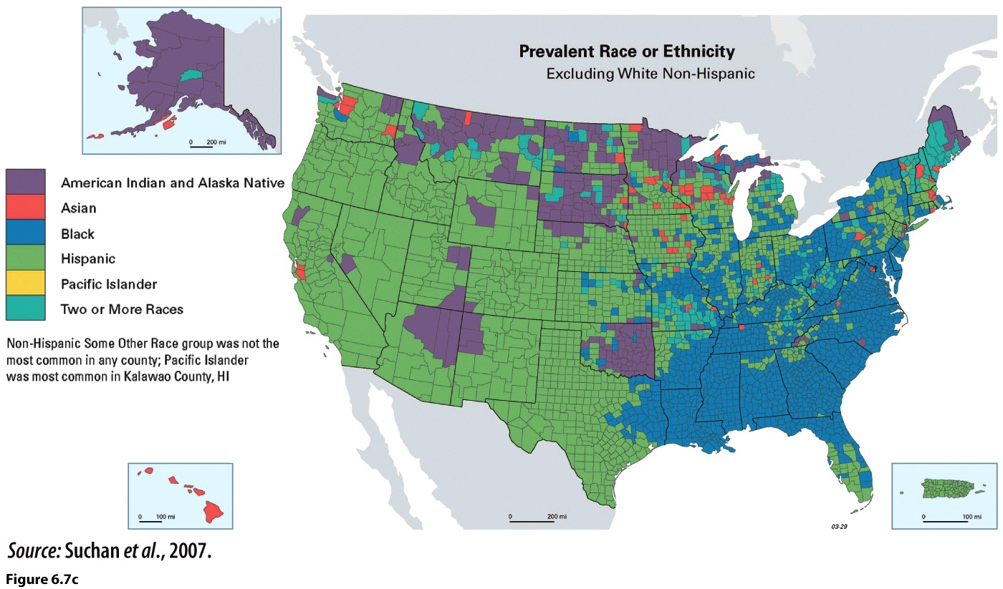
Prevalent Ethnicities
Notes:
(Form) U.S. census form questions on race Questions about race and ethnicity as they appear on the U.S. Census form, which is sent to all households every 10 years. Note that Hispanic origin is represented as something other than race.
(Chart) U.S. population composition from two perspectives The pie chart on the left shows Hispanic and non-Hispanic origin for the population. The pie chart on the right shows the count and percentage of those who selected just one racial category. (Source: Data from U.S. Census Bureau, 2013.)
(Map) Leading minority group, by county White, non-Hispanic is the majority population group. Excluding that data enables us to map and see the distribution of minority groups. California, Hawaii, New Mexico, Texas, Washington, D. C., and Puerto Rico are majority-minority, meaning that more than half of the population is minority.

Slide 15
Ethnicity in the Landscape
Notes:
15

Slide 16
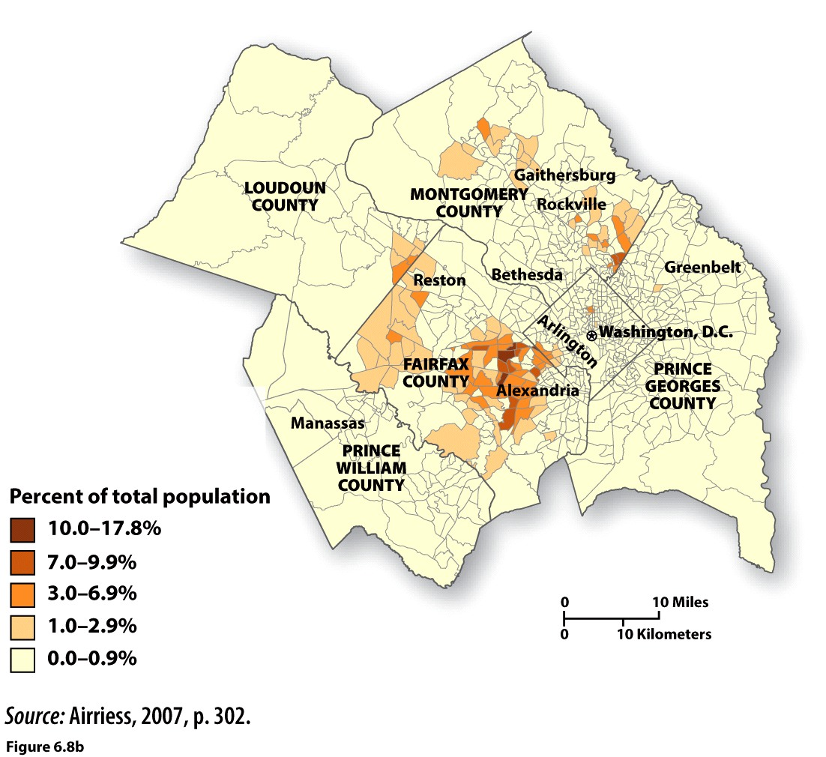
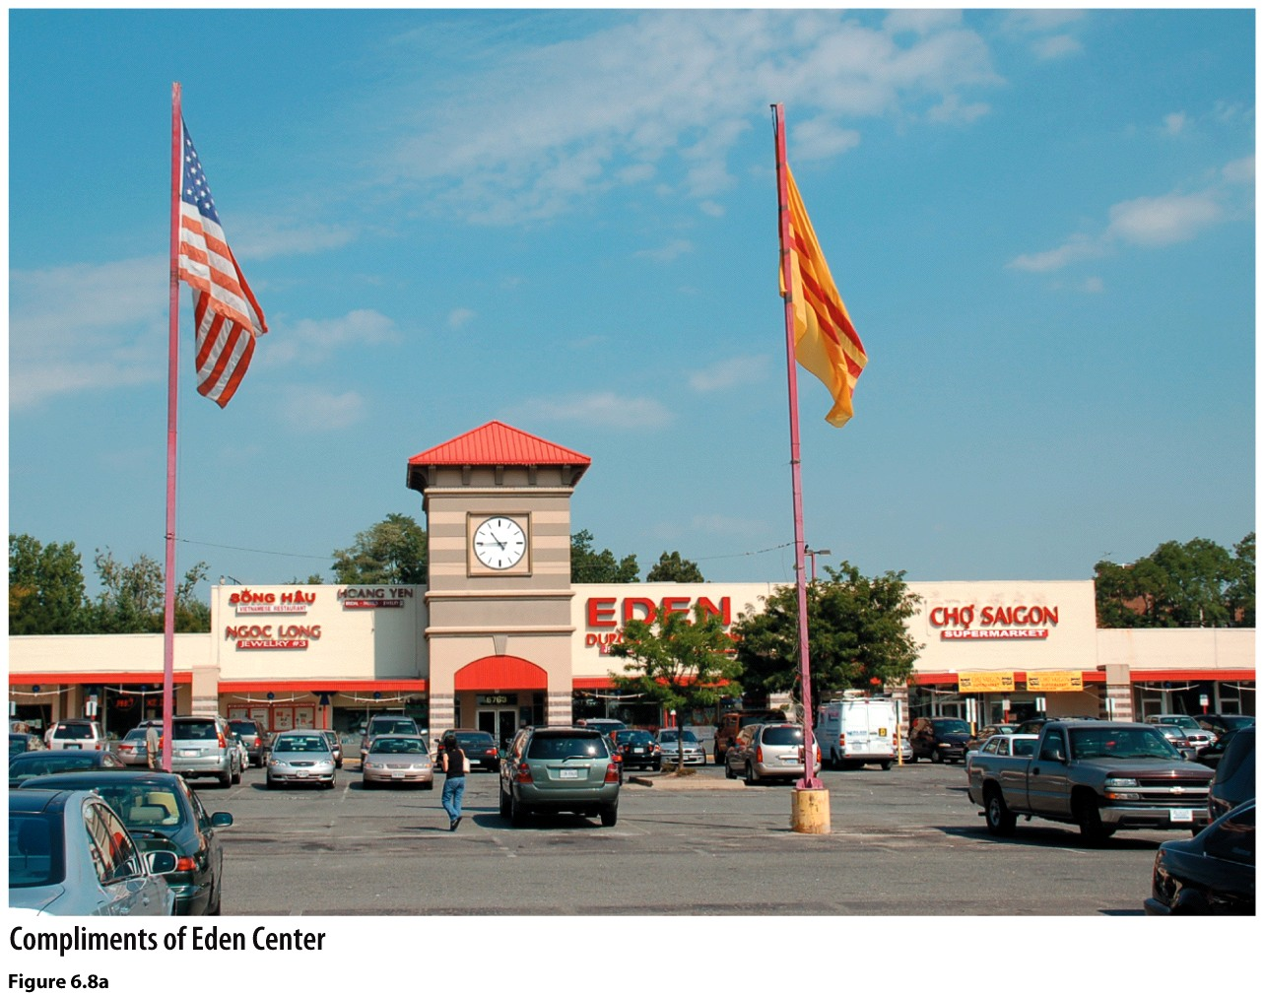
Ethnic Interaction and Globalization
Ethnoscape: A cultural landscape that reveals or expresses aspects of the identity of an ethnic group.
Ethnic Geography
Assimilation
Pluralism
Heterolocalism
- Four characteristics
Notes:
Some 40,000 Vietnamese live in and around Washington, D.C., but at the level of the census tract nowhere do they make up more than 18% of the population. By contrast, they accounted for less than 1% of the population in most census tracts. In this shopping center catering to Vietnamese clientele in Falls Church, Virginia, the clock tower resembles one in Saigon and the yellow flag is the flag of the former South Vietnam.

Slide 17
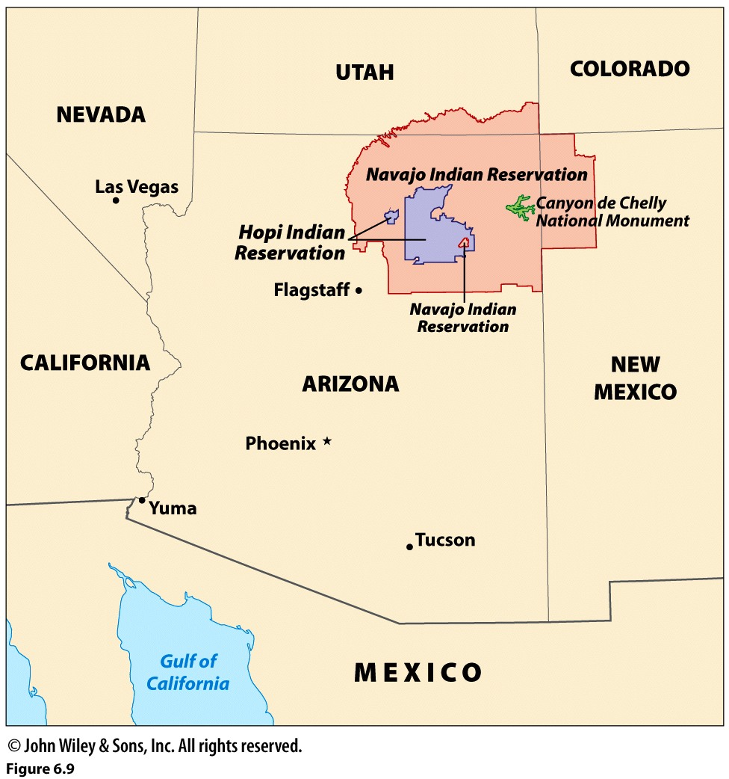
Ethnic Settlements
Ethnic Islands
Ethnic neighborhoods
Ghetto
Ethnoburbs: A multiethnic residential, commercial, or mixed suburban cluster in which a single ethnic group is unlikely to form a majority of the population.
Notes:
The Hopi and Navajo Reservations (population approximately 7000 and 174,000, respectively) are ethnic islands and enclaves in the U.S. When mapped, we can see that they also form enclaves of each other.

Slide 18
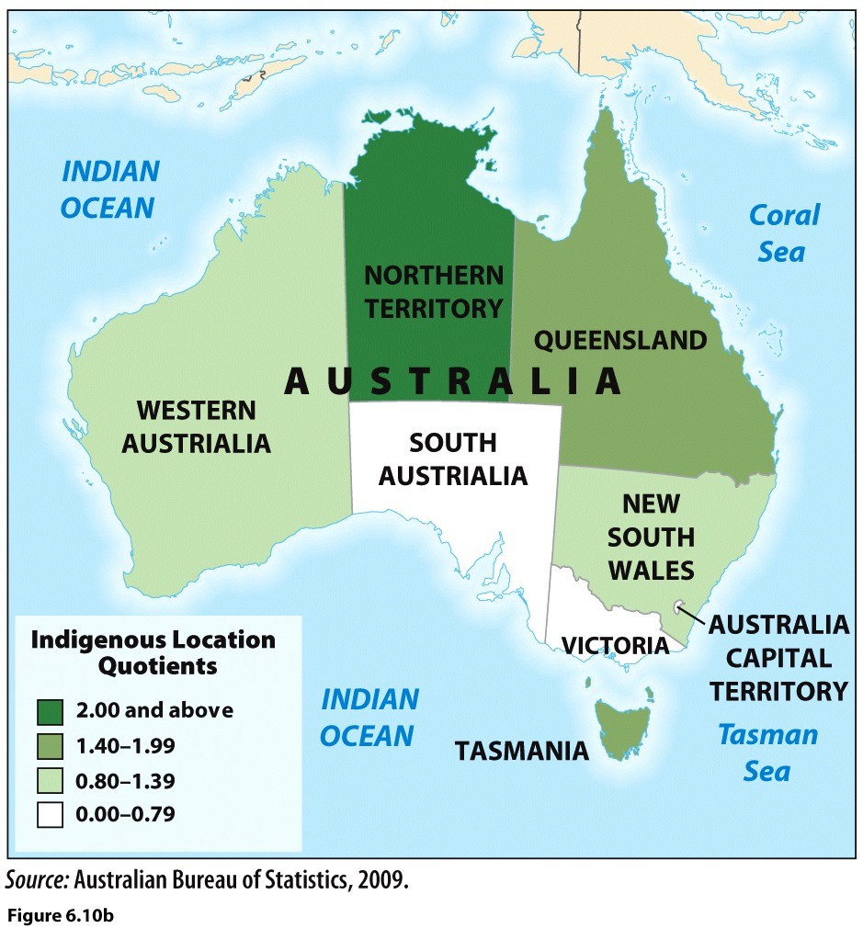
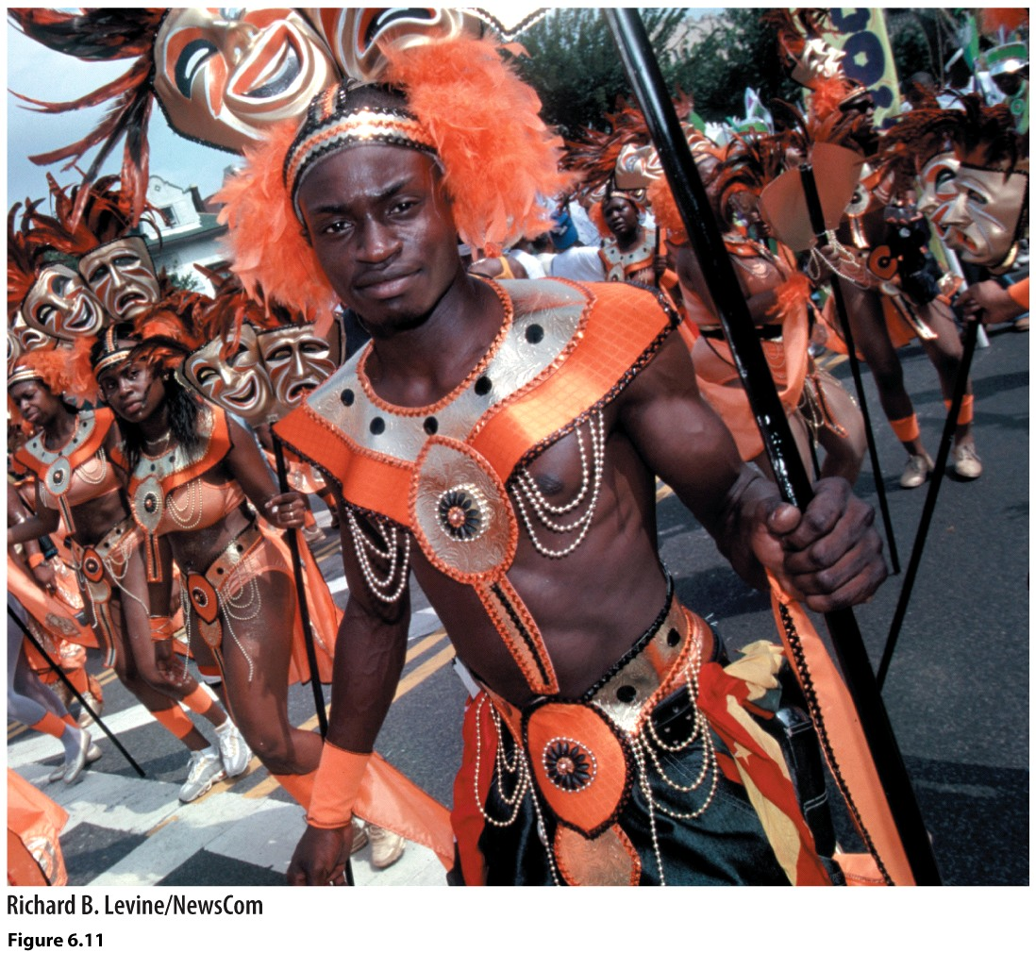
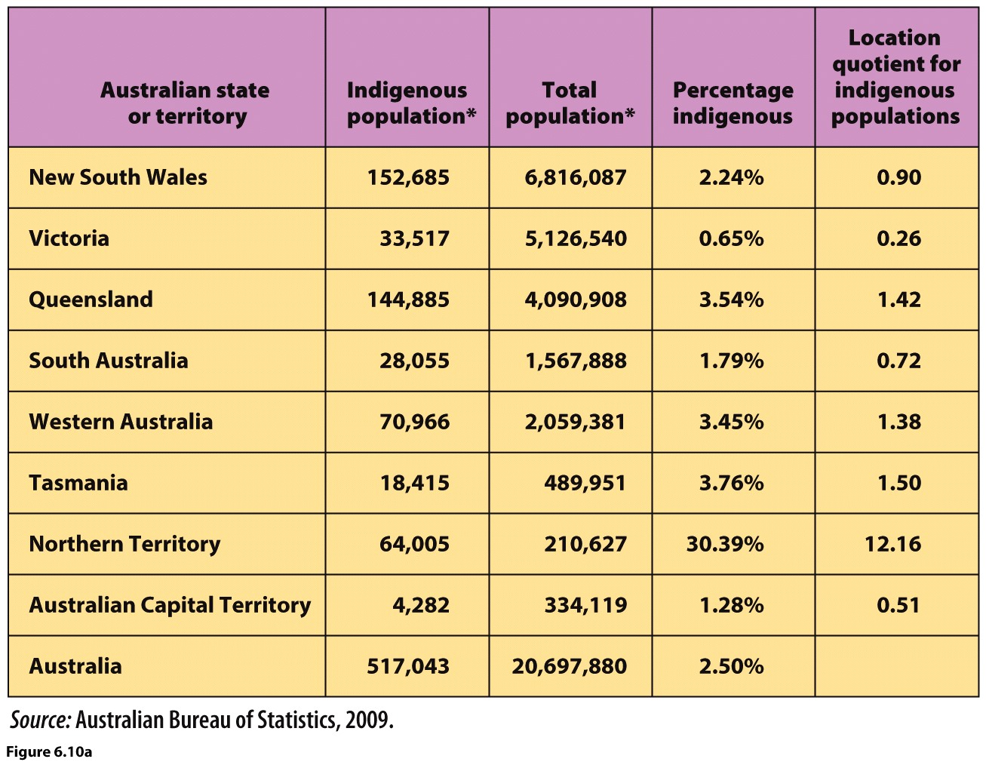
Local Quotients and other Ethnic Imprints
Local Quotients
Symbolic Ethnicity
Notes:
Calculating and mapping location quotients help reveal the spatial variation in patterns of ethnic group concentration.
The table presents population data for Australia and its indigenous populations, the Aboriginals and Torres Strait Islanders. Nationally, they constitute just 2.5% of the population, and only in the Northern Territory do they make up more than one-quarter of the population. (Source: Australian Bureau of Statistics, 2009.)
(Map) Where are Australia’s indigenous peoples over- and underrepresented? If you noticed that the location quotient for the Northern Territory is well above all the other values, then you have discovered one of the limitations of this measure. Although the location quotient can be less than one, it can never be lower than zero. This means that the location quotient is not as effective at capturing the degree of underrepresentation of a particular group.
(Left) Participants in the annual Carnival parade in Crown Heights, Brooklyn, an area with a sizable population of immigrants from the Caribbean. As a way of experiencing and enjoying traditions associated with an ethnic group, symbolic ethnicity often involves performance. Making and parading in elaborate costumes has long been a part of Carnival.

Slide 19
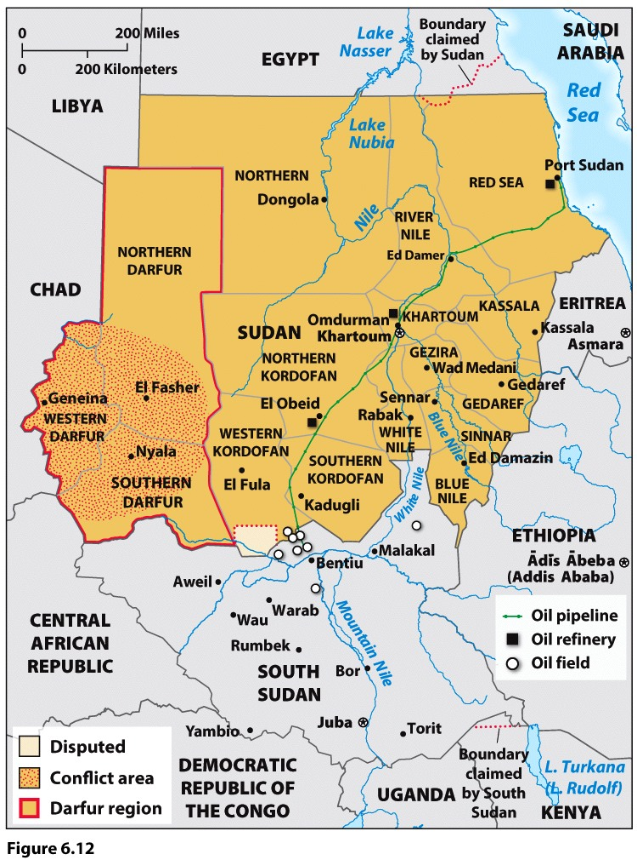
Ethnic Conflict
Conflict in Sudan
- janjaweed
Ethnic Cleansing
Why do many human geographers find the term “ethnic conflict” to be problematic?

Slide 20
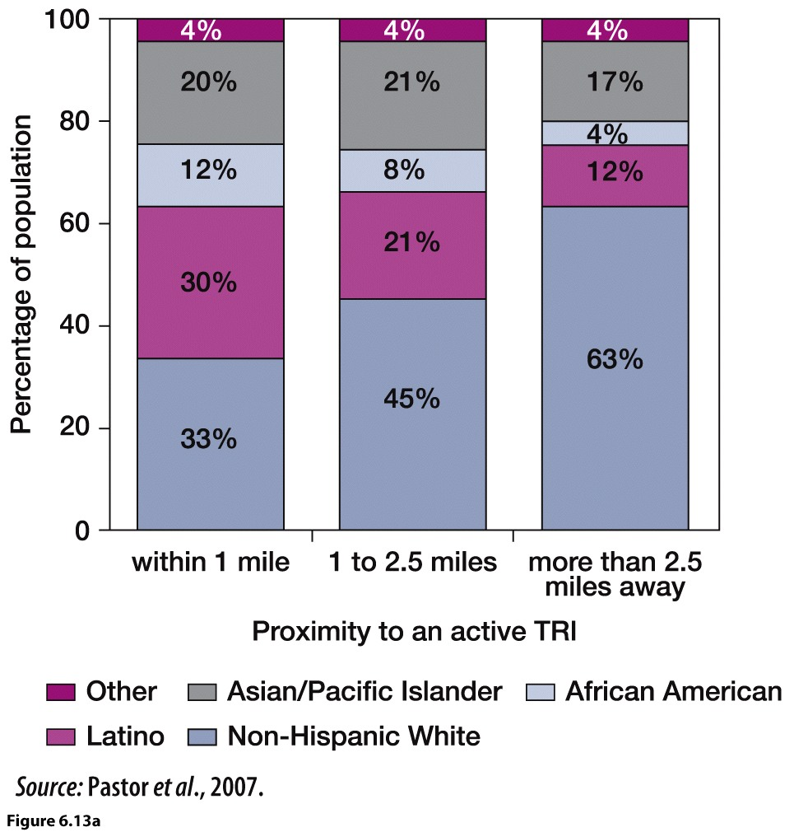
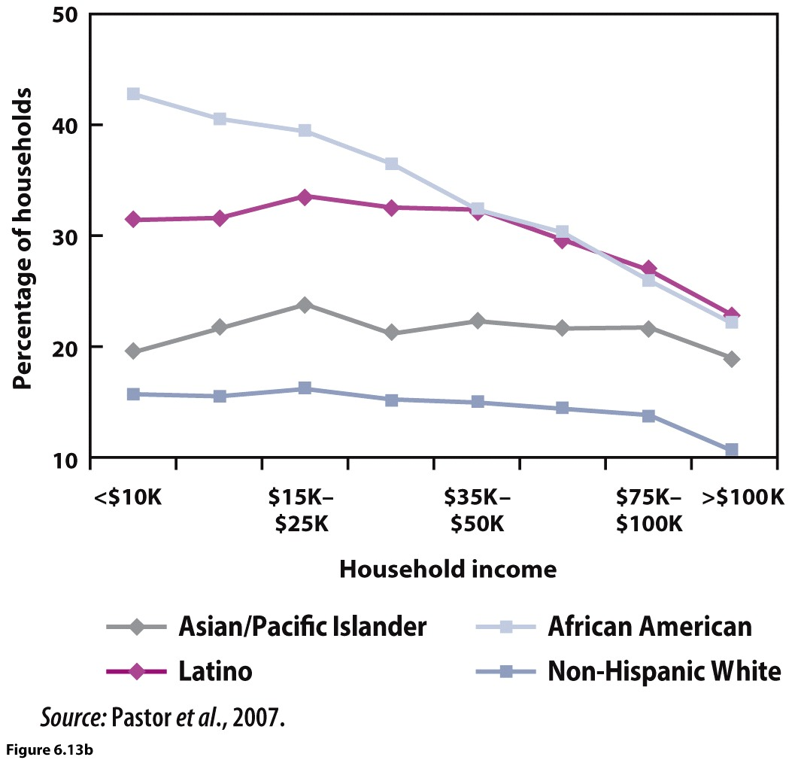
Proximity to Environmental Burdens
What do these data suggest in terms of the distribution of environmental burdens in the San Francisco Bay area and the interconnectedness of geography, race or ethnicity, and income?
Notes:
Certain large industrial facilities (called toxic release facilities or TRIs) are required to report to the Environmental Protection Agency amounts of toxins they emit into the air. Data from the San Francisco Bay Area shows that some ethnic groups are more likely than others to live near such a facility.
(Bar Graph) Population by race/ethnicity and proximity to a toxic release facility. Notice how the composition of population groups changes with increasing distance from the toxic release facility.
(Line Chart) Households within one mile of a toxic release facility by income, race/ethnicity. Compare this chart to the bar graph.

Slide 21
Sexuality and Gender
Notes:
21

Slide 22
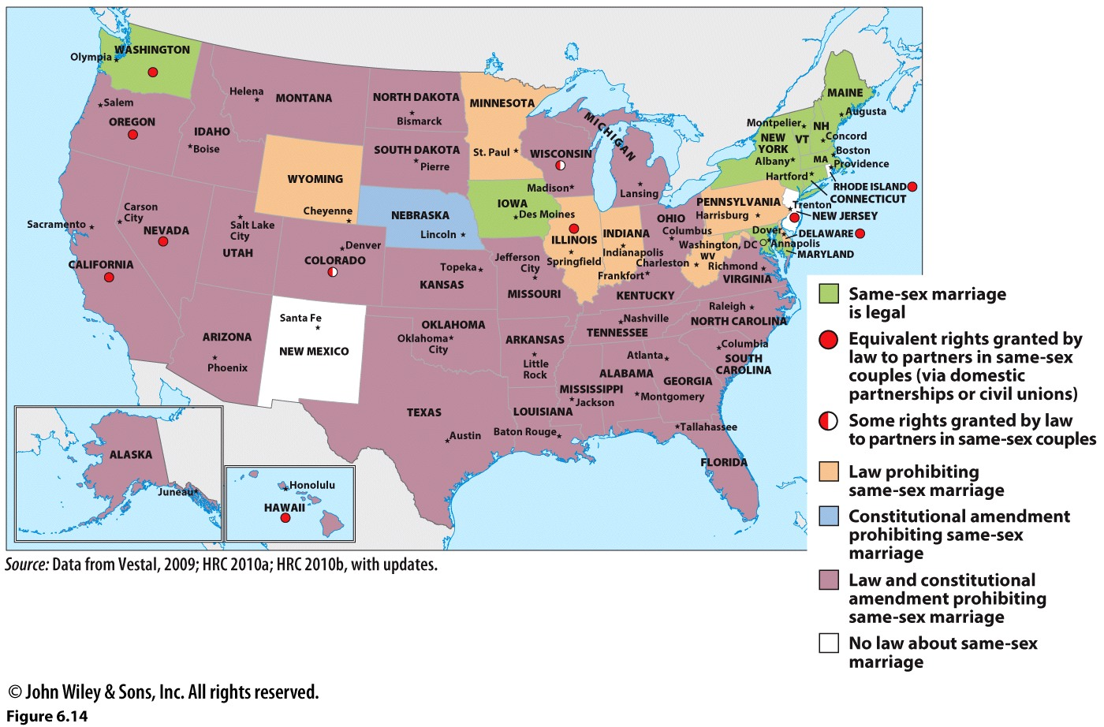
Sexuality, Identity, and Space
Gender role
Transgendered
Heterosexual norm
Public Space:
A kind of commons; a space intended to be open and accessible to anyone.
Notes:
The status of same-sex marriage and other legal alternatives such as domestic partnerships and civil unions demonstrates the politically charged nature of sexuality. Most U.S. states have both a law and a constitutional amendment that define marriage as the union of a man and a woman and, in effect, prohibit same-sex marriage. Same-sex marriage is legal in nine states and the District of Columbia. (Source: Data from Vestal, 2009; HRC 2010a; HRC 2010b, with updates.)

Slide 23
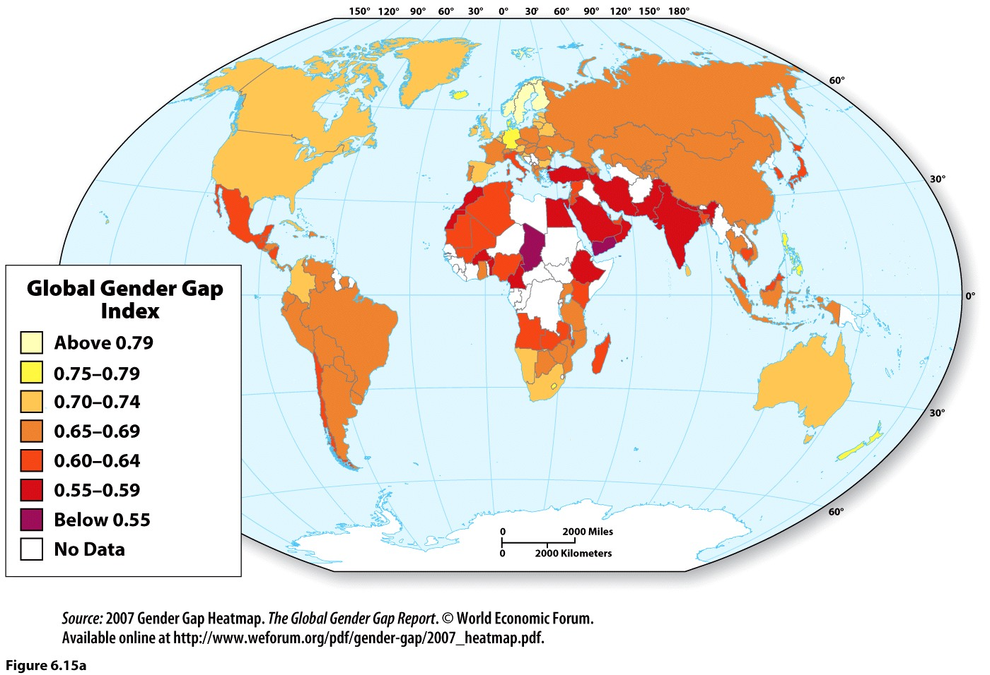
Geography and Gender
Gender Gap: A disparity between men and women in their opportunities, rights, benefits, behavior, or attitudes.
Notes:
Sweden has the narrowest gender gap (0.81), and Yemen has the widest (0.45). To calculate the index, male and female enrollments in school are examined, as are labor participation rates. (Source: 2007 Gender Gap Heatmap. The Global Gender Gap Report. © World Economic Forum. Available online at http:// www.weforum.org/pdf/gendergap/ 2007_heatmap.pdf.)
DISCUSSION QUESTION: How might you explain the large gender gap index for Japan?

