Slide 1
Visualizing Human Geography: At Home in a Diverse World
Second Edition
Alyson Greiner
Chapter 3
Population and Migration

Slide 2
Population Fundamentals

Slide 3
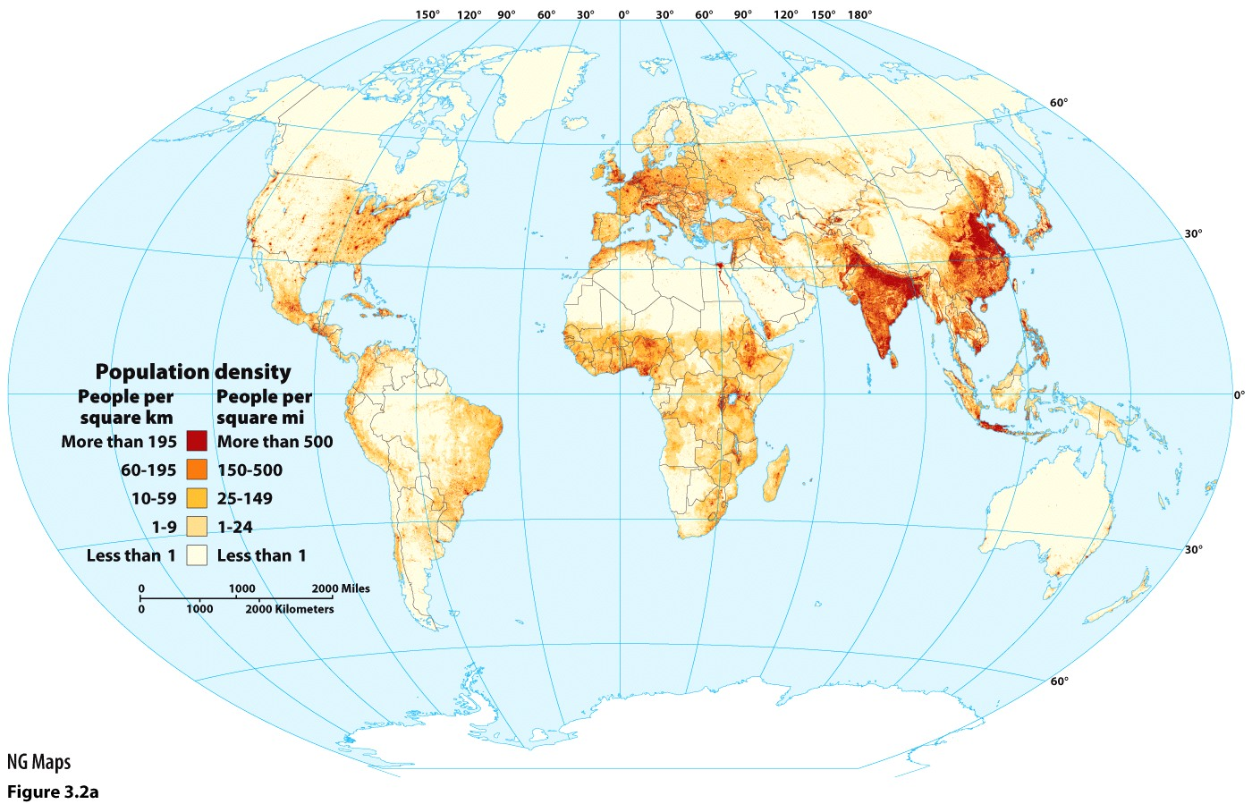
Population Distribution and Density
Where does the population tend to be concentrated in the world?
Notes:
DISCUSSION QUESTIONS: There is a spatial variation in human population distribution.
From personal experience, which areas in the United States have high or low population concentration?
Similarly, which areas in the world have high or low population concentration?

Slide 4
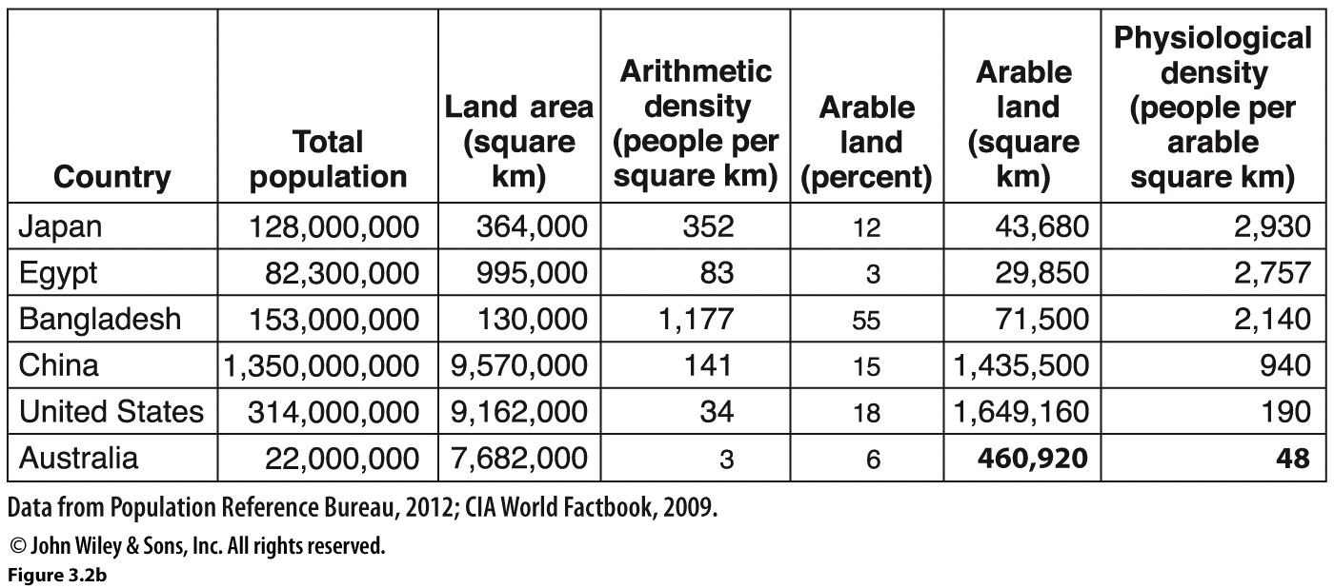
Population Distribution and Density
Arithmetic Density: The number of people per unit area of land.
Physiological Density: The number of people per unit area of arable land.

Slide 5
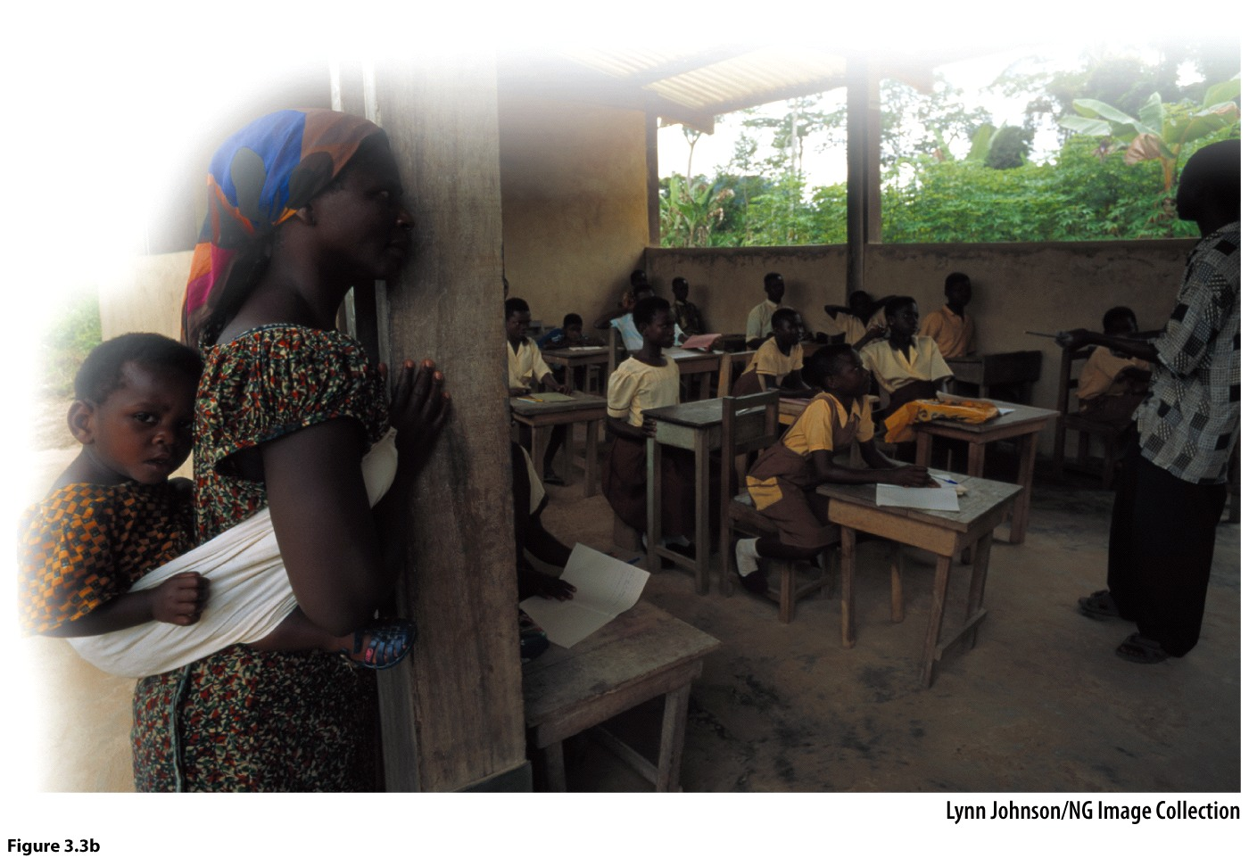
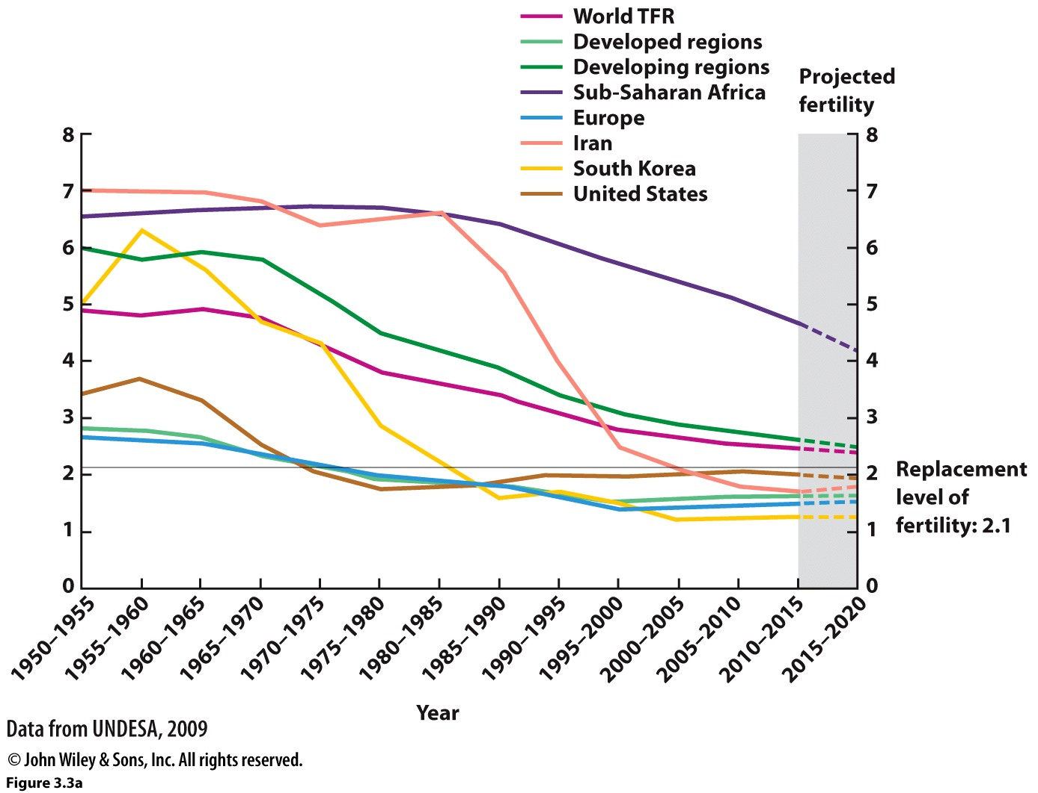
Fertility
Crude Birth Rate (CBR)
Total Fertility Rate (TFR)
Factors Influencing Fertility
How do economic factors influence the patterns of fertility? Are there other factors influencing the patterns of fertility?

Slide 6
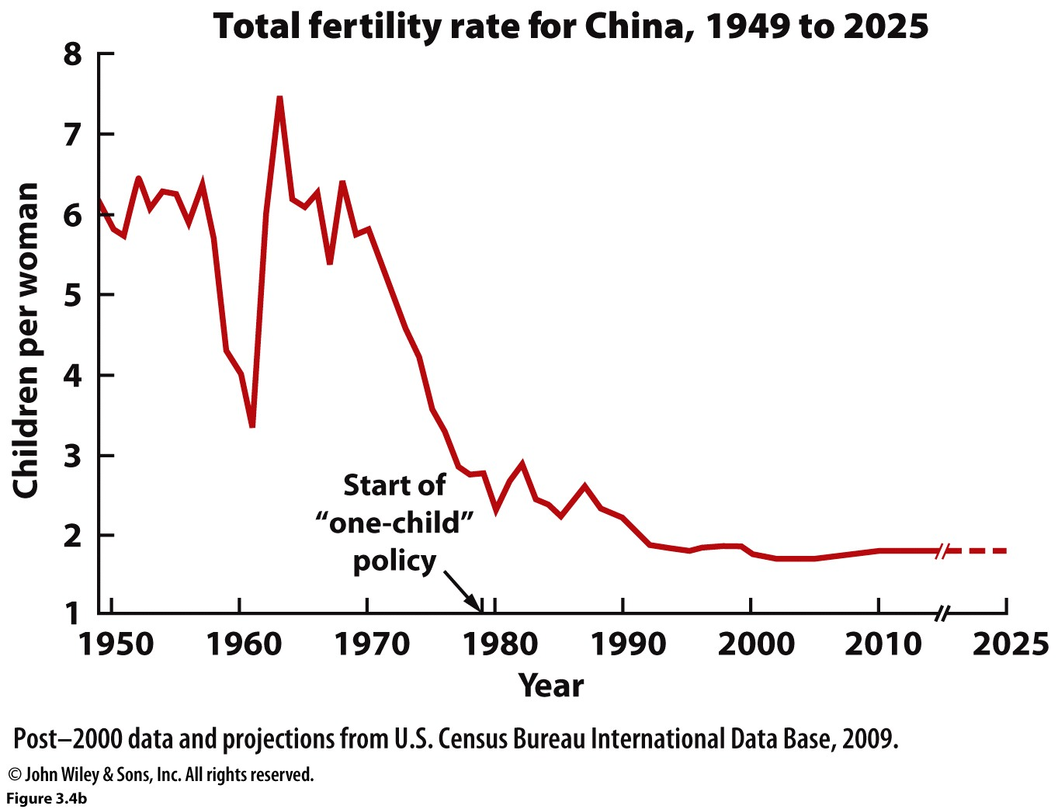
Population Control in China
First attempt 1956
One-Child Policy
Its rules
Its consequences
Critical Thinking: One-Child Policy: the Pros and the Cons

Slide 7
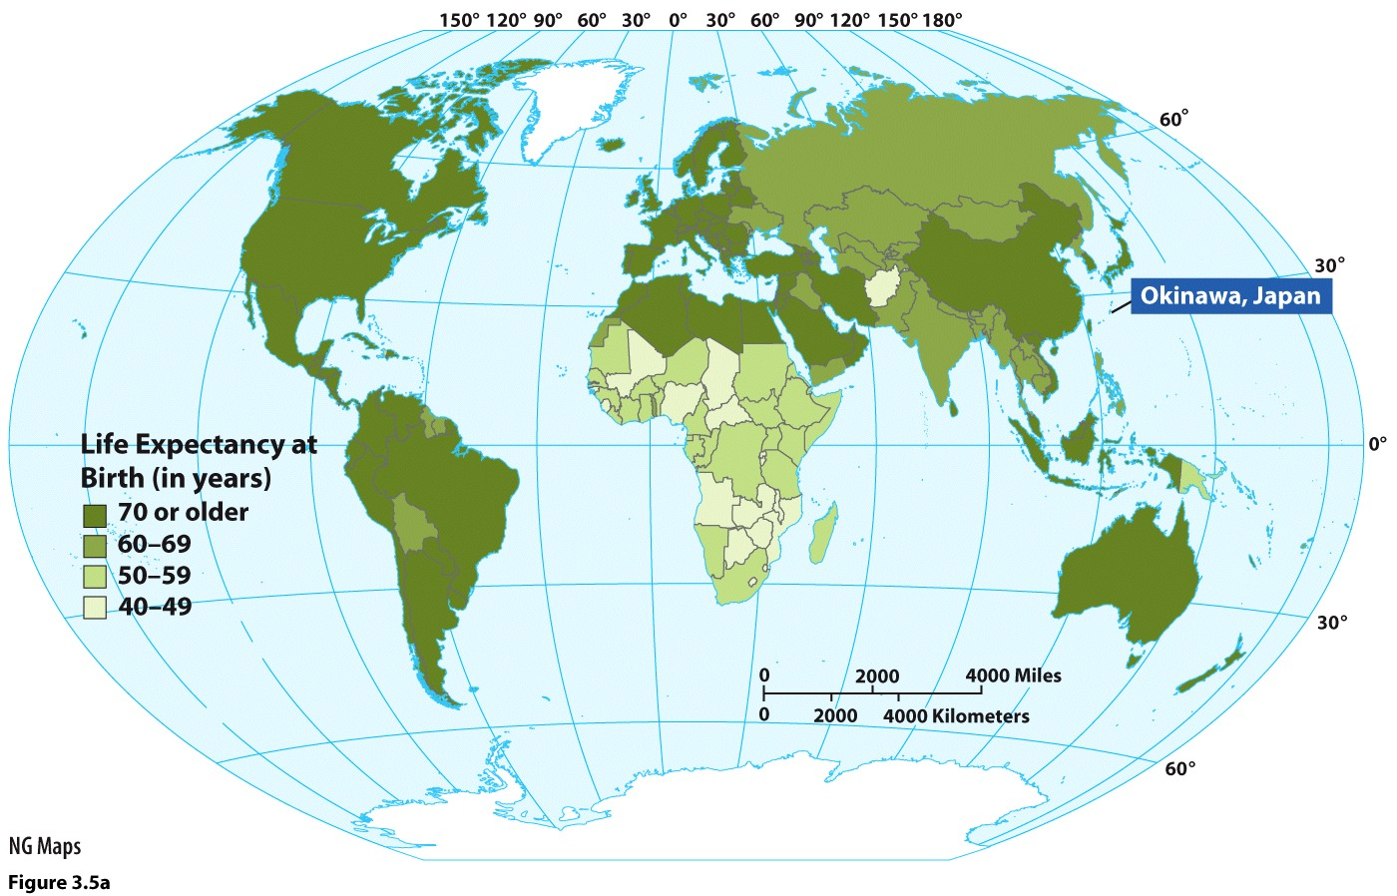
Mortality
Crude Death Rate (CDR)
How do economic factors influence the patterns of death? Are there other factors influencing the patterns of death?
Life Expectancy
Infant Mortality
Notes:
DISCUSSION QUESTIONS: Different cultural, economic, and political factors affect the patterns of birth and death rates in the world.
How do the following factors influence a country’s population? Provide an example of a country for each factor.
birth rate (high vs. low)
death rate (high vs. low)
infant mortality rate
life expectancy rate

Slide 8
Population Composition and Change

Slide 9
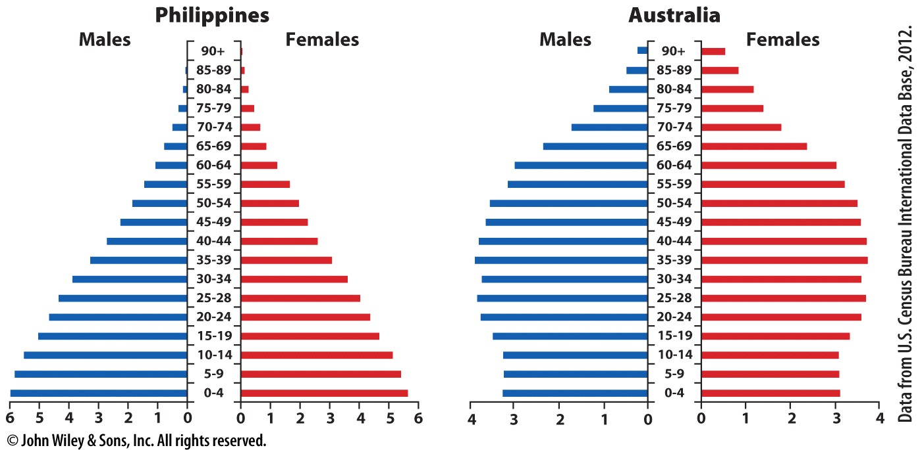
Population Pyramids
Rapid Population Growth
Slow Population Growth
Why do you think gender would be important in determining a population of a country?

Slide 10
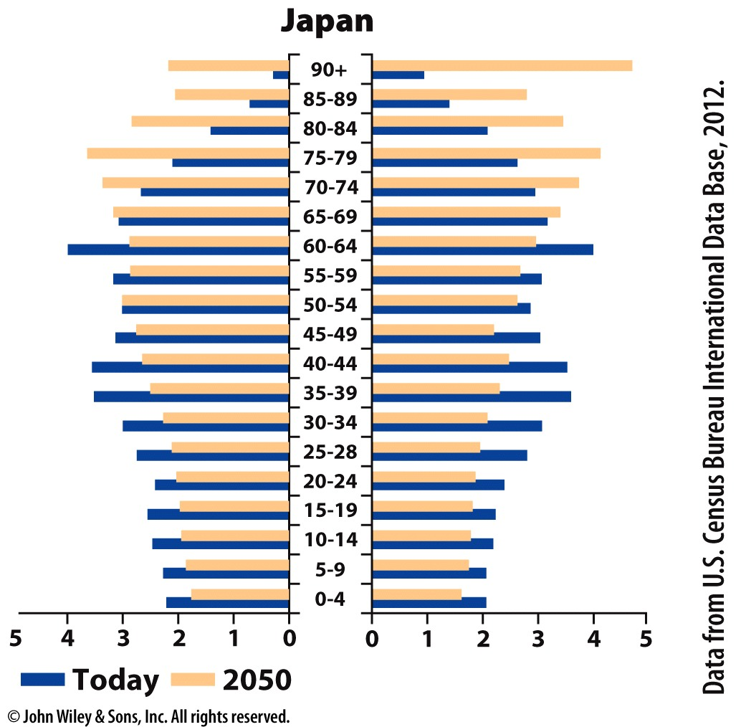
Age-Dependency Ratio
Age-Dependency Ratio: The number of people under the age of 15 and over the age of 65 as a proportion of the working-age population.
- This group is called dependents
Japan’s age-dependency ratio: 60:100
Population Decline
What kind of problems does Japan’s age-dependency ratio present for the future of their population?

Slide 11
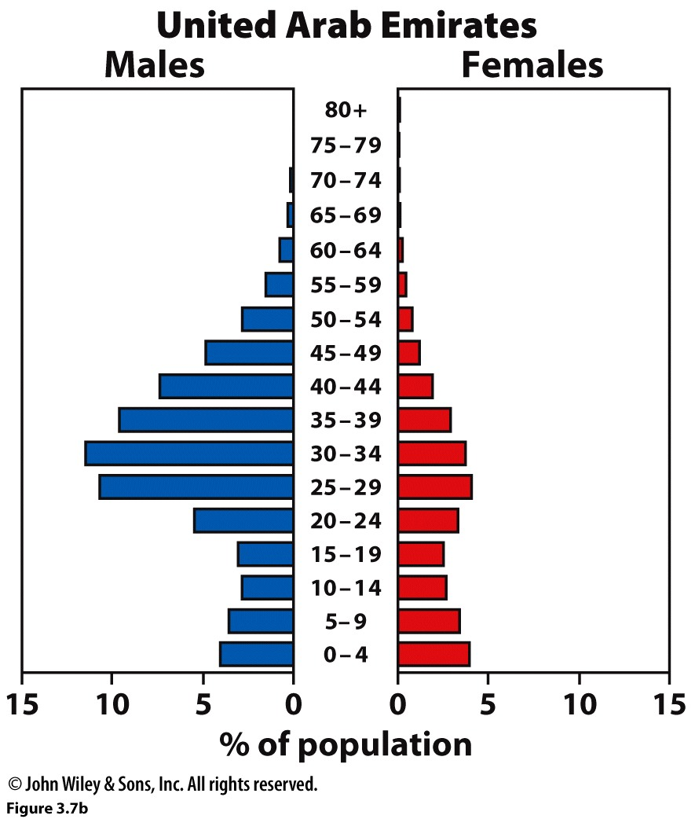
Sex Ratio
Sex Ratio: The proportion of males to females in a population.
What impact might the gender imbalance have upon a population of a country?
Notes:
DISCUSSION QUESTIONS: Age-dependency ratio and sex ratio are two important concepts of population composition.
Why is gender an important factor in determining the population of a country?
What is the impact of a country’s age composition (old or young age groups) on its population? How do age groups affect population growth and decline of a country?

Slide 12
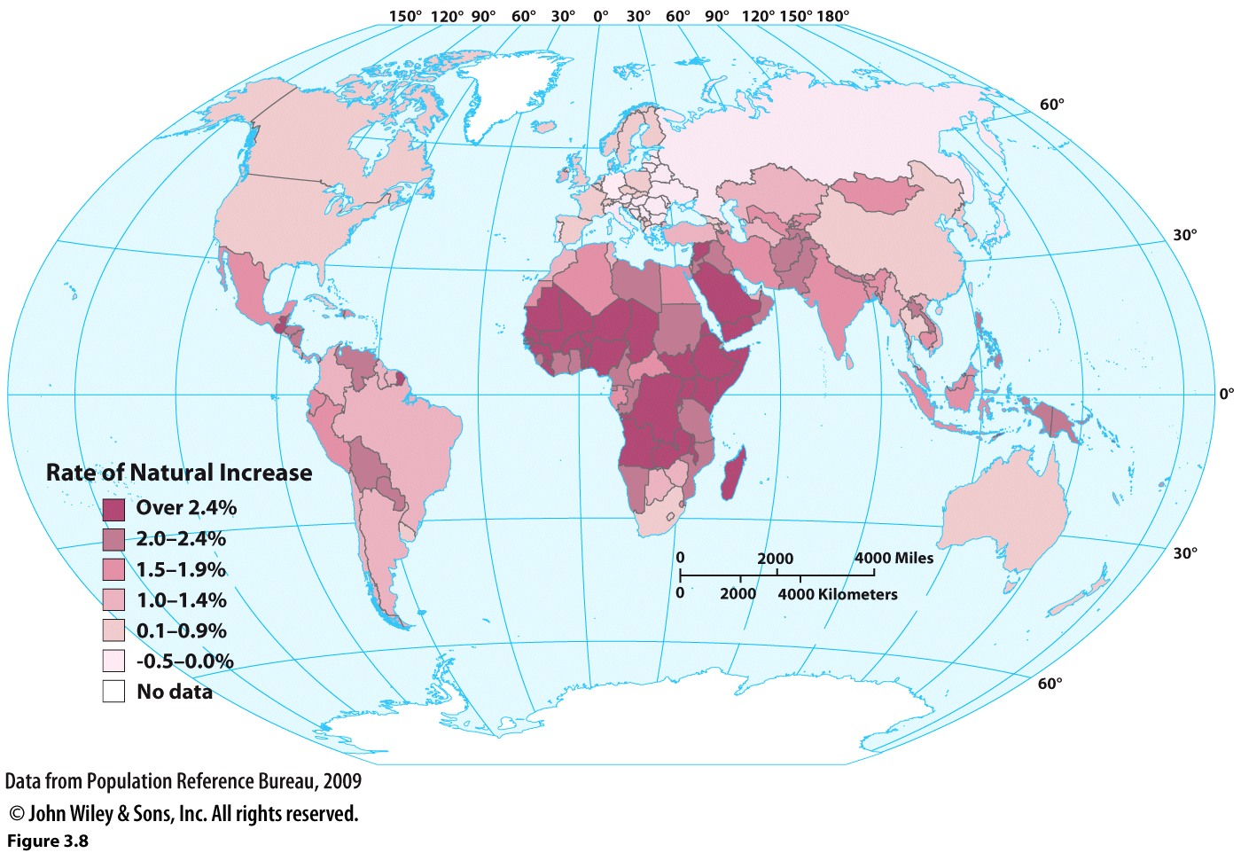
Rate of Natural Increase (RNI)
Rate of Natural Increase (RNI): The percentage of annual growth in a population excluding migration.
Notes:
DISCUSSION QUESTIONS: Geographers use the Rate of Natural Increase (RNI) to indicate its growth or decline in a year. The RNI can also be used to calculate the doubling time of a population.
In your best estimation, how long will it take for the population of the United States to double?
What countries or regions would you expect to see populations doubling within a shorter time? Why?

Slide 13
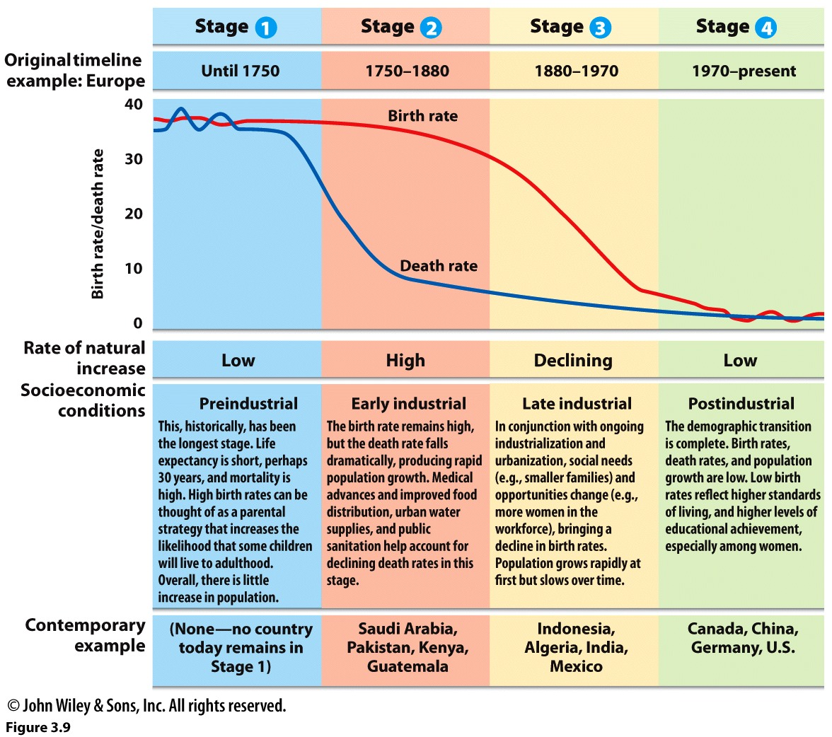
Demographic Transition Model
Does this demographic transition model apply to all the countries in the world?

Slide 14
Population-Environment Interactions

Slide 15
Malthusian Population Theory
Population Ecology
Malthusian Population Theory
How does this theory relate to Population Ecology?
Is Malthus’ theory still relevant?

Slide 16
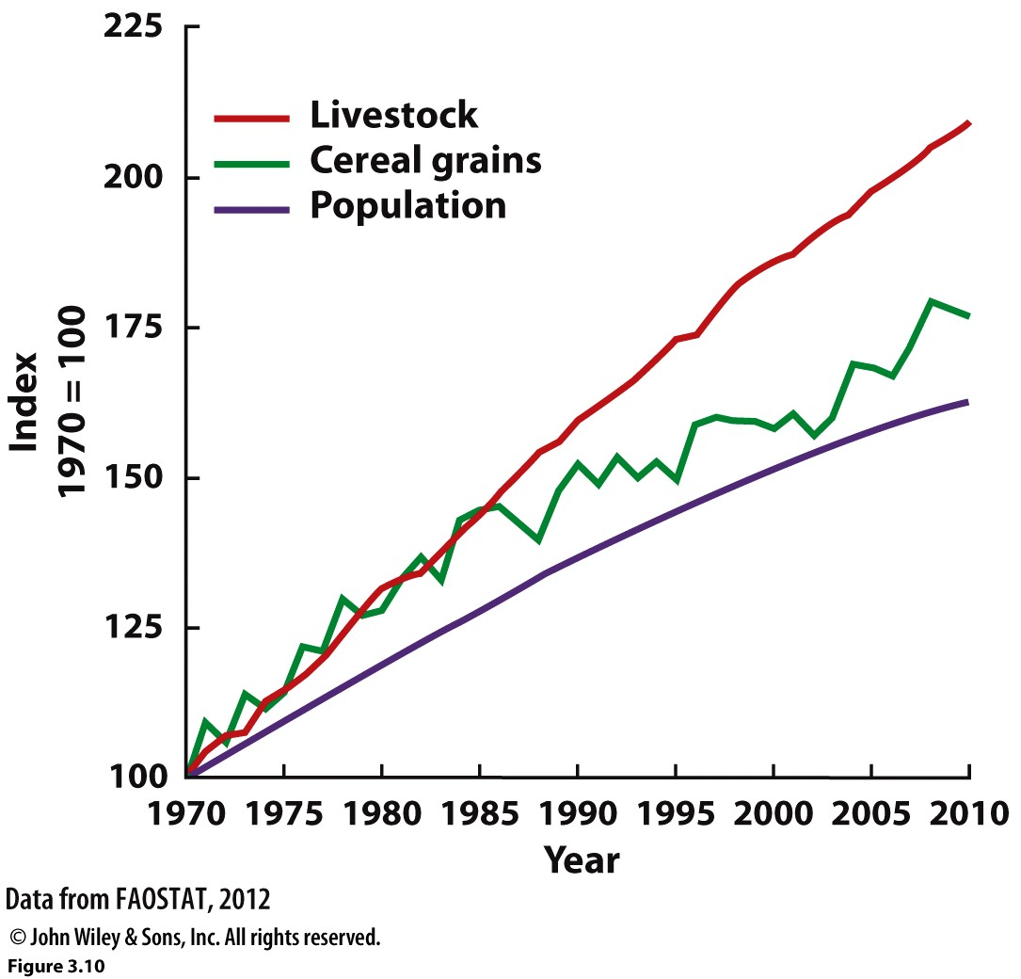
Beyond Malthusian
Neo-Malthusian Theory
Carrying Capacity
Cornucopian Theory
Agricultural production and population

Slide 17
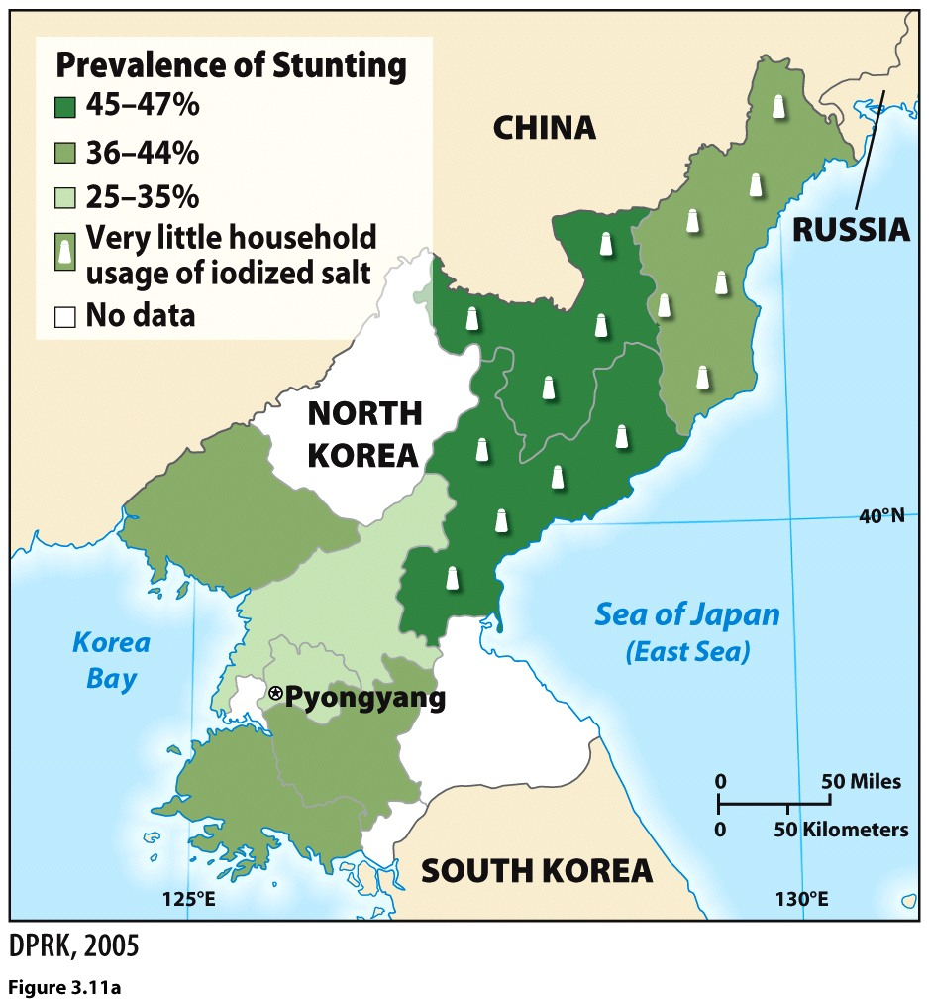
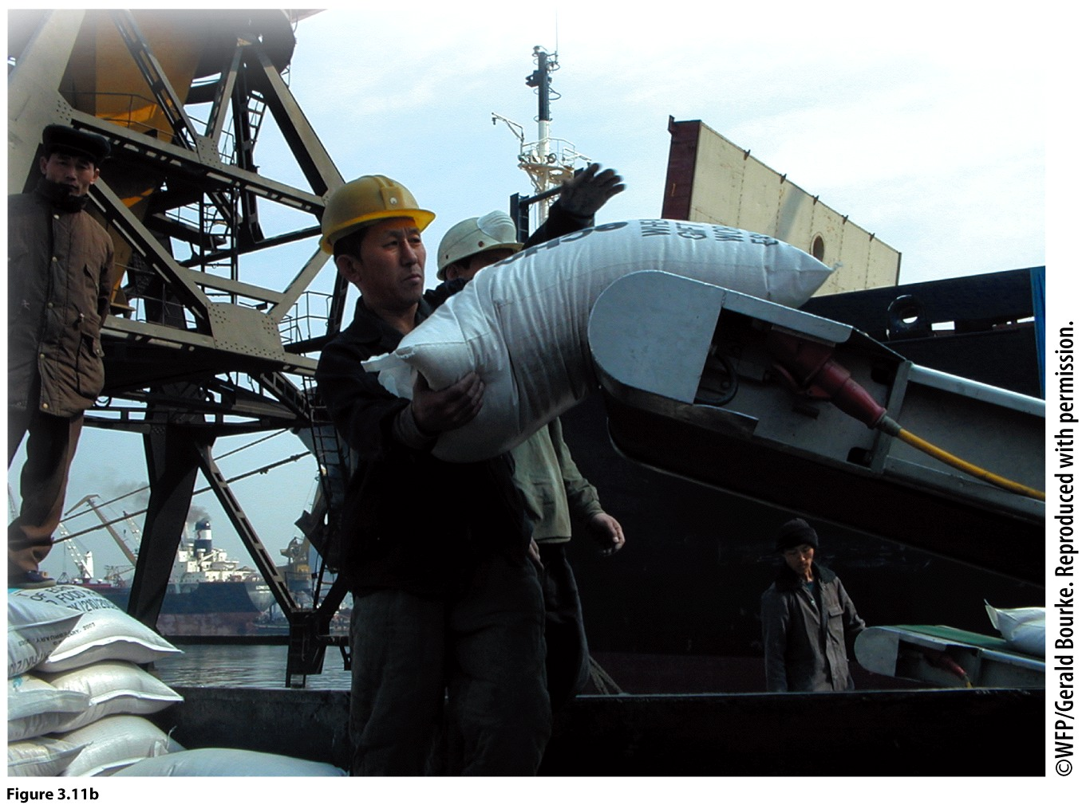
Food Insecurity
Food insecurity occurs when a population lacks access to basic food as a result of physical or financial limitations
Do you think food insecurity can be considered as one of main issues of the 21st century?
Notes:
DISCUSSION QUESTIONS: There are two theories about the impact of population growth on the Earth:
Neo-Malthusians believe that there is a limit (carrying capacity) on the Earth’s ability to support global population increase.
Cornucopian theory maintains that larger populations create economic opportunity and prosperity through technological innovations.
What are your views about these contrasting theories?
Do you think the world can support limitless population growth because of technological advancement or is there a potential breaking point?

Slide 18
Migration

Slide 19
Migration Principles
Ravenstein’s principles (laws of migration)
Migration is a two-way street
push factors: Unfavorable conditions or attributes of a place that encourage migration.
pull factors: Favorable conditions or attributes of a place that attract migrants.

Slide 20
Everett Lee’s four categories of migration factors

Slide 21
Internal Migration
Three factors of internal migration:
Age
Employment
Natural or environmental amenities
How do these three factors affect internal migration?

Slide 22
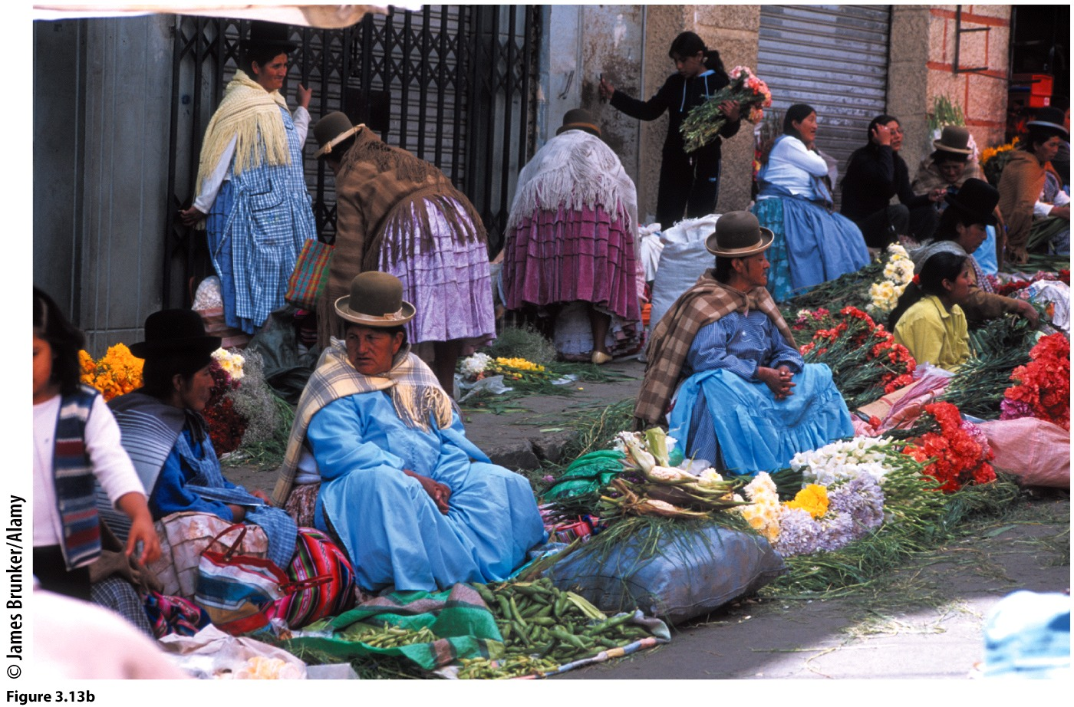
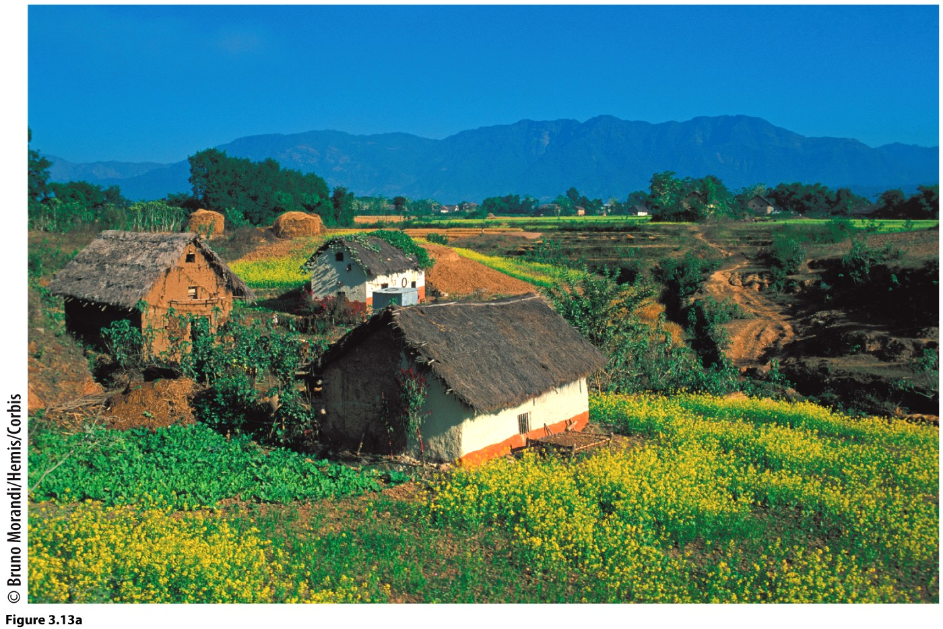
Rural Out-Migration
Rural-rural migration
Rural-urban migration

Slide 23
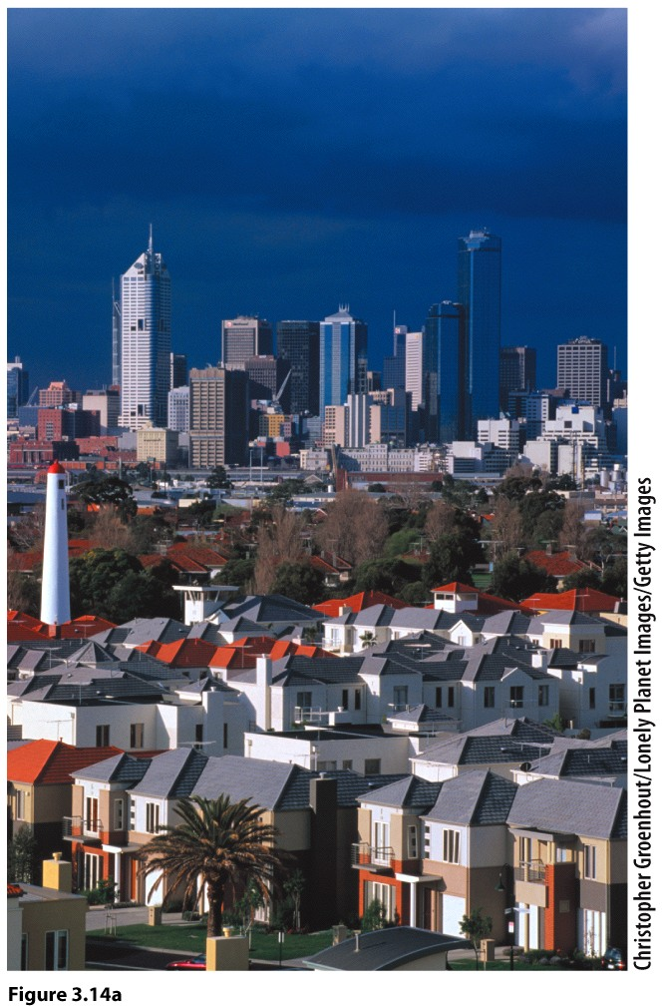
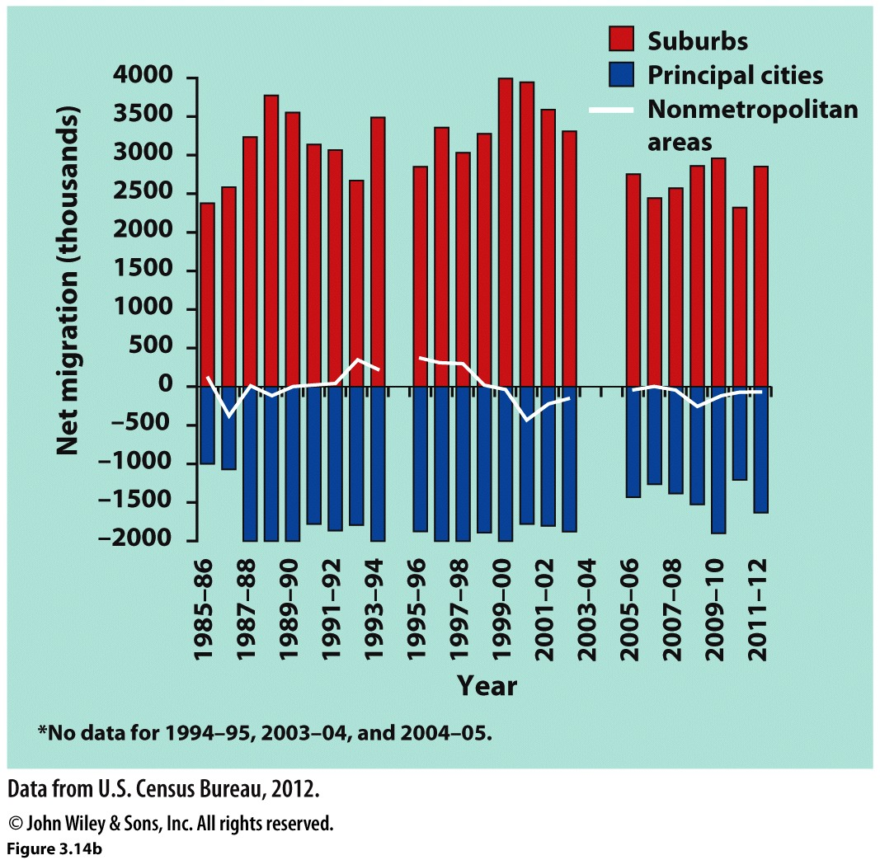
Urban Out-Migration
Urban-urban migration
Urban-rural migration
City to suburbs trends

Slide 24
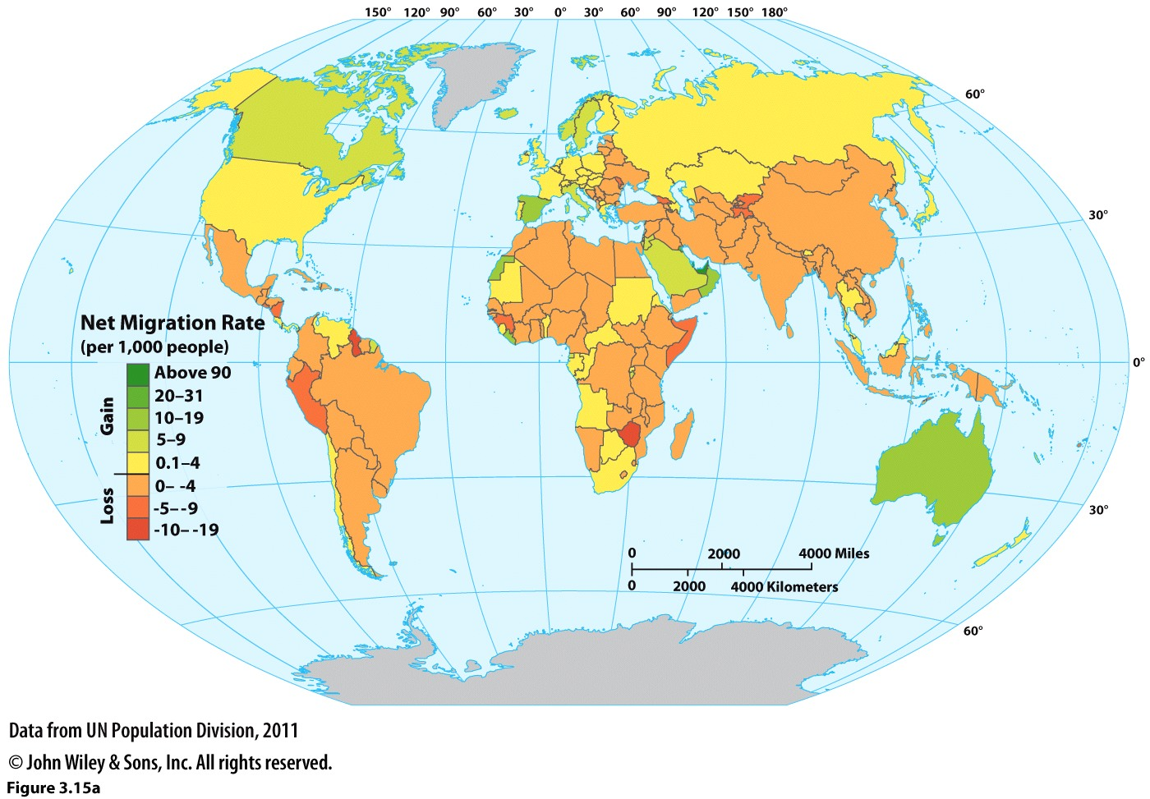
International Migration
Occurs when international boundaries are crossed
Net migration: difference in in-migrants and out-migrants

Slide 25
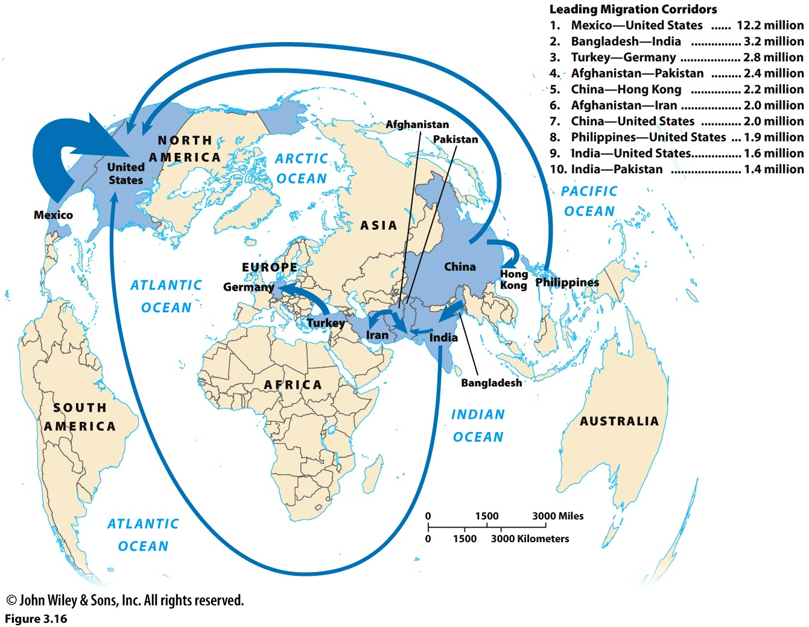
International Migration Corridors

Slide 26
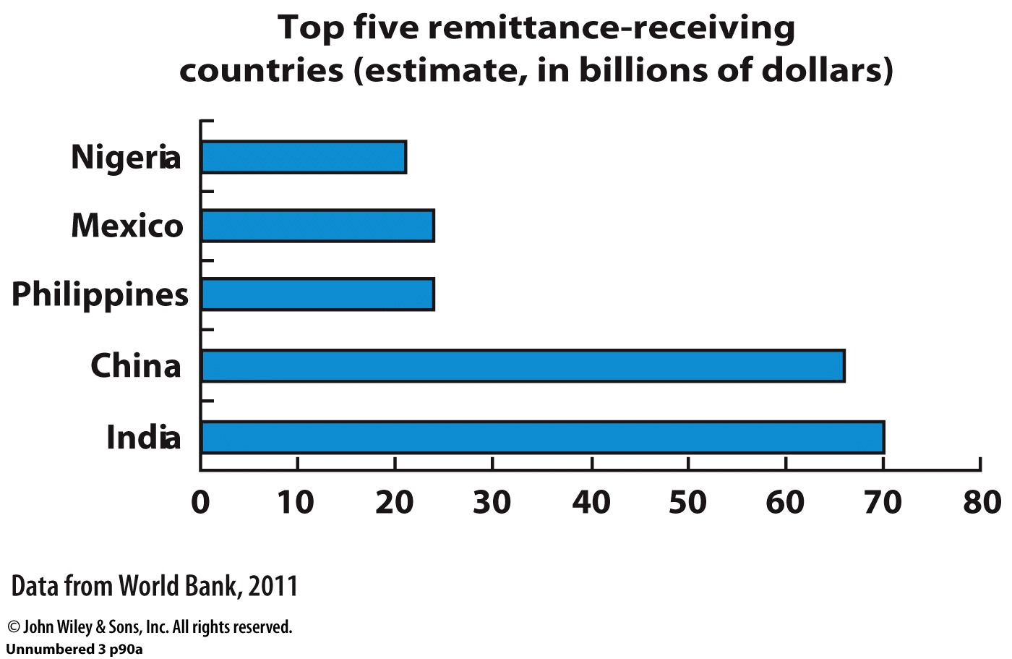
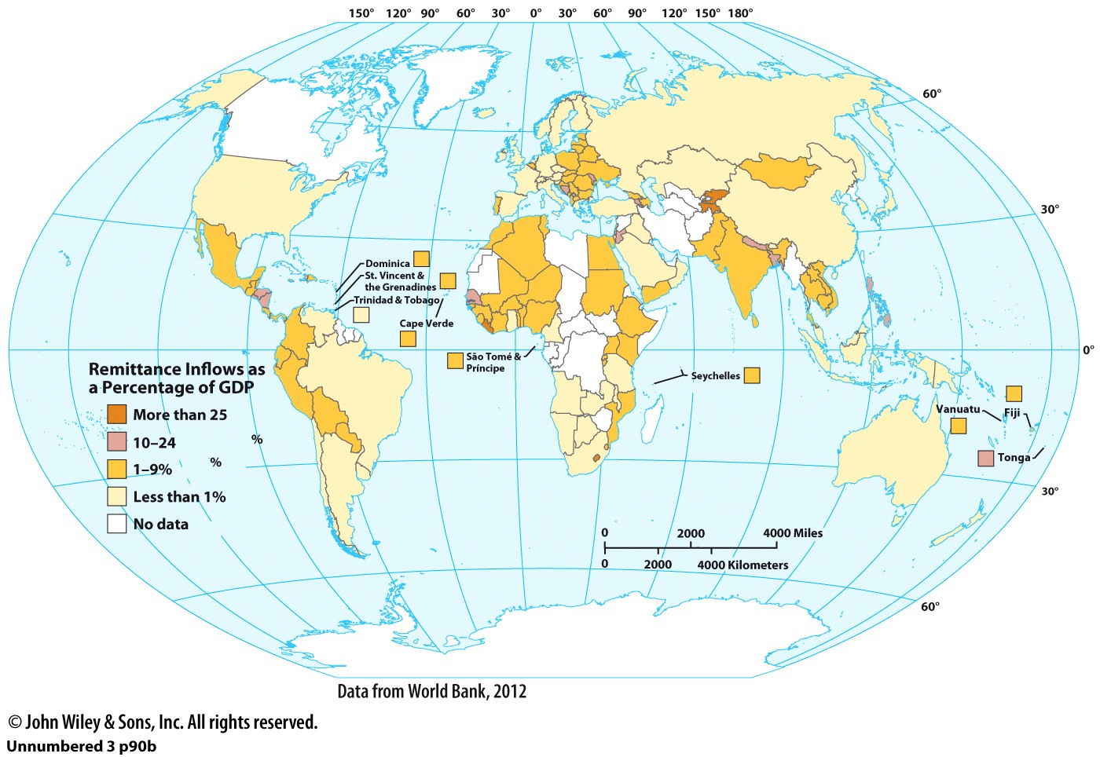
Economic Transnationalism
Monetary connections between an immigrant and her or his home country.

Slide 27
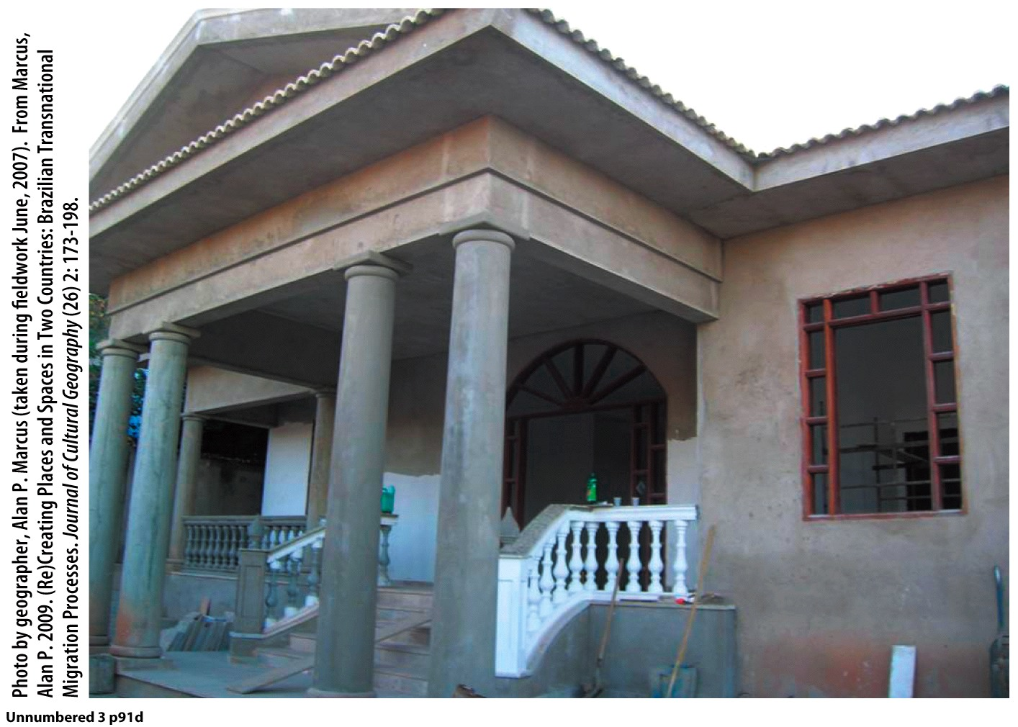
Sociocultural Transnationalism
Immigrants create political, social, or family-based ties that are rooted in the values and practices of their home country and community.
A Brazilian bakery in Marietta, Georgia.
The landscape in Piracanjuba, Brazil suggest it was influenced by Brazilians who lived in Marietta, Georgia.

Slide 28
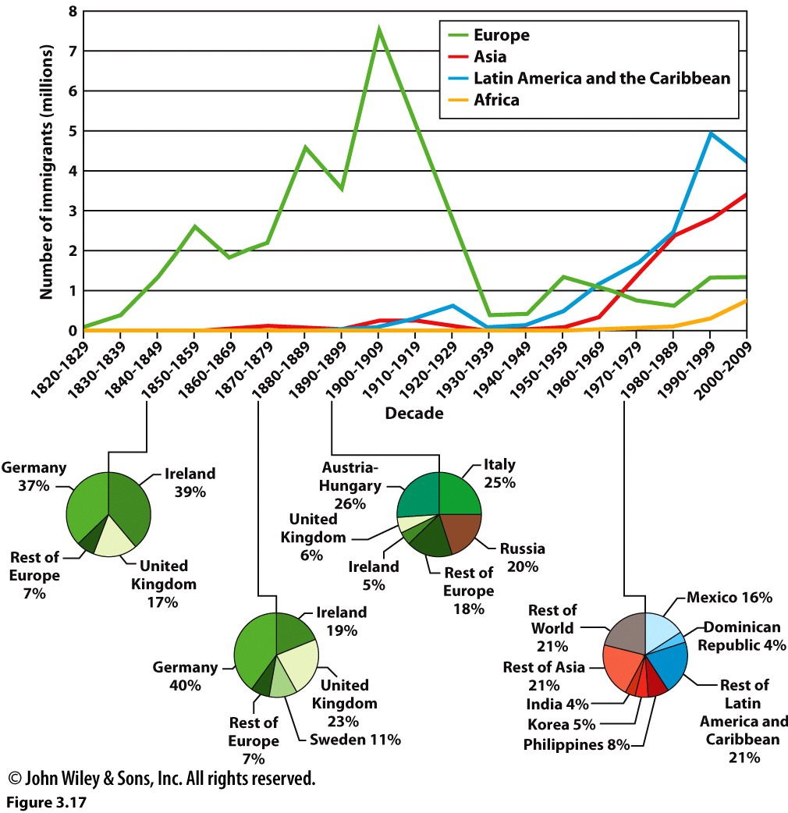
Immigration to the United States
Authorized vs. Unauthorized Migrants
Is an undocumented migrant the same as an illegal migrant? Why or why not?
Notes:
Migration of people is always in the news.
What are examples of migrations you heard about recently (from country to country, or within a country)?
Have you heard of the United States experiencing periods of migration, and if so, from where to where? What may have been the factors responsible for the migrations?

