Slide 1
Geopolitical Theories and the Organization of Space

Slide 2
The Early State
Development of the State as a concept can be traced to the Fertile Crescent.
Clans
Tribes
Villages
Kingdoms
Empires
City-states
Evolution of States
First states were known as city-states, which are sovereign areas that are comprised of towns and their surrounding countryside farms and estates.
Walls delineated boundaries and the area immediately outside walls controlled by city to produce food for urban residents.
Medieval States
Roman Empire collapse in 5th century led to its land being parceled up and controlled by various monarchies.
Charlemagne’s innovations such as the use of counties and yearly ‘calls to arms’ led to increased organization of parceled land and the beginnings of feudalism.

Slide 3
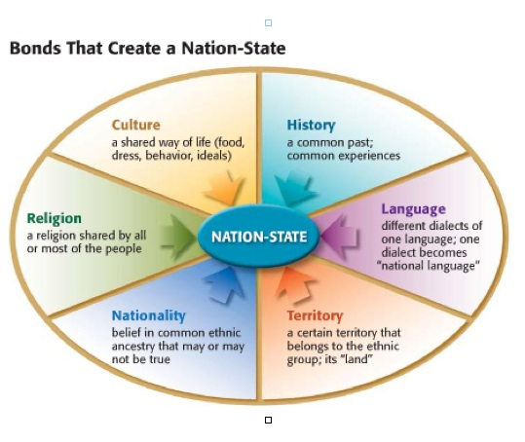
The Modern State Ideal
The early modern European nation-state ideal is the concept most responsible for the development of the modern state system.
Emerging political state theories during that time were accompanied by mercantilism.
Led to the accumulation of wealth through plunder, colonization, and the protection of home industries and their foreign markets.
Mercantilism is an economic theory:
Trade generates wealth and is stimulated by the accumulation of profitable balances
Governments should encourage this by means of protectionism

Slide 4
Dominant Colonial Influences, 1550–1950.

Slide 5
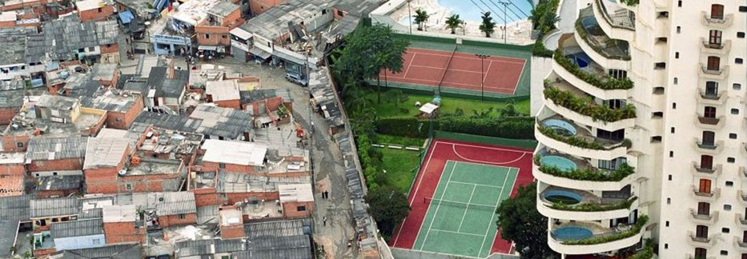
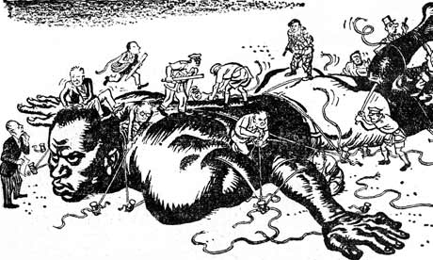
Building the Capitalist World Economy
One of the most powerful impacts of colonialism was the construction of a global order characterized by great differences in economic and political power.
This led to a concentration of wealth in Europe, and in parts of the world dominated by European settlers.
Colonialism is at the heart of highly uneven global distribution of power that continues even today.

Slide 6
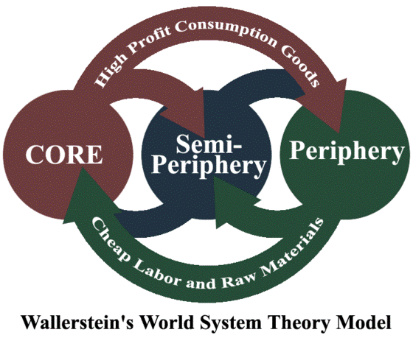
World-Systems Theory
The three basic components of the world-systems theory per Immanuel Wallerstein:
The world economy has one market and a global division of labor.
Almost everything takes place within the context of the world economy.
The world economy has a three-tier structure – core, semi-periphery, and periphery.

Slide 7
The World-Systems Theory Part I
The world economy has one market and a global division of labor.
Capitalism: in the world economy, individuals, corporations, and states freely produce goods and services that are exchanged for profit.
Commodification is the process of placing a price on a good, service, or idea and then buying, selling, and trading that item.

Slide 8
The World-Systems Theory Part II
Although the world has multiple states, almost everything takes place within the context of the world economy:
Colonialism played a major role in establishing this system by exporting the European state idea and facilitating the construction of an interdependent global economy.

Slide 9
The World-Systems Theory Part III
The world economy has a three-tier structure:
Core is where one is most likely to find higher levels of education, higher salaries, and more technology
Periphery: processes associated with a more marginal position in the world economy
Semi-periphery: places where core and periphery processes are both occurring

Slide 10
Key Questions by World-Systems’ Theorists
World-systems theory asks several key questions:
How is the world-system affected by changes in its components (nations, ethnic groups, social classes, etc.)?
How does the world-system affect its components?
To what degree, if any, does the core need the periphery to be underdeveloped?
What causes world-systems to change?
What system may replace capitalism?

Slide 11
Criticisms of World-Systems Theory
Major concerns of the world-systems theory:
Overemphasizes economic factors in political development
Very state-centric – what about other scales of interaction?
Does not fully account for how places move from one category to another

Slide 12
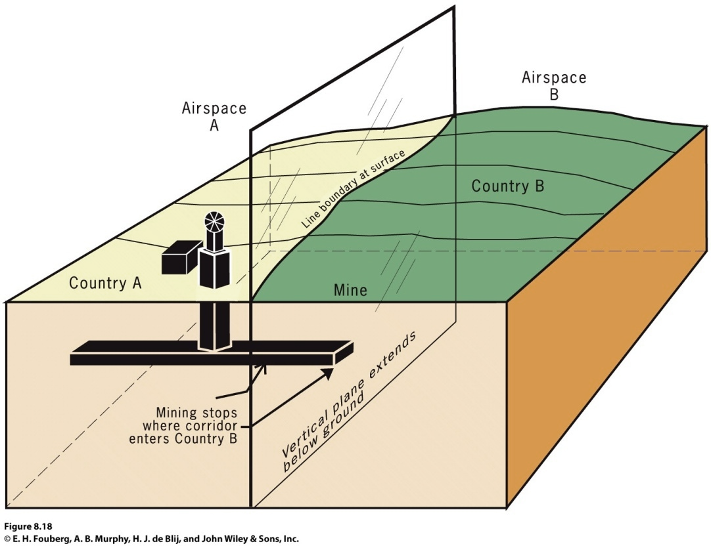
Why Do Boundary Disputes Occur?
A boundary between states is actually a vertical plane that cuts through the rocks below (called the subsoil) and the airspace above, dividing one state from another.
States typically define the boundary in a treaty-like legal document in which actual points in the landscape or points of latitude and longitude are described.
The Vertical Plane of a Political Boundary
Only where the vertical plane intersects the Earth’s surface (on land or at sea) does it form the line we see on the ground.

Slide 13
Boundary Disputes
Definitional boundary
Locational boundary
Allocational boundary
disputes focus on the legal language of the boundary agreement.
Operational boundary
disputes center on the delimitation and possibly the demarcation of the boundary. The definition is not in dispute, but its interpretation is.
disputes involve neighbors who differ over the way their border should function.
disputes are becoming more common as the search for resources intensifies.

Slide 14
Classical Geopolitics
Classical Geopolitics
Late 19th century/early 20th century geopoliticians were usually either part of the German school or the British/American school.
The German School
Tried to explain why certain states were powerful and how they became powerful.
Friedrick Ratzel: influenced by Darwin; the state resembles a biological organism whose life cycle extends from birth through maturity and, ultimately, decline and death.
The British/American School
Sir Halford J. Mackinder, “The Geographical Pivot of History” in the Royal Geographical Society’s Geographical Journal.
Land-based power, not sea power, would ultimately rule the world.

Slide 15
Critical Geopolitics
Geopolitical World Order into the early 21st century
Cold War: bipolar, with Soviet versus West alliances through military cooperation in Europe
NATO (North Atlantic Treaty Organization) - 16 democratic states, including the U.S., Canada, and 14 other European states.
Warsaw Pact - Military agreement among Communist Eastern European countries to defend each other in case of attack.
New World Order: Global cooperation to bring discipline to rogue states
Unilateralism: one country (e.g., United States) in position of dominance, with other countries following its lead

Slide 16
Cold War Competition and Alliances
Division of world into military alliances resulted from the emergence of two superpowers- U.S. and Soviet Union.
NATO and Warsaw Pact were designed to maintain a bipolar balance of power in Europe through alliance but also MAD (mutually-assured destruction).
NATO’s Objective: prevent the spread of communism by the Soviet Union.
Warsaw Pact Objective: Provide the Soviet Union a buffer of allied states between it and Germany to discourage a third German invasion of the Soviet Union in the 20th century.
Disbanded once Europe was no longer dominated by military confrontation between two blocs.

Slide 18
Without You, There is No Us
Supranational organizations
Three or more states that forge an association and form an administrative structure for mutual benefit and in pursuit of shared goals
Started with the League of Nations in 1919
United Nations (UN), FAO, WTO, UNESCO
European Union
After the Marshall Plan, the Organization for European Economic Cooperation (OEEC) formed.
EU formed in 1992.
Not all EU member states are currently a part of the euro-zone, but the euro has emerged as a significant global currency.

Slide 20
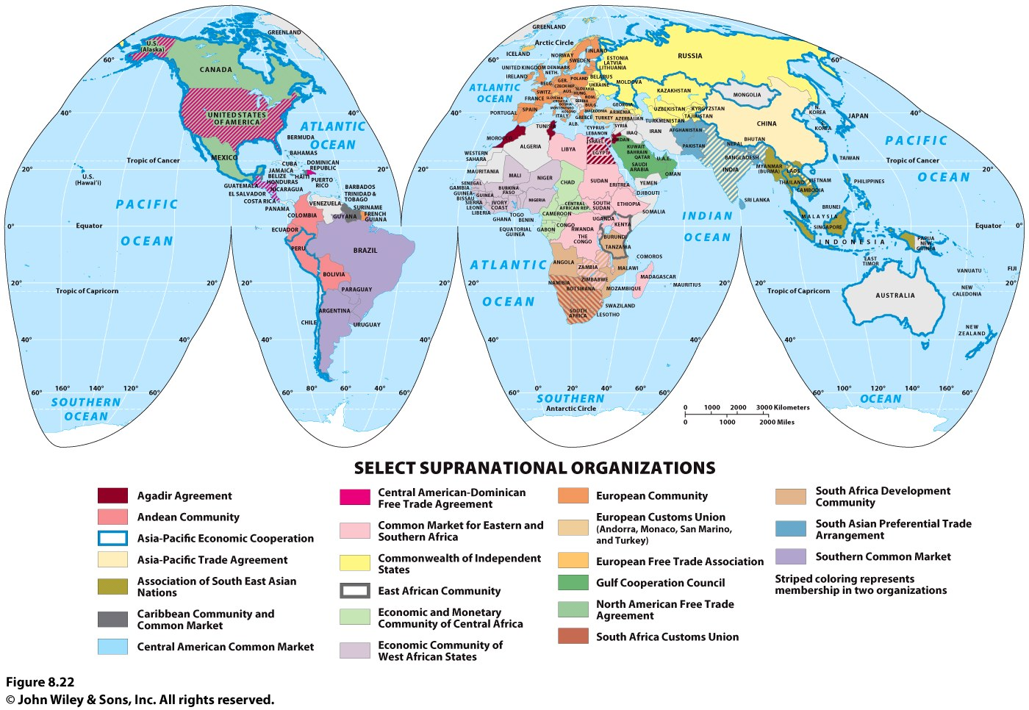

Slide 21
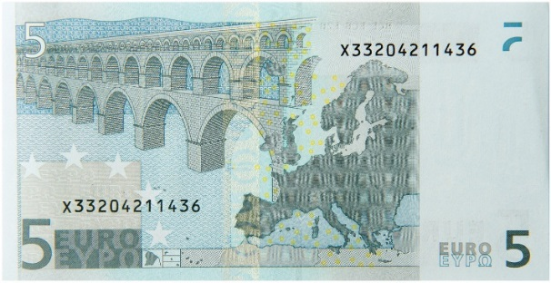
Economic Alliances in Europe
The EU in the 21st Century
Expanded to 12 countries during the 1980s; expanded to 27 in the 2000s.
Main task of the EU is to promote development within member states through economic and political cooperation.
Eurozone
Most dramatic step toward integrating Europe’s nation-states into a regional organization.
European Central Bank given responsibility of setting interest rates and minimizing inflation throughout the Eurozone.
Common currency established - Euro

Slide 22
Supranationalism and the State
Deterritorialization
Globalization, networked communities, etc. undermine the state’s traditional territorial authority
Reterritorialization
the state is moving to solidify control over its territory

Slide 23
Terrorism by Individuals and Organizations
Terrorism is the systematic use of violence by a group in order to intimidate a population or coerce a government into granting its demands.
Distinctive characteristics of terrorists’ tactics include:
Trying to achieve their objectives through organized acts of terror.
e.g. bombing, kidnapping, hijacking, taking of hostages, and assassination.
Viewing violence as a means of bringing widespread publicity to their cause, rescaling a local or regional issue into a global scale.
Believing in a cause so strongly they attack despite knowing they will probably die in the act.
Differs from other acts of political violence
Attacks aimed at ordinary people rather than military or political leaders.

Slide 24
State Sponsoring of Terrorism
Several Middle Eastern states have supported terrorism in recent years, at three increasing levels of involvement.
Providing sanctuary for terrorists wanted by other countries
Afghanistan and probably Pakistan have provided sanctuary for al-Qaeda terrorists.
Supplying weapons, money, and intelligence to terrorists.
Iraq and Iran accused of providing material and financial support for terrorists.
Extent of involvement is controversial.
Planning attacks using terrorists, including cyberattacks such as hacking and identity theft

Slide 25
Electoral Geography
Boundaries separating legislative districts within the U.S. and other countries are redrawn periodically to ensure each has about the same population.
435 districts of the U.S. House of Representatives are redrawn every 10 years, following the Census Bureau’s release of the official population figures.
Process of redrawing legislative boundaries for the purpose of benefits the party in power is called gerrymandering.

Slide 26
Gerrymandering
Gerrymandering takes three forms:
Wasted vote - spreads opposition supporters across many districts but in the minority.
Excess vote - concentrates opposition supported into a few districts.
Stacked vote - links distant areas of like-minded voters through oddly shaped boundaries.
U.S. Supreme Court ruled gerrymandering illegal in 1985 but did not require dismantling of existing oddly shaped districts.
Gerrymandering hinders communication and makes integration of people fragmented from others difficult.

Slide 27
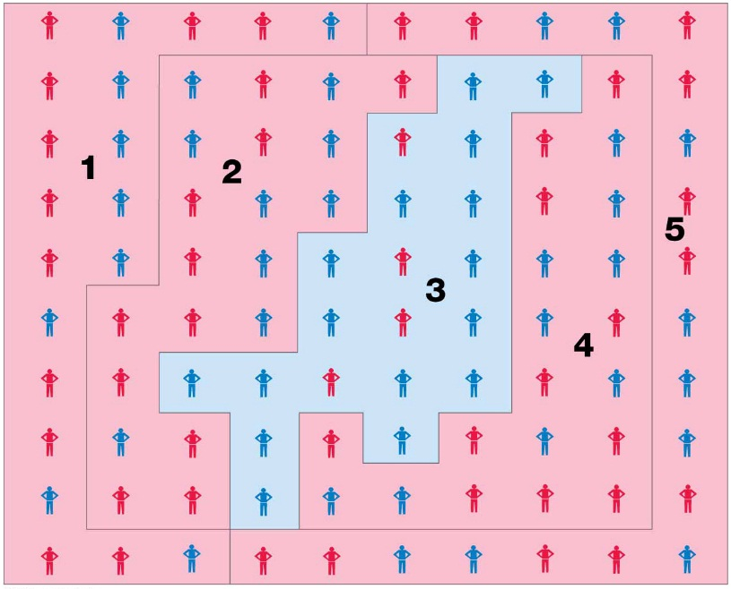
Gerrymandering - (52 Blue vs. 48 Red)
Wasted Vote
Excess Vote
Stacked Vote
Wasted vote gerrymandering spreads opposition supporters across many districts as a minority. If the Blue Party controls the redistricting process, it could create a wasted vote gerrymander by creating four districts with a slender majority of Blue Party voters and one district (#1) with a strong majority of Red Party voters.
Excess vote gerrymandering concentrates opposition supporters into a few districts. If the Red Party controls the redistricting process, it could create an excess vote gerrymander by creating four districts with a slender majority of Red Party voters and one district (#3) with an overwhelming majority of Blue Party voters.
A stacked vote gerrymander links distant areas of like-minded voters through oddly shaped boundaries. In this example, the Red Party controls redistricting and creates five oddly shaped districts, four with a slender majority of Red Party voters and one (#3) with an overwhelming majority of Blue Party voters.

